Slide 1
PIP CSE7301 - INTERNSHIP
Review-4 Presentation
INTERNSHIP MANAGEMENT SYSTEM
Student Details
Name | TRISHANYA
Roll No | 20211CSE0361
Section | 8CSE04
Batch No. | CSE-37
Under the Supervision of,
Ms. Rakheeba Taseen
Assistant Professor
School of Computer Science and Engineering
Presidency University
Name of the Program: BTech
Name of the HoD: Dr. Asif Mohammad
Name of the School Internship: Mr. Md Ziaur Rahman /Dr. Sampath A K

Slide 2
Content
Title
Abstract
Review of literature
Objectives
Problem identification, and formulation of problem statement.
Road map, impact and advantages of the proposed work. (Time Line by GanttChart).
References

Slide 3
Title
INTERNSHIP MANAGEMENT SYSTEM

Slide 4
Abstract
The Internship Management System is a web-based application designed to simplify and automate the management of student internships. It enables the creation of internship batches, management of student records, attendance tracking, and PDF report generation. Built using ASP.NET Core MVC, Dapper, and SQL Server, the system ensures accuracy, efficiency, and ease of use for coordinators and administrators.

Slide 5
Review of Literature
Existing Internship Tracking Systems: Most academic portals and spreadsheets lack integrated batch management and attendance features, leading to manual errors and inefficiencies.
Academic Project Management Systems: General project tracking tools (e.g., Jira, Trello) enable task assignment but are not tailored for internship workflows like batch creation and PDF reporting.

Slide 6
Objectives
To understand the .NET MVC architecture and its core components.
To build a secure and scalable website using .NET MVC.
To implement efficient coding practices for better performance and maintainability .
To analyze the impact of MVC in modern web development.

Slide 7
Problem Identification and Formulation
Manual internship tracking is error-prone and time-consuming.
No system to auto-generate batch numbers based on college, course, and duration.
Difficult to manage multiple students under each batch.
Attendance tracking is not centralized or standardized.
No easy way to generate PDF reports for records.
Proposed Solution:
A web-based Internship Management System using ASP.NET Core, Dapper, and SQL Server to automate batch creation, student management, attendance tracking, and report generation.

Slide 8
Roadmap and Proposed Work
Technology Stack
  Framework: .NET MVC
  Programming Language: C#
  Database: Firebase , MySQL
  Frontend: Bootstrap, HTML, CSS, JavaScript
  Tools: Visual Studio, Visual Studio Community, Sql Server management studio

Slide 9
Development Phases
  Requirement Gathering & System Design
  Frontend & UI Design
  Backend Development (Models, Controllers, Database)
  Testing & Debugging
  Deployment & Maintenance

Slide 10
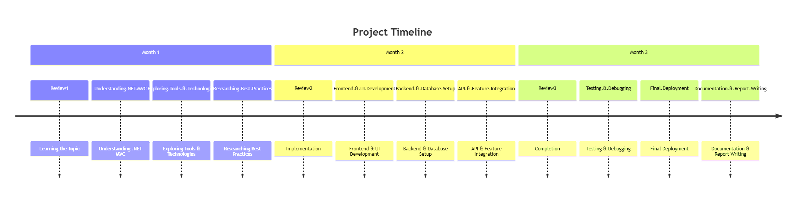
Timeline Gantt Chart

Slide 11
Impact and Advantages of Proposed Work
Impact
  Provides a structured development approach for future applications.
  Ensures better security and performance in web applications.
Advantages of Using .NET MVC
  Separation of concerns: Easier to maintain and scale.
  Built-in security: Protects against SQL injection & cross-site scripting (XSS).
  Faster development: Code reusability speeds up project completion.
  Integration with databases & third-party APIs.

Slide 12
References
Microsoft Documentation: https://learn.microsoft.com/en-us/aspnet/mvc/overview/
.NET Official Site: https://dotnet.microsoft.com/
Research Paper on MVC Frameworks in Web Development

Slide 13
Github Link
https://github.com/trishanya921/internship-management-system

Slide 14

Q&A

Slide 15
Thank you !!

