Slide 1
Testing

Slide 2
unittest — Unit testing framework
Supports test automation, sharing of setup and shutdown code for tests, aggregation of tests into collections, and independence of the tests from the reporting framework.

Slide 3
Test fixture
A test fixture represents the preparation needed to perform one or more tests, and any associated cleanup actions. This may involve, for example, creating temporary databases, directories, or starting a server process.
Therefore, instead of running the same code for every test, we can attach fixture function to the tests and it will run and return the data to the test before executing each test.

Slide 4
Test case
A test case is the individual unit of testing. It checks for a specific response to a particular set of inputs. unittest provides a base class, TestCase, which may be used to create new test cases.

Slide 5
Test suite
A test suite is a collection of test cases, test suites, or both. It is used to aggregate tests that should be executed together.

Slide 6
Test runner
A test runner is a component which orchestrates the execution of tests and provides the outcome to the user.

Slide 7
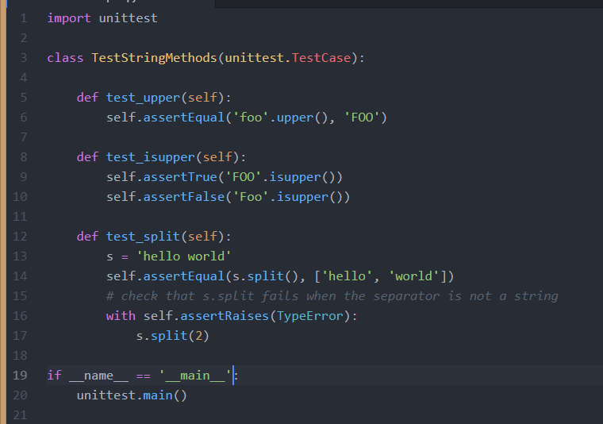

Slide 8
A testcase is created by subclassing unittest.TestCase. The three individual tests are defined with methods whose names start with the letters test. This naming convention informs the test runner about which methods represent tests.

Slide 9
assertEqual() to check for an expected result
assertTrue() or assertFalse() to verify a condition
assertRaises() to verify that a specific exception gets raised.
These methods are used so the test runner can accumulate all test results and produce a report.

Slide 10
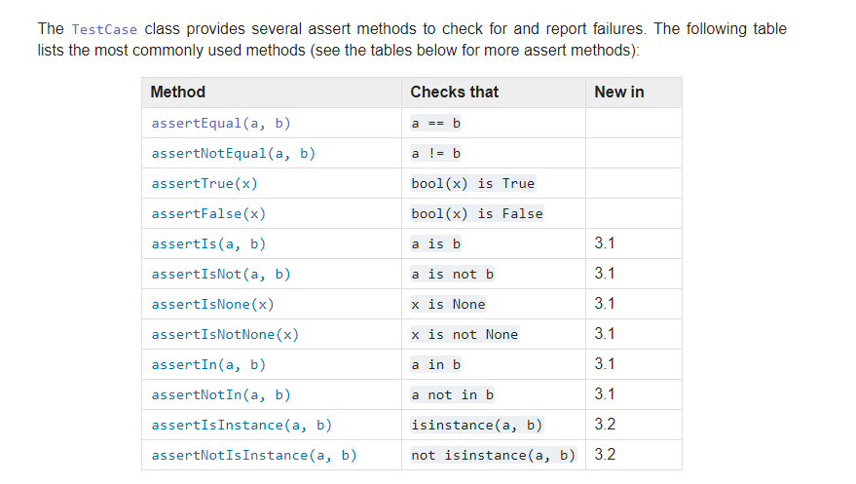

Slide 11
python example1.py
python example1.py -v

Slide 12
The setUp() and tearDown() methods allow you to define instructions that will be executed before and after each test method.

Slide 13
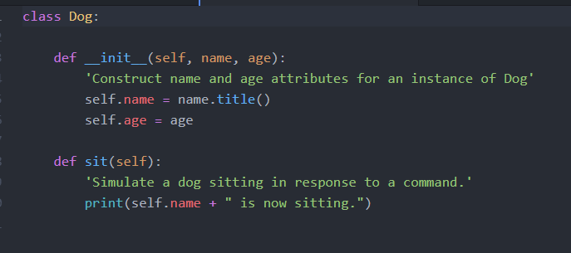

Slide 14
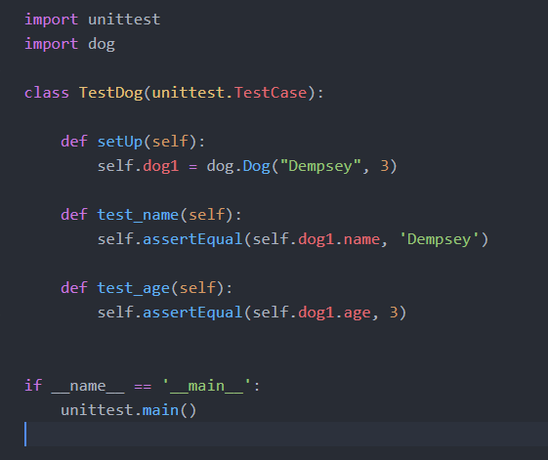

Slide 15
Django Testing
Django’s unit tests uses Python’s standard library module: unittest.
Here is an example which subclasses from django.test.TestCase, which is a subclass of unittest.TestCase that runs each test inside a transaction to provide isolation:

Slide 16
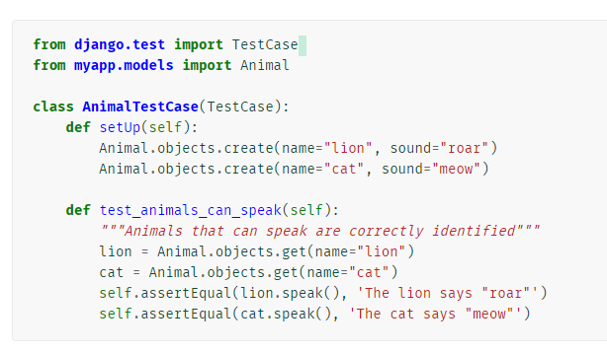

Slide 17
There are two methods that you can use for pre-test configuration (for example, to create any models or other objects you will need for the test):
setUpTestData() is called once at the beginning of the test run for class-level setup. You'd use this to create objects that aren't going to be modified or changed in any of the test methods.
setUp() is called before every test function to set up any objects that may be modified by the test (every test function will get a "fresh" version of these objects).

Slide 18
Running tests
Once you’ve written tests, run them using the test command of your project’s manage.py utility:
$ python manage.py test
Test discovery is based on the unittest module’s built-in test discovery. This will discover tests in any file named “test*.py” under the current project.

Slide 19
The test client
The test client is a Python class that acts as a dummy Web browser, allowing you to test your views and interact with your Django-powered application programmatically.

Slide 20
Some of the things you can do with the test client are:
Simulate GET and POST requests on a URL and observe the response – everything from low-level HTTP (result headers and status codes) to page content.
See the chain of redirects (if any) and check the URL and status code at each step.
Test that a given request is rendered by a given Django template, with a template context that contains certain values.

Slide 21
Use Django’s test client to establish that the correct template is being rendered and that the template is passed the correct context data.

Slide 22
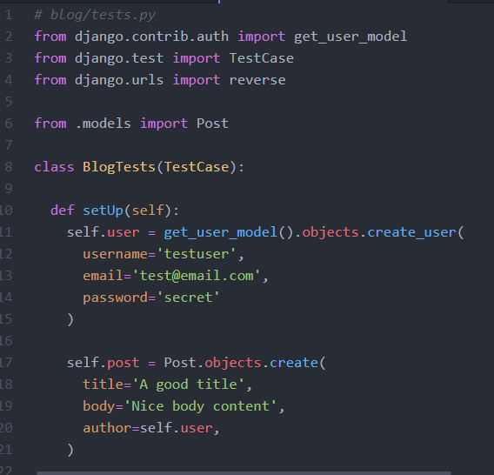

Slide 23
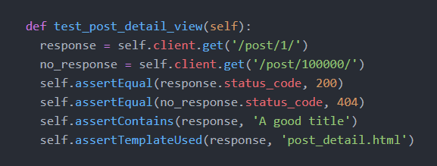

Slide 24
You should test all aspects of your own code, but not any libraries or functionality provided as part of Python or Django.
This would include models, views, forms….
Methods such as get_absolute_url, __str__
You must include appropriate testing for your models and views in your personal project.

