Slide 1
Earmark Veraciously
By
Trishla Jain
Nivedita Ravi
Mikhail Pinto

Slide 2
Problem Statement
Our business problem deals with scanning receipts using the Azure form Recognizer API to extract the bill details using python.
The details include item name,total expense,merchant name, etc.
Using python we insert these details into Azure Data Studio.
These details help us understand how we can budget our expenses more effectively by using visualization using Power BI

Slide 3
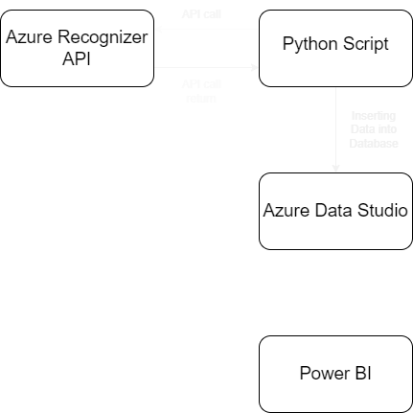
Flow

Slide 4
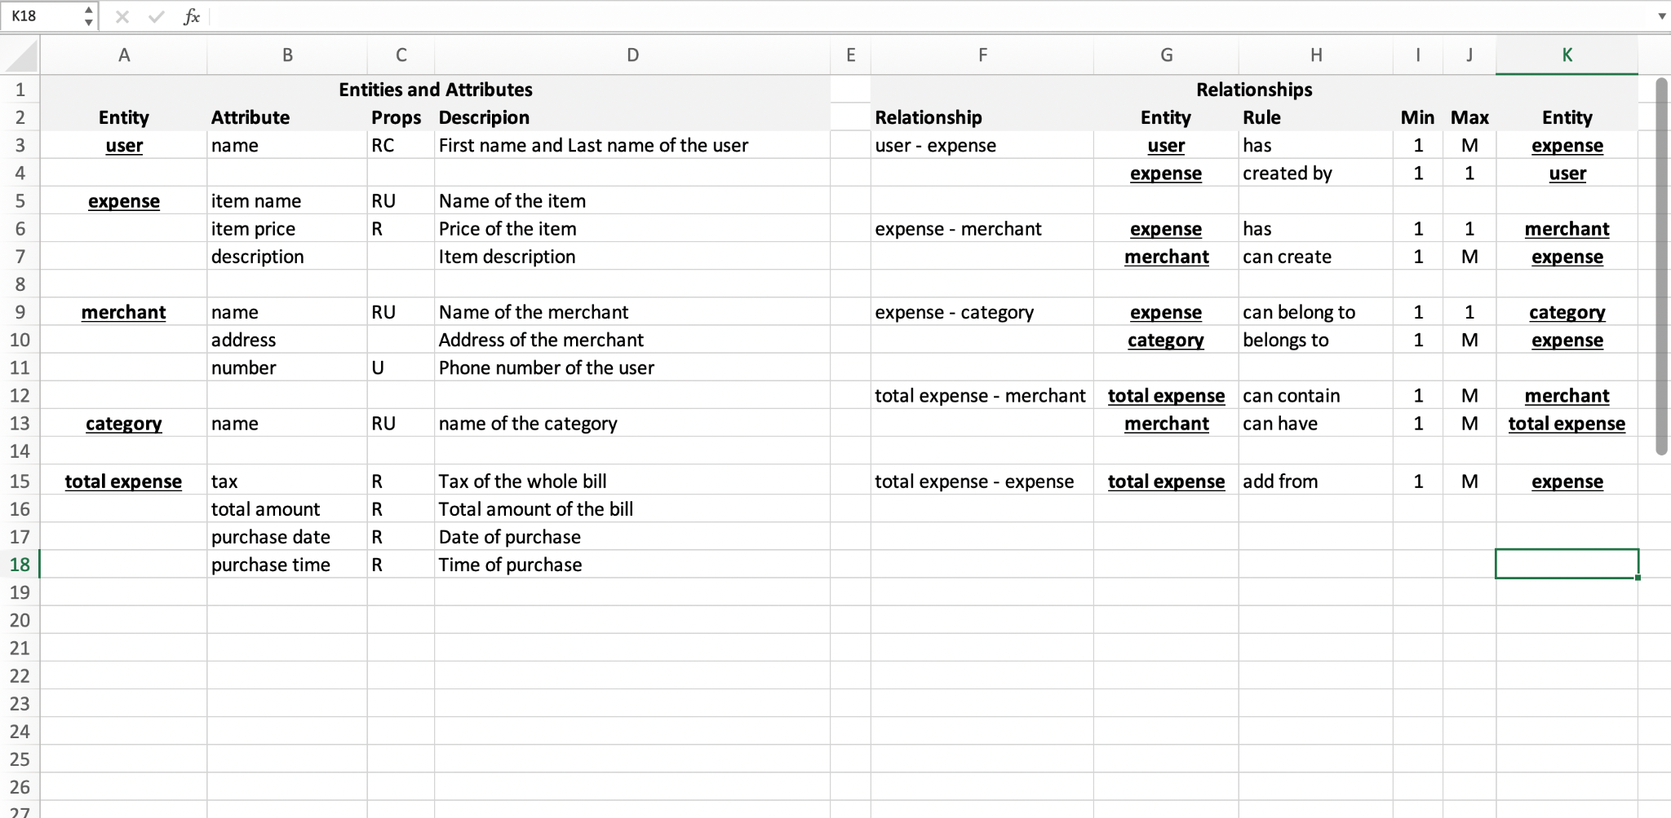
Business Rule and Entity Relationships

Slide 5
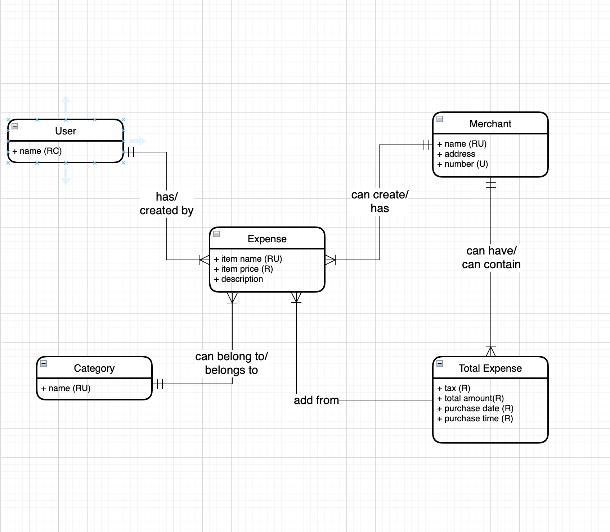
Conceptual Data Model

Slide 6
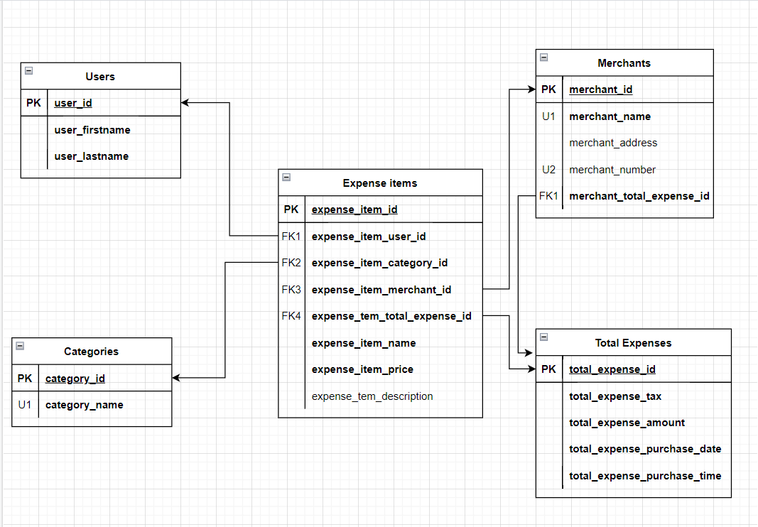
Logical Diagram

Slide 7
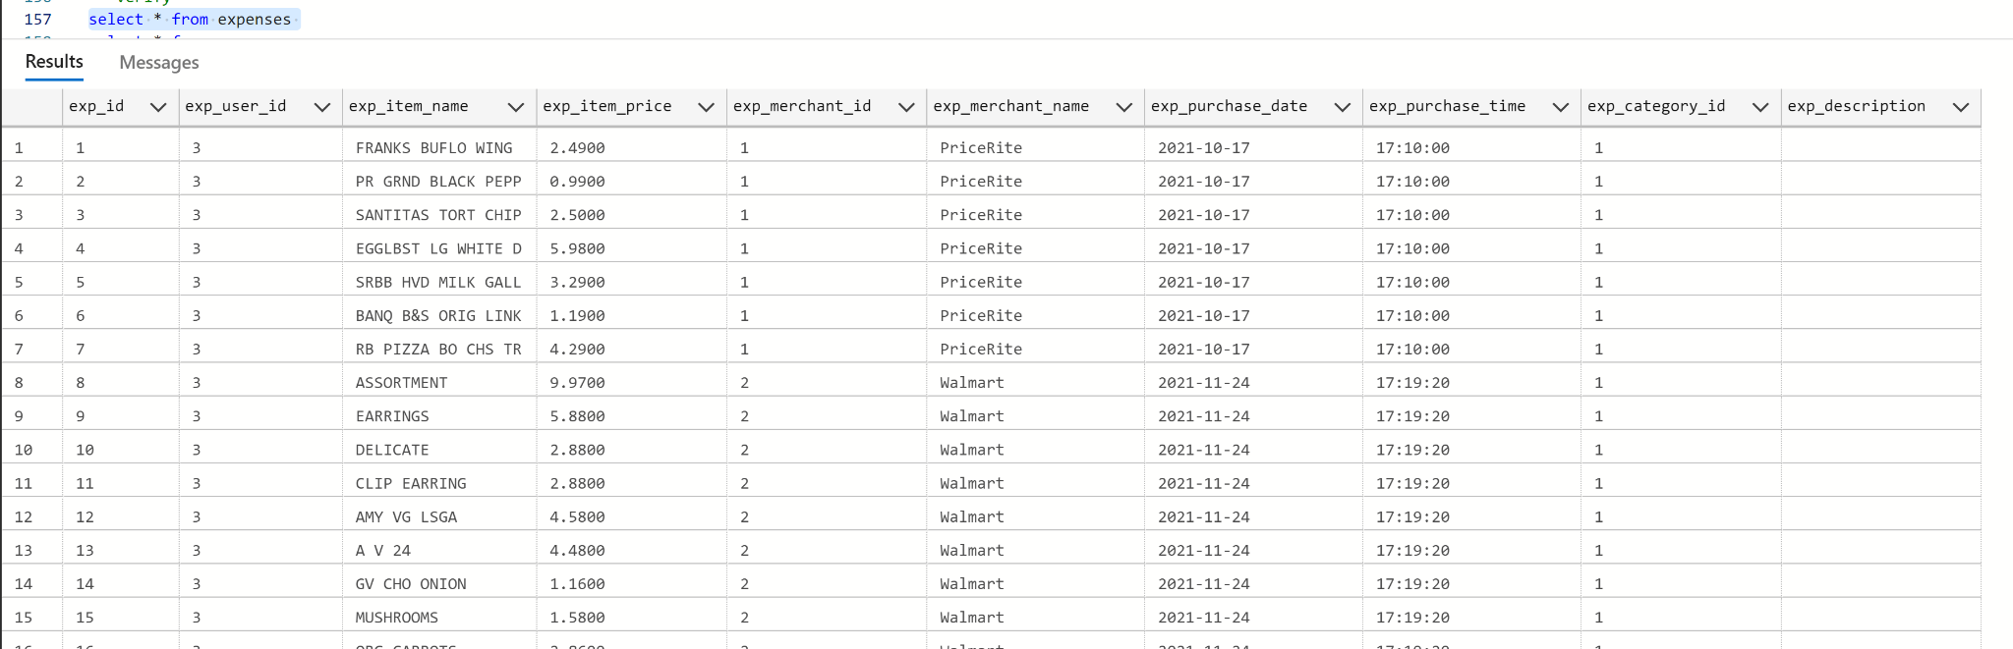
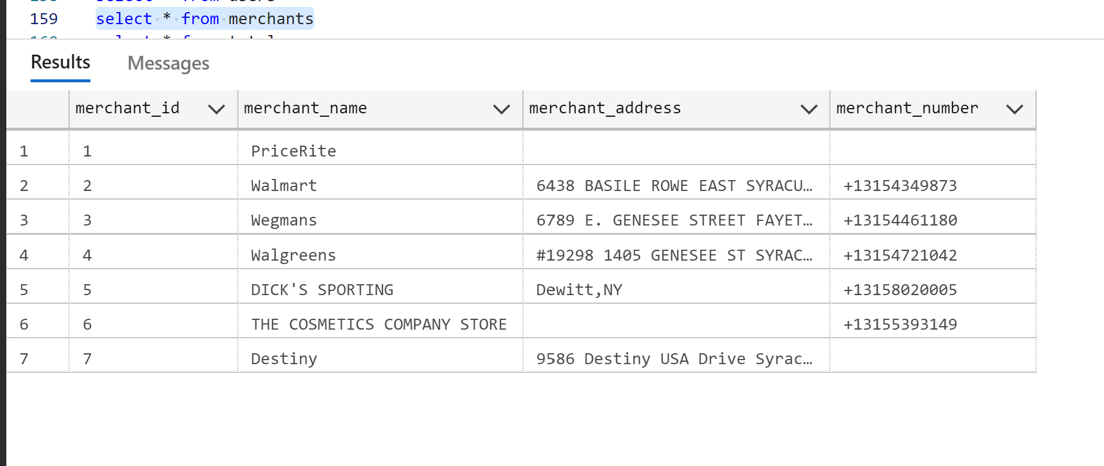
Table Data

Slide 8
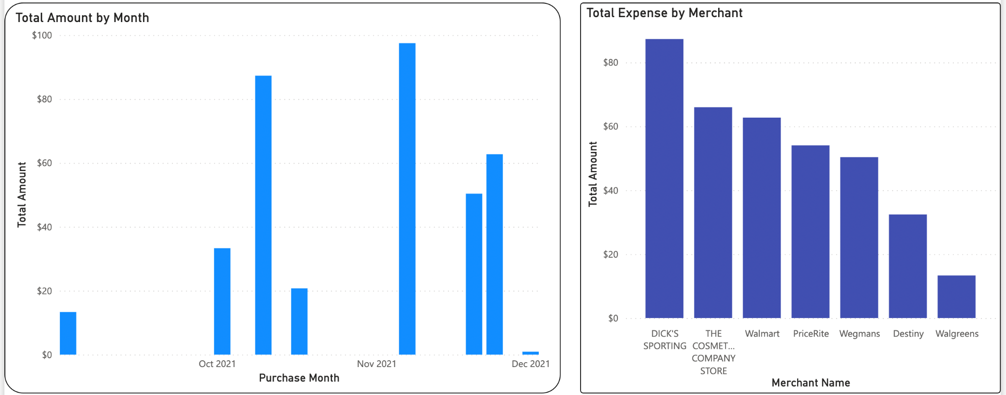
Visualization

Slide 9
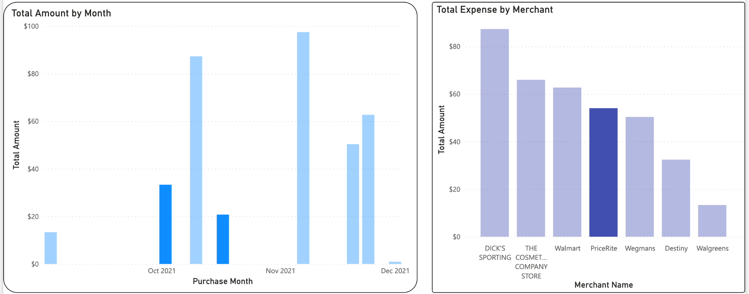
Visualization

Slide 10
Questions
???

Slide 11
Thank You!!!!

