Slide 1
STOCKLENS
NVIDIA Stock Forecasting
with LSTM Neural Networks
A deep learning approach to next-session closing-price forecasting, deployed as an interactive Streamlit web application.
Data Science Project | Python · TensorFlow · Streamlit

Slide 2



Problem Statement & Objective
Why forecast NVIDIA's stock, and what does this project set out to do?
The Problem
The Approach
The Objective
Stock prices are volatile and non-linear, and traditional statistical models often struggle to capture long-range temporal patterns in daily price movement.
This project applies an LSTM (Long Short-Term Memory) neural network, built for sequential data, to learn patterns from historical NVIDIA closing prices.
The objective is to forecast the next trading session's closing price using the last 60 sessions, and to surface that forecast through a deployed, usable web app.

Slide 3
Dataset Overview
Ten years of NVIDIA (NVDA) daily trading history sourced via Yahoo Finance.
NVDA Yearly Average Closing Price (split-adjusted)
2,514
Trading days
2016–2025
Date range (10 yrs)
5
Features: Open, High,
Low, Close, Volume

Slide 4




Data Preprocessing Pipeline
Turning raw daily prices into LSTM-ready input sequences.
→
→
→
→
Fetch OHLCV
Select Close
Scale (0–1)
Window (60)
Feed to LSTM
Pull daily NVDA data via yfinance
Use closing price as the target signal
MinMaxScaler normalizes the series
Build sequences of 60 past sessions
Sequences become model input tensors
The 60-day lookback window mirrors the deployed forecast logic — the model always looks at the most recent 60 trading sessions.

Slide 5
Final Optimized LSTM — Architecture
A stacked, univariate LSTM network using only closing-price sequences.
Input
LSTM
Dropout
LSTM
Dropout
Dense
Output
Shape: (60, 1)
60 timesteps × 1 feature
→
50 units · tanh
return_sequences
→
rate = 0.2
→
50 units · tanh
→
rate = 0.2
→
25 units · linear
→
1 unit · linear
predicted next-session close
Framework: TensorFlow / Keras | ~32K trainable parameters | Input feature: closing price only (univariate)
Two stacked LSTM layers let the network learn both short-term fluctuations and longer sequential dependencies in closing-price movement, with Dropout layers added between them to reduce overfitting. This is the exact architecture deployed in the Streamlit app.

Slide 6
Model Performance & Evaluation
Three iterations were benchmarked before arriving at the final architecture.
Model
MAE
RMSE
R² Score
Baseline LSTM
42.22
46.49
-0.6070
Multivariate LSTM
52.31
56.97
-1.4135
Final Optimized LSTM
6.81
8.05
0.9194
BEST MODEL
The Final Optimized LSTM achieved the strongest test performance among the evaluated models — MAE 6.81, RMSE 8.05, and R² 0.9194 — and was integrated into a Streamlit application for next-session closing-price forecasting.

Slide 7
How the Deployed Forecast Works
Every time a user clicks “Generate Forecast,” this sequence runs end-to-end.
1
2
3
4
5
Take last 60 observations
Scale with final_scaler
Reshape to (1, 60, 1)
Run Final Optimized LSTM
Inverse-transform output
→
→
→
→
The latest 60 closing-price observations are pulled from the recent NVDA data.
The sequence is scaled using the saved final_scaler (the same MinMaxScaler fit during training).
The scaled sequence is reshaped to match the model's expected input tensor shape.
The reshaped input is passed to the saved Final Optimized LSTM model for inference.
The scaled output is inverse-transformed with final_scaler to get the predicted closing price.

Slide 8



The StockLens Web App
Built with Streamlit — turning the model into an interactive, no-code dashboard.
Market Overview
One-Click Forecasting
Forecast Comparison
Latest close, daily % change, and 6-month high/low, refreshed from a cached yfinance pull of recent NVDA data.
A single “Generate Forecast” button runs the full LSTM inference pipeline on demand.
Bar chart comparing the latest close against the model's forecasted next-session close.
Historical Trend Chart
Recent Trading Table
Direction Signal
Six-month line chart of NVIDIA's closing price movement.
Sortable table of the last 10 sessions' Open, High, Low, Close, and Volume.
Projected movement is labeled Upward, Downward, or Stable based on the forecast.

Slide 9
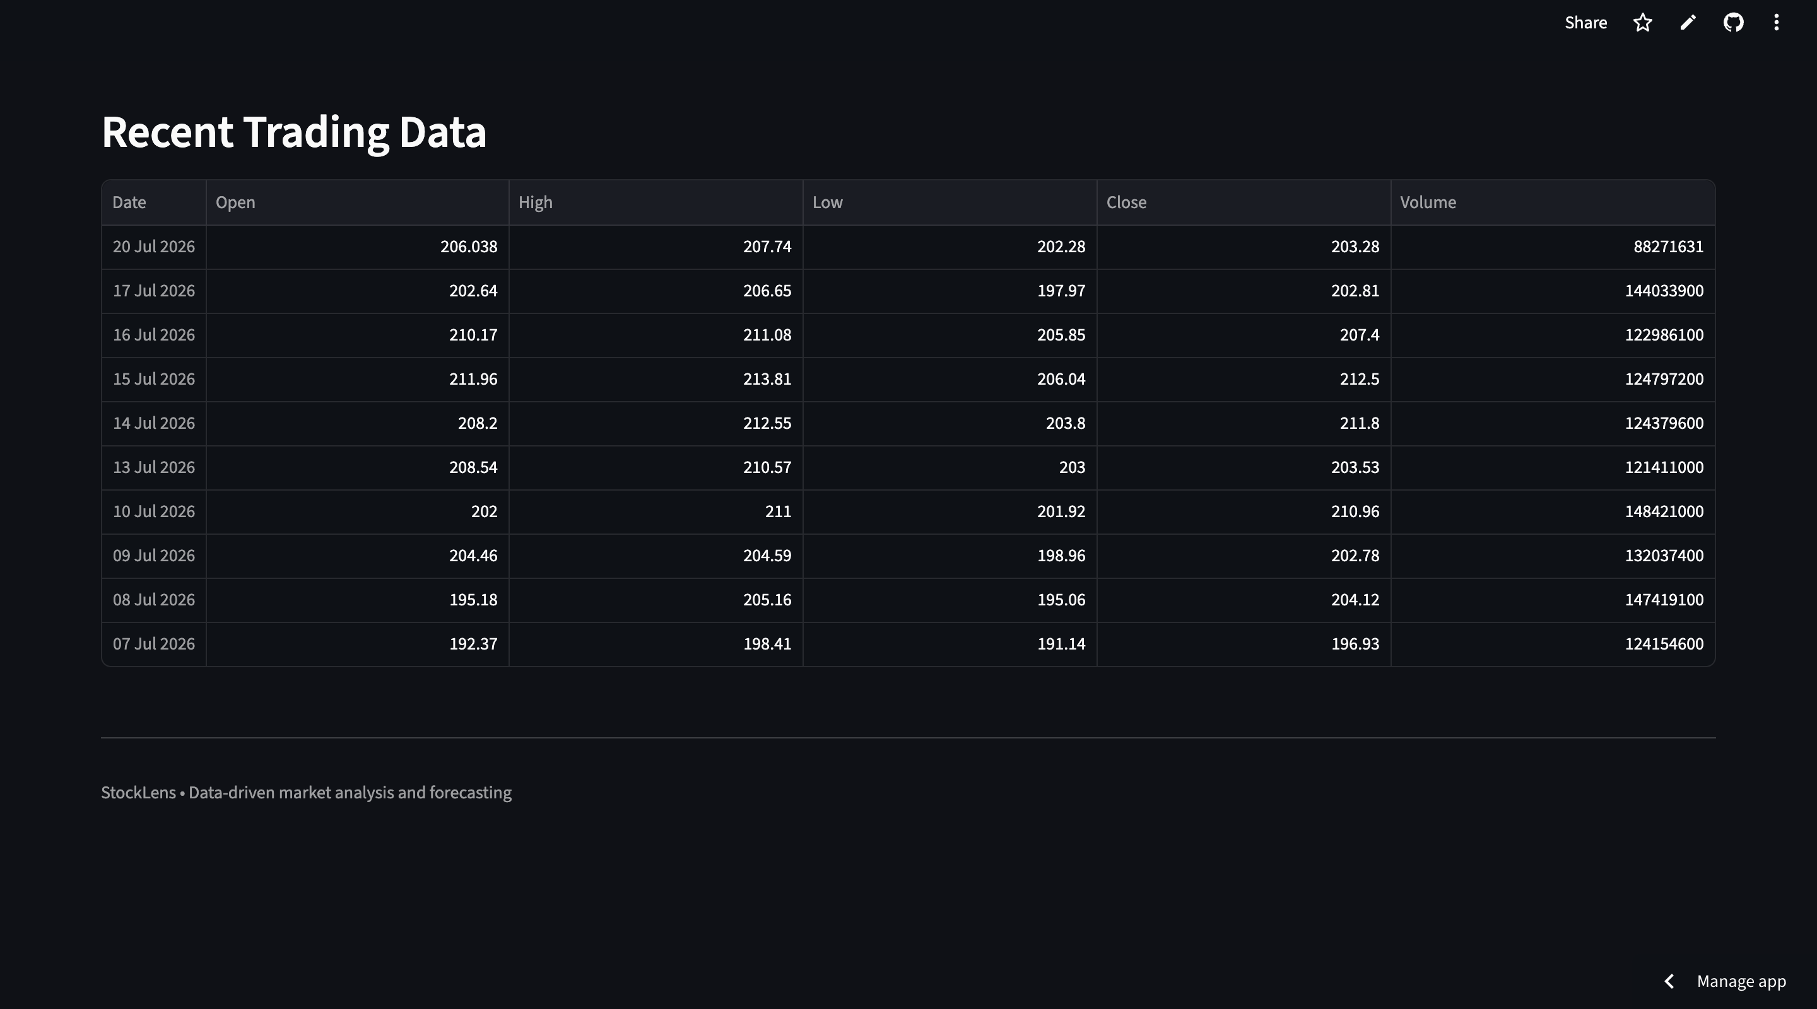
App Demo — Overview & Forecast
Deployed view of stocklens-nvda.streamlit.app

Slide 10
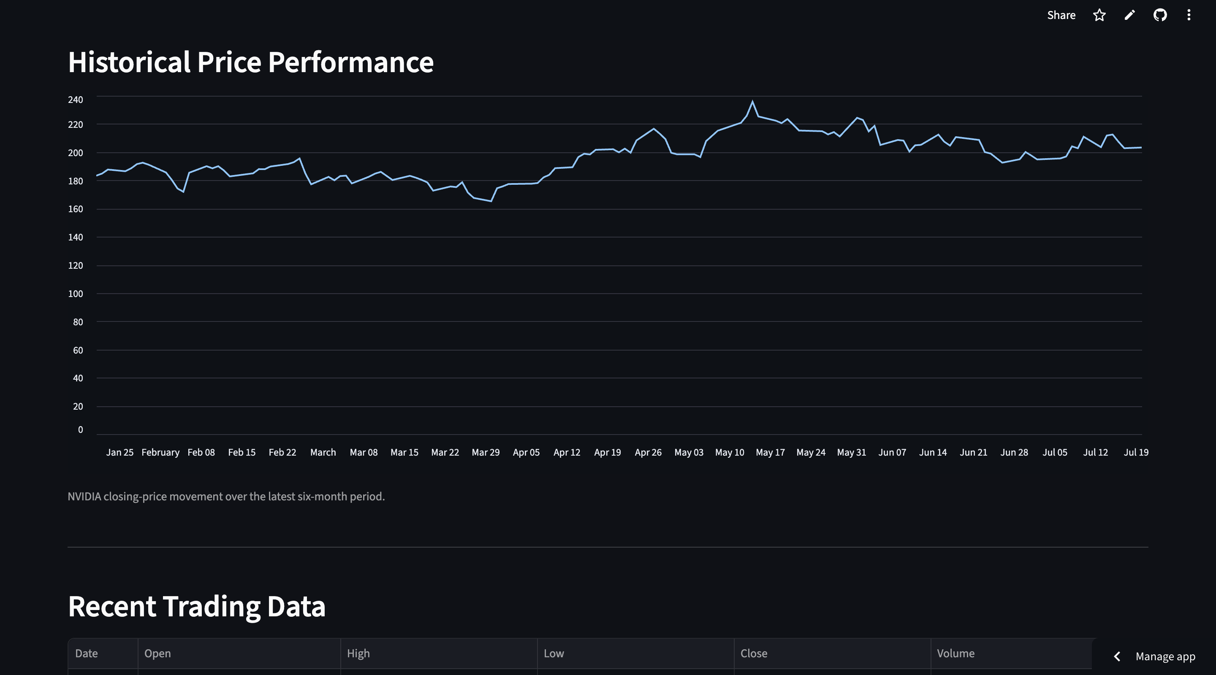
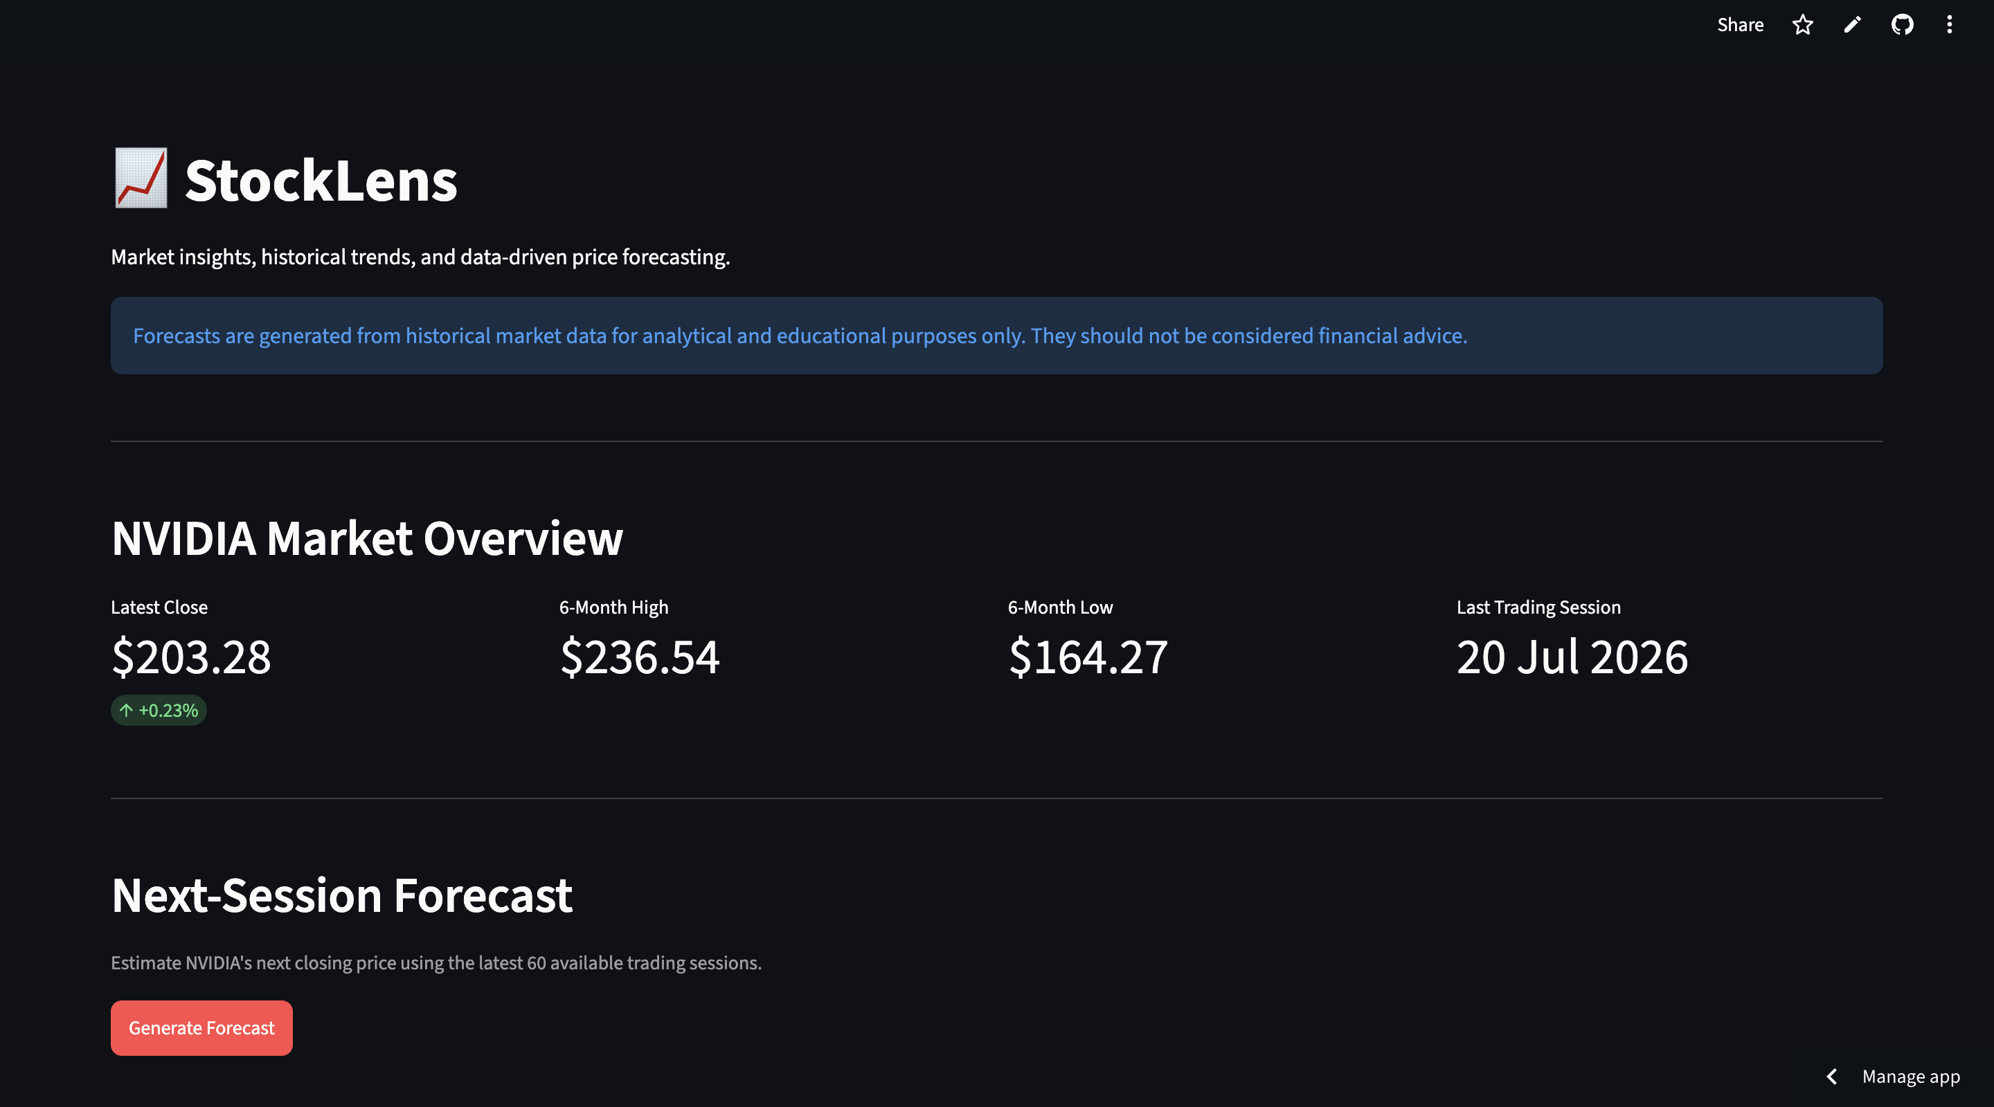
App Demo — Trends & Trading Data
Historical chart and the most recent trading sessions.

Slide 11


Tech Stack
Every layer of StockLens, from data to deployment.
Python
TensorFlow / Keras
Streamlit
Core programming language
LSTM model training & inference
Interactive web application framework
Pandas / NumPy
scikit-learn
yfinance
Data processing & numerical operations
Data scaling with MinMaxScaler
Recent NVIDIA market data retrieval

Slide 12
Key Takeaways & Future Scope
What this project demonstrates, and where it could go next.
What It Demonstrates
Future Scope
End-to-end ML workflow: raw data → preprocessing → model → deployment
Add technical indicators (RSI, MACD, moving averages) as extra features
Sequence modeling with stacked LSTM layers for time-series data
Benchmark against GRU / Transformer-based time-series models
Deploying a trained forecasting model as an interactive web application
Backtest forecast accuracy with rolling RMSE / MAE tracking
Handling recent market-data retrieval and stateful forecasting UI in Streamlit
Extend to multi-step forecasting and additional stock tickers

Slide 13
Thank You
Questions & Discussion
StockLens | github.com/trishita03/StockLens | stocklens-nvda.streamlit.app

