Slide 1


Kubernetes cluster with High Availability and Scalability of Web server
Guided by:
Presented by:
Ms. Tejaswini Apate
Pranjali Patil
Sushmita Diwakar
Sukanya Mane
Trishna Dhruw
Tarun Shori

Slide 2
Introduction
In today's era of cloud-native applications, ensuring high availability and scalability of web services is crucial for businesses to meet the demands of their users while maintaining reliability and performance. Kubernetes, as a powerful container orchestration platform, provides robust solutions for deploying, managing, and scaling applications in a cloud-native environment.
This project envolves the creation of a strong Kubernetes cluster deployed on AWS instances. We use Docker containers within Kubernetes pods to manage Apache Web server. This server is orchestrated to ensure both high availability and scalability. With careful configuration and management.This deployment architecture promises to elevate the reliability and efficiency of web services while maximizing resource utilization.

Slide 3
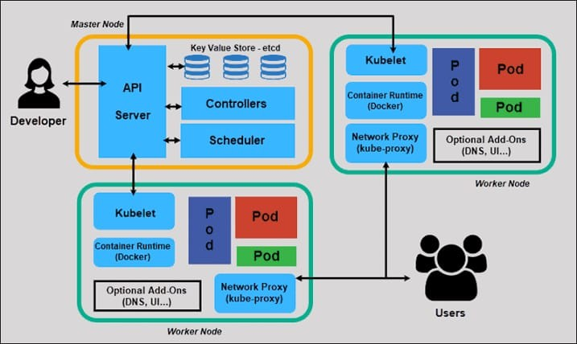
Work flow

Slide 4
Use Cases
1. Implement High Availability:
- Configured Kubernetes Pod Replication Controllers or Deployments to
ensure redundancy
2. Enable Scaling:
- Implement Kubernetes Horizontal Pod Autoscaler (HPA) to automatically
scale the web server based on demand.
- Adjust HPA settings for CPU or memory utilization thresholds.
3. Configure Load Balancing:
- Used Kubernetes Services to expose the web server, automatically an creating internal load balancer.

Slide 5
System And Software Requirements
System requirement:
RAM: 4 GB
HDD: 15 GB
Processors: 2 cores
OS: AWS Linux
Software requirement:
Kubernetes Tools: Kubeadm
Container Runtime: Containerd
Networking Plugin: Calico
Web Server: Apache2 httpd
Cloud Provider: AWS
Repository: Docker hub

Slide 6
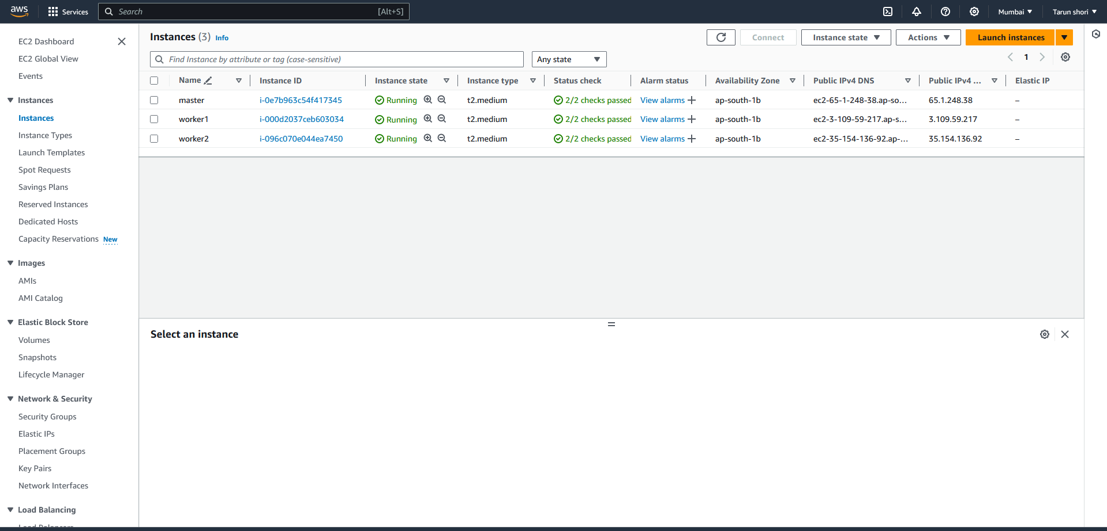
Instance Snapshots
Setting up AWS Instance:

Slide 7
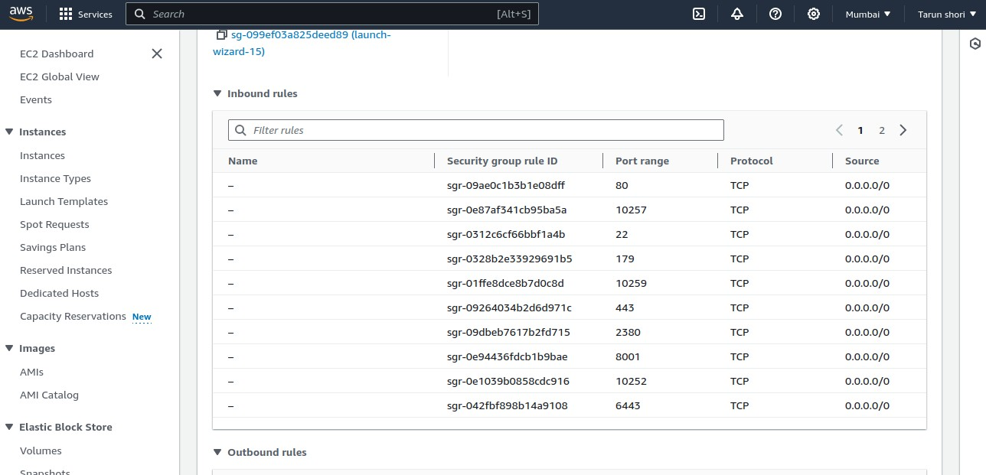
Create Security group for instances of master and worker nodes.
For master node :

Slide 8
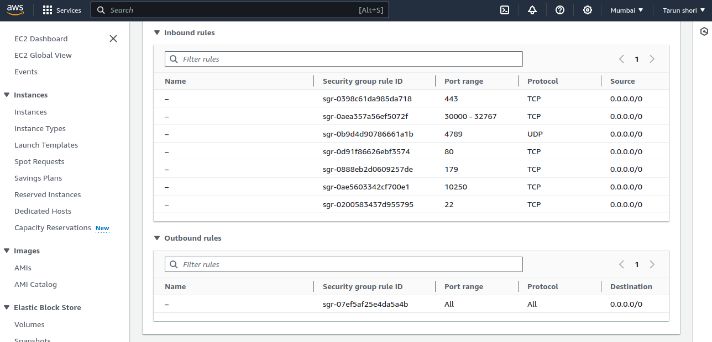
For worker nodes :

Slide 9
Kubernetes Installation
Step 1: Disable swap space
To disable swap space and to make the changes persistent:
$ sudo swapoff -a
$ sudo sed -i '/swap/d' /etc/fstab
Step 2: Disable SELinux
To achieve this, open the SELinux configuration file,change the SELINUX value from enforcing to permissive or alternatively you can use the sed command as follows.
$ sudo vi /etc/selinux/config
SELINUX=permissive
$ sudo sed -i 's/^SELINUX=enforcing$/SELINUX=permissive/'
/etc/selinux/config
Step 3: Configure networking in master and worker node and install traffic control
utility and allow specific port on master and worker nodes.
$ sudo vi /etc/hosts
$ sudo dnf install -y iproute-tc

Slide 10
Step 5: Install Containerd container runtime:
First, create a modules configuration file for Kubernetes, then load both the modules using the modprobe command.
$ sudo tee /etc/modules-load.d/containerd.conf <<EOF
$ sudo modprobe overlay
$ sudo modprobe br_netfilter
Next, configure the required sysctl parameters as follows:
cat <<EOF | sudo tee /etc/sysctl.d/k8s.conf
net.bridge.bridge-nf-call-iptables = 1
net.ipv4.ip_forward = 1
net.bridge.bridge-nf-call-ip6tables = 1
EOF
$ sudo sysctl –system

Slide 11
Step 6: Install containerd runtime
$ sudo dnf config-manager –add-repo
https://download.docker.com/linux/centos/docker-ce.repo
$ sudo yum install containerd.io -y
$ sudo containerd config default | sudo tee /etc/containerd/config.toml
>dev/null 2>&1
$ sudo sed -i 's/SystemdCgroup \= false/SystemdCgroup \= true/g'
/etc/containerd/config.toml
Start and enable the containerd service.
$ sudo systemctl start containerd
$ sudo systemctl enable containerd
$ sudo systemctl status containerd
Step 7: Install Kubernetes Packages
$ sudo vi /etc/yum.repos.d/kubernetes.repo
Finally, install k8s package as follows.
$ sudo dnf install -y kubelet kubeadm kubectl disableexcludes=kubernetes
$ sudo systemctl enable kubelet
$ sudo systemctl start kubelet

Slide 12
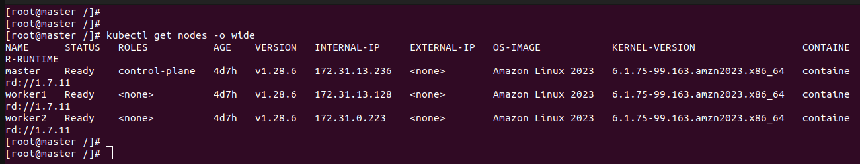
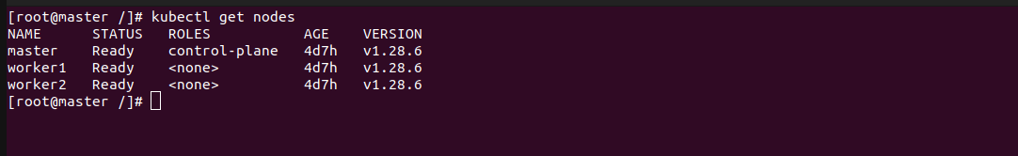
Kubernetes Cluster Installation:
$ sudo kubeadm init –control-plane-endpoint=master
Join the worker nodes to run token:
This output confirms that the master node is ready. Additionally, you can
check the pod namespaces:

Slide 13
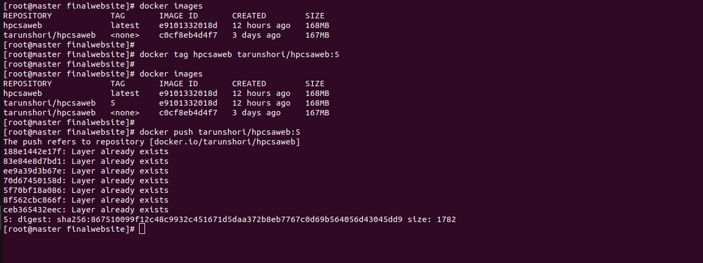
Create Docker Image And Push To Docker Hub
Create a Dockerfile: Create a Dockerfile in our project directory with the necessary instructions to build your Docker image.
Build the Docker image: navigate to the directory containing your Dockerfile and execute the following command to build the Docker image.

Slide 14
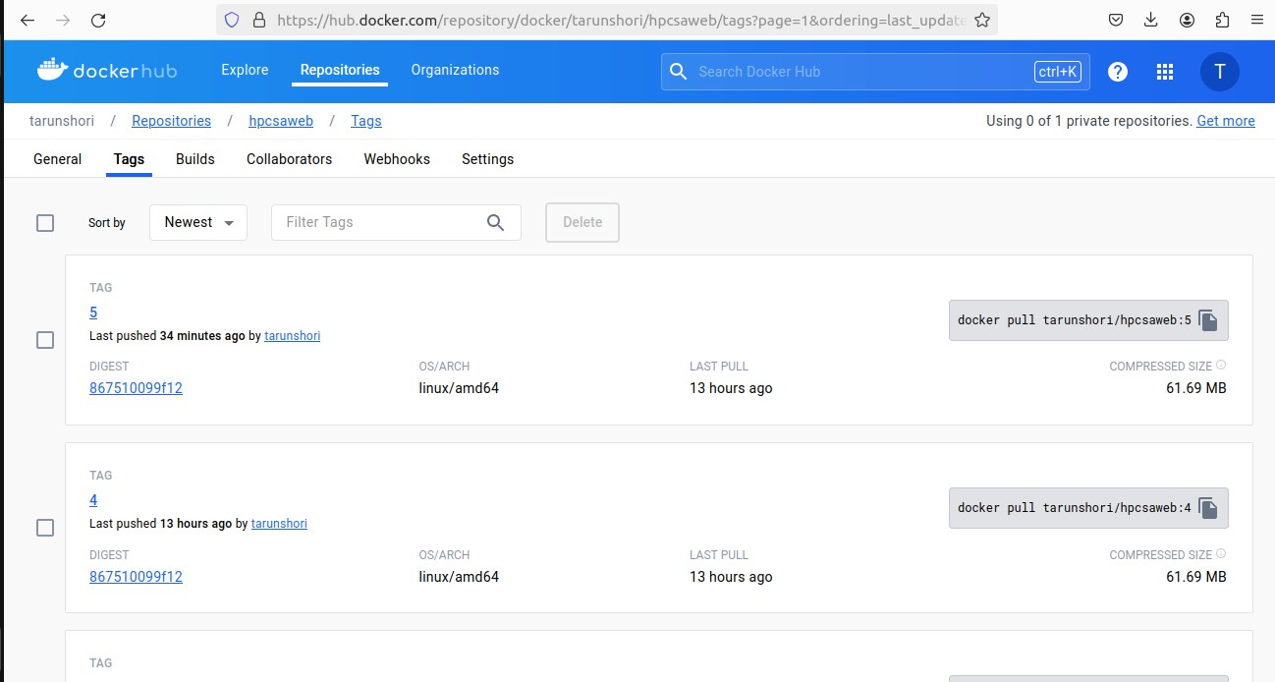
Verify on Docker Hub: After pushing the image, verify that it's available on
Docker Hub by visiting repository's page on the Docker Hub website.

Slide 15
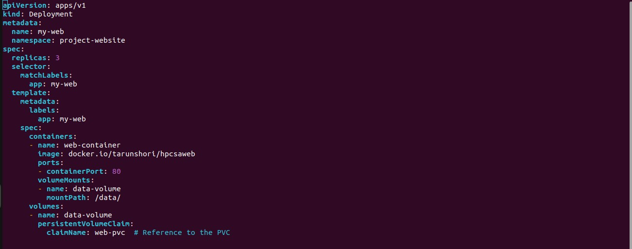
Create YAML Manifest:
run an application by creating a Kubernetes Deployment,Services,Horizontal Pod
Autoscaler and other object. we describe all configurations in a YAML file.
Create a Deployment based on the YAML file:

Slide 16
PersistentVolume (PV): A PersistentVolume is a piece of storage in the cluster that has been provisioned by an administrator or dynamically provisioned using a StorageClass. In our case we provisioned 4 gb.
PersistentVolumeClaim (PVC): When a user creates a PVC, Kubernetes finds a matching PV that satisfies the claim's requirements (capacity, access mode, etc.) and binds the claim to the PV. In our case we binds 2 gb .
livenessProbe: This probe checks whether the container is alive or not. In this case, it sends an HTTP GET request to / on port 80 of the container. If the container responds successfully, indicating that it's alive, Kubernetes considers it healthy. If the probe fails, Kubernetes restarts the container after a specified period.
readinessProbe: This probe checks whether the container is ready to serve traffic. Similar to the liveness probe, it sends an HTTP GET request to / on port 80. If the container responds successfully, indicating that it's ready to serve traffic, Kubernetes considers it ready. If the probe fails, Kubernetes stops sending traffic to the container until it becomes ready. Again,

Slide 17
Deployment: A Deployment manages a set of replicated Pods in the cluster. It provides declarative updates to applications, such as rolling out new features or updating container images. Deployments ensure that desired state is maintained by managing replica sets and controlling the rollout process.
Service: A Service defines a set of Pods and a policy to access them. It provides an abstract way to expose an application running on a set of Pods as a network service. Services enable external traffic to access applications running inside the cluster and allow intercommunication between different parts of the application. In our case we use NodePort service
RollingUpdate: In this strategy the Deployment gradually replaces old Pods with new ones, ensuring that the application remains available throughout the update process. It allows fine-grained control over the rollout, including parameters such as the maximum number of Pods that can be unavailable and the maximum number of new Pods that can be created at once.

Slide 18
HorizontalPodAutoscaler : (HPA) Automatically scales the number of pods in a replication controller, deployment, or replica set based on observed CPU utilization (or, more recently, custom metrics). It ensures that your application has enough resources to handle incoming traffic efficiently while minimizing costs during periods of low demand.
In this project HorizontalPodAutoscaler continuously monitors the CPU utilization of the pods managed by the my-web Deployment. If the average CPU utilization exceeds 70%, it will scale up the number of replicas (pods) up to a maximum of 10. If the CPU utilization drops below 70%, it will scale down the number of replicas down to a minimum of 3. This dynamic scaling ensures that your application can handle varying levels of traffic efficiently.

Slide 19
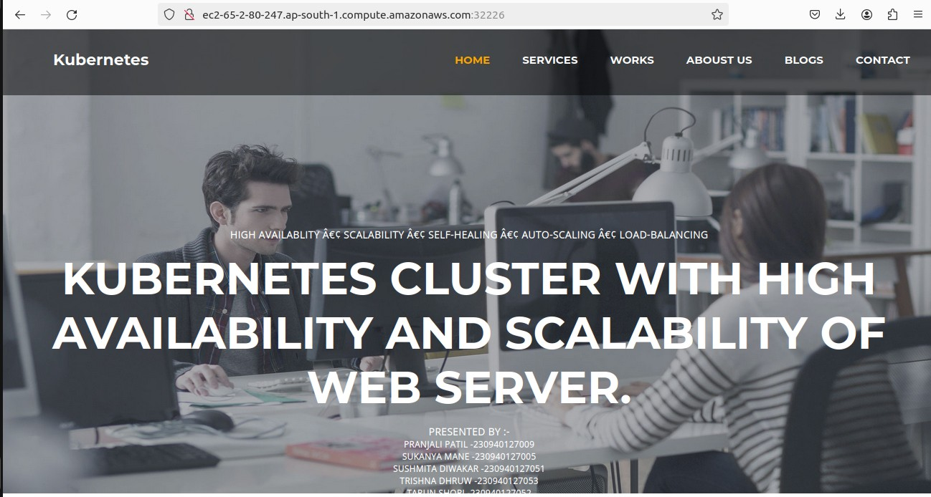
Access Web-Server From Outside The Cluster Using Node Port:

Slide 20
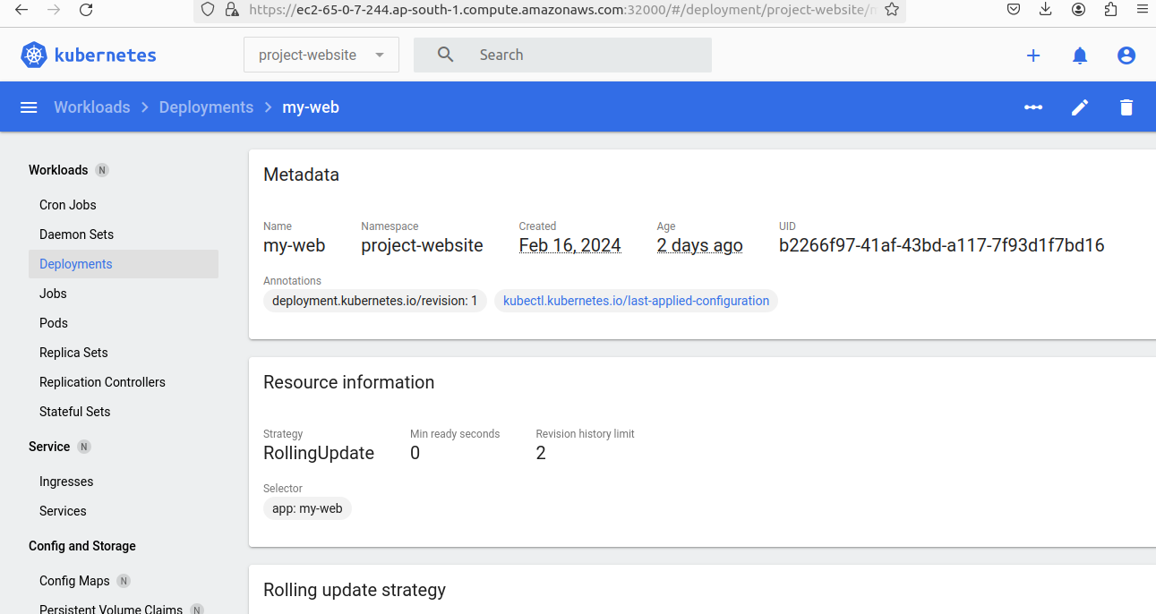
Kubernetes Dashboard Setup
The Kubernetes Dashboard provides a user-friendly interface for managing and monitoring Kubernetes clusters, making it easier for both novice and experienced users to work with Kubernetes resources effectively.

Slide 21
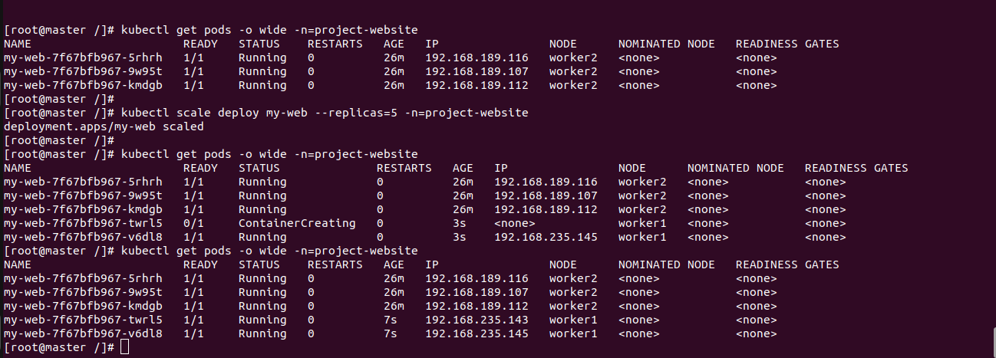
Validation
1. Verify High Availability of Pods if worker node is Failed:
2. Verify Scalability of Pods - Horizontal Pod Autoscaling (HPA):
3. verify Manual Scaling:

Slide 22
References & Bibliography
1. Kubernetes Documentation:
https://kubernetes.io/docs/home/
2. Containerd Documentation:
https://containerd.io/docs/
3. AWS Cloud Documentation:
https://docs.aws.amazon.com/
4. Calio Documentation:
https://docs.tigera.io/
Project Link:
Github: https://github.com/tarun-code/KUBERNETES-CLUSTER-PROJECT

Slide 23
Limitation’s
1. Vendor lock-in: While Kubernetes itself is open-source and portable, using it on AWS may tie you to AWS-specific services and features, making it harder to migrate to another cloud provider in the future.
2. Service limitations: Some AWS services may not be fully compatible or optimized for Kubernetes. For example, AWS Load Balancers may require additional configuration to work seamlessly with Kubernetes services.
3. Regional availability: Not all AWS services and features are available in every AWS region, which could impact your Kubernetes deployment's flexibility and availability

Slide 24
Conclusion
In conclusion, deploying a Kubernetes cluster on AWS for high availability, load balancing, and scaling of web server applications is a complex but rewarding endeavor. By addressing challenges, leveraging best practices, and embracing automation and scalability principles, organizations can build robust and resilient Kubernetes environments that meet the demands of modern cloud-native applications.
1. Benefits: Kubernetes provides a powerful platform for automating the
deployment, scaling, and management of containerized applications. By
leveraging AWS infrastructure, we can take advantage of scalable compute
resources, managed services, and global reach to build resilient and efficient
Kubernetes clusters.
2. Challenges : Deploying and managing a Kubernetes cluster on
AWS involves addressing various challenges, including complexity, cost,
resource management, networking considerations, and security concerns. It
requires expertise in Kubernetes administration, AWS services, infrastructure
management, and DevOps practices.

