Slide 1

ZOMATO RESTAURANTS EXPANSION ANALYSIS
A Data-Driven Market Expansion Study
Prepared by:
CharuTrishoola Mohan Udaiyar
Date:
October 23, 2025

Slide 2

PROBLEM STATEMENT
  Zomato operates across multiple countries with varying market maturity and competition levels.
  Selecting the right countries for expansion is essential to drive sustainable growth and reduce market entry risk.
  This project analyzes global restaurant data to identify high-potential markets using data-driven insights.

Slide 3

DATA OVERVIEW
Dataset Size: 9,552 restaurant records
  Major attributes analyzed include country, ratings, votes, cost for two, cuisines, online delivery, and table booking.
  Data covers restaurants operating in diverse market conditions.
  Currency values were standardized and converted into INR for consistency.
  Data was cleaned to handle missing values and duplicates.

Slide 4

METHODOLOGY
  Cleaned and standardized the raw restaurant dataset.
  Converted all cost-related values into INR for consistency.
  Used pivot tables to aggregate and summarize data at the country level.
  Analyzed patterns across ratings, votes, pricing, cuisines, and digital features.
  Presented insights through an interactive Excel dashboard.

Slide 5
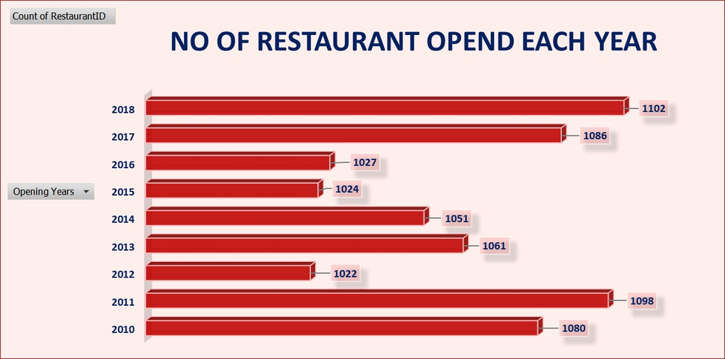
RESTAURANT COUNT BY YEAR
  A steady increase in restaurant openings indicates rising global demand for food services.
  Peak years reflect rapid adoption of online food platforms like Zomato.
  The trend helps distinguish mature markets from emerging expansion opportunities.

Slide 6
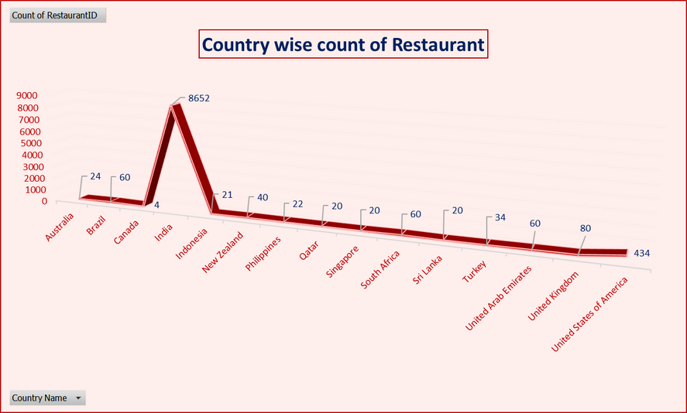
RESTAURANT COUNT BY COUNTRY
  Countries with a high number of restaurants represent mature or saturated markets.
  Countries with fewer restaurants indicate early-stage or under-penetrated markets.
  This distribution helps prioritize countries for strategic expansion planning.

Slide 7
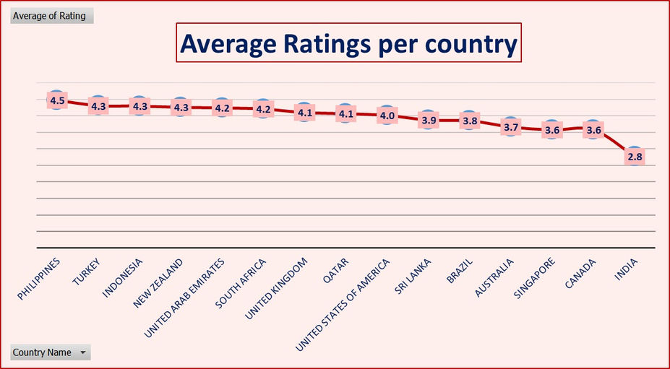
AVERAGE RATING BY COUNTRY
  Countries with higher average ratings demonstrate stronger customer satisfaction.
  Lower-rated countries highlight opportunities for service quality improvement.
  Rating comparison helps benchmark market quality across regions.

Slide 8
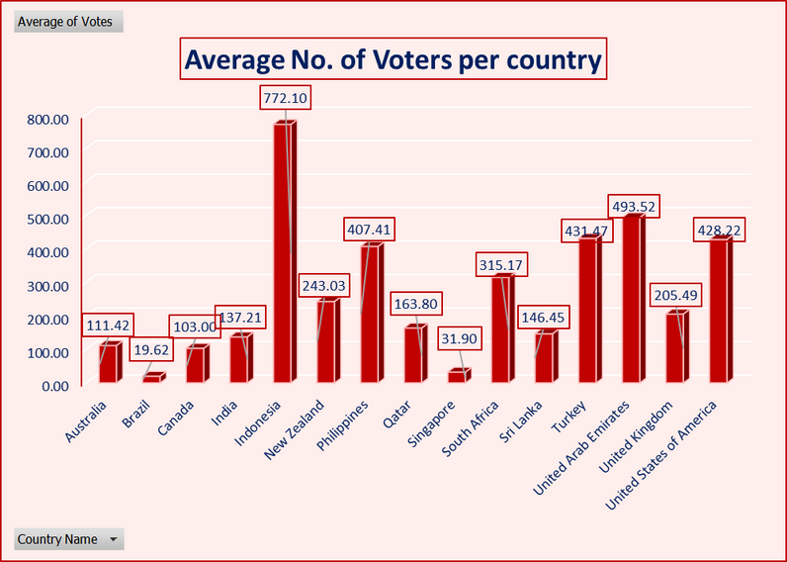
AVERAGE VOTES BY COUNTRY
  Countries with higher average votes show stronger online customer engagement.
  High vote counts reflect active review and feedback culture.
  Digitally engaged markets are ideal for platform-led growth strategies.

Slide 9
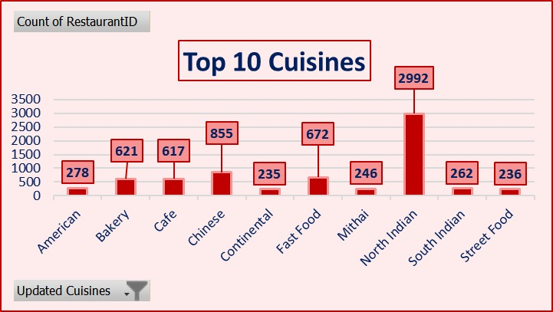
TOP 10 CUISINES
  The most popular cuisines highlight global consumer food preferences.
  High-demand cuisines should be prioritized for restaurant onboarding.
  Cuisine insights support localized and region-specific menu strategies.

Slide 10
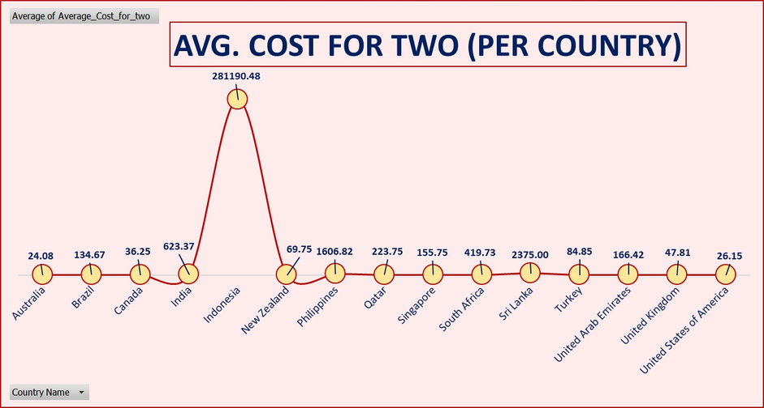
AVERAGE COST FOR TWO (INR)
  Countries with higher average cost support premium and fine-dining positioning.
  Lower-cost countries are better suited for value-driven and high-volume models.
  Cost comparison enables market-specific pricing strategies.

Slide 11
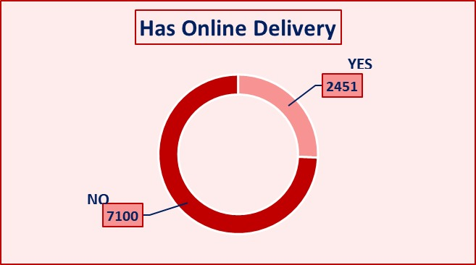
ONLINE DELIVERY ADOPTION (%)
  Countries with high online delivery adoption show strong digital readiness.
  These markets are ideal for delivery-first expansion strategies.
  Adoption patterns reflect evolving customer ordering behavior.

Slide 12
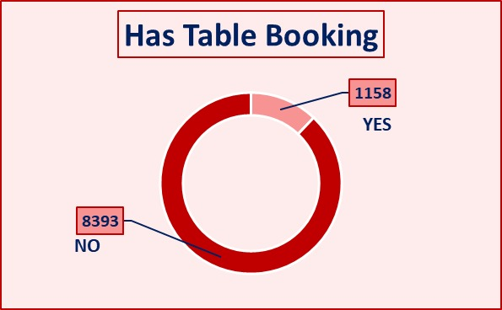
TABLE BOOKING ADOPTION (%)
  High table booking adoption reflects strong dine-in preferences.
  Lower adoption suggests markets are more delivery-oriented.
  These insights help prioritize feature investments by region.

Slide 13
SUGGESTED COUNTRIES FOR EXPANSION
Recommended Markets:
  Australia
  Brazil
  Canada
  Singapore
  Sri Lanka
Why These Markets?
  Balanced pricing and affordability.
  Strong online delivery adoption.
  Positive customer ratings and engagement.
  Relatively lower market saturation.
  High demand for popular cuisines.

Slide 14
SUMMARY
  Global restaurant data was analyzed across countries, ratings, pricing, cuisines, and digital adoption.
  Market characteristics vary significantly across regions.
  Several countries demonstrate strong expansion potential based on balanced demand and digital readiness.
  Insights are consolidated through an interactive dashboard for decision-making.

Slide 15
RECOMMENDATIONS
  Prioritize entry into high-potential, low-competition markets.
  Focus on countries with strong online delivery adoption.
  Onboard restaurants offering high-demand cuisines.
  Customize pricing strategies based on market affordability.
  Launch delivery-first models before expanding dine-in features.

Slide 16
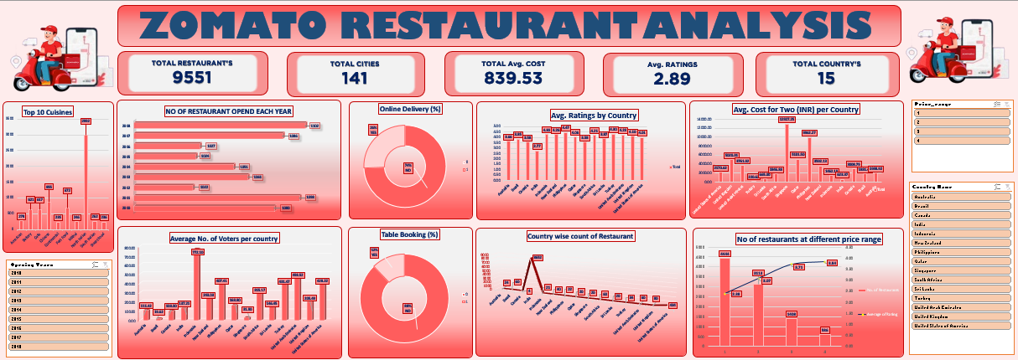
DASHBOARD

Slide 17
THANK YOU
EMAIL
trishoolamohan.2311@gmail.com
PROJECT
Zomato Restuarants Expansion Analysis
TOOLS USED
Excel | Pivot Tables | Data Cleaning | Dashboarding | PPT
SKILLS APPLIED
Data Analysis | Visualization | Storytelling.

