Slide 1
PROJECT 01 • MACHINE LEARNING
YES BANK
Stock Price Prediction
Exploratory Data Analysis | Regression Modelling | Model Evaluation
INSIGHTS PRESENTATION
Prepared by: Trishuli D Patel • Vidyavardhaka college of engineering Mysore
YES BANK / STOCK PRICE PREDICTION
01

Slide 2
AT A GLANCE
Executive Summary
A complete workflow from historical market data to test-set model comparison.
OBSERVATIONS
BEST MODEL
RMSE
R² SCORE
185
Random Forest
55.7065
0.8089
Monthly records
Lowest reported RMSE
Test set
Test set
The target is the next month's closing price.
Random Forest slightly outperformed the tuned Random Forest.
Results are a baseline and should not be interpreted as a reliable trading signal.
YES BANK / STOCK PRICE PREDICTION
02

Slide 3
WHAT ARE WE TRYING TO ESTIMATE?
Problem Statement
Estimate the next month's YES BANK closing price using prior monthly price information.
Target variable: next-month Close.
Predictors: historical Open, High, Low and Close values and engineered lag/rolling features.
Task type: supervised regression with a continuous numeric target.
The model estimates a price; it does not predict market events or guarantee future performance.
YES BANK / STOCK PRICE PREDICTION
03

Slide 4
DATA USED IN THE ANALYSIS
Dataset Profile
ROWS
START
END
FIELDS
185
Jul 2005
Nov 2020
5
Monthly observations
Date + OHLC
Date: month of the record.
Open: opening price; High: highest price; Low: lowest price; Close: closing price.
Records were converted to dates and sorted chronologically before analysis.
YES BANK / STOCK PRICE PREDICTION
04

Slide 5
END-TO-END METHODOLOGY
Project Workflow
01
02
03
04
05
Inspect
Explore
Prepare
Train
Evaluate
Load, profile and validate data
Trend, distributions and correlation
Clean and engineer lag features
Chronological split and model fitting
Metrics, tuning and residual review
Chronological ordering is important because this is a time-dependent prediction problem.
YES BANK / STOCK PRICE PREDICTION
05

Slide 6
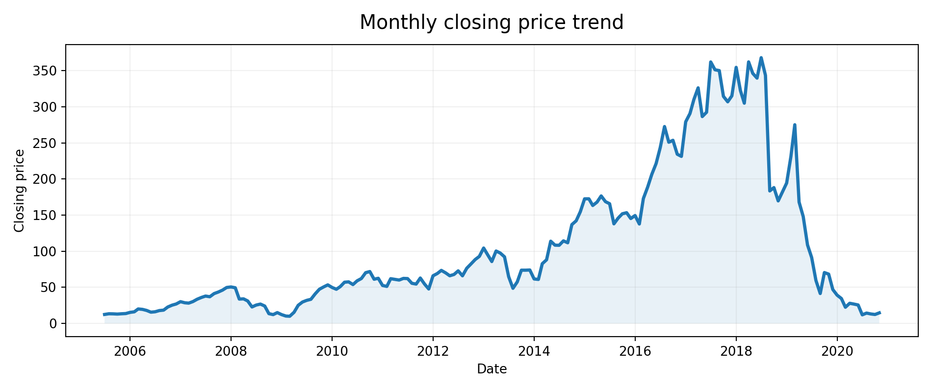
HISTORICAL CLOSING-PRICE MOVEMENT
Exploratory Analysis
The monthly series shows substantial variation, including a sharp decline after the high-price period around 2018.
YES BANK / STOCK PRICE PREDICTION
06

Slide 7
CHECKS BEFORE MODELLING
Data Quality & Preparation
Reviewed dataset dimensions, data types and summary statistics.
Checked for missing values and duplicate records.
Used visual inspection and IQR-based checks to identify potential outliers.
Outliers require context: unusual stock prices may reflect real market events.
Lag and rolling calculations create initial rows without complete feature values; these are handled before training.
YES BANK / STOCK PRICE PREDICTION
07

Slide 8
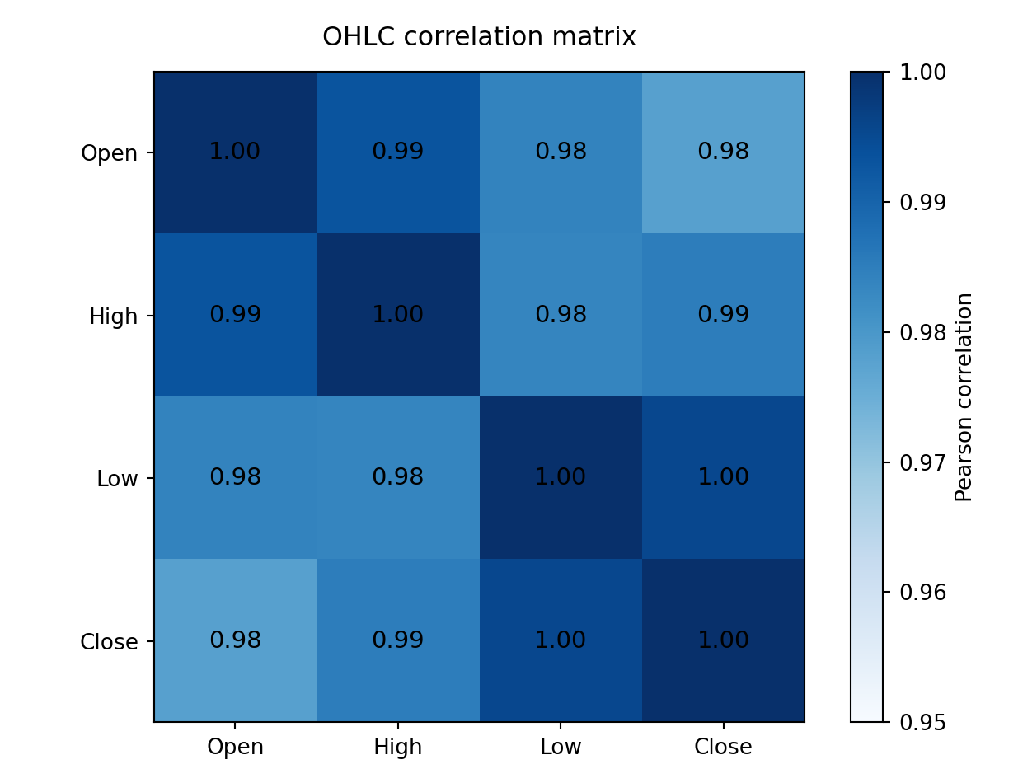
RELATIONSHIP BETWEEN OHLC VARIABLES
Correlation Analysis
KEY INSIGHT
OHLC variables are strongly positively correlated in this dataset.
Correlation indicates association, not causation. Highly related inputs may contain overlapping information.
YES BANK / STOCK PRICE PREDICTION
08

Slide 9
CREATING PREDICTORS FOR THE NEXT-MONTH TARGET
Feature Engineering
INPUTS • MONTH t
Open_Lag1
TARGET • MONTH t+1
High_Lag1
Next month's
Closing Price
Low_Lag1
Close_Lag1
3M / 6M rolling averages
Predictors from month t are aligned with the Close value for month t+1 to preserve temporal order.
YES BANK / STOCK PRICE PREDICTION
09

Slide 10
ALGORITHMS AND VALIDATION STRATEGY
Model Development
MODEL 01
MODEL 02
MODEL 03
Linear Regression
Random Forest
Tuned RF
Baseline model
Ensemble of decision trees
Grid-search selected settings
Chronological holdout: first 80% for training, final 20% for testing (as implemented in the notebook).
Hyperparameter search used TimeSeriesSplit on the training data.
Test data was used for final comparison.
YES BANK / STOCK PRICE PREDICTION
10

Slide 11
REPORTED TEST-SET PERFORMANCE
Model Evaluation
MODEL | MAE | MSE | RMSE | R²
Linear Regression | 43.5067 | 3900.6719 | 62.4554 | 0.759806
Random Forest | 40.1682 | 3103.2156 | 55.7065 | 0.808911
Tuned Random Forest | 40.4051 | 3104.1693 | 55.7151 | 0.808853
MAE / RMSE: lower is better • R²: higher is better
LOWEST RMSE
HIGHEST R²
TUNING IMPACT
55.7065
0.808911
Minimal
Random Forest
Random Forest
Baseline slightly better
YES BANK / STOCK PRICE PREDICTION
11

Slide 12
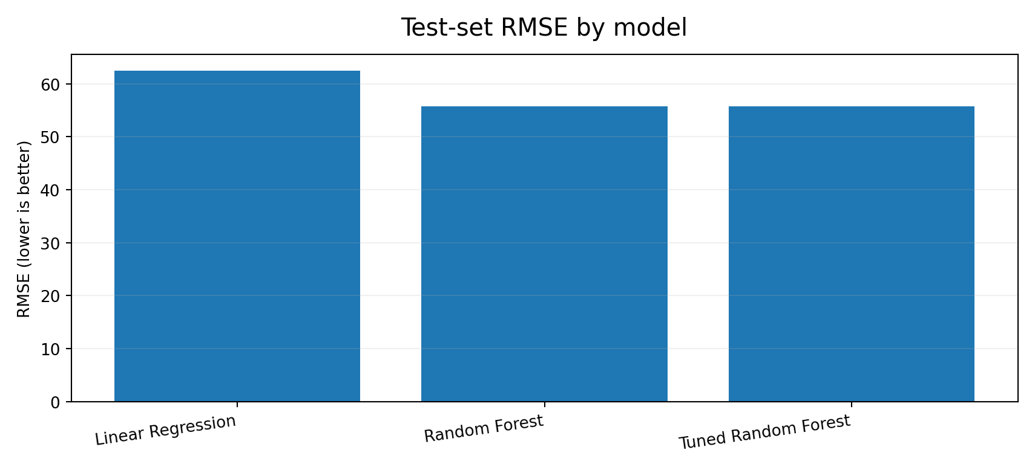
RMSE ON THE HELD-OUT TEST PERIOD
Comparing the Models
Random Forest has the lowest RMSE, but its margin over the tuned model is very small.
YES BANK / STOCK PRICE PREDICTION
12

Slide 13
UNDERSTANDING MODEL BEHAVIOUR
Model Explainability & Error Review
Feature importance ranks the input variables by their contribution within the Random Forest model.
Residuals are the differences between actual and predicted target values.
The residual plot showed larger errors for some higher predicted-price observations.
This suggests the model does not capture every large price movement.
Explainability and residual analysis help identify limitations beyond a single score.
YES BANK / STOCK PRICE PREDICTION
13

Slide 14
WHAT WE LEARNED
Key Insights & Limitations
KEY FINDINGS
LIMITATIONS
Random Forest performed best on the reported test metrics.
• Small monthly dataset; limited generalisation.
Tuning did not materially improve the baseline model.
• OHLC-only inputs omit wider market and economic factors.
OHLC values have strong positive correlations.
• Stock prices are volatile; model outputs are uncertain.
YES BANK / STOCK PRICE PREDICTION
14

Slide 15
CONCLUSION
Random Forest was the strongest
of the three tested models.
TEST RMSE
TEST R²
TUNING OUTCOME
55.7065
0.808911
No material gain
Lowest among tested models
Highest among tested models
Very similar to baseline
The project demonstrates an end-to-end workflow for analysing historical YES BANK prices and building a regression baseline. It is an educational analysis, not investment advice.
YES BANK / STOCK PRICE PREDICTION
15

