Slide 1
UROP 2016 Summer Project
Trishita Tiwari, Ata Turk, Ayse Coskun

Slide 2
Motivation
Task: create a framework to allow for real-time monitoring for power data from MGHPCC
Real time data analysis uses:
- Easier anomaly detection
- More flexible for research and calculations.
- Necessary for implementing data center demand response energy program

Slide 3
Methodology
Outline: 1) The data from the physical sensors is stored in a Redis database in an AWS server.
2) Use Sensu (monitoring framework) to execute python scripts that will pull data from Redis every minute.
3) These scripts will also push the data to InfluxDB (a time-series DB used for monitoring data).
4) Now use the data in InfluxDB to calculate per hour totals of power consumption.
REDIS ➔ SENSU ➔ INFLUXDB
Notes:
And after we have pushed the data into influxDB, we again use sensu to pull all that influxDB data, calculate aggregate stats such as per hour power consumption, and then push all that aggregate data into a separate table in influxDB.

Slide 4
Redis
Redis is a key value database.
Hence, the sensor data was stored as a key, which was the name of the data being measured, and a value, which was json formatted data containing the timestamp and the numbers.
Example:
Key = "mechanical:cooling:CH1:JSON"
Value = "{\"timestamp\": 1467990000.0, \"kwh\": 88387}"
Notes:
So on the AWS server we had around 1700 keys, and each key had the name of the metric it is storing. The values of all keys are JSON objects, containing the time at which the data was collected and the value of the data point itself, and often some other meta-data (like tags).

Slide 5
Sensu
Sensu provides a monitoring framework.
Consists of 2 components: the Sensu-client and the Sensu-server.
Server: the server contains various “check definitions”, which are json files that define a what needs to be monitored, how often, which scripts need to be executed, what should be done with the data, etc.
The client subscribes to these one or more of the checks on the server, thereby allowing the checks to be executed on the client.
Standalone model: client and server run on the same machine.
Notes:
Check definitons are files that we create to tell the sensu server what to monitor, how often to monitor it, what to do with the output data, etc.
The client subscribes to those checks that the client wants to be executed on itself.

Slide 6
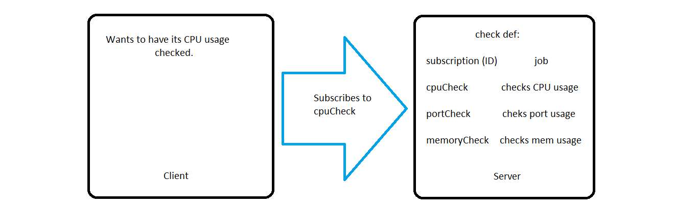
Client-Server model
Notes:
On the sensu-server, we can create checks for a lot of different purposes. So here we have checks for monitoring cpu usage, port usage, etc. Lets say we have a client that is interested in monitoring its CPU usage. So now the client will subscribe to the check named “CPUcheck”, and this act of subscription basically tells the sensu server that this client wants that to be executed on itself. So the server will then start executing the cpu check on this client at whatever interval is specified on the check.

Slide 7
Sensu-server: check definitions
{"checks":
{"busplug1":
{"type": "metric",
"command": "busplug.py electrical:busplug*R1*PA*", ➔ Which script to be executed
"standalone": true, ➔ client and server on same machine
"subscribers": ["busplugR1PA"], ➔ like a check ID (used by clients to subscribe)
"handler": "influxdb24", ➔ how the output from script should be handled
"interval": 60 ➔ how often should script be executed (seconds)
}
}
}
Notes:
Check command is the script that does all the work: so this is the script that pulls data from redis and formats it for influxdb.
Subscribers: This is basically acts like the ID of the check, and so to subscribe to this check the client would have to add THIS name to its subscriptions list

Slide 8
Sensu-Client
{"client":{
"name": "ubuntu",
"address": "127.0.0.1",
"subscriptions":["busplugR1PA"], ➔
"socket": {
"bind": "127.0.0.1",
"port": 3030
}
}
}
this tells the server that the client wants that particular check to be executed on itself
Notes:
This list of all subscriptions lets the server know which all checks the client wants to execute on itself.

Slide 9
Check command: the scripts
The python scripts did the following:
Created a connection with the Redis database
Parsed the key-values to obtain the data
Format the data for InfluxDB
Output the formatted data to sys.stdout

Slide 10
Script output
mechanical_cooling CH3_(kwh)=126437 1468249200000000000
electrical_generator fuel_consumption=6006.0 1468249200000000000
.
.
.
.
(typically 50-100 lines per script)
InfluxDB format
Timestamp
Column name
Table name
Notes:
Explain each of the components

Slide 11
Published Check Result
{"client":"ubuntu",
"check": {"type":"metric","command":"others.py",
"standalone":true,"subscribers":["others"],
"handler":"influxdb","interval":60,
"name":"others",
"issued":1468250603,"executed":1468250603,"duration":1.314,
"output":"mechanical_cooling CH3_(kwh)=126437 1468249200000000000\n electrical_generator total_fuel_consumption_GENF=6006.0 1468249200000000000\n”,
"status":0}}
Notes:
After the script outputs the data to the standard output, the sensu server grabs the data and adds some more information. After doing that, it finally publishes the “check-result”. And so this is what a check result looks like.

Slide 12
Transferring only necessary data: mutator
Since we don’t want that extra data to be transferred, execute another script on these check results that picks out only the relevant data.
This script is called a mutator.
This is what a simplified mutator looks like:
data = json.load(sys.stdin)
output = data["check"]["output"]
sys.stdout.write(output)
sys.exit(0)
Notes:
A mutator is a script that operates on a check result in order to, as the name suggests, mutate it into a more desirable form.

Slide 13
Handler:
After the mutator is executed, we are now ready to send the data to InfluxDB.
Handler: sensu provision that will allow us to transfer data.
Different types exist; we use the UDP handler as it is compatible with InfluxDB. Ex:
{"handlers":
{"influxdb":
{"type": "udp",
"mutator":"only_check_output", ➔ the mutator to be executed before handler
"socket": {"host": “10.13.37.179","port": 8090} ➔ which host and port to transfer to.
} }}
Once InfluxDB is configured to listen through UDP on that particular port, we are ready.
Notes:
Handlers allow you to handle the output data in whatever way you like. So you can create handlers that send you e-mail notifications, and other things like that. In our case we wanted to create a handler that actually transferred the data to influxdb.

Slide 14
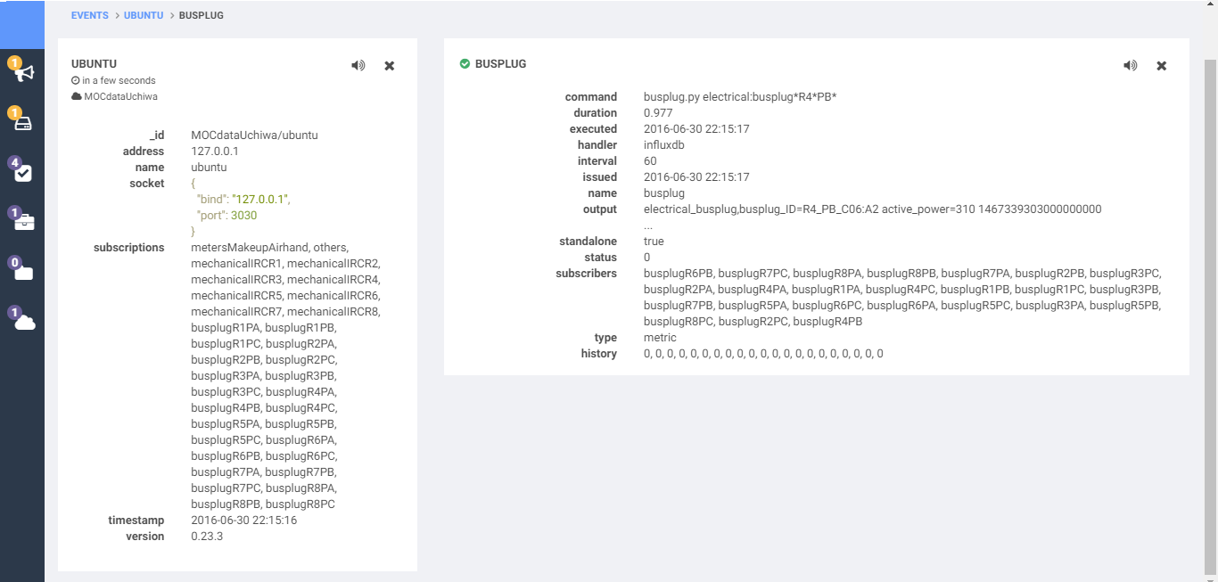
Uchiwa: monitoring health of checks
Uchiwa provides a great mechanism to monitor all our sensu checks
Uchiwa-server: http://129.10.5.134:3020/#/client/MOCdataUchiwa/ubuntu

Slide 15
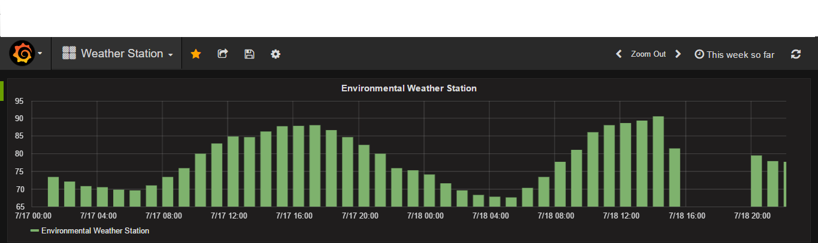
Grafana: visualizing our data
Grafana allows us to use data in InfluxDB to creat graphs that allow us to visualize data in real time. Ex:
Grafana-server: http://129.10.5.134:3000/dashboard/db/electrical-busplug

Slide 16
Datastore: InfluxDB
InfluxDB: http://129.10.5.134:8083/
Sample query: select metered_active_energy,busplug_ID from electrical_busplug order by time desc limit 10

Slide 17
Setbacks
Problem: Sensu-handlers fail silently when too much data is transferred.
Solution: break one check into multiple checks so that each check transfers small amount of data.

