Slide 1
Predicting College Football Upsets
27.1%
of FBS games end in an upset
An independent statistical research study
Tristan Morton · November 2026
3,900 NCAA FBS games · 2019, 2021–2024
Notes:
Thanks for being here. I'm Tristan Morton, and this is an independent statistical study of college football upsets. I looked at 3,900 FBS games across five seasons and asked one question: can anyone see upsets coming, or are they simply the dice? Over the next twenty or so minutes I'll show you where the data came from, how I tested the question, what I found, and the two traps hiding in the data that would have given me a very different and wrong answer. [~30 sec]

Slide 2
The closing spread captures nearly all predictive signal; what remains is consistent with irreducible randomness
1
0.177
2
+0.001
3
p = 0.77
Spread forecast error (Brier)
Gain from 5 extra features
Monte Carlo upset-count test
versus 0.244 for the naive baseline: 27.4% lower error on the temporal holdout (n = 1,554 complete-case games)
Brier change vs the spread alone: 95% CI [−0.001, +0.003] includes zero, so no out-of-sample gain
444 observed upsets sit mid-distribution across 10,000 simulated seasons
Upsets look like the expected tail of a well-priced distribution.
Notes:
Let me give you the answer first, then spend the rest of the talk earning it. Three numbers. One: the betting market's closing point spread produces a forecast with a Brier score of 0.177. Brier score is just the average squared error of a probability forecast, lower is better, and a naive forecast that ignores the spread scores 0.244. So the spread cuts forecast error by 27.4%. Two: when I add five more public features, things like team strength, venue and week, the Brier score moves by +0.001, and the confidence interval [minus 0.001, +0.003] includes zero, so no measurable gain. Three: a 10,000-trial Monte Carlo simulation says the 444 upsets we actually saw are consistent with what randomness around the line produces, with a p-value of 0.77. In plain terms: upsets look like the expected tail of a well-priced distribution. Now let me show you why. [~1 min]

Slide 3

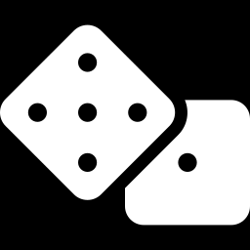
About one FBS game in four is an upset, so the question is whether anyone can see them coming
Upsets are predictable
Upsets are randomness
27.1%
Hypothesis: measurable factors the market underweights, such as team strength, venue, conference play or time of season, mark games where the underdog is underrated.
Hypothesis: the closing line already holds the public information, so once the spread is known the leftover variation is noise, like dice.
of 3,900 FBS games were upsets
The closing-line underdog won outright
Implies: a model with public features beats the spread.
Implies: no public-feature model beats the spread; outcomes look like random draws.
Research question Once the closing spread is known, do public features predict upsets, or is the remaining variation consistent with irreducible randomness?
Notes:
About 27.1% of the 3,900 games in this study ended with the betting underdog winning outright. Upsets drive the drama of the sport, the playoff chaos, and a large share of the betting market, so the natural question is whether there's a pattern a careful analyst could exploit. There are two competing explanations. The first says upsets are predictable: measurable things like team strength, venue, conference play or time of season mark games where the underdog is underrated. The second says upsets are randomness: the closing line already contains the public information, so once you know the spread, what's left over is just noise. Both views make a testable prediction. If the first is right, a model with extra features should beat the spread. If the second is right, nothing should, and outcomes around the line should look like random draws. That is the research question I put to the data. [~1 min]

Slide 4
The spread works like a market price: if it is efficient, outcomes around it should be random noise
1
2
3
≈ 14 pts
A market price
15.4 pts
NFL: outcome minus spread is approximately normal, SD about 14 points
The point spread is a price set by bookmakers and moved by bettors
This study: SD of the margin around the closing line, FBS training seasons
Stern, H. (1991). On the probability of winning a football game.
Levitt, S. D. (2004). Why are gambling markets organised so differently from financial markets?
This study: training seasons 2019, 2021 and 2022.
What we test If the spread is efficient, no public-feature model should beat it, and outcomes around it should behave like draws from a fixed distribution.
Notes:
Two pieces of prior work frame this study, and I want to keep my claims modest about both. Hal Stern, in 1991, studied NFL games and found that the final margin minus the point spread is approximately normally distributed with a standard deviation of roughly 14 points. In other words, the spread is a good forecast, and what's left behaves like bell-curve noise. Steven Levitt, in 2004, treated the point spread as a market price, set by bookmakers and moved by bettors, which gives us an efficient-markets framing. If the spread is an efficient price, public information is already in it. So what this study tests is whether college football behaves the same way. Our own number, for FBS games in the training seasons, is a standard deviation of 15.4 points: the same kind of noise, a little wider than the NFL figure. The next section shows how the pipeline was built to test it. [~1 min]

Slide 5

Data & Pipeline
From API calls to an audited dataset
Notes:
Section break: data and pipeline. [~5 sec]

Slide 6
The study runs as one reproducible pipeline, from raw API calls to the final report
1
Extract
2
Clean & audit
3
Model
REST client with retries and a raw response cache
Verify FBS membership, build the consensus spread, count every exclusion
Hypothesis tests, Brier and calibration scoring, cluster bootstrap
cfb/api.py
cfb/etl.py
cfb/models.py
4
Simulate
5
Controlled reruns
6
Report
10,000 Monte Carlo trials under two null models
Switch the leak and the filter defect back on to measure their impact
Figures, one results.json and the written report
cfb/simulate.py
run_study.py
report/
Notes:
Here's the whole study on one slide. Six stages, and one command runs all of them. Stage one, extract: a small REST client pulls games, betting lines, official FBS membership and team ratings from the CollegeFootballData API, with retries, and caches every raw response so the study can rerun offline. Stage two, clean and audit: the data is flattened, validated and joined, and every build writes an audit that counts every record removed and why. Stage three, model: the four hypothesis tests, the forecast scoring and a cluster bootstrap. Stage four, simulate: ten thousand synthetic seasons. Stage five, controlled reruns: I deliberately switch the two data problems back on, to measure what each would have done. And stage six, the report: figures, a single results file and the written paper. Every headline number traces back to that one results file. [~1 min]

Slide 7
All data comes from one public API, filtered to 3,900 FBS-vs-FBS games with a consensus closing line
Endpoint | What it provides
/games | Scores, venue, conference, season type, team classification
/lines | Point spreads and over/unders by sportsbook
/teams/fbs | Official FBS membership for each season
/ratings/sp | SP+ team-strength ratings
Inclusion rules
FBS vs FBS: both teams on that season's /teams/fbs list
Regular season and bowl games
Completed, with a closing line
Pick'em (spread 0) excluded: no underdog
2019
2021
2022
2023
2024
2020 excluded
771
769
773
789
798
COVID cut it to 534 usable games, many without crowds, which distorts home-field advantage
games
games
games
games
games
Notes:
All the data comes from one public source, the CollegeFootballData REST API, through four endpoints. The games endpoint gives scores, venue and conference. The lines endpoint gives point spreads from several sportsbooks. The teams endpoint gives the official FBS membership list for each season, which turns out to be important later. And the ratings endpoint gives SP-plus team-strength ratings. The population is FBS against FBS, regular season and bowls, completed games that have a closing line, and I take the median spread across sportsbooks so one stale line can't move it. Ten pick'em games with a spread of zero are excluded, because with no favorite there's no upset to define. The result is 3,900 games over five seasons, 2019 and 2021 to 2024. I excluded 2020: COVID cut it to 534 usable games, many played without crowds, which distorts home-field advantage. [~1 min]

Slide 8
The audit removed 601 records on the way from 4,501 raw rows to 3,900 analysis games
590
non-FBS rows removed
13.1% of raw rows; the API filter keeps games with one FBS team
1 + 10
incomplete score + pick'em games
No result, or no underdog to define
72.9%
favorites won: sign-check gate passed
The build stops if this falls outside 60–90%
Notes:
This is the data funnel, and it's built from the audit file the pipeline writes on every build. We start with 4,501 game rows from the API's FBS-classified games request. The first and biggest cut: 590 rows, 13.1% of the total, involved a team that is not actually on that season's FBS list. That's the filtering defect I'll come back to. One game had no final score, and 10 were pick'em games with no underdog. That leaves 3,900 games. Also on this slide is a safety check I call the sign-check gate. Favorites should win roughly sixty to ninety percent of the time. If I had the spread's sign backwards, favorites would appear to win only about twenty-seven percent, and the build would stop before any analysis. They won 72.9%, so the gate passes. The point is that every exclusion is counted, not silently absorbed. [~1 min]

Slide 9
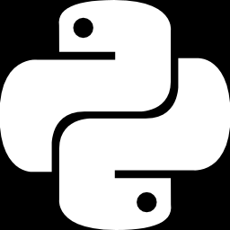
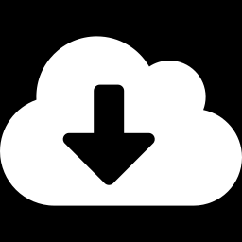
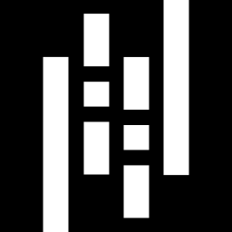
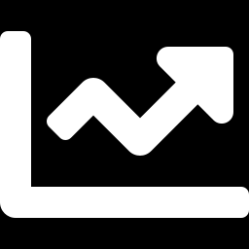
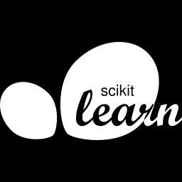
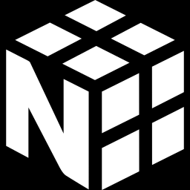
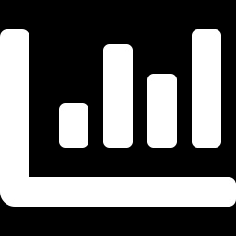
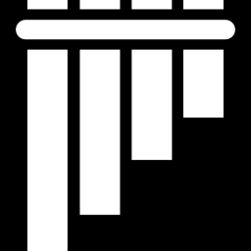
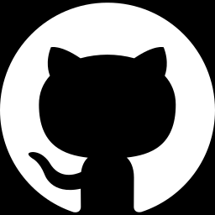
Each tool was chosen for one job: inference with statsmodels, scoring with scikit-learn, simulation with NumPy
Python 3.12
requests
pandas 3.1.1 + Parquet
One language from API call to PDF
Simple HTTP with timeouts, retries and a raw cache
Readable cleaning rules; typed, checksummed storage
statsmodels 0.15.0
scikit-learn 1.9.1
NumPy 2.5.4 + SciPy 1.18.1
Standard errors and p-values for the hypothesis tests
Tested Brier, log-loss, AUC and calibration scoring
Vectorized Monte Carlo; chi-square and normal CDFs
matplotlib
pytest
Git + GitHub
Static figures, rendered headless
20 tests pin the cleaning rules, statistics and leak guard
Every change is a reviewed commit and pull request
Notes:
A quick tour of the toolbox, because each choice was deliberate. Python for everything, so one language runs from the API call to the final figure. The requests library for simple, dependable HTTP. Pandas and Parquet for cleaning and storage, so each cleaning rule is one readable line and the data types are preserved. The interesting pair is statsmodels and scikit-learn. They answer different questions. Statsmodels fits the models and gives inference, meaning standard errors and p-values, which hypothesis testing needs. Scikit-learn scores the forecasts on games the model never saw. A research study needs both. NumPy and SciPy run the Monte Carlo as fast array operations, matplotlib draws the figures, pytest pins 20 tests on the cleaning rules and the statistics, and Git with GitHub keeps every change a reviewed commit. [~1 min]

Slide 10

Methods
Hypotheses and evaluation design
Notes:
Section break: methods. [~5 sec]

Slide 11
Four null hypotheses, each with a named test, ask whether the spread, or anything beyond it, carries signal
Null hypothesis
Test
α = 0.05
H₀₁
The spread does not predict who wins
Logistic regression of home win on the spread; Wald test on the slope
H₀₂
Other public information adds nothing once the spread is known
Likelihood-ratio test (df = 5): spread-only logit nested in a model adding prior-season SP+ difference, neutral site, conference game, week and over/under
H₀₃
Spread-implied probabilities are calibrated
Calibration intercept and slope plus Hosmer–Lemeshow (10 bins) on the temporal holdout; reliability diagram
H₀₄
The spread is an unbiased forecast of the margin
OLS of margin on spread: ideal intercept 0 and slope −1; R² against a multivariate OLS
Notes:
Before looking at results, here are the four null hypotheses, stated up front, each with the test that goes with it. A null hypothesis is the boring default we try to knock down. H-zero-one: the spread does not predict who wins. We test it with a logistic regression of home win on the spread. H-zero-two: other public information adds nothing once the spread is known. That's a likelihood-ratio test comparing a spread-only model against one that adds prior-season team strength, neutral site, conference game, week and the over-under, five extra terms. H-zero-three: the spread's implied probabilities are calibrated, meaning that when it says seventy percent, favorites win about seventy percent. We check the calibration slope and intercept and a Hosmer-Lemeshow test on the holdout seasons. And H-zero-four: the spread is an unbiased forecast of the margin, checked with a linear regression where the ideal is intercept zero and slope minus one. Everything uses a significance level of five percent. [~1 min]

Slide 12
A temporal holdout (out-of-sample) scores the models on seasons they never saw, against a named naive baseline
Train: 2,313 games
Temporal holdout (out-of-sample): 1,587 games
Naive baseline: every game gets the training home-win rate
2019
2021
2022
2023
2024
Brier score
Brier skill score
Log loss
Mean squared error of the probability; lower is better
1 − Brier(model) / Brier(naive): percent better than baseline
A second proper score; punishes confident misses
AUC (discrimination)
Calibration
Cluster bootstrap
How well forecasts rank winners above losers
Slope and intercept, Hosmer–Lemeshow, reliability diagram
2,000 resamples over 31 season-weeks; games in a week are not independent
Scoring: Brier (1950). Calibration and discrimination reported separately: Murphy (1973); Collins et al. (2024), TRIPOD+AI.
Notes:
Now the evaluation design. I split by season, never at random, so no future game can inform a prediction. The models are fit on 2019, 2021 and 2022, 2,313 games. They are then scored on 2023 and 2024, 1,587 games they have never seen. That's a temporal holdout, an out-of-sample test. The naive baseline is stated explicitly: every game just gets the training home-win rate. A forecast only counts as skillful if it beats that. The scoring metrics are the Brier score, the mean squared error of the probability; the Brier skill score, which turns that into percent better than the baseline; log loss as a second check; and AUC for discrimination, how well forecasts rank winners above losers. Calibration, whether the stated probabilities are honest, is reported separately, with a slope, an intercept and a reliability diagram. Finally, the uncertainty comes from a cluster bootstrap over the 31 season-weeks, because games in the same week aren't independent. [~1 min]

Slide 13

Results
Hypothesis tests, then out-of-sample scoring
Notes:
Section break: results. [~5 sec]

Slide 14
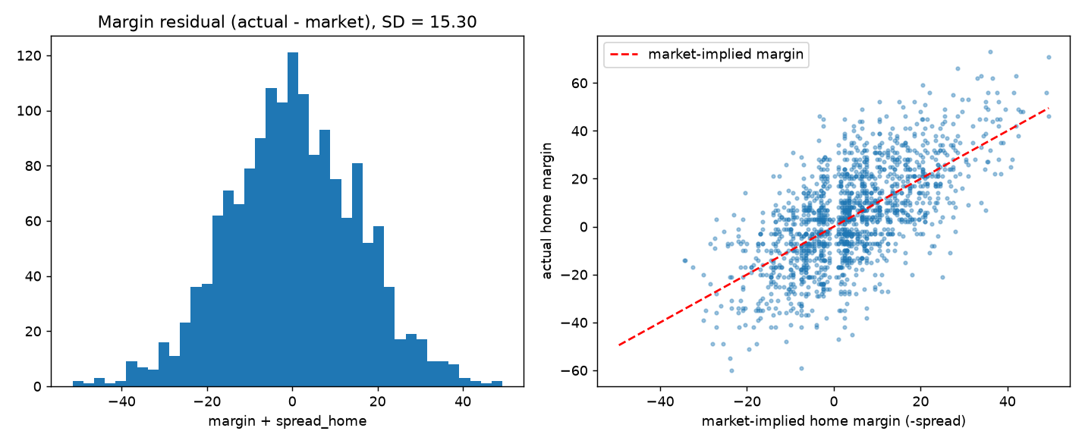
The spread strongly predicts winners and is an unbiased forecast of the final margin
z = −21.3
H₀₁ rejected (p < 0.001)
Slope −0.109/point, 95% CI [−0.119, −0.099]
−1.000
H₀₄ not rejected: unbiased margin
Slope 95% CI [−1.044, −0.955]; intercept −0.16 (p = 0.63)
Residuals are roughly normal (SD 15.30 on the holdout); actual margins scatter symmetrically around the market line.
R² = 0.456
69.3%
82.8%
Margin variance the spread explains
7-point home favorite wins
14-point home favorite wins
Five extra features lift it only to 0.459
Notes:
Start with the first and fourth hypotheses. For H-zero-one, each point of spread shifts the log-odds of a home win by minus 0.109, with a z-statistic of minus 21.3, and a p-value far below one in a thousand. The spread predicts winners, and the null is rejected decisively. In plain terms, a seven-point home favorite wins about 69.3% of the time in the model, and a fourteen-point favorite about 82.8%. For H-zero-four, I regress the actual margin on the spread. If the market is unbiased, the slope should be exactly minus one and the intercept zero. The fitted slope is minus 1.000, with a confidence interval of [minus 1.044, minus 0.955] that contains minus one, and the intercept is minus 0.16, p equals 0.63. So we don't reject: the spread is an unbiased forecast of the margin. The plot shows residuals roughly normal and actual margins scattered symmetrically around the market line. [~1 min]

Slide 15
Five extra public features add nothing out of sample, and the p = 0.048 signal seen in training does not survive
+0.001
Brier change, full minus spread
95% CI [−0.001, +0.003] includes zero (n = 1,554)
p = 0.048
H₀₂ in-sample LR test (df = 5)
Marginal in-sample; does not hold out of sample
0.806 vs 0.803
AUC: spread only vs full model
Brier skill vs naive: 27.4% vs 27.0%
Notes:
The second hypothesis is the one that decides whether public information beats the market. In-sample, on the training seasons, the likelihood-ratio test of the five extra features gives p equals 0.048, just under the five percent line. If I stopped there, I might claim a small edge. But the out-of-sample test is decisive. On the holdout seasons, the naive forecast scores a Brier of 0.244, the spread alone scores 0.177, and the full model with all the extra features scores 0.178. The full model is slightly worse. The paired difference is +0.001, with a cluster-bootstrap ninety-five percent interval of [minus 0.001, +0.003], which includes zero. AUC, the ranking measure, tells the same story: 0.806 for the spread alone, 0.803 for the full model. A marginal in-sample result that fails on new seasons is the classic signature of fitting noise. The market spread alone captures nearly all the predictive signal in these public features. [~1 min]

Slide 16
Spread-implied probabilities are well calibrated: when the spread says 70%, favorites win about 70%
1.09
Calibration slope (ideal 1)
95% CI [0.96, 1.21]; intercept −0.03 (SE 0.06), ideal 0
p = 0.062
H₀₃ not rejected (Hosmer–Lemeshow)
χ² = 14.9 on 8 df, 10 bins
0.806
AUC: discrimination, not calibration
How well forecasts rank winners above losers
Full-model deciles use its own predictions; mean predicted differs from spread-only by at most 2.6 points.
Notes:
The third hypothesis asks whether the probabilities are honest. This chart is a reliability diagram. I sort the holdout games into ten groups by predicted probability, and for each group compare the average prediction to how often the home team actually won. A perfectly calibrated forecast sits on the gray reference line, where predicted equals observed. Both the spread-only and the full model track it closely across the whole range. The numbers back that up. The calibration slope is 1.09 with a standard error of 0.06, and the ideal is one. The intercept is minus 0.03, ideal zero. A Hosmer-Lemeshow test gives p equals 0.062, so we don't reject the null of good calibration. Separately, because calibration and discrimination are different things, the AUC is 0.806: the forecast ranks winners above losers well. When the spread says seventy percent, the favorite wins about seventy percent of the time. [~1 min]

Slide 17
Close games are nearly coin flips, and upsets fall from 51% to 5% as the spread grows
51.0%
upset rate when the spread is under 3 points
n = 257 holdout games
7.1% vs 13.8%
Largest gap: 14–21 point spreads
n = 239; one of six buckets, so read with caution
Notes:
This slide turns calibration into the question the audience cares about: how often do underdogs actually win? I group the holdout games by the size of the spread. When the spread is under three points, the game is close to a coin flip: 51.0% of those 257 games ended in an upset. As the spread grows, upsets fall steadily, down to 4.7% for spreads of 21 or more. The predicted rates, in the lighter bars, come from the spread-only model and follow the same pattern. One bucket stands out: for spreads between 14 and 21, 7.1% of games were upsets against 13.8% predicted. That's the largest gap, but it's one bucket of six, so I'd treat it as something to watch, not as an edge. Overall the spread tracks the pattern closely, with one notable gap: in the 14 to 21 bucket, about 7 percent observed versus 14 percent predicted, roughly 3 standard errors. Overall calibration is not rejected, with a Hosmer-Lemeshow p of 0.062. [~1 min]

Slide 18

Validation
Monte Carlo, controlled reruns and safeguards
Notes:
Section break: validation. [~5 sec]

Slide 19
A Monte Carlo asks whether the real seasons look any different from worlds that are only line plus noise
1
Outcome redraw
Upset count
10,000
Underdog wins in a simulated season
Each holdout game's winner is a coin flip weighted by the spread-only model's probability
simulated 2023–24 seasons
Residual SD
Spread of actual margins around the market line
1,587 games per trial, fixed seed 42, fit on training data only
2
Margin redraw
Each margin is the market-implied margin plus Normal(0, σ), σ = 15.43 points (training SD)
Brier score + oracle Brier
Oracle (margin model): the Brier a forecaster with the true probabilities would expect
Notes:
The regression tests tell us the spread is good and extra features don't help. The Monte Carlo goes after the bigger claim: that what remains is randomness. The logic is simple. Build thousands of fake versions of the 2023 and 2024 seasons in which, by construction, outcomes are nothing but the market line plus chance, then see whether the real seasons look any different. I used two such worlds, both fit on training data only. In the outcome redraw, each game's winner is a weighted coin flip using the spread model's probability. In the margin redraw, each margin is the market-implied margin plus bell-curve noise with a standard deviation of 15.43 points. Each world is run 10,000 times with a fixed seed of 42. For each simulated season I record three things: the number of upsets, the residual spread of margins, and the Brier score. The margin model also gives an oracle Brier, the score of a forecaster who knows the true probabilities, which is what even a perfect forecaster would expect under line plus noise. [~1 min 15 sec]

Slide 20
Every observed statistic falls inside its simulated range, so the 444 observed upsets are ordinary
Statistic | Observed | Simulated 95% | p
Upsets (outcome redraw) | 444 | 405–472 | 0.77
Residual SD (points) | 15.30 | 14.89–15.97 | 0.63
Brier, spread model | 0.177 | 0.173–0.191 | 0.26
0.182
Oracle Brier (margin model)
95% range 0.174–0.191; the market's 0.177 sits inside it, leaving little room for any forecaster
Observed 444 upsets: 63.9th percentile of the simulated distribution (p = 0.77).
Notes:
Here are the Monte Carlo results. The histogram shows the number of upsets across 10,000 simulated seasons under the outcome-redraw world. The amber bar is where the real 2023 and 2024 seasons landed: 444 upsets, right in the middle of the distribution, at the 63.9th percentile. The empirical p-value is 0.77, so nothing unusual. The table gives the other two checks. The residual standard deviation of margins is 15.30 points observed against a simulated range of 14.89 to 15.97, p equals 0.63. And the market's Brier score of 0.177 sits inside its simulated range too. On the right, the oracle Brier, the best score a forecaster with perfect knowledge of the probabilities could expect, averages 0.182. That is the margin-model oracle, with a 95% range of 0.174 to 0.191. The market's 0.177 sits inside that range, which leaves little room for improvement. The careful way to say it: the residual variance is consistent with irreducible randomness. A simulation can fail to find a departure from the null, but it can't prove the null. [~1 min 15 sec]

Slide 21
Look-ahead bias would have reversed the central conclusion: the full model would appear to beat the market
Look-ahead bias (temporal leakage): features not available at prediction time. Here, end-of-season SP+ ratings used as pregame features (cf. Kapoor & Narayanan, 2023).
Leaky: same-season SP+
Clean: prior-season SP+ (as reported)
Brier skill, full model vs naive
Brier skill, full model vs naive
37.8%
27.0%
Brier(full) − Brier(spread), 95% CI
vs
Brier(full) − Brier(spread), 95% CI
−0.025
[−0.032, −0.019]
+0.001
[−0.001, +0.003]
Does the full model beat the market?
Does the full model beat the market?
Yes (false)
No
Identified at design time; impact measured by a controlled rerun on the same 3,857 matched games (same split, same seed).
Notes:
Now the first of the two data traps, and the more dangerous one. The API's SP-plus ratings for a season are computed after that season ends, from that season's own games. If you feed them to a model as pregame features, the model is partly being told the results it's supposed to predict. The technical name is look-ahead bias, or temporal leakage: features that aren't available at prediction time. I identified this at design time, before any data was pulled, and the pipeline uses prior-season ratings, so no reported result is affected. Then I measured what the leak would have done with a controlled rerun: same split, same seed, same 3,857 matched games, only the rating's season changes. With the leak, the full model's Brier skill jumps from 27.0% to 37.8%, and it appears to beat the spread by minus 0.025 Brier, with an interval of [minus 0.032, minus 0.019] nowhere near zero. We'd have confidently reported the opposite of the truth. Clean, the difference is +0.001, interval including zero. [~1 min 15 sec]

Slide 22
An API filtering defect inflated measured skill by 4.7 points and faked a miscalibration finding
Metric | Trusting the API filter | After the fix
Games analyzed | 4,461 | 3,900
Brier skill vs naive | 32.1% | 27.4%
Test-season upset rate | 24.9% | 28.0%
Hosmer–Lemeshow p | 0.029 (rejects H0₃) | 0.062 (does not reject)
Mean |spread| (points) | 13.4 | 11.1
+4.7 pts
Inflated Brier skill
32.1% vs 27.4%
Matched-rows check
On the 1,587 test games in both datasets, a model trained on contaminated data scores the same as one trained on clean data: Δ Brier −0.00003, 95% CI [−0.00017, +0.00013]. The defect corrupted the evaluation, not the model.
Defect: /games?classification=fbs returns games with at least one FBS team, not both. 590 of 4,501 rows (13.1%) were non-FBS-vs-FBS, 561 of them with betting lines.
Notes:
The second trap was a data-provenance defect, a filtering bug in the API. My first audit flagged 590 of 4,501 returned records, 13.1%, as involving a team that isn't on the official FBS list. The cause: the request asking for FBS games keeps any game with at least one FBS team, not games where both are FBS. 589 of the 590 were FBS teams hosting FCS opponents. 561 of them even had betting lines, so a pipeline that trusted the filter would have kept almost all of them. The pipeline now checks both teams against the official list and a regression test guards it. To measure the damage, I rebuilt the dataset trusting the filter. Lopsided FBS-versus-FCS games are easy to call, so they make the market look 4.7 points more skillful, they understate the upset rate, and they push the calibration test to p equals 0.029, a false rejection. The key check: on the same 1,587 matched games, models trained either way score the same. The bug corrupted the evaluation, not the model. [~1 min 15 sec]

Slide 23
Eight safeguards make the result checkable, repeatable and robust to the two threats we found
20
2
3
4
Automated tests
Byte-identical reruns
Recorded provenance
Cluster bootstrap
Pin cleaning rules, statistics, leak guard and a synthetic end-to-end run
Fixed seed 42; same inputs give the same results.json
Library versions and data SHA-256 (9d9e1fd7…)
Resamples 31 season-weeks, not single games
5
6
7
8
Convergence checks
Independent code reviews
Sign-check gate
Controlled reruns
Every logistic fit must converge before results are used
Caught a wrong noise SD and mismatched rows between arms
Build stops if favorites win outside 60–90%
Leak and filter-defect impact measured, not assumed
Notes:
Beyond the two big traps, here are the safeguards that make this study checkable by someone else. One: 20 automated tests that pin the spread's sign convention, the median consensus, the FBS filter, the leak guard, the scoring formulas and an end-to-end run on synthetic data where the true answer is known. Two: byte-identical reruns, because every seed is fixed. Three: provenance is recorded, library versions and a SHA-256 checksum of the clean dataset, so anyone can confirm they analyze the same data. Four: the cluster bootstrap resamples whole weeks, so the intervals respect dependence. Five: every logistic fit asserts convergence, so a failed optimization can't produce a p-value. Six: independent code reviews, which caught among other things a wrong noise standard deviation in the margin model and mismatched rows between the arms of the leakage comparison. Seven: the sign-check gate. And eight: controlled reruns, so the impact of each threat is a number, not a guess. [~1 min]

Slide 24
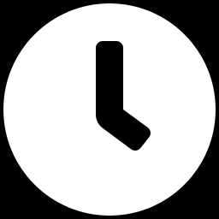
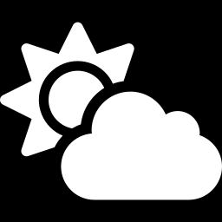
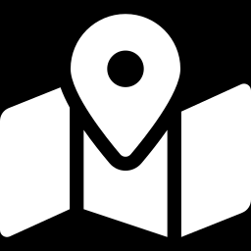
Four limitations bound the claim to public features, FBS-vs-FBS games and these five seasons
Closing-line definition
31
31 test weeks
The API's spread field is taken to be the closing line; timestamps cannot verify it
The 95% CI [−0.001, +0.003] rules out gains larger than about 0.003 Brier; smaller effects cannot be ruled out
Public features only
Scope
Injuries, weather, line movement and betting splits were not available
FBS-vs-FBS games, 2019, 2021–2024; FCS matchups and earlier eras untested
Language discipline “Consistent with irreducible randomness” is what the evidence supports. A Monte Carlo can fail to find a departure from the null; it cannot prove the null.
Notes:
Every study has limits, and I'd rather name them than have you find them. First, the closing line. The API reports a spread field and a separate opening-spread field, and I take the spread to be the closing line, but timestamps aren't available to verify that. Second, the test set spans only 31 season-weeks, so the cluster-bootstrap interval is wide: the 95% interval [minus 0.001, +0.003] rules out gains larger than about three thousandths of a Brier point, but smaller effects can't be ruled out. Third, public features only. Injury reports, weather, line movement and betting splits weren't available. A richer information set could carry some edge, but it would have to beat a market whose Brier already sits inside the oracle range. Fourth, scope: these are FBS-versus-FBS games from 2019, 2021 to 2024. Finally, a word on language. I say the results are consistent with irreducible randomness, not that upsets are proven random. A Monte Carlo can only fail to find a departure from the null. [~1 min]

Slide 25
Upsets look like the expected tail of a well-priced distribution
1
2
3
27.4%
+0.001
p = 0.77
The spread is the signal
No extra feature adds to it
What remains looks random
Brier 0.177 vs 0.244 naive: lower error, unbiased and calibrated
Five extra features: 95% CI [−0.001, +0.003] includes zero out of sample
Upsets (p = 0.77) and residual SD (p = 0.63) sit inside simulated ranges
Implication With a 15.4-point SD around the line, the spread-only model implies a 7-point underdog wins about 31% of the time.
Notes:
So, three takeaways. One: the spread is the signal. It cuts forecast error by 27.4% against the naive baseline, a Brier of 0.177 versus 0.244, and it is unbiased and well calibrated. Two: nothing public adds to it out of sample. Five extra features change the Brier score by +0.001, with an interval that includes zero. Three: what's left looks like randomness. The upset count and the residual spread both sit inside their simulated ranges, with p-values of 0.77 and 0.63. The implication is the headline of this slide. With a standard deviation of about 15.4 points around the line, the spread-only model implies a seven-point underdog wins about 31 percent of the time. An upset rate of about 29 percent in 2024 isn't a sign something changed. And the methodological lesson matters as much: the biggest threats to a valid conclusion came from the data, not the model. The look-ahead leak was identified at design time and its impact measured by a rerun; the filter defect was found by the audit and then measured. Thank you. [~1 min 15 sec]

Slide 26
Questions
?
Thank you
Tristan Morton
Repository: trism-dev/cfb-upset-study (private)
Notes:
That's the study. To recap in one sentence: the closing spread captures nearly all the predictive signal in public data, and what remains is consistent with irreducible randomness. The code, the audit log and every number are in the repository, and the backup slides after this one cover the full coefficient tables, the Monte Carlo and the two controlled reruns in detail, the reproducibility commands, and answers to the questions I expect. I'm happy to take questions now. [~30 sec]

Slide 27

Appendix
Backup slides
Notes:
Section break: appendix. Backup slides for questions. [~5 sec]

Slide 28
A1. In the full models the spread dominates; over/under is the only other feature with p < 0.05
Feature | Logit coef | p | OLS coef (margin) | p
Spread (home) | −0.117 | < 0.001 | −1.023 | < 0.001
Prior-season SP+ difference | −0.0095 | 0.058 | −0.0319 | 0.333
Over/under | 0.0158 | 0.010 | 0.088 | 0.027
Neutral site | −0.122 | 0.524 | 0.061 | 0.962
Conference game | 0.0258 | 0.858 | 0.113 | 0.899
Week | 0.0003 | 0.987 | −0.108 | 0.277
Intercept | −0.841 | 0.020 | −4.362 | 0.065
Training seasons, n = 2,303 complete rows in both models. Negative sp_diff sign once the spread is included reflects collinearity: the spread already prices team strength.
Notes:
Backup: the full coefficient tables from the training seasons. The left pair of columns is the logistic model for a home win, the right pair is the linear model for the margin. The spread dominates both, with a p-value below one in a thousand. Over-under is the only other feature below five percent in both models, at p equals 0.010 in the logit, but it doesn't survive the holdout. Prior-season team strength is borderline in the logit at 0.058. Its sign is negative once the spread is in the model, which reflects collinearity: the spread already prices team strength, so this is not a clean independent effect. Venue, conference and week are nowhere near significant. [~1 min]

Slide 29
A2. All five Monte Carlo statistics sit inside their simulated distributions (p ≥ 0.26)
Statistic (2023–24) | Observed | Simulated mean | Simulated 95% range | Percentile | Two-sided p
Upsets (outcome redraw) | 444 | 438.7 | 405–472 | 63.9 | 0.77
Upsets (margin redraw) | 444 | 444.7 | 411–478 | 49.5 | 0.99
Residual SD (points) | 15.30 | 15.43 | 14.89–15.97 | 31.6 | 0.63
Brier, spread model | 0.1767 | 0.1817 | 0.1732–0.1905 | 12.9 | 0.26
Oracle Brier (margin model) | — | 0.1825 | 0.1741–0.1910 | — | —
10,000 trials per null model, seed 42, 1,587 holdout games per trial. Both null models are fit on training seasons only.
Notes:
Backup: the complete Monte Carlo table for the holdout seasons. Five rows. Upset counts under both null models: the outcome redraw gives a simulated mean of 438.7 against 444 observed, and the margin redraw gives 444.7, with p-values of 0.77 and 0.99. The residual standard deviation is 15.30 observed versus 15.43 simulated. The market's Brier is 0.1767, against a simulated mean of 0.1817. The last row is the margin-model oracle Brier, what a forecaster with the true probabilities would expect, at 0.1825. All p-values are two-sided empirical p-values from 10,000 trials. [~1 min]

Slide 30
A3. Filter defect, full before and after: the evaluation changes, the fitted model does not
Metric | Trusting the API filter | After the fix
Games (test games) | 4,461 (1,808) | 3,900 (1,587)
Upset rate, all seasons (test seasons) | 24.4% (24.9%) | 27.1% (28.0%)
Favorite win share | 75.6% | 72.9%
Mean |spread| (points) | 13.4 | 11.1
Naive Brier (all test games) | 0.2338 (n = 1,808) | 0.2433 (n = 1,587)
Spread-only Brier (all test games) | 0.1588 (n = 1,808) | 0.1767 (n = 1,587)
Brier skill vs naive | 32.1% | 27.4%
Calibration slope | 1.107 | 1.086
Hosmer–Lemeshow p | 0.029 | 0.062
Matched comparison, 1,587 shared test games: Δ Brier (contaminated minus clean model) −0.00003, 95% CI [−0.00017, +0.00013]. The defect corrupts the evaluation, not the model.
Notes:
Backup: the full before-and-after table for the API filtering defect. Trusting the filter gives 4,461 games instead of 3,900, a lower upset rate, a higher favorite win share, a larger average spread, and a spread-only Brier of 0.159 instead of 0.177, which is the apparent skill inflation. The calibration slope barely moves, but the Hosmer-Lemeshow p-value drops from 0.062 to 0.029, crossing the five percent line. The bottom line is the matched comparison on the 1,587 shared test games: a difference of minus 0.00003 Brier, with a cluster-bootstrap interval around zero. [~1 min]

Slide 31
A4. Same split, same seed, same 3,857 games: only the rating's season changes, and the conclusion flips
Metric (holdout unless noted) | Leaky: same-season SP+ | Clean: prior-season SP+
H0₂ likelihood-ratio statistic (df 5), train | 313.8 (p < 0.001) | 11.2 (p = 0.048)
sp_diff logit coefficient (p) | 0.136 (p < 0.001) | −0.0095 (p = 0.058)
Spread-only Brier (both arms) | 0.177 | 0.177
Full-model Brier | 0.151 | 0.178
Full-model AUC | 0.858 | 0.803
Brier skill vs naive, full model | 37.8% | 27.0%
Brier(full) − Brier(spread), 95% CI | −0.025 [−0.032, −0.019] | +0.001 [−0.001, +0.003]
Full model beats the spread out of sample? | Yes | No
Multivariate OLS R² | 0.564 | 0.459
Both arms scored on 3,857 matched games (1,554 holdout, 2,303 train); 43 games with no prior-season rating dropped from both.
Notes:
Backup: the full leakage comparison. Both arms use the same split, the same seed and the same 3,857 games, the 3900 minus the 43 with no prior-season rating, so the spread-only Brier is identical in both, 0.177, and the entire gap comes from the rating feature. The likelihood-ratio statistic for the extra features is 313.8 with the leak and 11.2 without. The team-strength coefficient flips from strongly positive to borderline negative. Full-model AUC drops from 0.858 to 0.803, and the multivariate R-squared from 0.564 to 0.459. The decisive row: with the leak the full model beats the spread out of sample, without it, it does not. [~1 min]

Slide 32
A5. One command reproduces every number, and two runs give byte-identical output
py -3.12 -m venv .venv
.venv/Scripts/pip install -r requirements.txt
# put CFBD_API_KEY=<key> in .env
.venv/Scripts/python run_study.py --seasons 2019,2021-2024 --seed 42 --trials 10000
.venv/Scripts/python -m pytest -q
.venv/Scripts/python report/build_pdf.py
Outputs
Recorded in results.json config
results/results.json: every number in the report
results/audit.json: data-integrity counts
results/figures/: the figures
Seasons 2019, 2021–2024, seed 42, 10,000 trials
Library versions (NumPy, pandas, scikit-learn, SciPy, statsmodels)
SHA-256 of the clean dataset (9d9e1fd7…)
Notes:
Backup: how to reproduce the study. Create a Python 3.12 virtual environment, install the pinned requirements, put your CollegeFootballData API key in a git-ignored dot-env file, and run the study script with the seasons, the seed and the number of trials. A second command runs the test suite, and a third builds the report PDF. The raw API responses are cached, so after the first run everything is offline. The run writes every reported number into one results file, plus an audit file with the data-integrity counts and the figures. The results file also records the seasons, the seed, the library versions and a SHA-256 checksum of the clean dataset, so two runs produce byte-identical output. [~1 min]

Slide 33
A6. Anticipated questions, with short answers
Question | Short answer
Multiple testing? H0₂ p = 0.048 is marginal | Agreed, and it fails out of sample (Δ Brier +0.001, CI [−0.001, +0.003]). The decisive evidence is the holdout and the Monte Carlo, not one in-sample p-value.
Why is the spread the baseline? | It is the market's consensus margin forecast. If public features cannot beat it, there is no exploitable edge to find.
Why exclude 2020? | COVID cut it to 534 usable games, many played without crowds, which distorts home-field advantage.
Why prior-season SP+? | Same-season SP+ is computed after the games it would predict (look-ahead bias). 43 games lack a prior rating (teams with no prior-season rating) and are reported, not imputed.
Are 31 test weeks enough? | The cluster bootstrap resamples whole weeks, so the CI is honestly wide, [−0.001, +0.003]. It rules out gains larger than about 0.003 Brier; smaller effects cannot be ruled out.
Closing line not timestamp-verified? | True. If some lines were earlier ones they would be easier to beat, and the extra features still did not beat them. Calibration is measured against whatever line the API reports.
Could injuries or weather add signal? | Possibly; they were not available. They would have to beat a market whose Brier (0.177) already sits inside the oracle range (mean 0.182, 95% range 0.174–0.191).
Notes:
Backup: seven questions I expect, with short answers. On multiple testing: the in-sample p of 0.048 for the extra features is marginal, and the decisive evidence is the out-of-sample Brier comparison and the Monte Carlo, not any single in-sample p-value. On why the spread is the baseline: it's the market's consensus forecast, so if public features can't beat it there's no exploitable edge. On 2020: only 534 usable games and many games without fans. On prior-season SP-plus: the same-season rating is computed after the games, which is look-ahead bias. On whether thirty-one test weeks is enough: the bootstrap interval is honestly wide: it rules out gains larger than about three thousandths of a Brier point, but not smaller ones. On the closing line: not timestamp-verified, but if some lines were earlier ones they would be easier to beat, and the extra features still did not beat them. Calibration is measured against whatever line the API reports. On injuries and weather: not available, and they'd have to beat a market whose Brier already sits inside the oracle range. [~1 min]

Slide 34
A7. References
Alley, M. The assertion-evidence approach to presentations. Pennsylvania State University.
Brier, G. W. (1950). Verification of forecasts expressed in terms of probability. Monthly Weather Review.
Collins, G. S., et al. (2024). TRIPOD+AI statement: updated guidance for reporting clinical prediction models that use regression or machine learning methods. BMJ.
CollegeFootballData.com. College football data API. collegefootballdata.com
Kapoor, S., & Narayanan, A. (2023). Leakage and the reproducibility crisis in machine-learning-based science. Patterns.
Levitt, S. D. (2004). Why are gambling markets organised so differently from financial markets? The Economic Journal.
Murphy, A. H. (1973). A new vector partition of the probability score. Journal of Applied Meteorology.
Stern, H. (1991). On the probability of winning a football game. The American Statistician.
Notes:
Backup: the references. The reporting conventions follow the TRIPOD-plus-AI statement from Collins and colleagues, 2024, and Kapoor and Narayanan's 2023 paper on leakage and reproducibility in machine-learning-based science. The probability scoring uses Brier, 1950, and Murphy, 1973. The efficient-markets framing is Levitt, 2004, and Stern, 1991, for the normal approximation of margins around the spread. The slide design follows Alley's assertion-evidence approach, and the data is from CollegeFootballData.com. [~1 min]

