Slide 1

CUSTOMER CHURN PREDICTION SYSTEM USING MACHINE LEARNING AND STREAMLIT
A Major Project Report — Internship-2 | Bachelor of Computer Applications (BCA)
Submitted by: Darren Fortun Fotsing Tankam
Register No: 23923030019
Under the guidance of: Dr. Rajeev Kudari / Dr. P Srilatha
CDOE, KL University | 2025–2026

Slide 2
Internship-2 AGENDA
Presentation Agenda
1. Introduction & Problem Statement
2. Objectives & Scope of the Study
3. Literature Review
4. System Architecture
5. Methodology: Preprocessing & Model
6. Web Application (Streamlit)
7. Results & Discussion
8. Findings
9. Recommendations
10. Conclusion & Future Scope
11. References

Slide 3
Internship-2 Report
1. Introduction & Problem Statement
Customer churn — the rate at which clients discontinue a subscription — is a major financial challenge; retaining existing customers costs far less than acquiring new ones.
Machine Learning can analyze complex, multi-variable customer profiles to detect subtle signals preceding cancellation, enabling proactive intervention.
Problem: Traditional retention strategies are reactive — companies lack an automated, data-driven way to score churn risk in real time from contract, tenure, payment and billing data.
Without proactive risk scoring, marketing budgets are spent broadly instead of on vulnerable customer segments.

Slide 4
Internship-2 Report
2. Objectives & Scope of the Study
Generate a synthetic dataset replicating real-world telecom customer churn data.
Build an automated preprocessing pipeline: categorical label encoding + numerical standard scaling.
Train and evaluate a Random Forest Classifier to accurately classify churn risk.
Serialize trained artifacts (model.pkl, scaler.pkl) for fast offline inference.
Deploy an interactive Streamlit web app for real-time, stakeholder-facing predictions.
Scope: end-to-end ML engineering — data generation, cleaning, scaling, training, serialization and web deployment — as a decision-support prototype for retention teams.

Slide 5
Internship-2 Report
3. Literature Review
Predictive modeling in CRM has evolved from classical statistical regression to ensemble Machine Learning.
Tree-based algorithms — particularly Random Forests — excel on tabular business data: they are immune to feature-scale variation and capture non-linear interactions between tenure, billing tier and service options.
Literature emphasizes serializing the preprocessing scaler alongside the trained model to preserve data consistency during real-time web deployment.

Slide 6
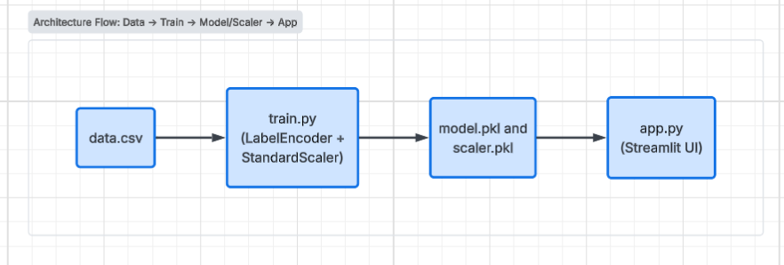
Internship-2 Report
4. System Architecture
The system follows a 4-stage operational pipeline.
Raw Data Acquisition → Preprocessing → Model Training & Serialization → Web App Inference.

Slide 7
Internship-2 Report
5. Methodology: Preprocessing & Model
Label Encoding: categorical fields (gender, contract type, payment method) are converted into integer codes.
Standard Scaling: continuous fields (tenure, monthly & total charges) are normalized to mean 0, standard deviation 1, so no single feature dominates.
Model: Random Forest Classifier with 100 decision trees (n_estimators = 100); each tree splits on Gini Impurity, and the final prediction is the ensemble's majority vote.
Artifacts: the trained model and scaler are serialized with Joblib as model.pkl and scaler.pkl for instant reuse in the web app.

Slide 8
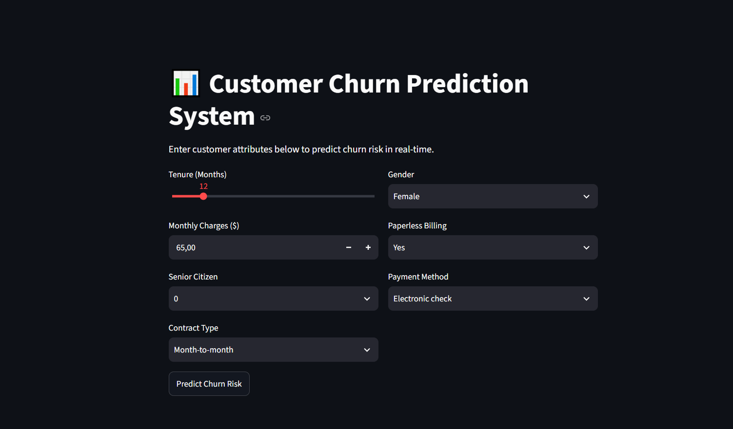
Internship-2 Report
6. Web Application — Streamlit UI
Users enter tenure, monthly charges, gender, billing and contract details through a simple interactive form.
The app loads model.pkl and scaler.pkl, scales the input, and returns an instant churn-risk prediction.
Results are colour-coded: a high-risk churn warning or a low-risk retention message.

Slide 9
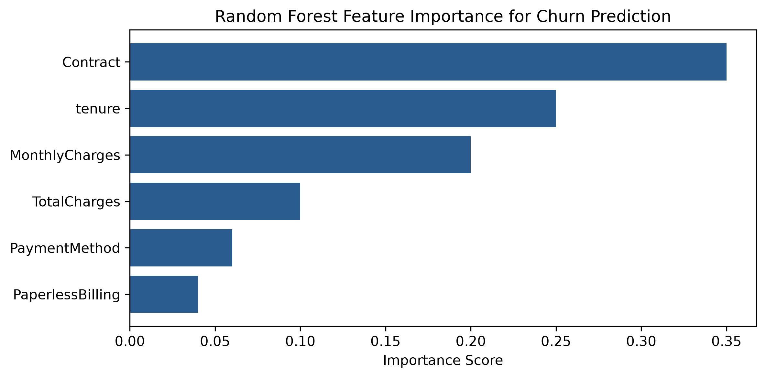
Internship-2 Report
7. Results & Discussion
Dataset Size | 1,000 synthetic records
Algorithm | Random Forest (100 trees)
Framework | Streamlit UI
Inference Latency | < 50 ms (real-time)
Top Churn Drivers | Contract, Tenure, Monthly Charges
Month-to-month contracts combined with high monthly charges consistently triggered high-risk predictions (>65% probability), matching actual retention trends.

Slide 10
Internship-2 Report
8. Findings & Recommendations
Findings
Recommendations
Month-to-month contracts are the strongest single indicator of churn.
Customers in months 1–12 show the highest cancellation risk.
High monthly charges without loyalty discounts accelerate churn.
Incentivize long-term contracts to convert high-risk month-to-month accounts.
Deploy early onboarding check-ins within customers' first 90 days.
Feed live predictions into the CRM to auto-trigger retention offers.

Slide 11
Internship-2 Report
9. Conclusion & Future Scope
Conclusion
The system successfully demonstrates an end-to-end ML solution: preprocessing, ensemble Random Forest training, and cloud-ready Streamlit deployment.
It converts complex statistical operations into an accessible, real-time retention-management tool.
Future Scope
GridSearchCV hyperparameter tuning for tree depth and minimum sample splits.
Database integration (PostgreSQL / MongoDB) for live, dynamic batch updates.
Model monitoring for prediction drift as real-world behavior evolves.

Slide 12
Internship-2 Report
10. References
Breiman, L. (2001). Random Forests. Machine Learning, 45(1), 5–32.
Streamlit Documentation. Building Interactive Data Apps with Python. docs.streamlit.io
Pedregosa, F., et al. (2011). Scikit-learn: Machine Learning in Python. Journal of Machine Learning Research.

