Slide 1

MARKET BASKET ANALYSIS
OF

Slide 2

What is Instacart?
Instacart is an app for on-demand grocery shopping with same-day delivery service operating in the United States and Canada and was founded in 2012.
It uses a crowdsourced marketplace model, similar to that of Uber or Lyft.
Aims to make it easy to fill your refrigerator and pantry with your personal favorites and staples when you need them.

Slide 3
What is Market Basket Analysis?
Identifying the purchasing habits and patterns of customers.
Used by retailers to increase sales.
Involves analyzing dataset, purchase history, product groupings and products likely to be purchased together.
Predictive Market Basket Analysis: Items purchased in sequence to determine cross-sell.
Provides purchasing insights such as- which combinations are bought, when they are purchased, sequence.

Slide 4
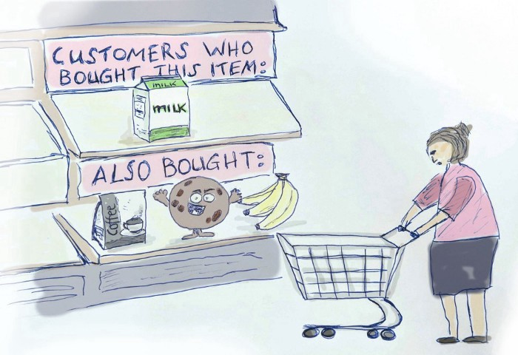
Association Rule
Association Rules are commonly used to evaluate retail basket or transaction data and are intended, based on the principle of strong rules, to define strong rules discovered in transaction data using measures of interest.

Slide 5
Problem to be solved
The objective of this project is to
Predict whether a product will be reordered or not in the future by the customer.
Predict which department will the next product ordered belong to

Slide 6
DATASET
Instacart released a public dataset, “The Instacart Online Grocery Shopping Dataset 2017”.
The dataset contains over 3 million anonymized grocery orders from more than 200,000 Instacart users
There are 6 files under the dataset.
aisles, departments, orders, products, order_products_prior, order_ products_train

Slide 7
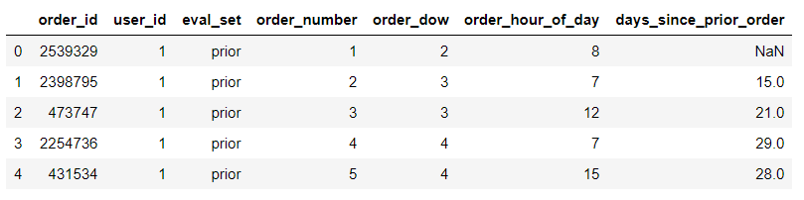
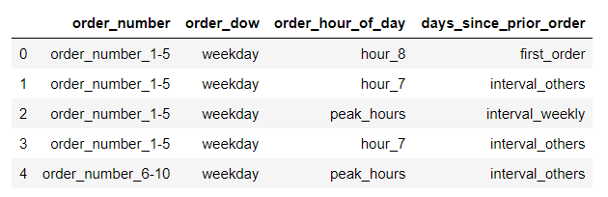
Data Preprocessing
Raw Data
Clean Data

Slide 8
Exploratory Data Analysis

Slide 9
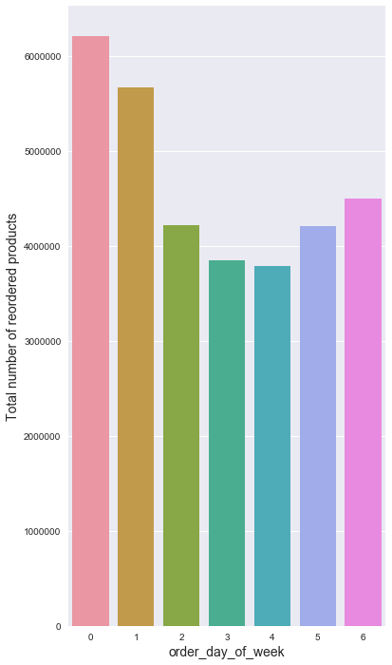
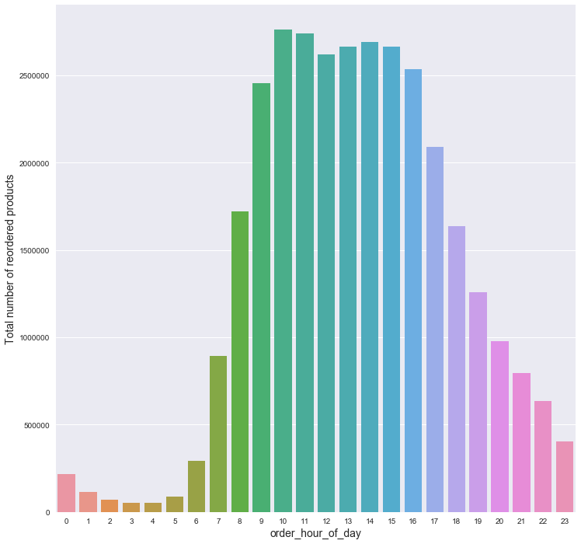
Visualizing Instacart User Behavior
Notes:
0 being Monday to 6 being Sunday.

Slide 10
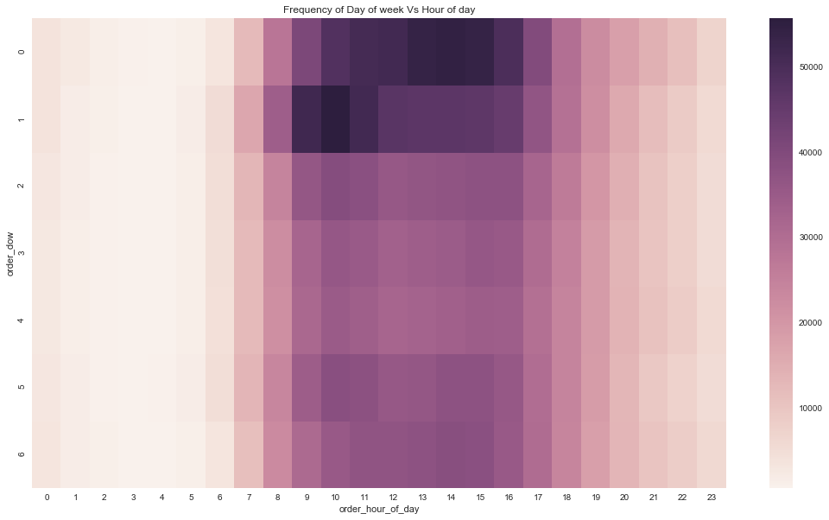
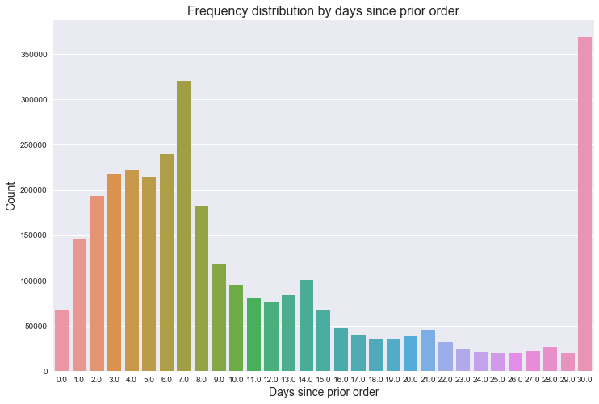
Visualizing Instacart User Behavior
Notes:
It is very obvious that moast users made their orders weekly (every 7 days) and monthly (every 30 days). See the peak of day 7 and day 30 in the chart below.

Slide 11
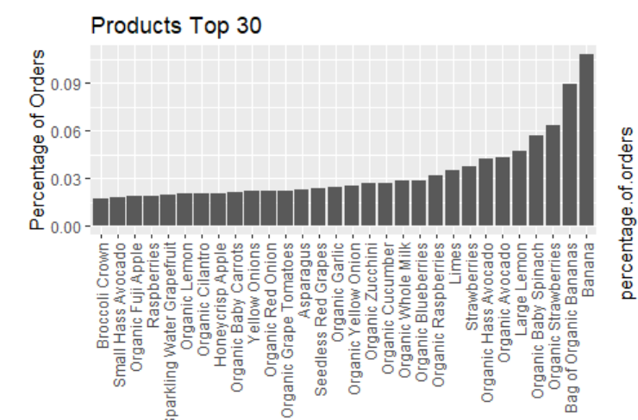
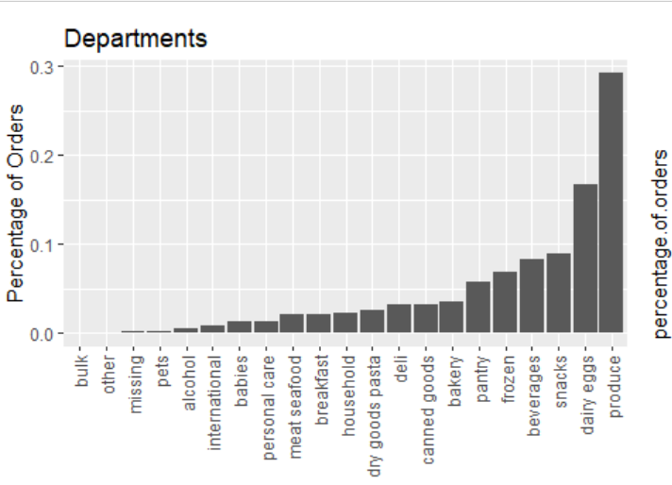
Visualizing Instacart User Behavior

Slide 12
Feature Engineering

Slide 13
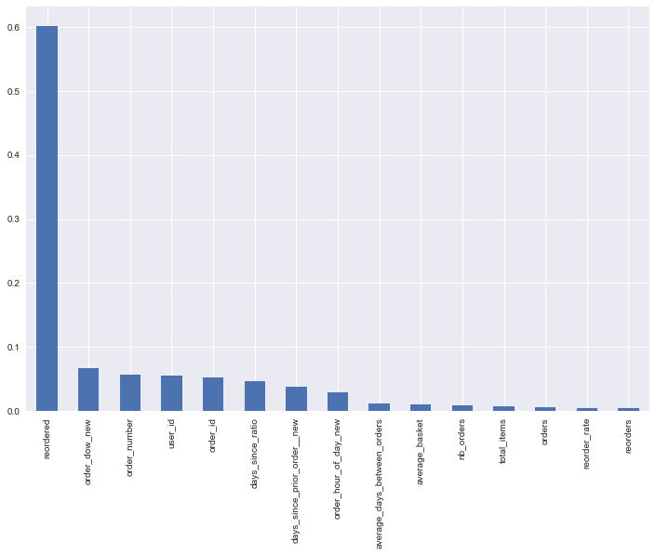
Important Features for Department prediction
Top 5 important features are:
Reordered
Day of week
Order number
User id
Order id

Slide 14
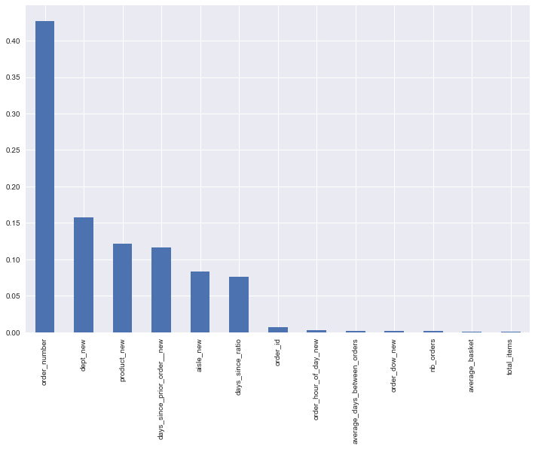
Important Features for Reorder prediction
Top 5 important features are:
Order number
Department
Product
Days since prior order
Aisle

Slide 15
Model Building

Slide 16
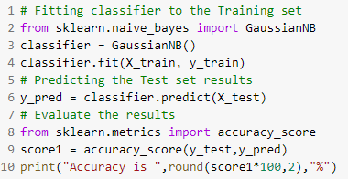
Naive bayes model

Slide 17
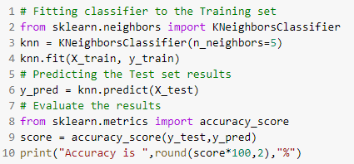
KNN Model

Slide 18
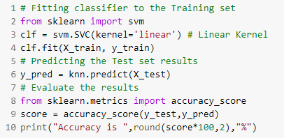
Support Vector Machine SVM Model

Slide 19
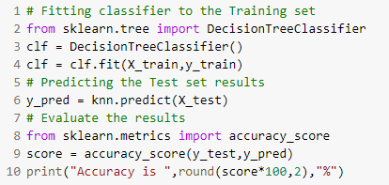
Decision Tree Classification Model

Slide 20
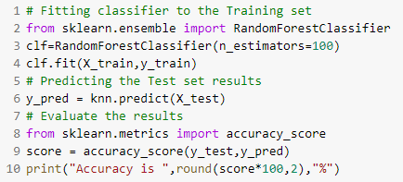
Random Forest Model

Slide 21
Recommendations
These analysis can be used to run promotional and marketing campaigns targeting specific customers during peak time.
The insights generated can be used to provide a seamless interface to enhance customer’s user experience by knowing about the customer’s reordered products and automatically adding those to cart.
Personalized communications can be sent to customers’ preferences, reminding them to order again.
To improve customer satisfaction by timely delivery and reduce wait time, the shopper base can be increased by hiring new shoppers who can especially work around the peak time.

Slide 22
Conclusion and Future Work.
For predicting the department, the parameters can be tuned more to get a better log-loss score. Better algorithms which work well with multi-category prediction can be used to get more accuracy.
To obtain a model that achieves a better log loss score than above, we can try running nonlinear models. The three models that were implemented here were all linear models.
In conclusion, these are the aspects which I would like to work on to achieve better results and a more accurate prediction.

Slide 23
Thanks.

