Slide 1

Air Pollutant Forecast
An Initiative For “Sustainable
Supply Chain Planning”

Slide 2
Identifying The Problem
Problem Statement – ‘Air Quality Chemical Multisensor Device’ has recorded Italian city’s air pollutant chemicals from March 2004 to February 2005. From the observations recorded, what could be the measure of Nitrogen dioxide (NO2) pollutant in future years.
Agenda – Motivated by the above problem statement we have derived our agenda of predicting Nitrogen dioxide and use forecasting techniques to predict its concentration in future years.

Slide 3
Why predict Nitrogen Dioxide concentration for Supply Chain?
Italy is amongst one of the most air polluted countries, hence many of the health and environmental factors depend on maintaining the levels of pollutants.
Nitrogen Dioxide is one such pollutant which can result in many respiratory diseases and other problems if its concentration is not maintained.
Therefore, the country plans to improve its air quality and plan sustainable development starting with forecasting the concertation of air pollutants including Nitrogen dioxide.

Slide 4
Why predict Nitrogen Dioxide concentration for Supply Chain? (cont’d)
Since, Nitrogen dioxide primarily gets in the air from the burning of fuel. NO₂ forms from emissions from cars, trucks and buses, power plants, and off-road equipment.
This sustainable development can affect ‘Supply Chain’ lines running through decades to transform and adapt in many ways more than one.
Planning out eco-friendly, logistically as well as financially efficient and sustainable ways to thrive the Supply Chain in Italy is the moto.

Slide 5
Understanding The Data
The Air Quality data is sourced from the UCI data repository and contains the following features :
Date
Time
Carbon Monoxide
Tin Oxide
Non-Methane Hydrocarbons
Benzene
Titania
Nitric Oxide
Tungsten Oxide NO
Nitrogen Dioxide
Tungsten Oxide NO2
Indium Oxide
Temperature
Relative Humidity
Absolute Humidity

Slide 6
Forecasting Models

Slide 7
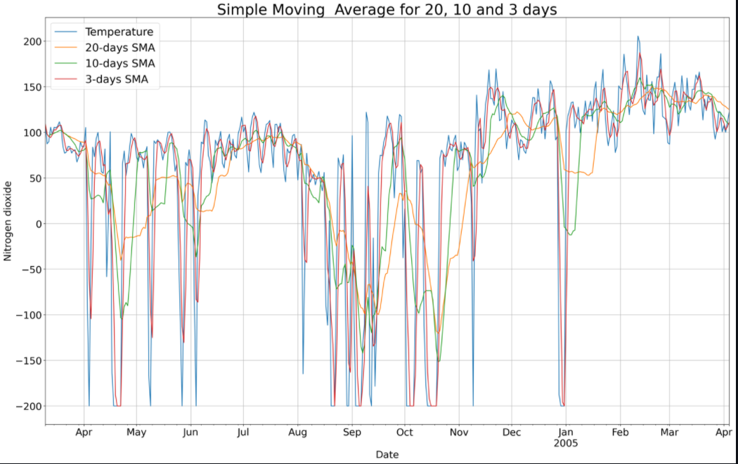
Simple Moving Average
MAE for 20 days is 57.83
MAE for 10 days is 51.66
MAE for 3 days is 28.32

Slide 8
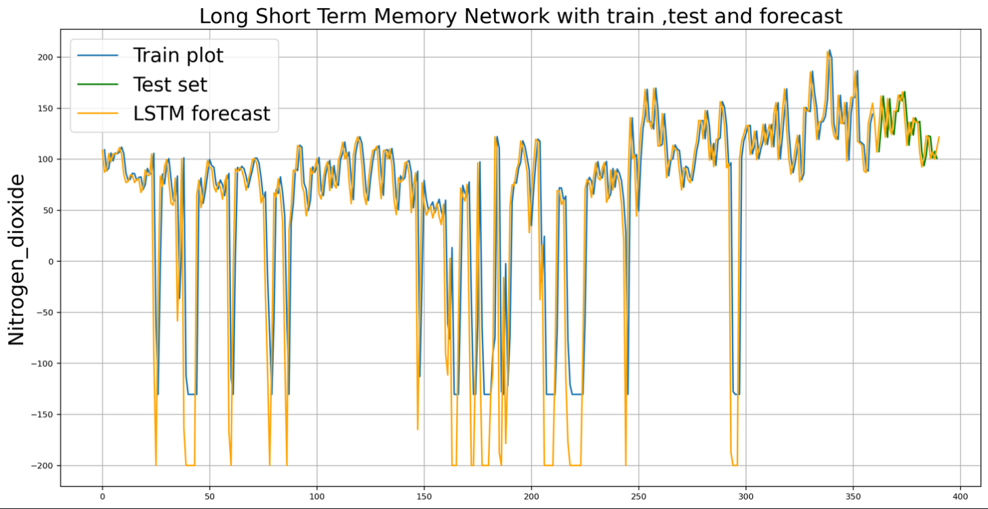
LSTM
Train Score: 38.657 MAE
Test Score: 16.158 MAE

Slide 9
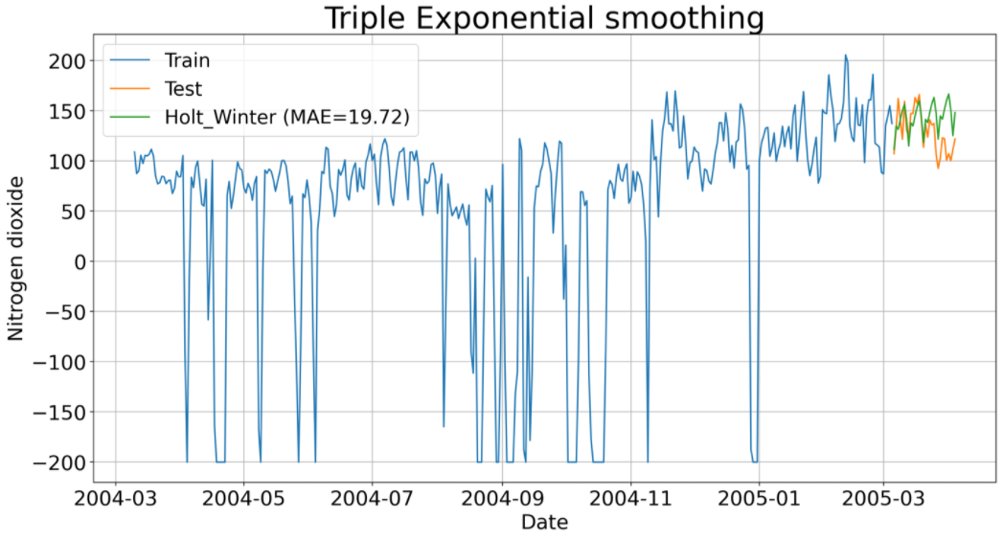
Triple Exponential Smoothing
MAE for 30 days is 19.72

Slide 10
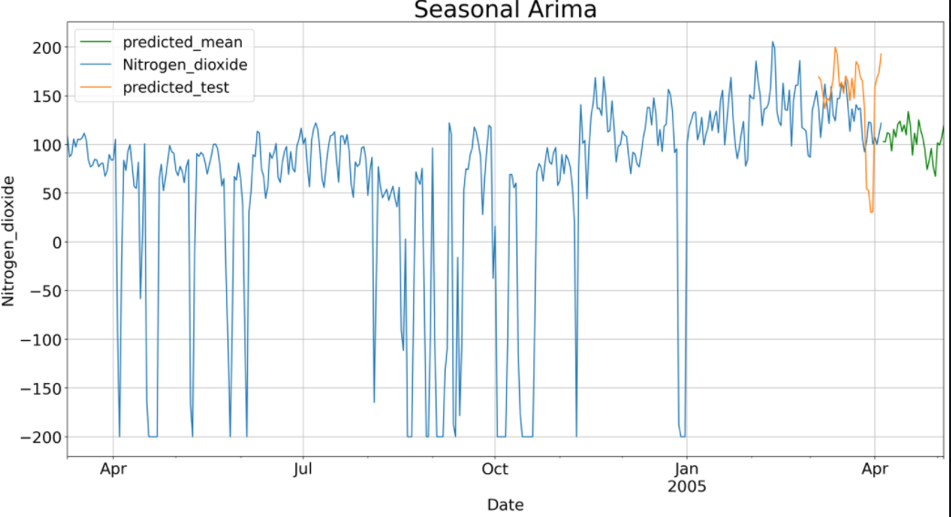
Seasonal Arima
MAE of Seasonal Arima is 39.45

Slide 11
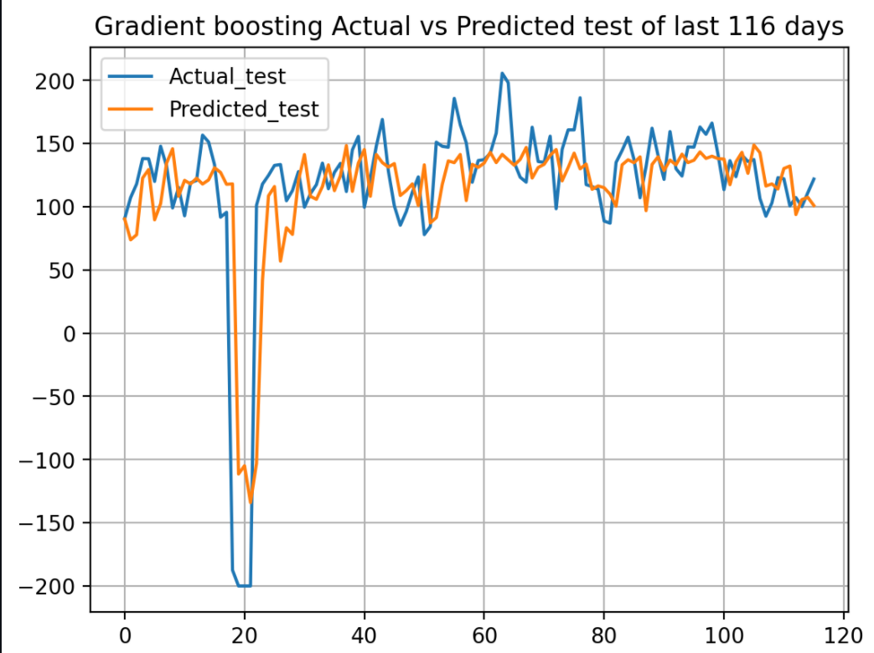
Gradient Boosting Regressor
Gradient boosting training score 0.83
Gradient boosting test score 0.50

Slide 12
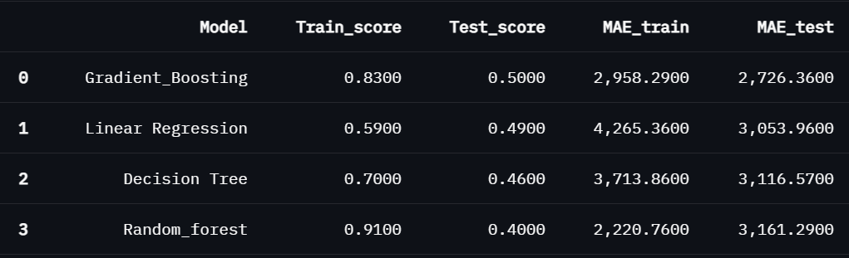
Machine Learning Model Comparison

Slide 13
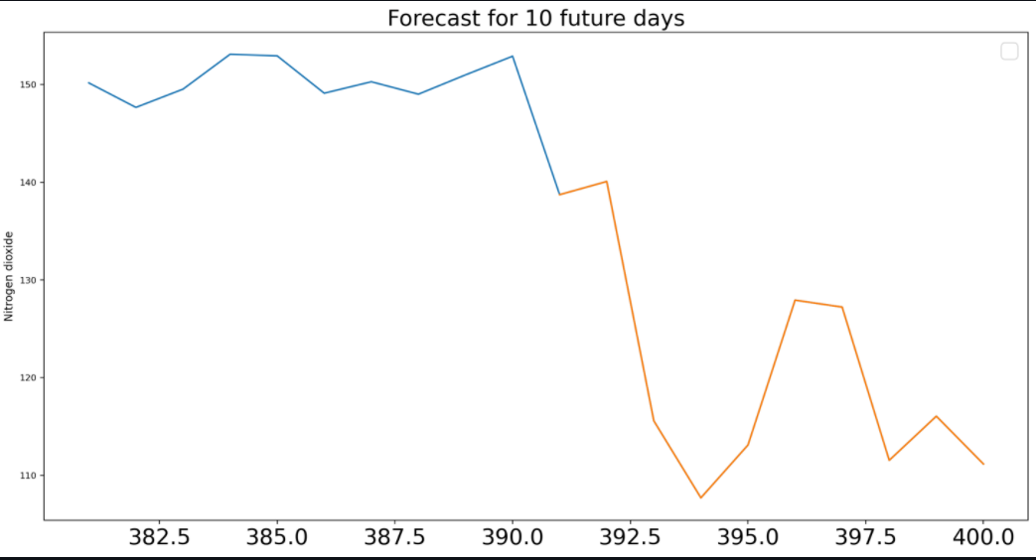
What do the predictions show? (Model Results)
The forecast shows that the levels of Nitrogen Dioxide decrease over the next 10 days.

Slide 14
Sustainability Plan Deployment
As seen previously, since the concentration of Nitrogen Dioxide is decreasing in the next 10 days; Italy can continue its sustainable Supply Chain Management plan to further decrease the pollutant.
1
Demand of more Electronic Vehicles instead of those run-on fuel, should be encouraged.
2
Air purifiers to detect and improve indoor air quality should be encouraged and implanted in public indoor areas as well.
3
Thus, manufacturers and sellers can rely on supplying goods that can add more value to this sustainable supply chain plan and help further in decreasing the pollutants.
4
Web Application URL to see the future forecast of the desired model :
https://share.streamlit.io/siddheshdmunagekar/supplychain/main/air_quality.py

Slide 15
THANK YOU

