Slide 1
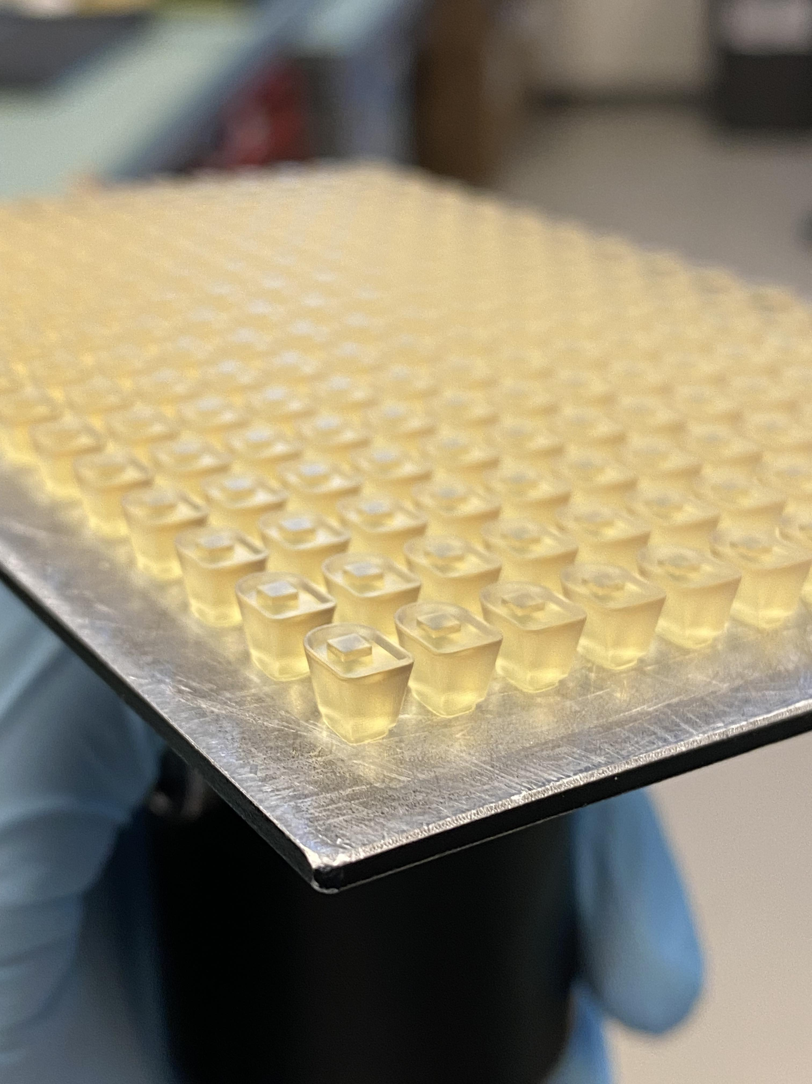
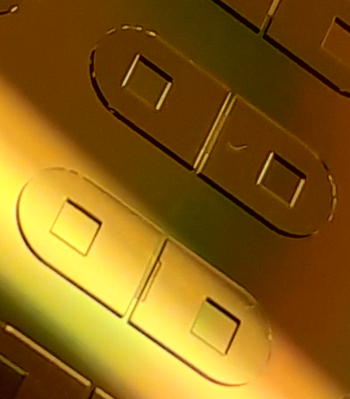
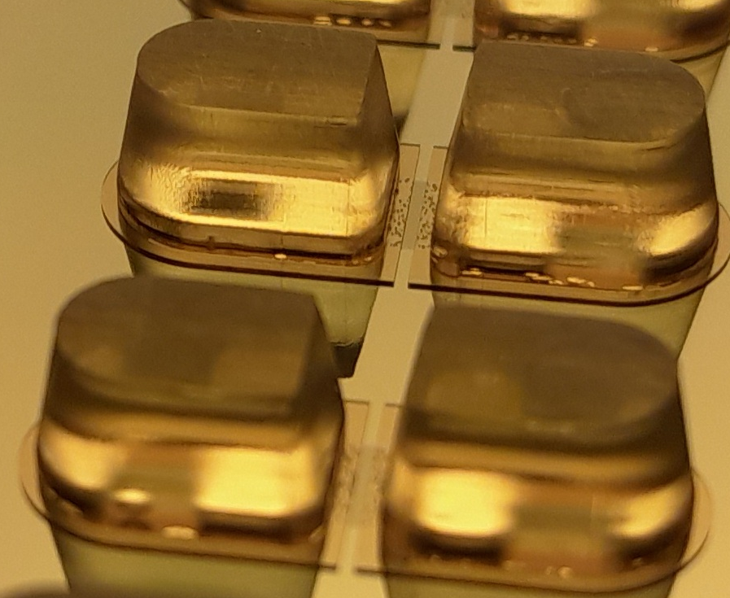
3D Printed Inserts
Cavity to Align Insert Pins
Assemble Pins on Wafer
2 mm
2 mm
1.85 mm
1.85 mm
+
=
Mervi Ristola et al 2019 J. Micromech. Microeng. 29 065009
Confidential
Notes:
- integrating well in mold saves time, more accurate, reproducible
- SU-8 is practically limited to 200um as resin, 500um as dry sheet
- Journal of Micromechanics and Microengineering paper uses steel 3D printed parts and glues on wafer with lock and key mechanism
- Used affordable resin printer instead

