Slide 1
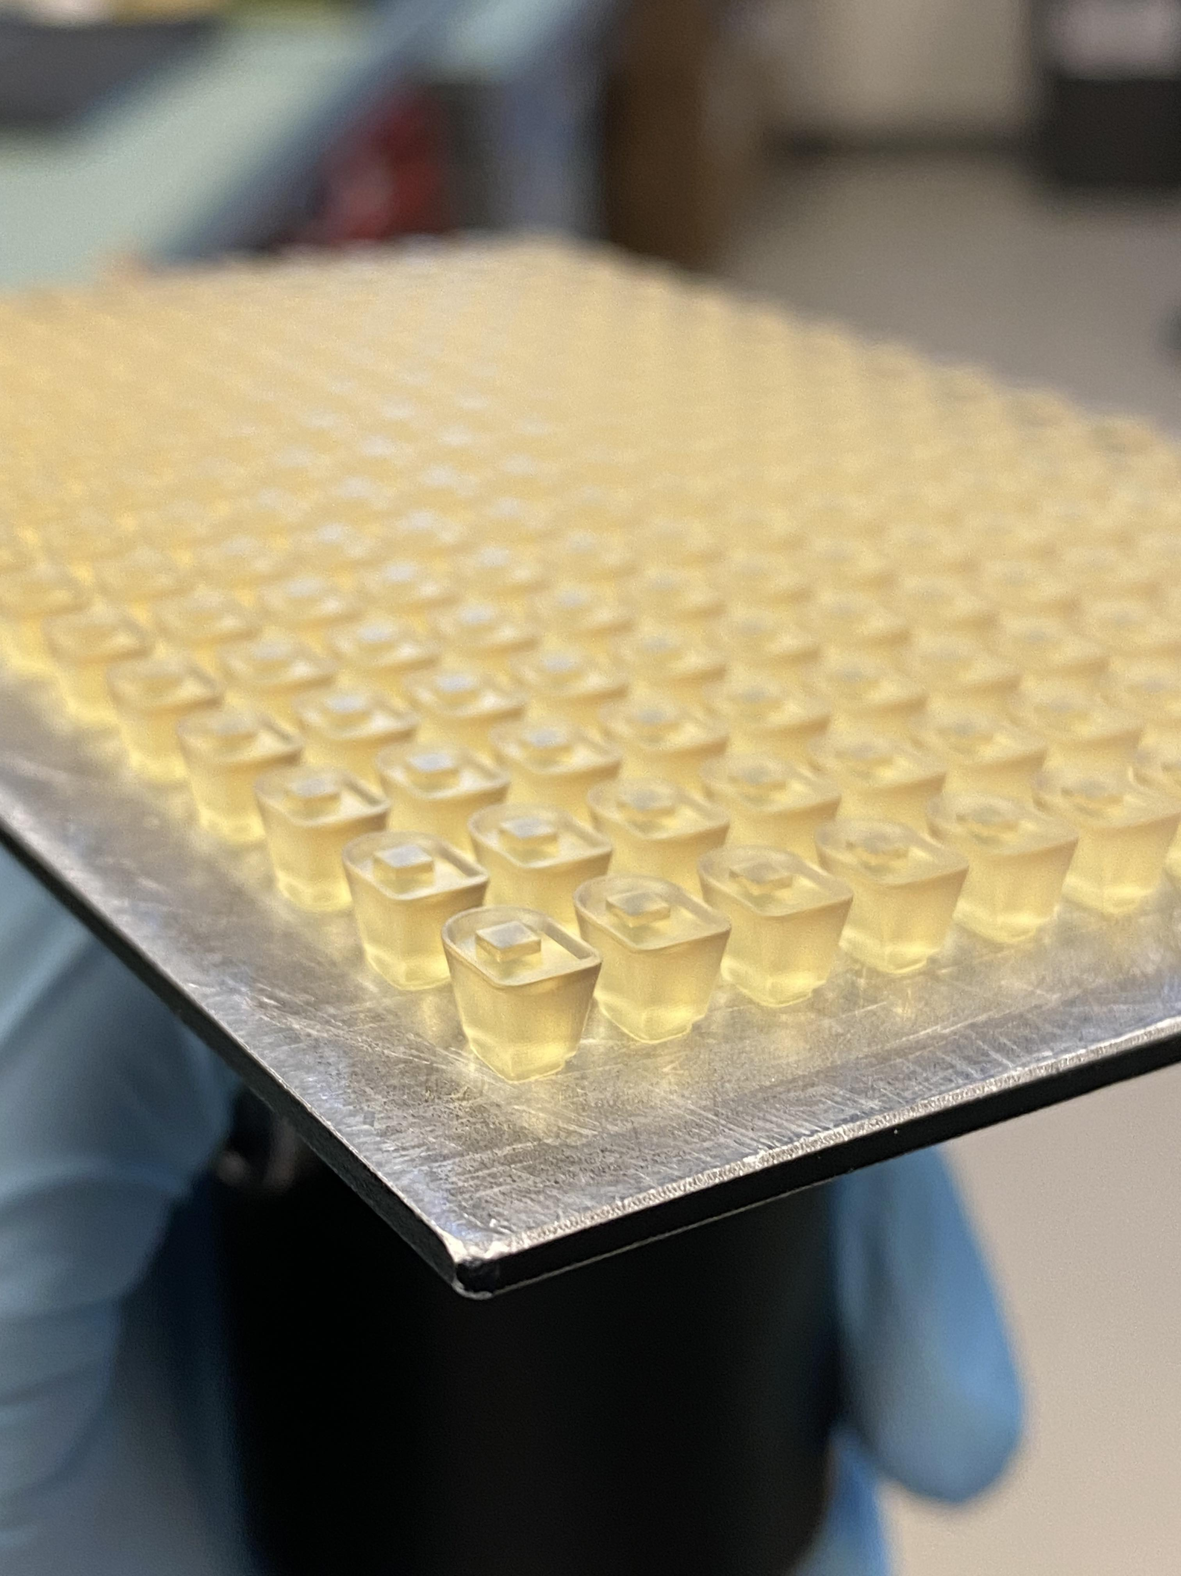
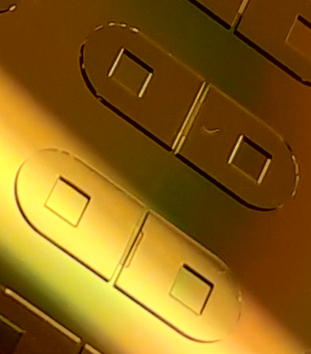
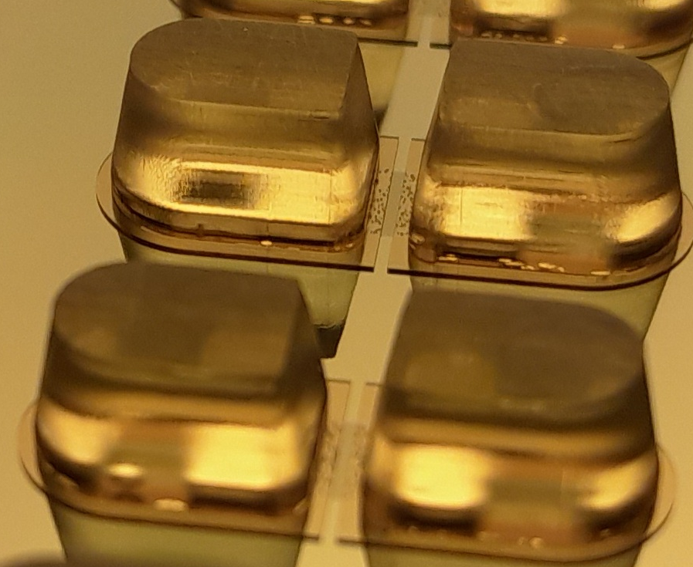
3D Printed Inserts
Cavity to Align Insert Pins
Assemble Pins on Wafer
2 mm
2 mm
1.85 mm
1.85 mm
+
=

