Slide 1
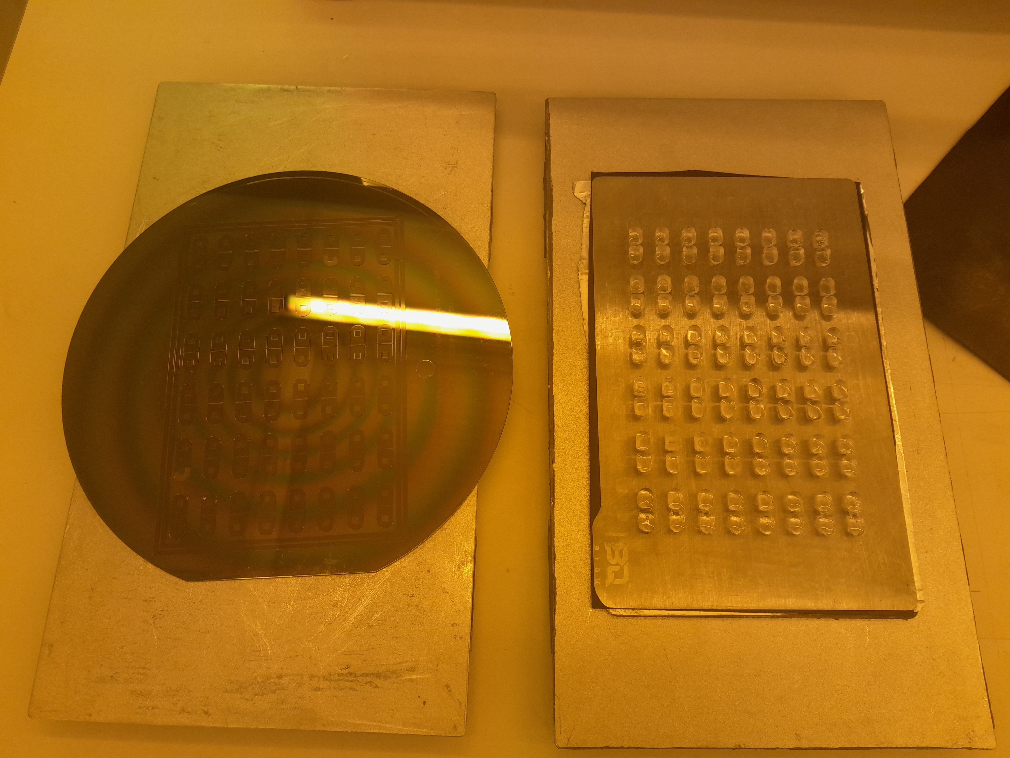
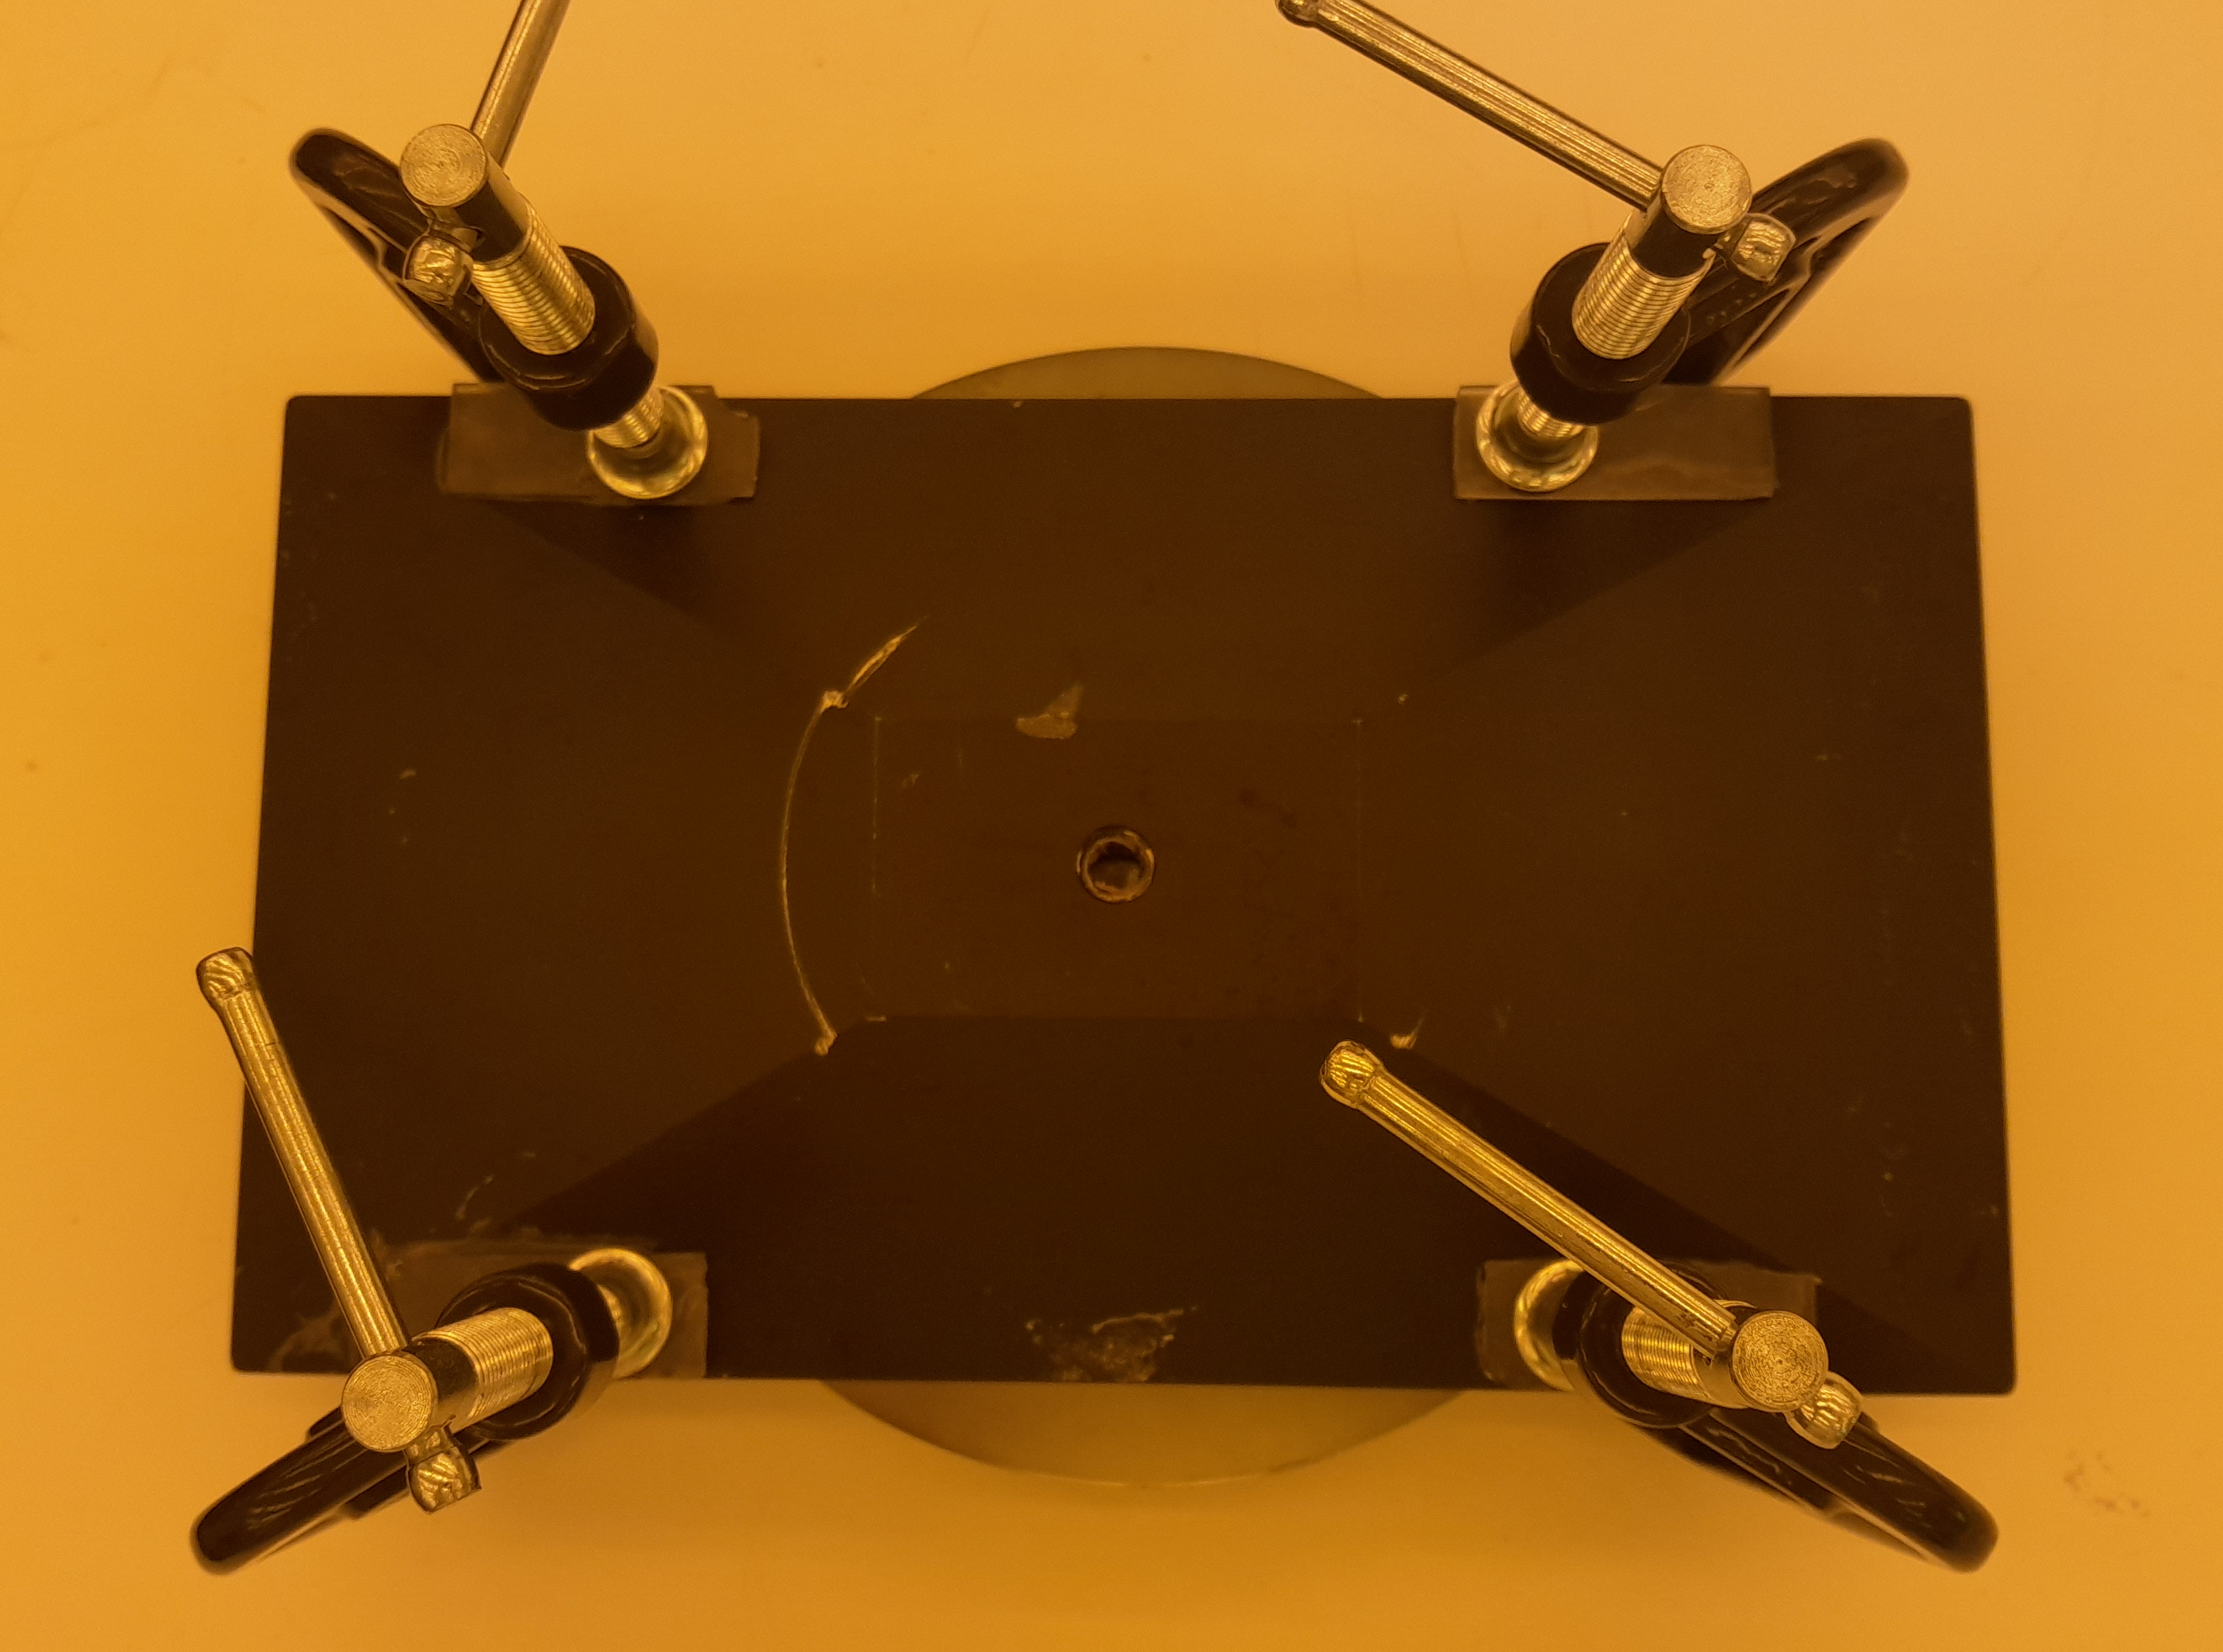
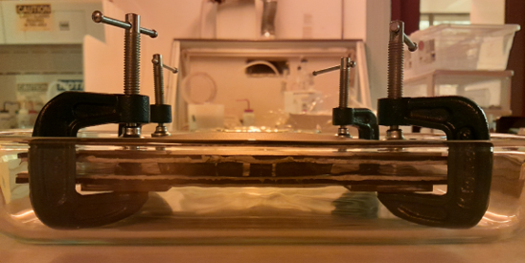
Inserts are printed in position aligned with the wafer and then covered in slow setting epoxy
Sealing the glue between the wafer and inserts allows excess epoxy to be washed by immersion in acetone
Aligned and Clamped Assembly

