Slide 1
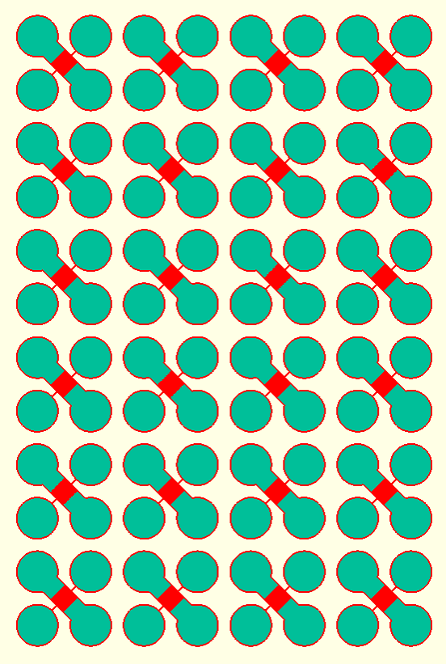
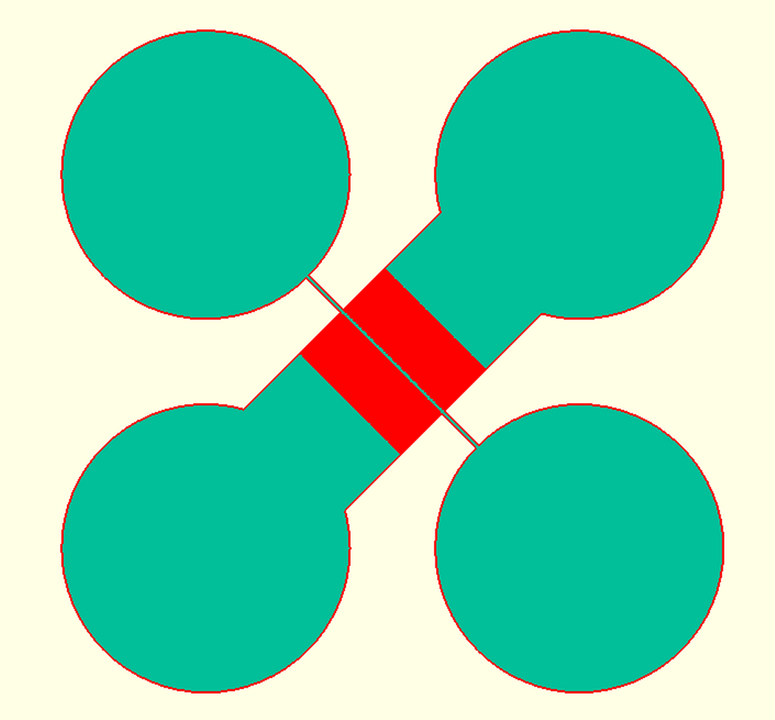

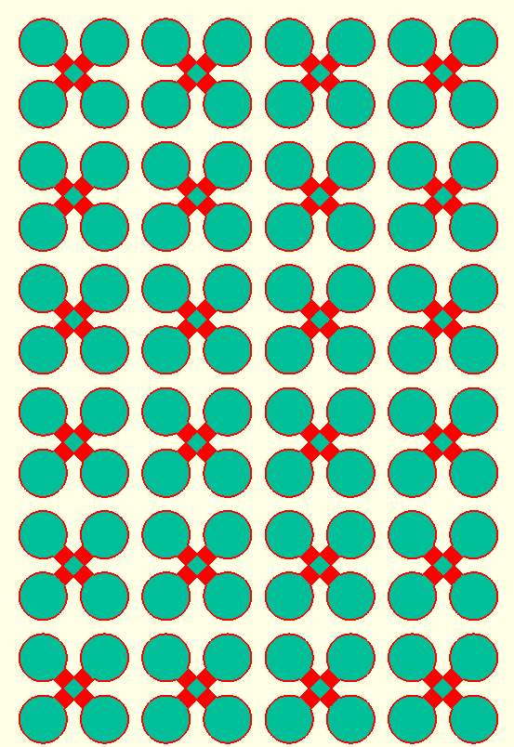
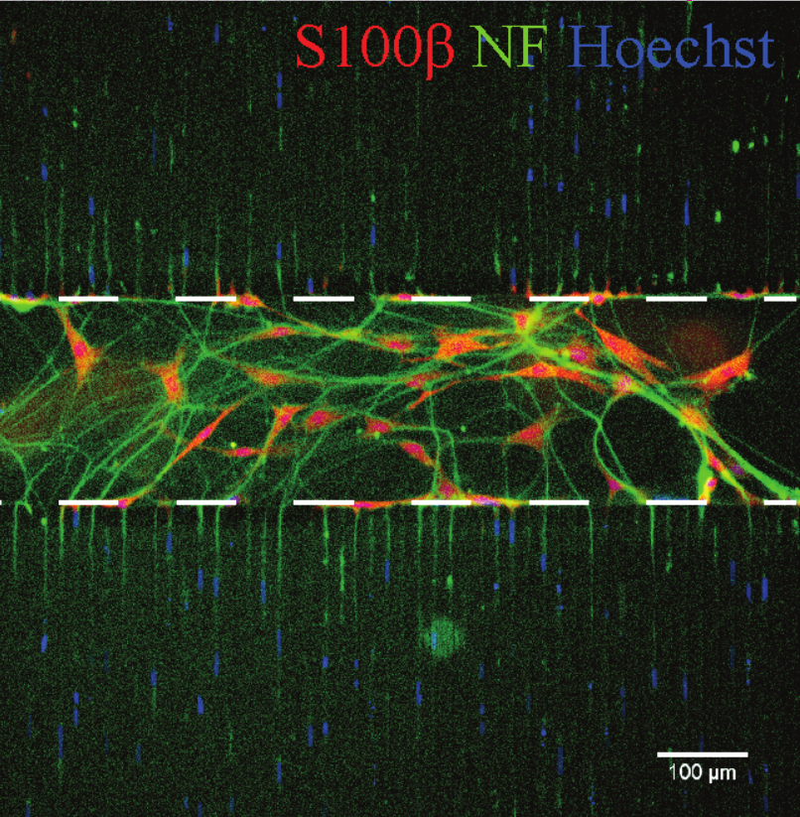
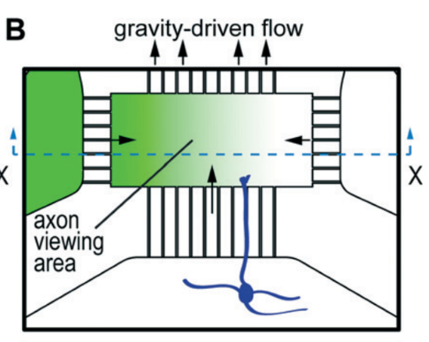
Other High-throughput Devices for Various Assays
Myelination Assay
Axon Guidance Assay
Oligo
Inlet
Axons
Cue 1
Waste /
Outlet
Myelin
Axons
Cell
Bodies
Oligo
Outlet
Cell
Bodies
Cue 2
Notes:
- Once 96-well axotomy works → can make high-throughput device of any layouts
- Recreation of published layout but transformed into high throughput version
- Example of myelination assay
- Example of Axon guidance assay

