Slide 1
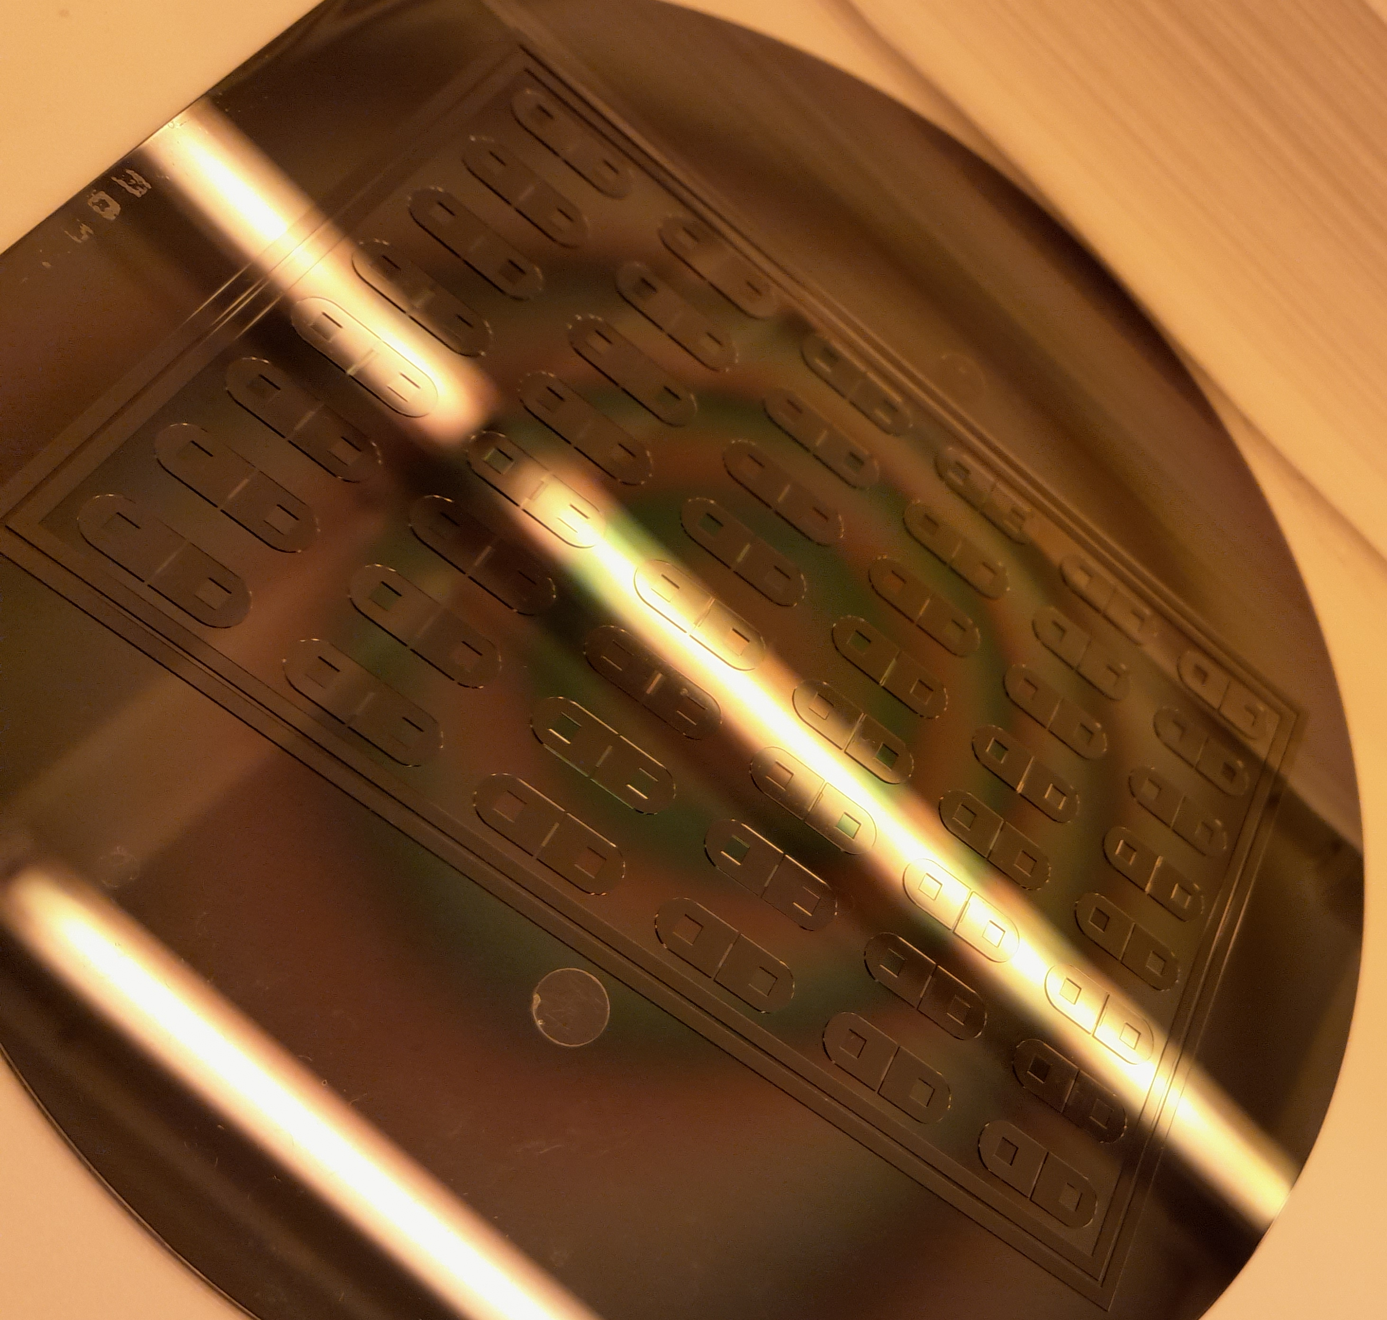
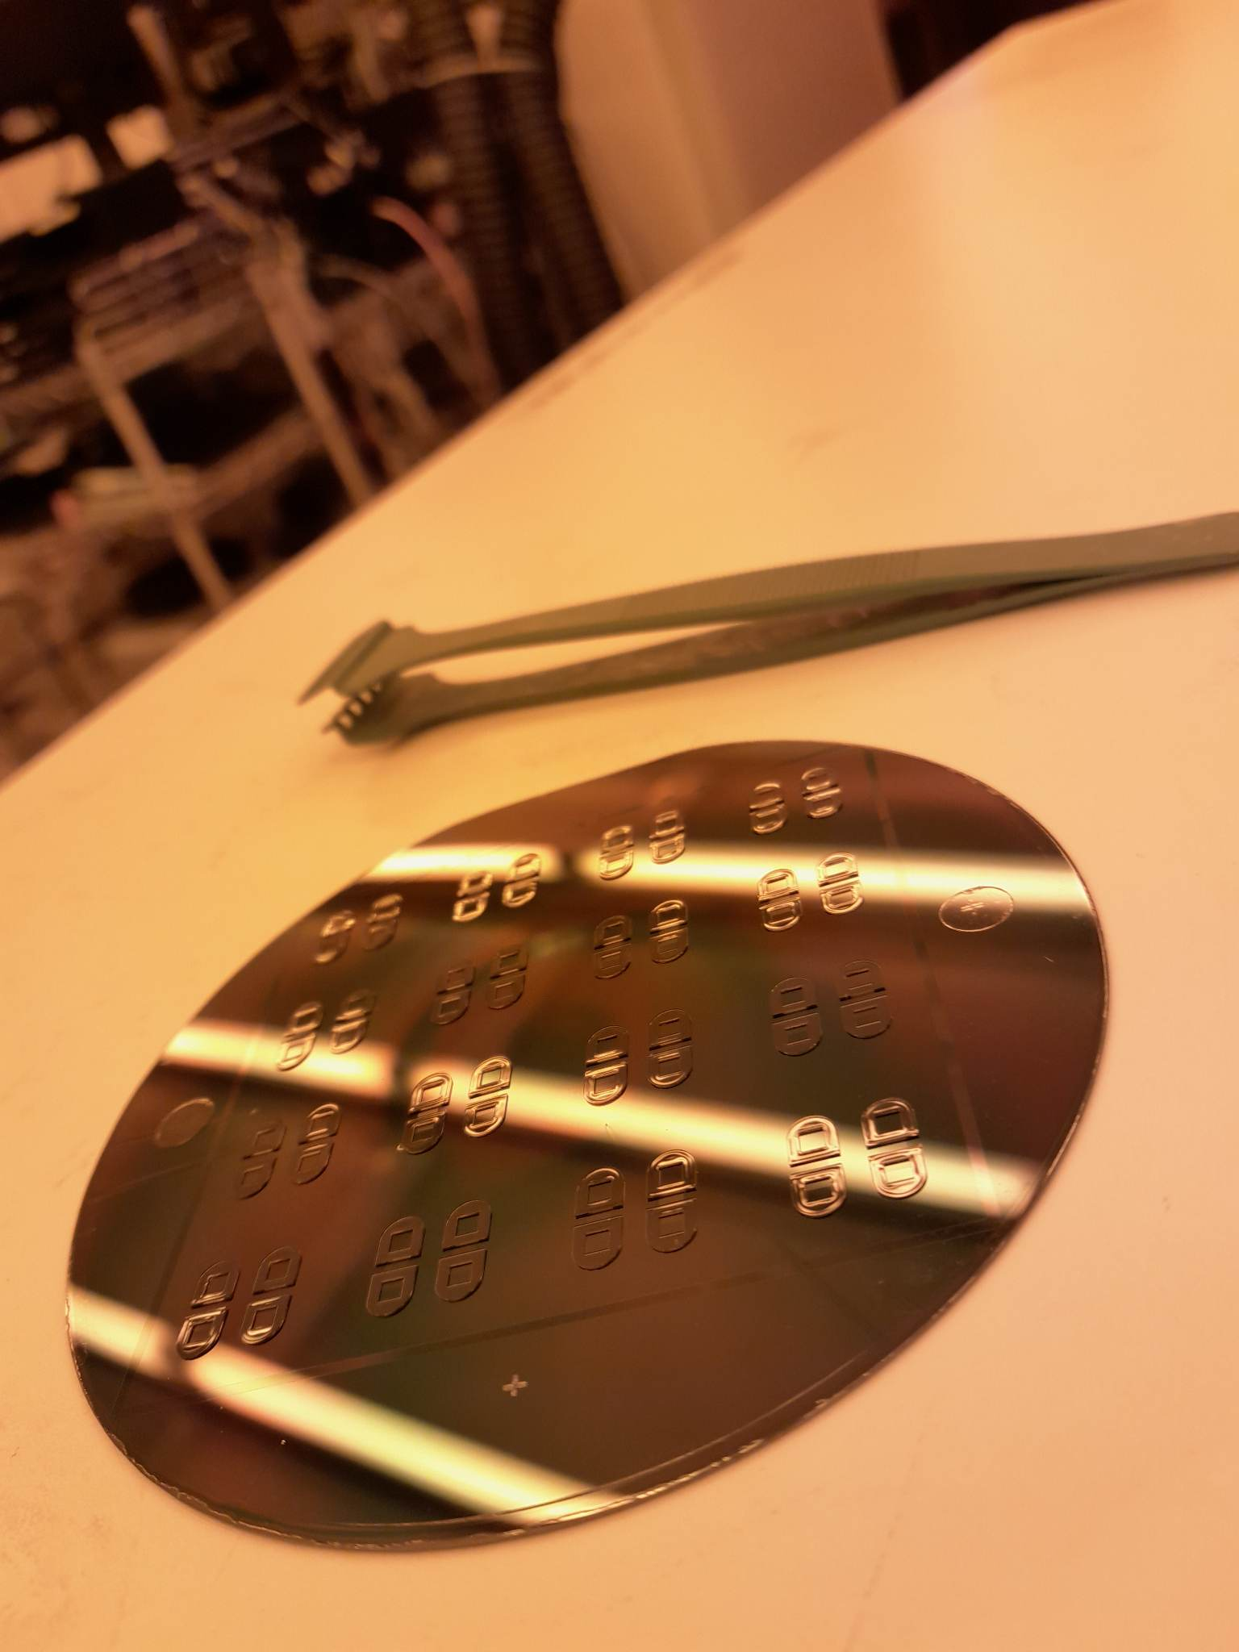
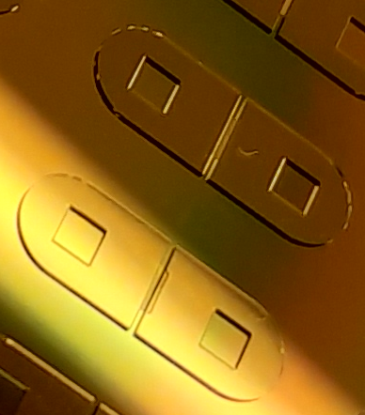
SUEX 200 without 360nm Long-Pass Filter
SUEX 200 with 360nm Long-Pass Filter

