Slide 1
Cell Profiler Support on OpenHCS
Prepared for lab meeting | v7 figures | 25-pipeline and 33-pipeline figure sets in progress

Slide 2
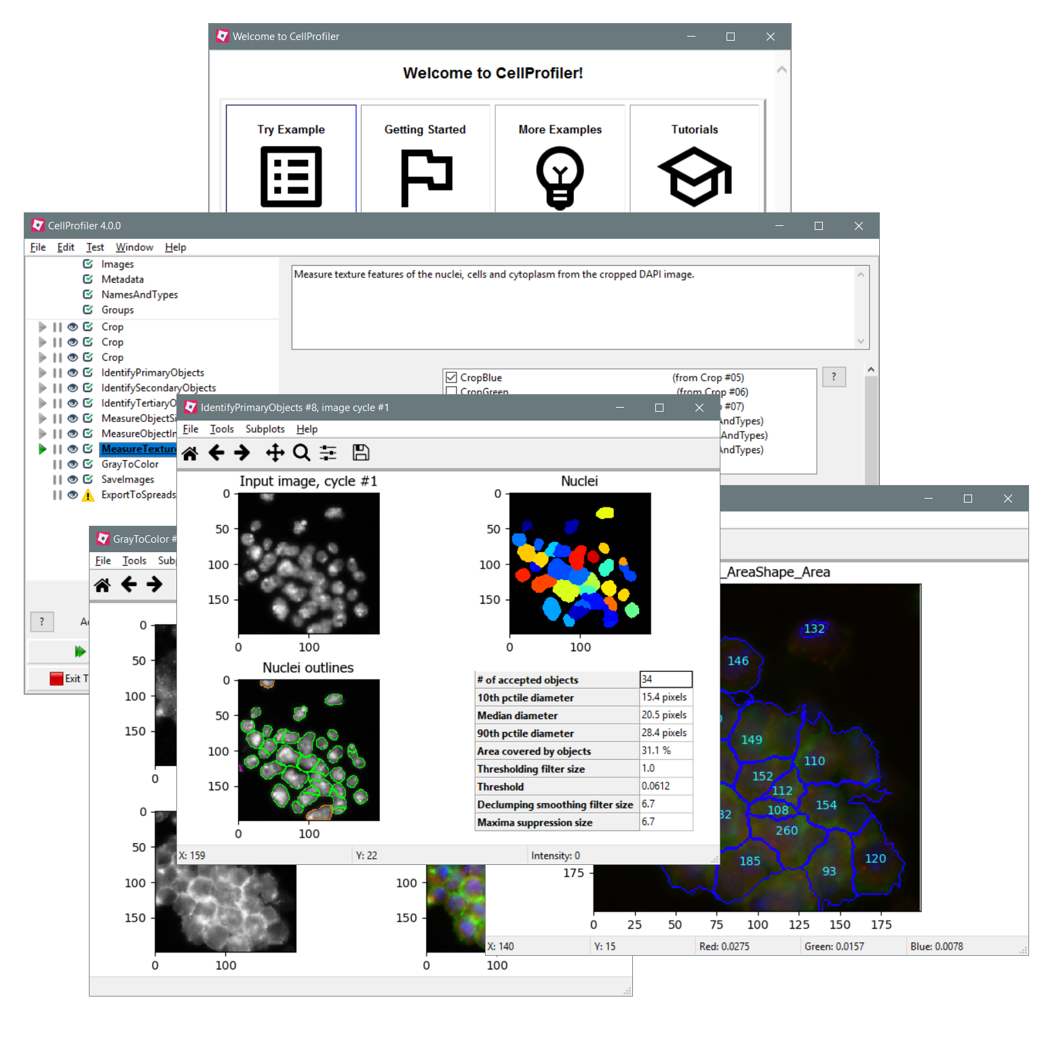
CellProfiler History
A trusted image-analysis workhorse since the early 2000s
Started in 2003; released as open-source software in 2005.
Official site lists 61 public published-pipeline entries: 58 downloads plus 3 GitHub repos.
Company example: Recursion publicly describes using CellProfiler plus CNNs in its image-processing pipeline.
Industry links go back to the original paper: Merck and Novartis fellowships helped support early development.
NIH RePORTER lists $6.16M for Broad/Carpenter image-based profiling grant R35GM122547 from FY2017-2026.

Slide 3




OpenHCS Sits Between The Tools We Already Use
Bring it in
CellProfiler pipelines and microscope images.
Run it
OpenHCS runs the work and keeps the outputs comparable.
Look at it
Results can go to napari, OMERO-style storage, Fiji/ImageJ, and tables.
Message: OpenHCS is a bridge, not a replacement for the tools biologists already know.

Slide 4
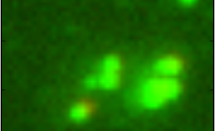
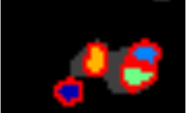
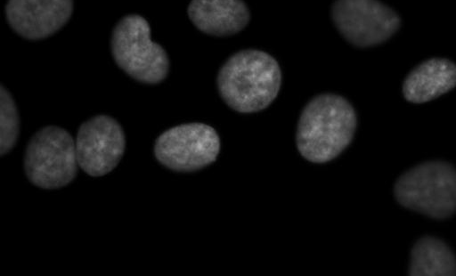

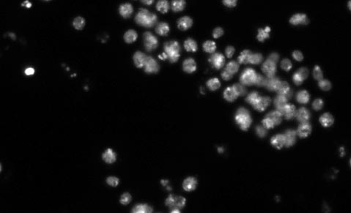
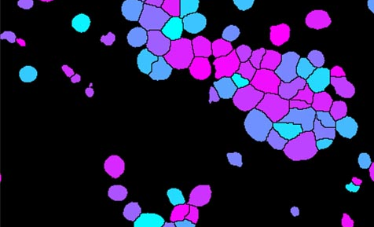
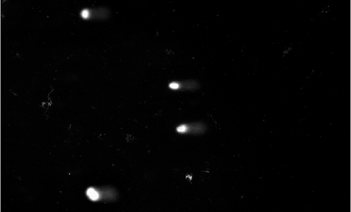
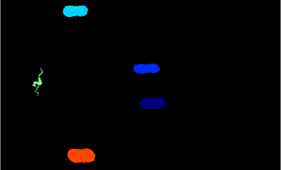
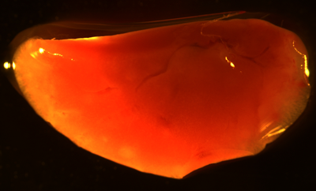

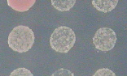
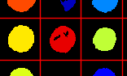
The Benchmarks Cover Real Imaging Jobs
Colocalization
Colocalization mask
Human nuclei
Human color overlay
Fly image
Fly objects
Comet assay
Comet objects
Tumor image
Tumor objects
Yeast patches
Yeast objects

Slide 5
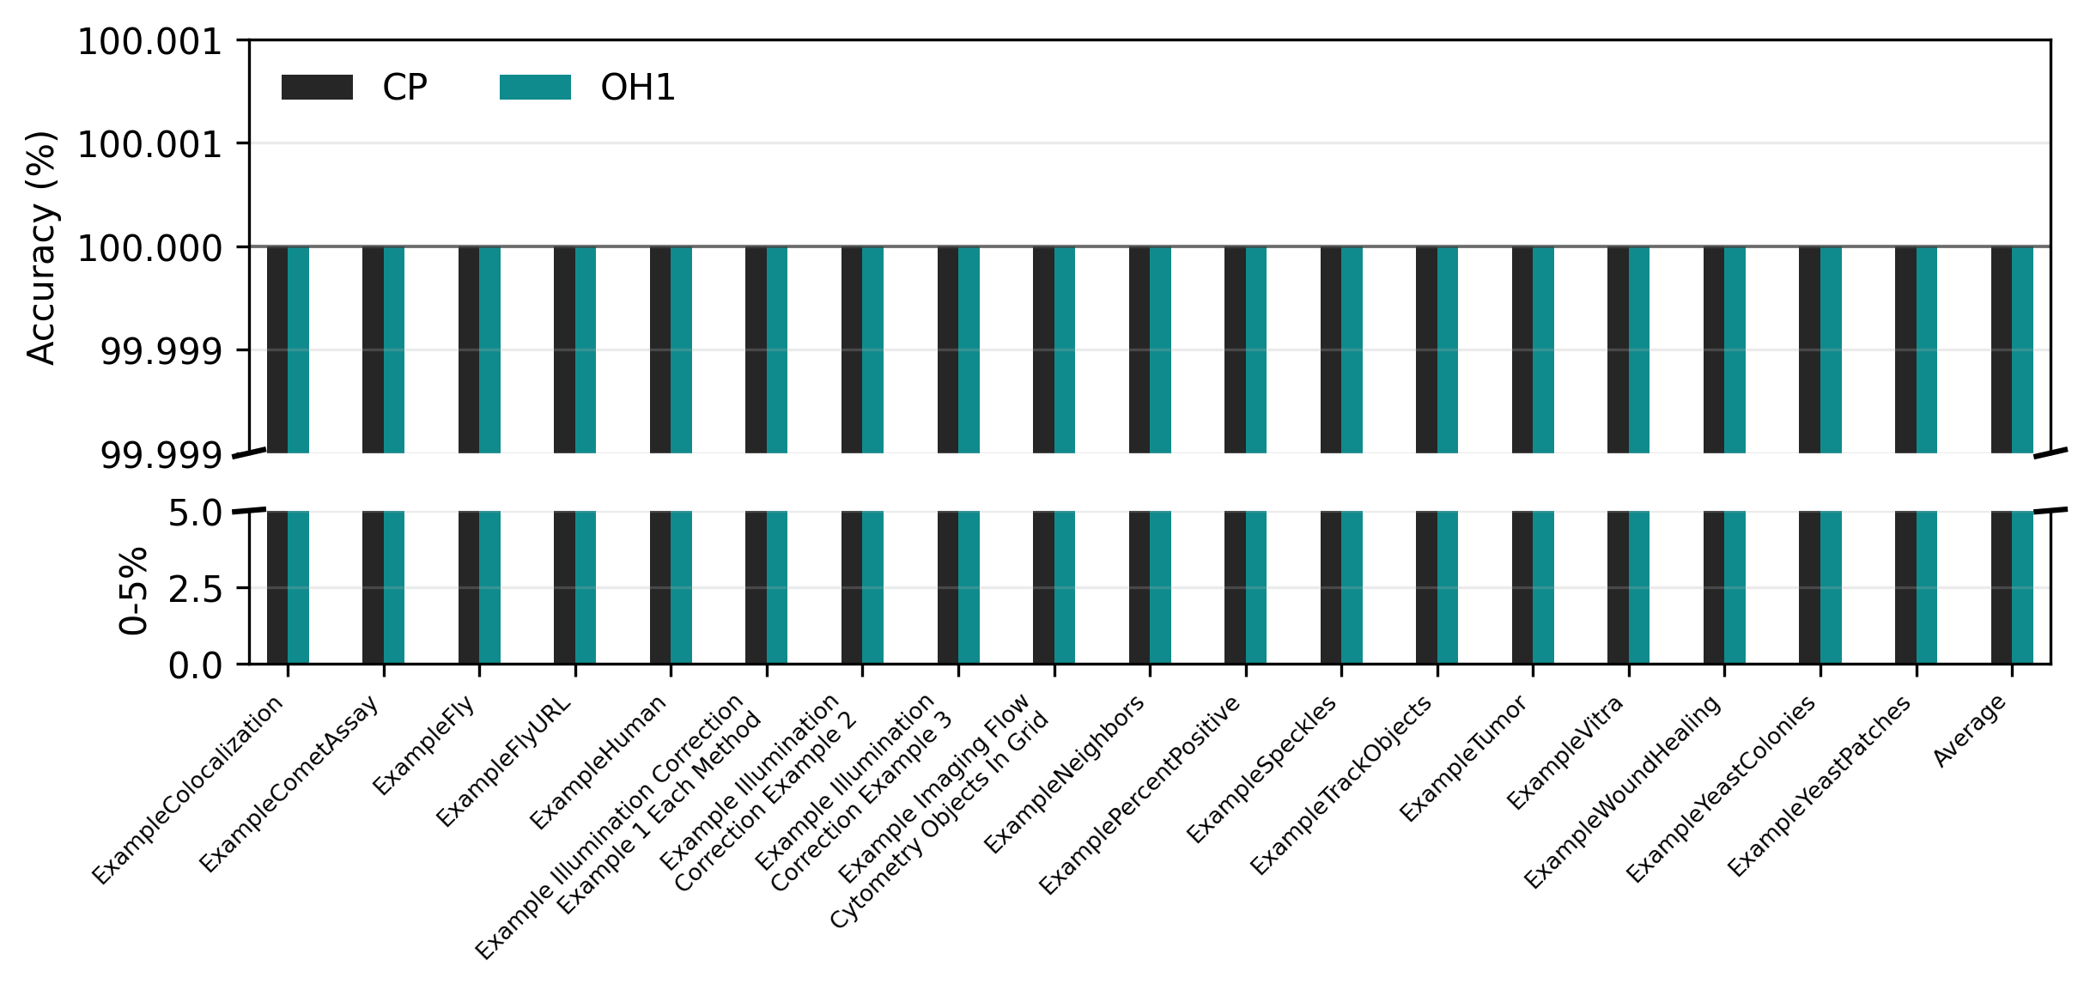
Do The Results Still Match?

Slide 6
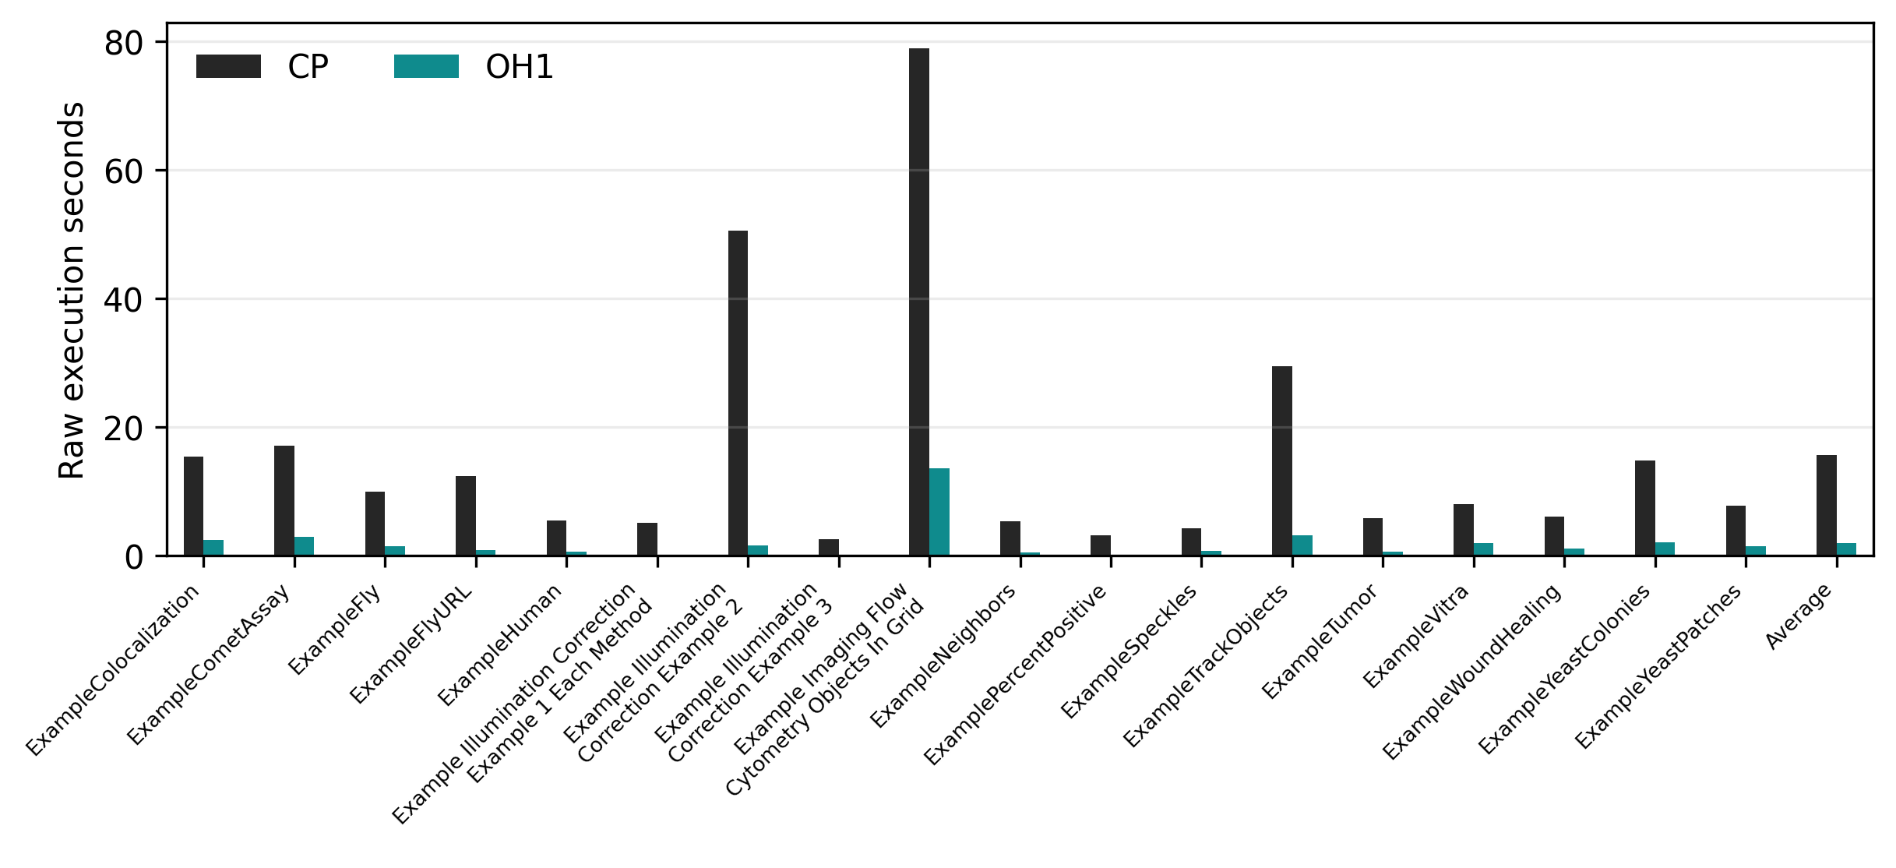
How Long Does It Take?

Slide 7
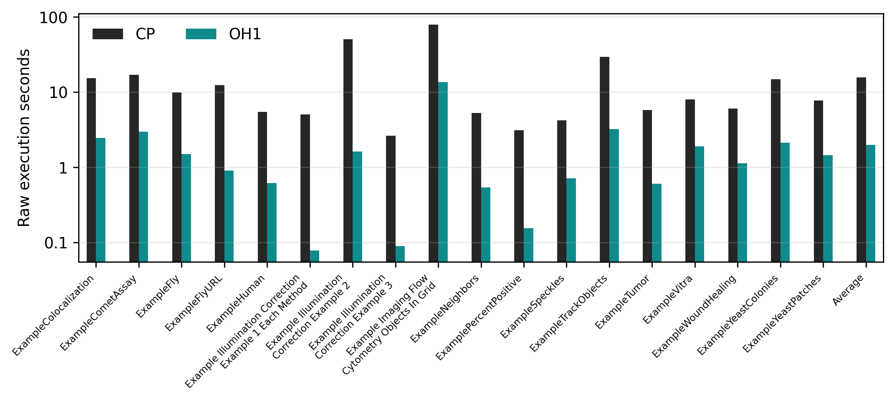
Same Runtime Chart, Log Scale

Slide 8
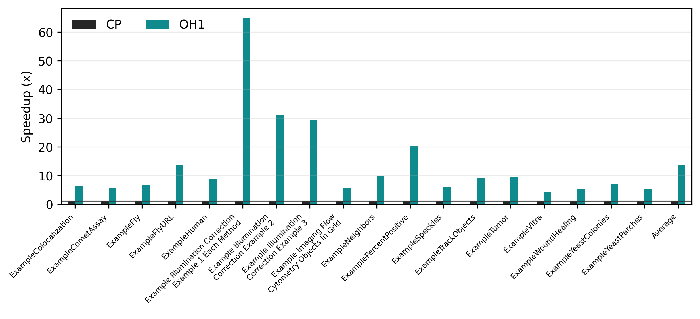
Speedup On One Core

Slide 9
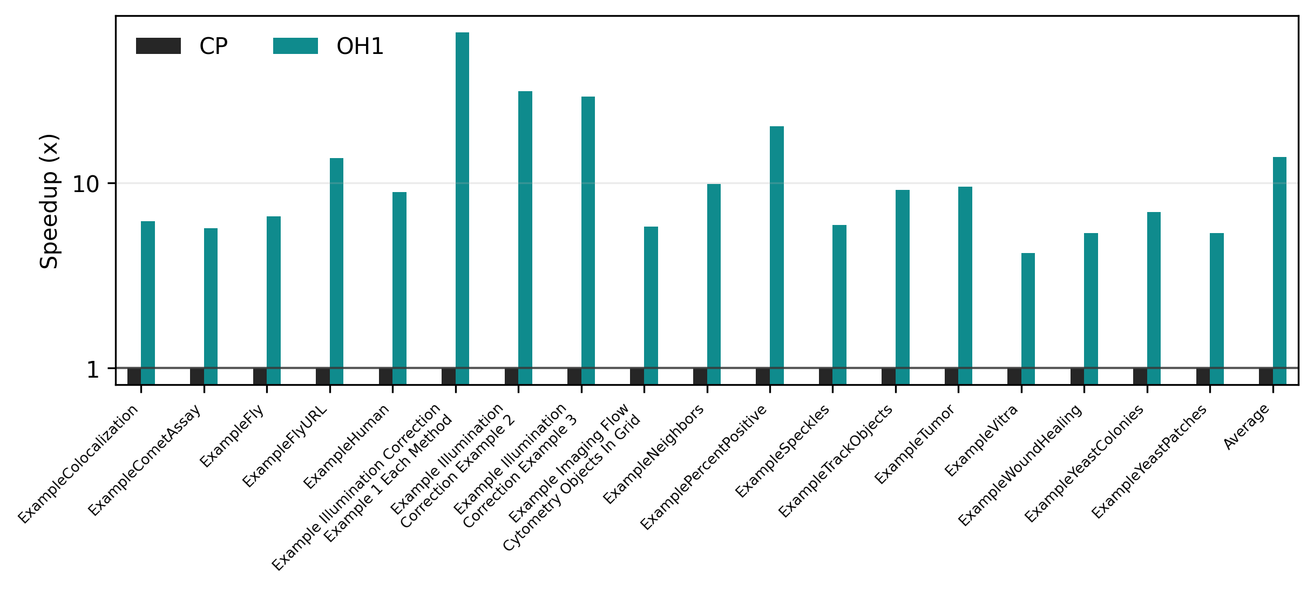
Same Speedup Chart, Log Scale

Slide 10
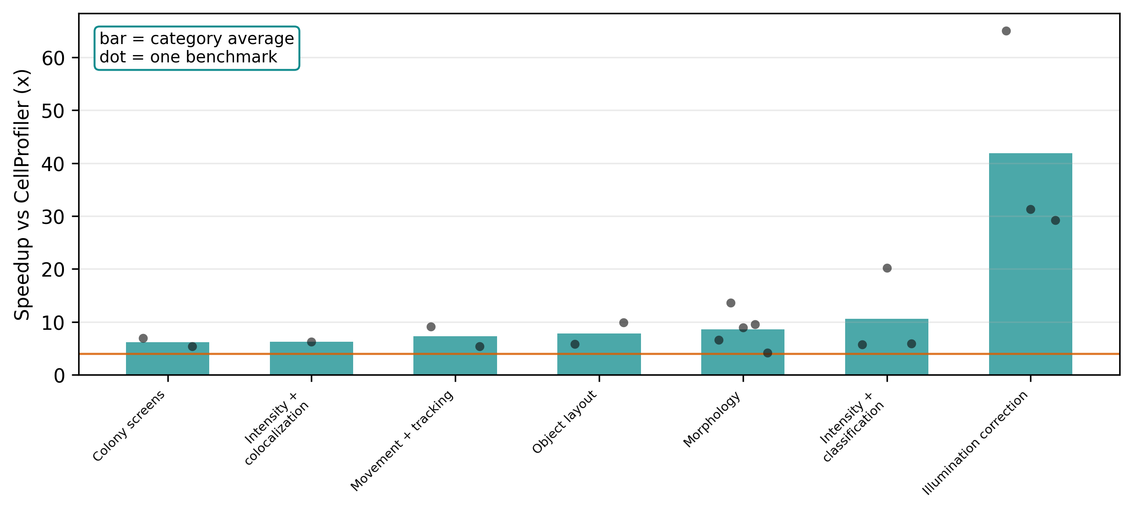
Speedup By Assay Type

Slide 11
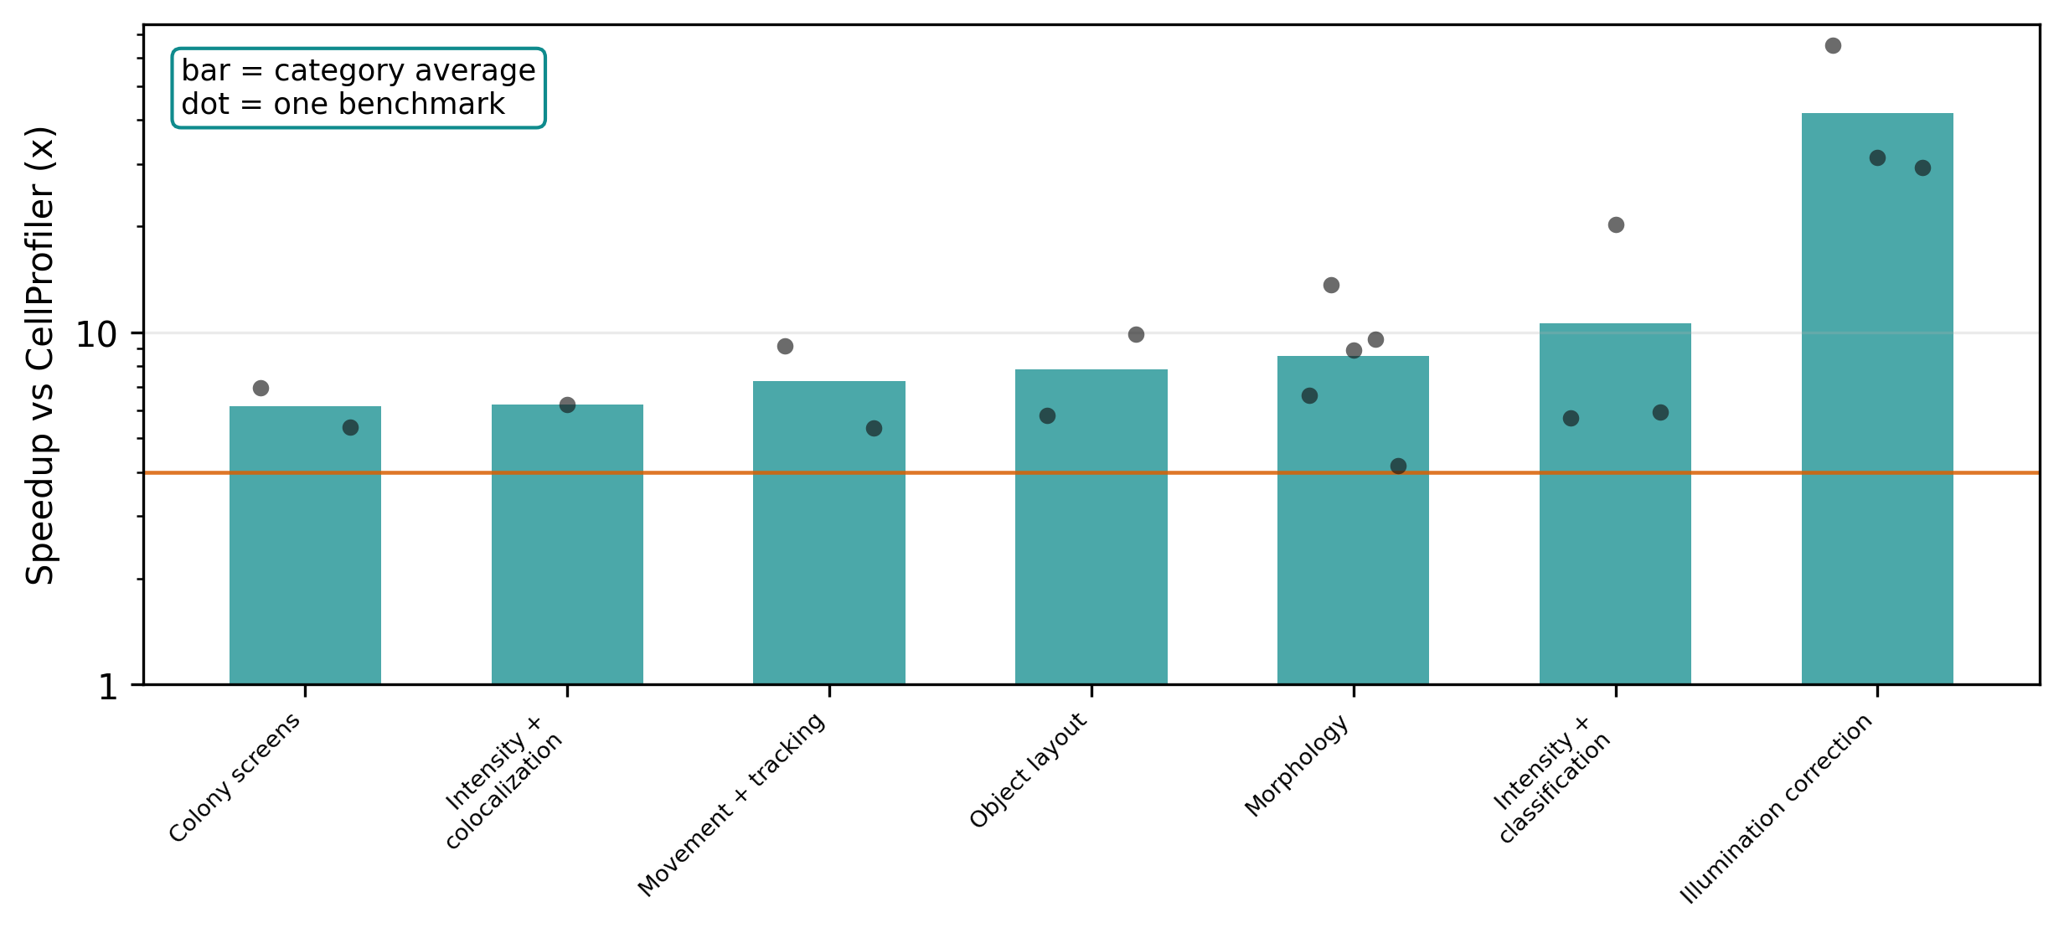
Speedup By Assay Type, Log Scale

Slide 12
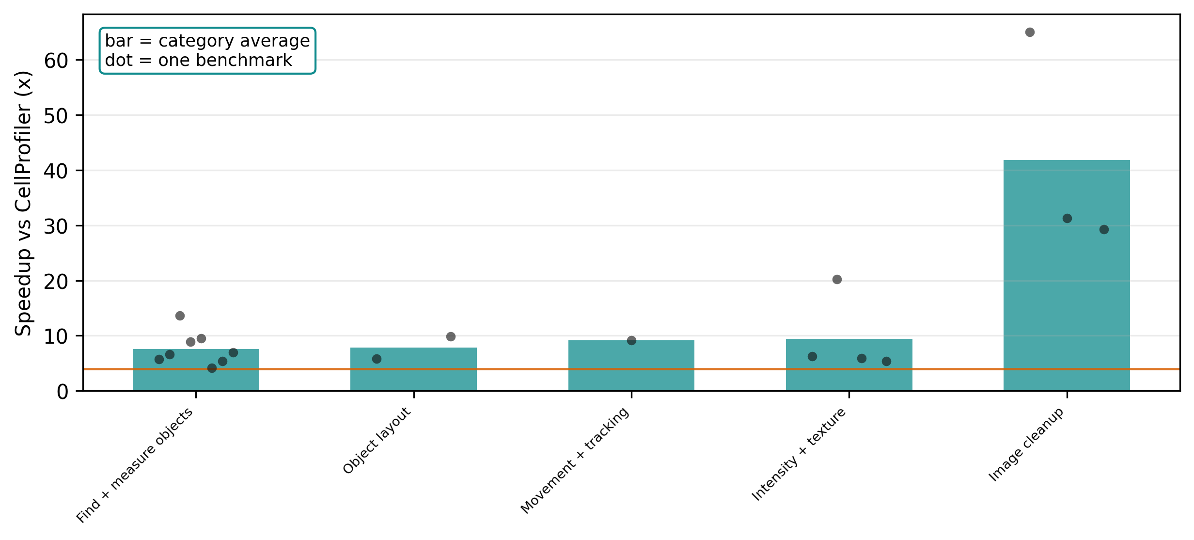
Speedup By Analysis Type

Slide 13
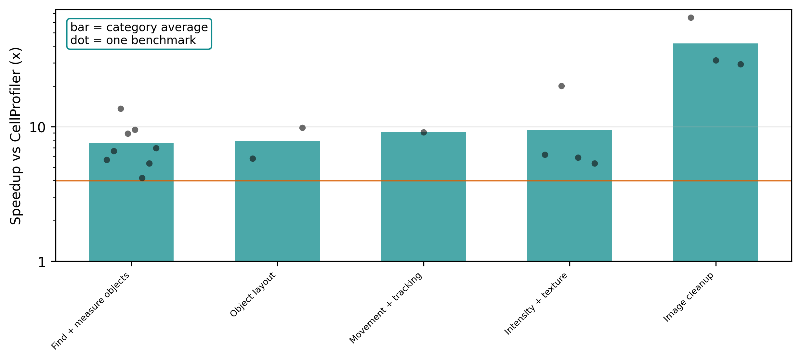
Speedup By Analysis Type, Log Scale

Slide 14
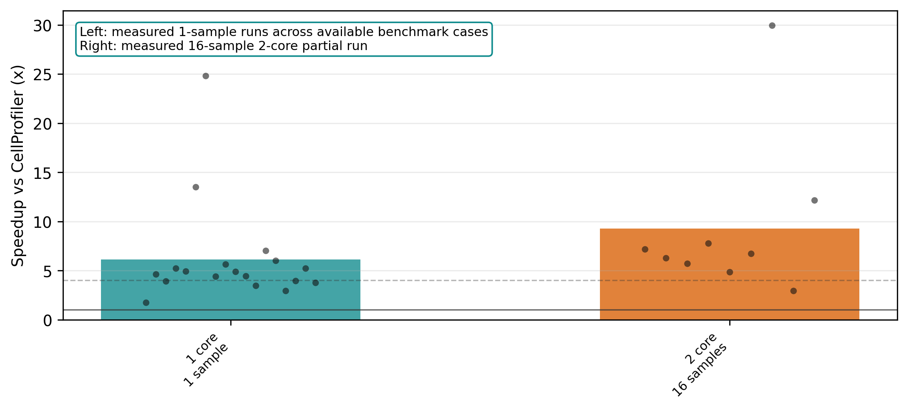
Measured Throughput: One Sample vs More Samples

Slide 15
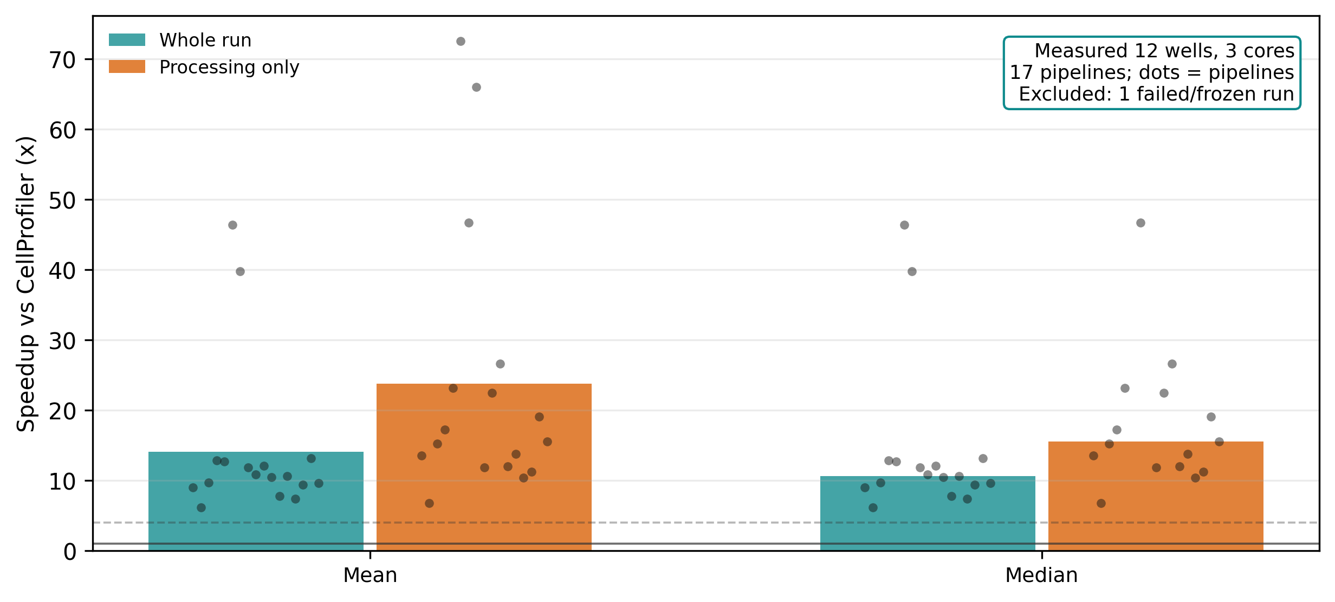
Measured 3-Core Scaling Across 12 Wells

Slide 16
What We Can Say Today
This is the polished figure set for lab meeting
18 official CellProfiler example pipelines are plotted here.
All 18 pass the result check.
All 18 are at least 4x faster on one core.
More pipelines are being added, but these are the clean figures for now.

Slide 17
Main Takeaway
Same trusted result shape, much faster runs
CellProfiler is a major scientific imaging tool, so matching it matters.
OpenHCS keeps the CellProfiler-style outputs while running faster.
The v7 figures show at least 4x speedup across all 18 plotted pipelines.
OpenHCS also gives one place to connect CellProfiler, napari, Fiji/ImageJ, and OMERO-style data.

Slide 18
Sources And Claim Boundary
NIGMS Biomedical Beat: CellProfiler cited in more than 15,000 scientific papers.
Genome Biology metrics: CellProfiler 2006 paper around 4,968 citations.
CellProfiler site: project started in 2003 and lists 61 public published-pipeline entries.
NIH RePORTER: Broad/Carpenter R35GM122547 award rows total $6.16M from FY2017-2026.
Genome Biology 2006 paper: early support included Merck and Novartis fellowships.
Google Cloud Recursion case study: Recursion uses CellProfiler plus CNNs in its imaging pipeline.
Broad/CellProfiler pages: use cases, open-source framing, and sustained funding/support context.
OpenHCS README: Fiji/ImageJ, napari, storage, and integration framing.
Performance figures: v7 OpenHCS benchmark outputs from 18 official CellProfiler examples.
Exact URLs are listed in docs/lab_meeting_cellprofiler_openhcs_slides.md

