Slide 1

Payoff Matric
Network:
Grid
ER random
WS small-world
Strategy:
Imitation
Tit for tat
Persistence/ collapse measurement:
Pr_allD / Pr_allC
mean_t_absorb
mean_barC
Cluster/percolation quantities:
mean_Smax: average largest cooperative cluster fraction (largest CC size / N)
mean_chi: average susceptibility (fluctuations in finite cluster sizes)

Slide 2



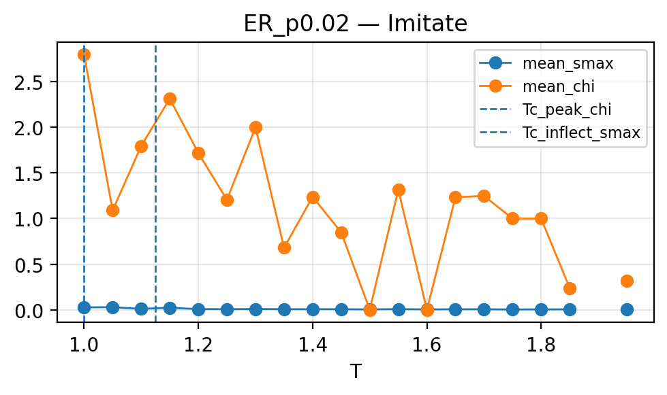

ER_p0.02 + Imitation

Slide 3


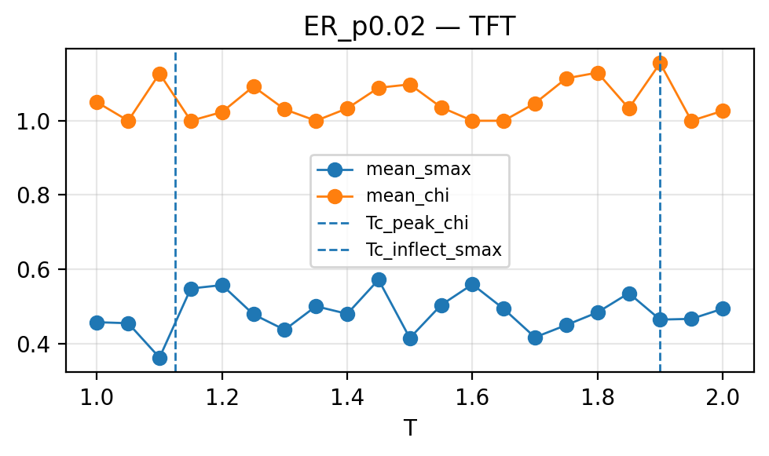


ER_p0.02 + TFT

Slide 4
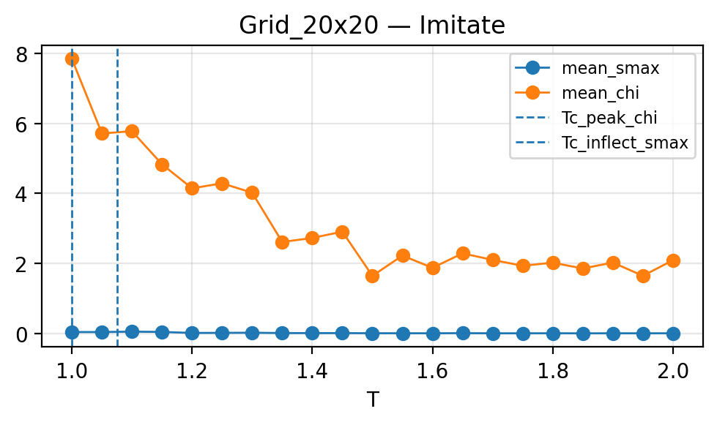

Grid 20*20 + Imitation

Slide 5
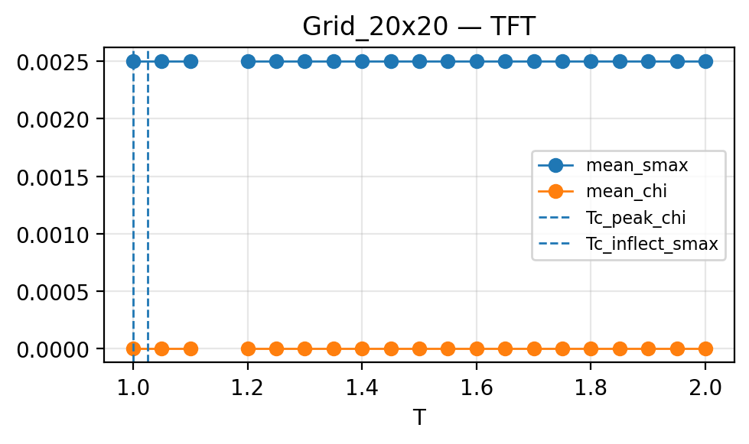


Grid 20*20 + TFT

Slide 6
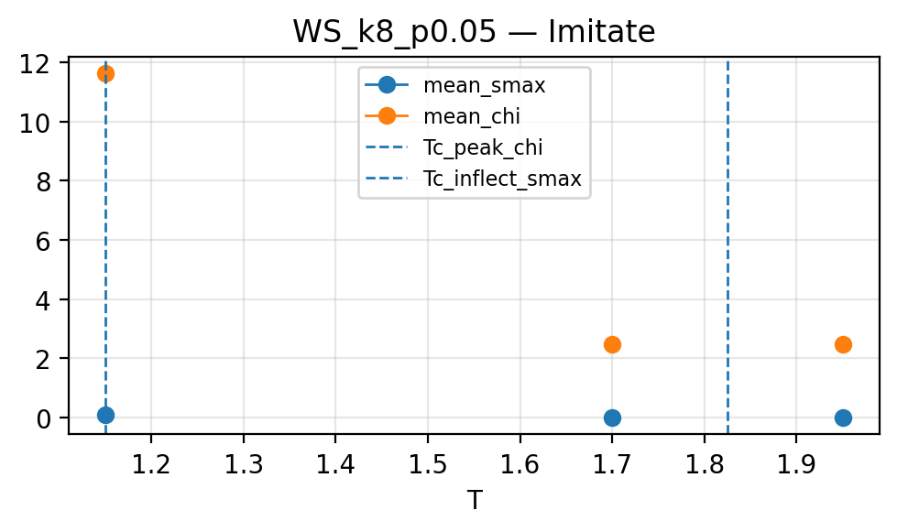

WS_p0.05 + Imitation

Slide 7
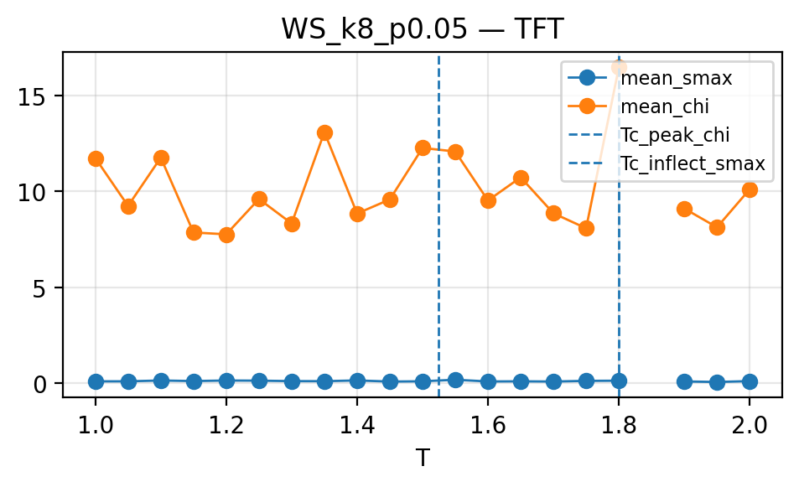

WS_p0.05 + TFT

Slide 8



Slide 9




Imitation

Slide 10
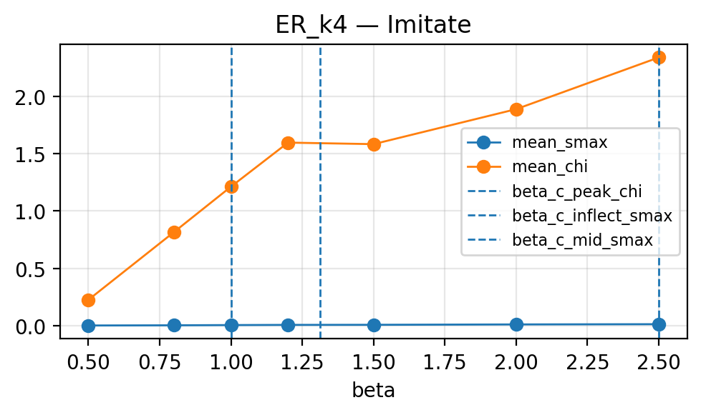
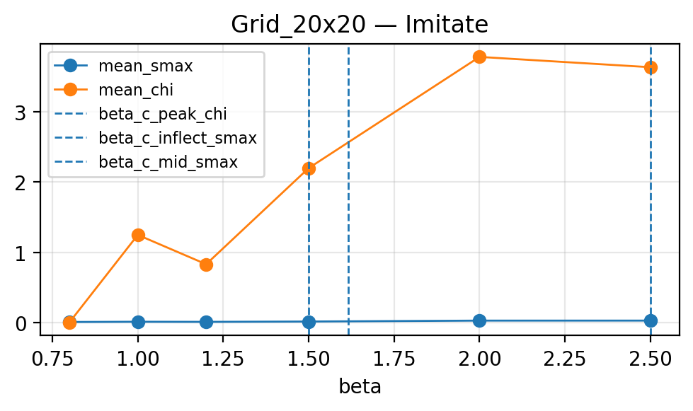
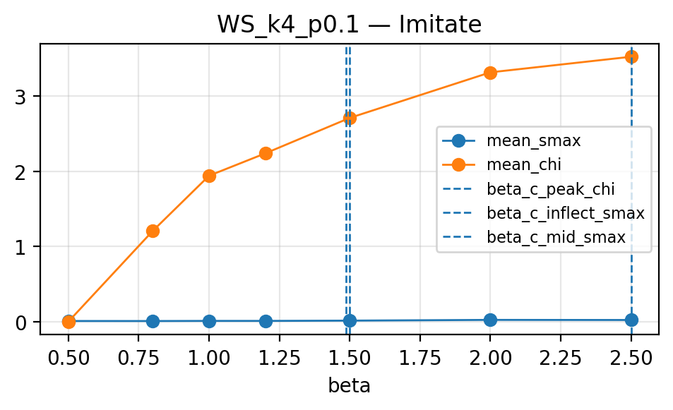
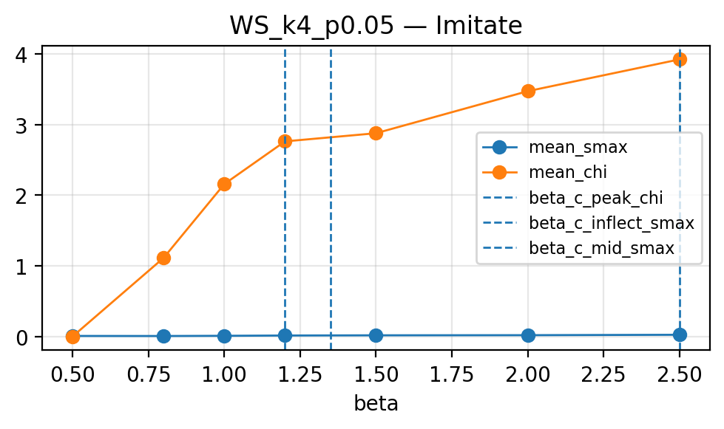

Imitation

Slide 11



TFT

Slide 12
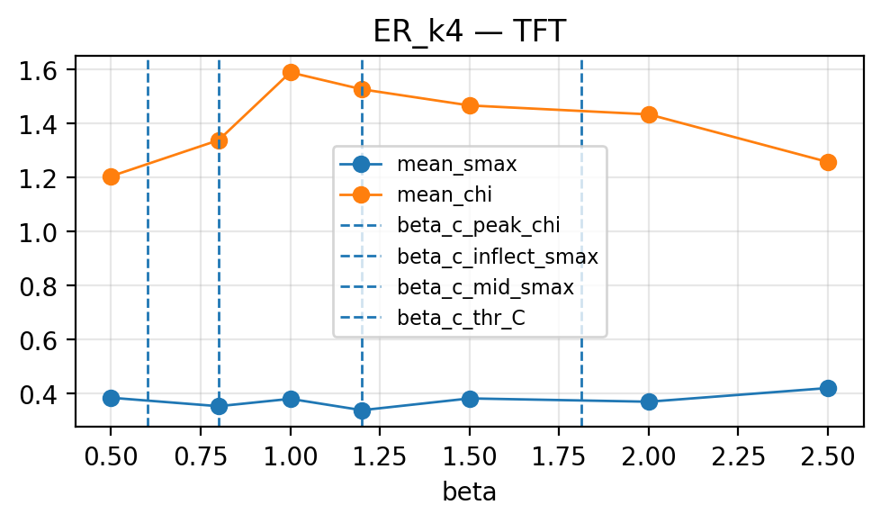
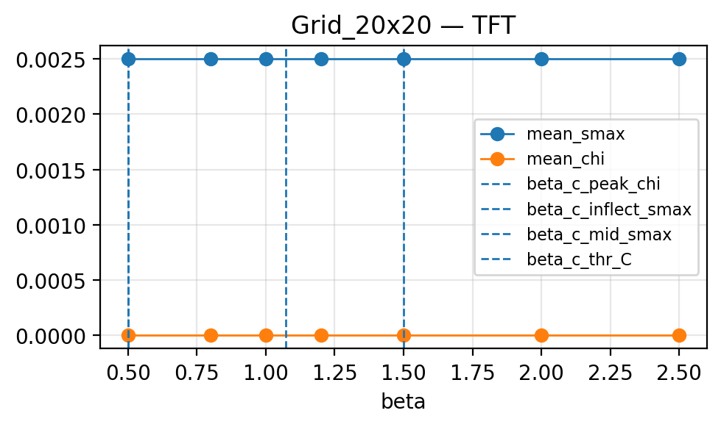
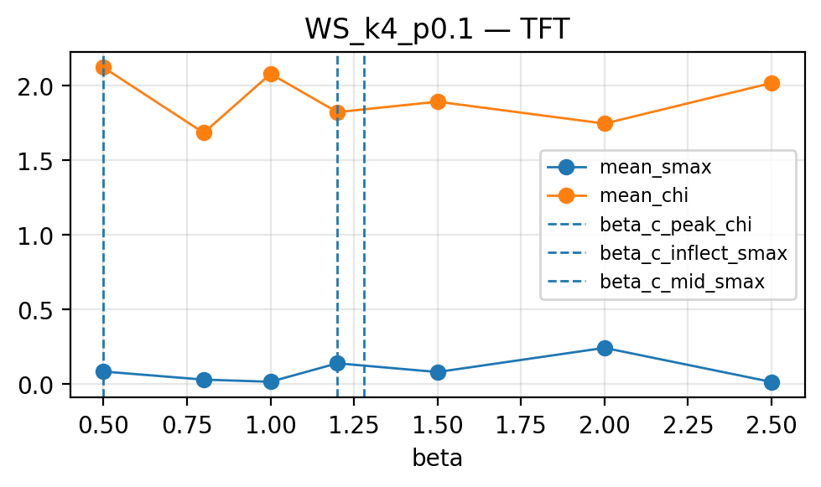
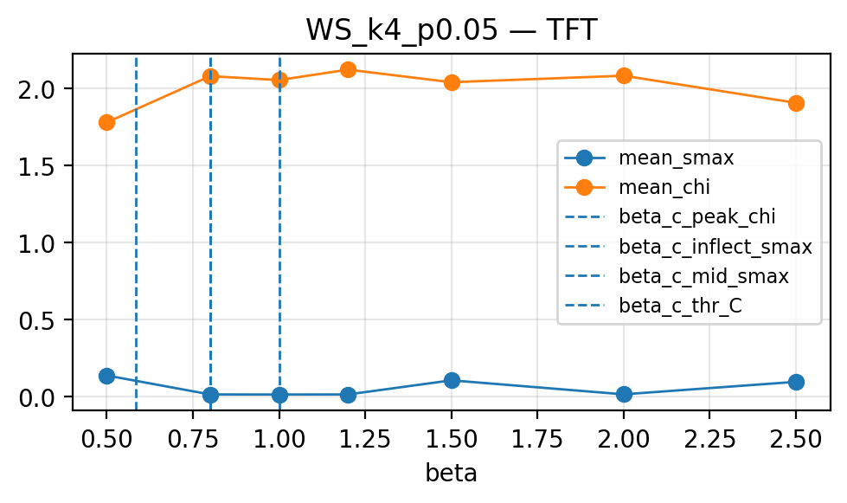

TFT
cooperators form a giant connected component in the random network.
cooperation exists but is extremely fragmented (largest C cluster ≈ single node).
bistability (both allC and allD occur fairly often) and cluster spikes.
the signature of a transition region: small parameter changes flip which absorbing basin wins.

