Slide 1
RQ: Does cooperation persist?
H0.1 Payoff: Snowdrift supports higher persistent cooperation than Default.
H0.2 Strategy: TFT sustains cooperation more than Imitate/RL.
H0.3 Network: Structure (Grid/WS vs ER) moderates persistence.

Slide 2
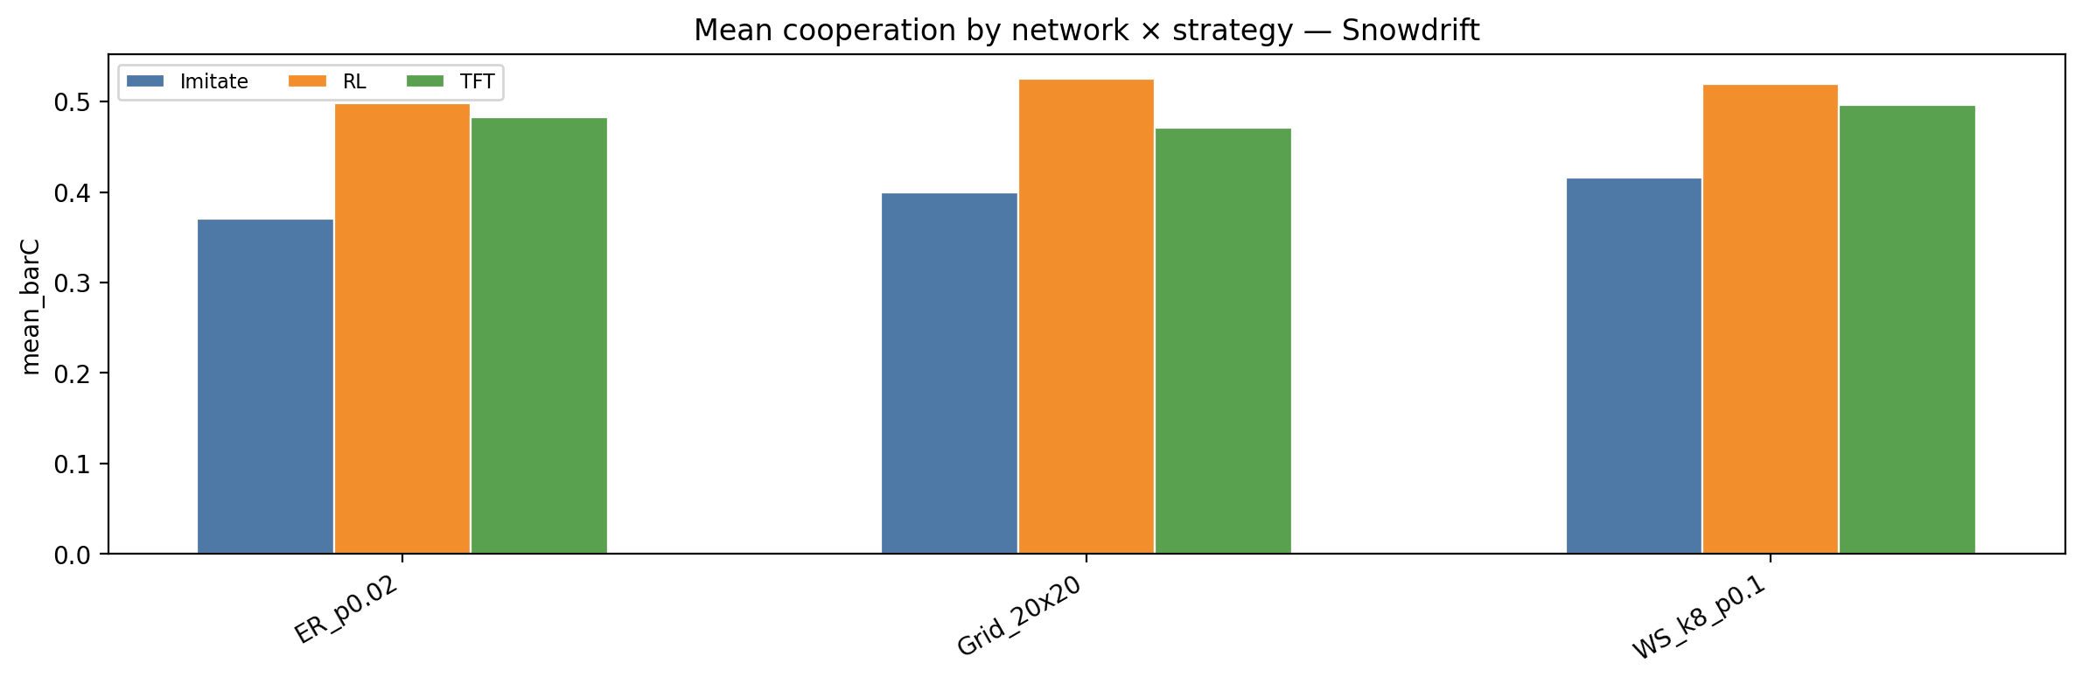
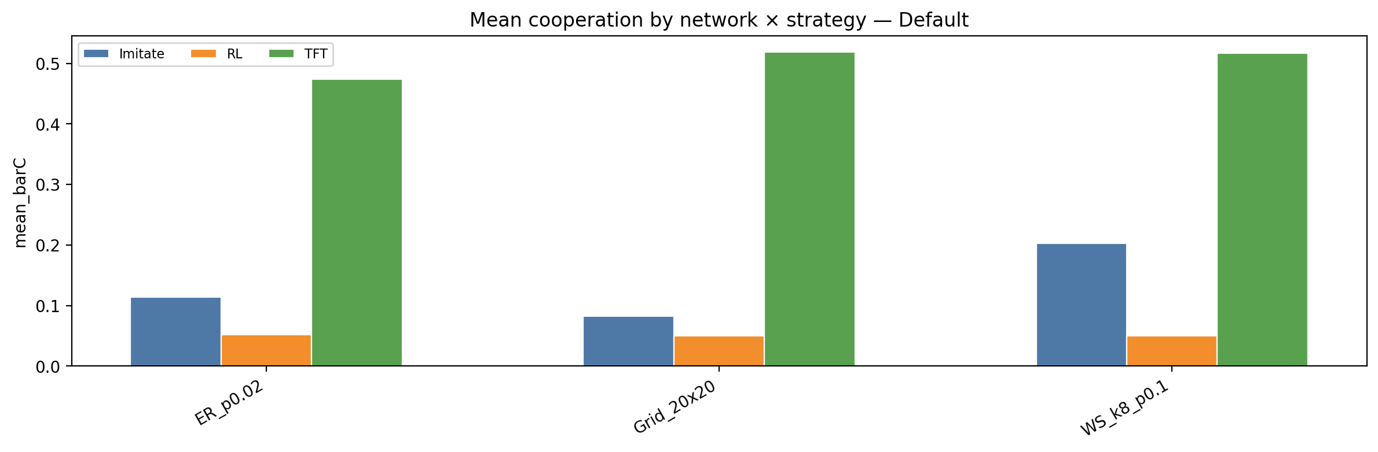
RQ: Does cooperation persist?
Snowdrift
Default
Notes:
I quantify persistence by mean cooperation bar C after burn-in.
First, payoff dominates (H1): Snowdrift lifts bar C across almost all settings.
Under Default, strategy differences are strong (H2): TFT is much higher; RL is lowest.
And Network modulates - WS tends to help Imitation a bit under Default

Slide 3
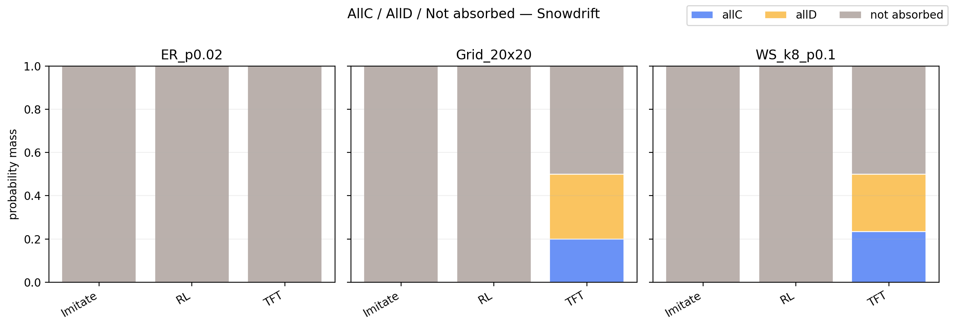
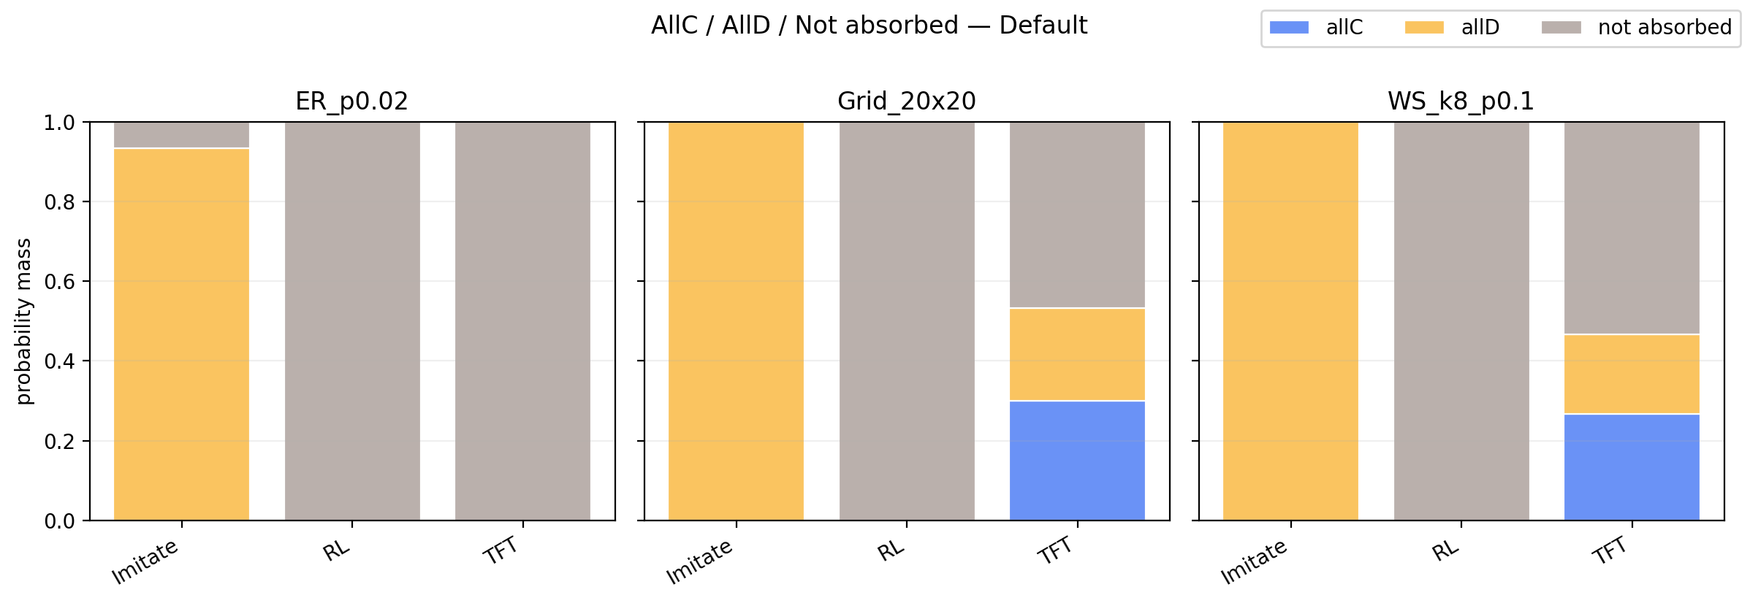
RQ: Does cooperation persist?
Snowdrift
Default
Notes:
Next we checked whether it’s stable coexistence or absorption. We want to see the long-run behavior of the simulation, beyond just “average cooperation.”
In Snowdrift, almost everything is not absorbed(with the gray portion) — it shows stable mixed states rather than fixation.
TFT is the only case that shows meaningful all-C probability (especially on Grid/WS), indicating cluster protection.
In Default, Imitation tends to end in all-D a lot, while RL is mostly not absorbed but at very low cooperation.
So we can say, high bar C in Snowdrift is not from all-C fixation; it’s from persistent mixed cooperation.
Overall, we find that cooperation persistence is highly sensitive to both the update strategy and the payoff matrix.
--- maybe that’s the reason we tune the payoff parameter to see the phase transition.

Slide 4
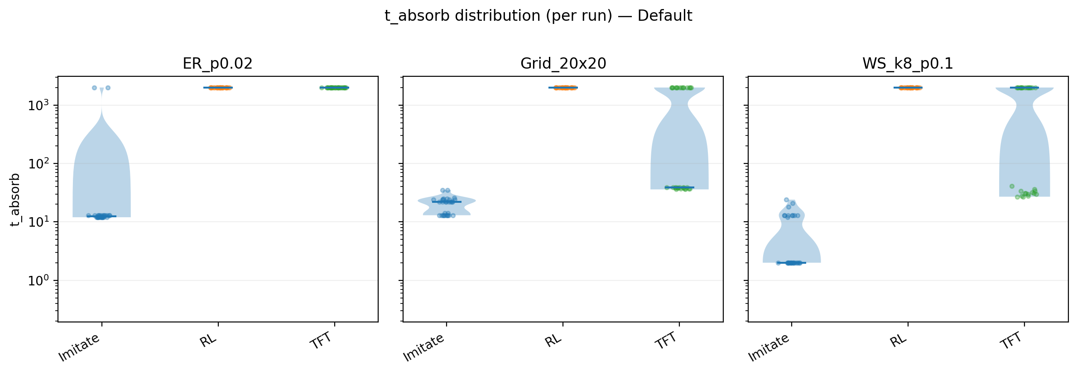
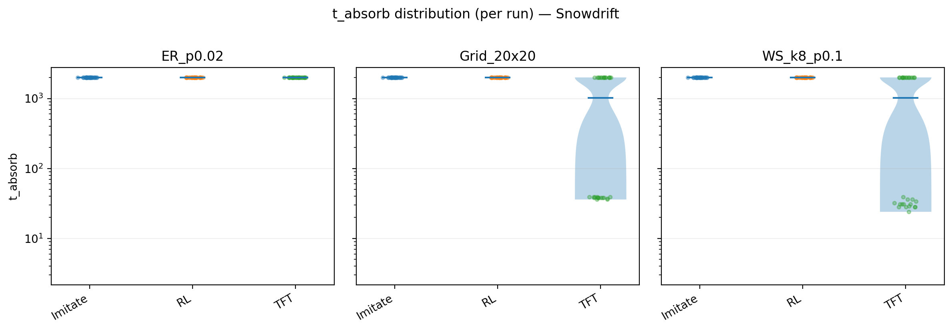

Slide 5
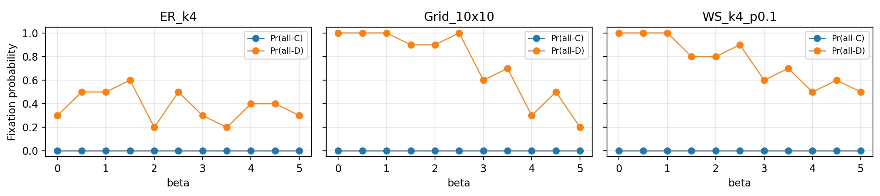
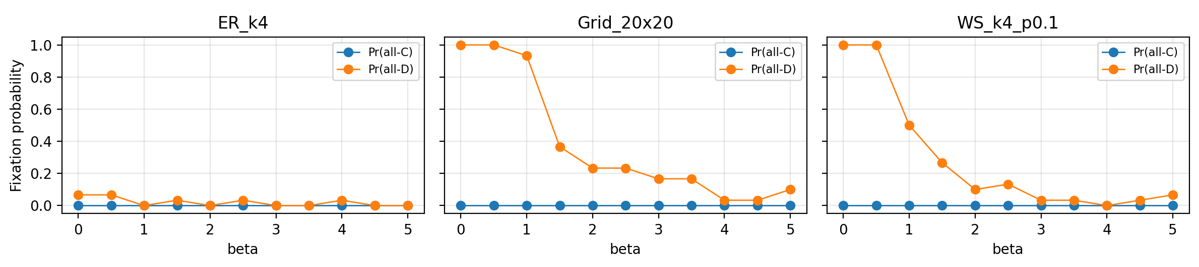
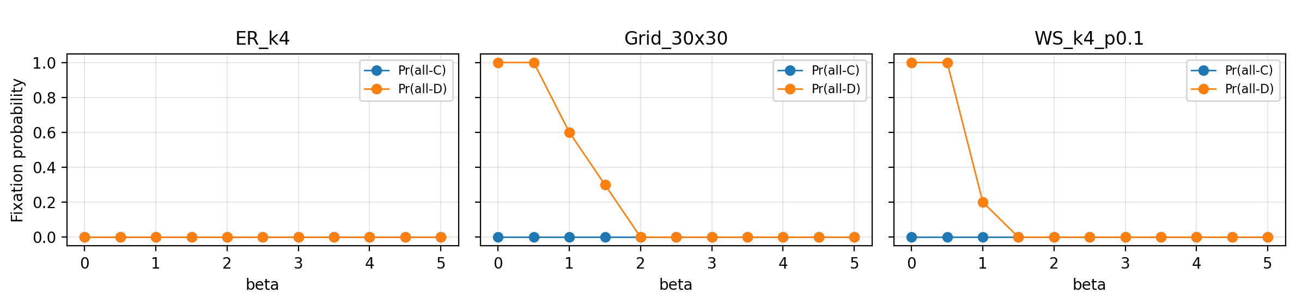

Imitation
Grid | beta*(max |dPr-allD|) | max slope | beta*(max chiD) | chiD
10*10 | 2.75 | -0.800 | 4.5 | 0.25
20*20 | 1.25 | -1.133 | 1.50 | 0.23
30*30 | 0.75 | -0.800 | 1.00 | 0.24
Fluctuation diagnostic
WS | beta*(max |dPr-allD|) | max slope | beta*(max chiD) | chiD
N=100 | 2.75 | -0.600 | 4.00 | 0.25
N=400 | 0.75 | -1.000 | 1.00 | 0.25
N=900 | 0.75 | -1.600 | 1.00 | 0.16
Notes:
We observe a sharp drop in Pr(all-D) over a narrow β-interval, and the maximum slope magnitude increases from N=100 to N=900, consistent with finite-size sharpening.
Under Imitation, WS networks show a sharp drop in the probability of all-D fixation, and this drop becomes steeper as N increases—behavior consistent with a finite-size phase transition (absorbing all-D → active/non-absorbed regime).
Grid shows the same qualitative behavior—a sharp decrease in Pr(all-D)over a relatively narrow β range—suggesting a similar transition-like crossover.
However, the estimated transition location varies more across the grid sizes we tested, so we treat the Grid evidence as preliminary compared with the clearer finite-size sharpening observed in WS.

