Slide 1


CAREER PLAYBOOK
01 / 05
SOFTWARE ENGINEERING IN 2026
Coding as a Career
Navigating specializations, critical engineering skills, education routes, and the AI era.
Market Demand
Core Asset
+15% Growth
System Judgment

Slide 2


TECHNICAL DOMAINS
02 / 05
Core Specializations
Primary focus areas across modern development teams
Front-End
Back-End
Full-Stack
Data & AI
Visual interfaces and interactive user experiences.
Server logic, database orchestration, and robust APIs.
End-to-end product implementation across all layers.
Scalable data pipelines and machine learning pipelines.
React • TypeScript
Python • Java • Go
Node.js • Full Web
PyTorch • SQL

Slide 3
ENGINEERING CAPABILITIES
03 / 05
Essential Skills Beyond Syntax
Traits that distinguish high-impact developers from code typists
Version Control
Systemic Debugging
Communication
System Design
Managing branch strategies and asynchronous team collaboration with Git.
Methodically diagnosing complex edge cases and failure modes.
Structuring software for long-term scalability and fault tolerance.
Translating complex technical tradeoffs into clear business decisions.

Slide 4
CAREER ENTRY
04 / 05
Learning & Entry Pathways
Three main routes to build technical competency
01
Academic
02
Accelerated
03
Autodidact
CS Degree
Coding Bootcamps
Self-Directed
Deep theoretical foundations in algorithms, data structures, and computer architecture.
Intensive, practical training focused on immediate web and software stack skills.
Flexible, portfolio-driven learning via open-source contribution and docs.

Slide 5

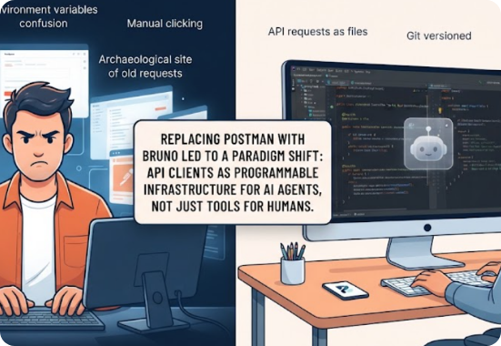
FUTURE OUTLOOK
05 / 05
Engineering in the AI Era
AI Acceleration
Shift from typing code to verifying logic and architecture.
Continuous Learning
Adaptability is key as tooling and frameworks evolve rapidly.
Leadership Paths
Progression toward Staff Architect, Tech Lead, or Management.

Slide 6


Image Sources
https://images.stockcake.com/public/6/3/6/636d9d91-36cb-45ac-b953-3d1c2507c056_large/hacker-in-action-stockcake.jpg
Source: stockcake.com
https://miro.medium.com/1*K6b31ib-xPZiH-0bkcgkDg.png
Source: medium.com

