Slide 1
Ptolemy Actor IO package
Prototype details
By Tristan

Slide 2
Problem
Ptolemy II does not follow a Model-View-Controller architecture.
Each actor handles it’s own business logic as well as it’s user interface.
This makes it difficult to use actors in various environments.
I.e. It’s impossible to get the readings from a Display actor in a headless environment.
http://en.wikipedia.org/wiki/Model-view-controller

Slide 3
Solution
Implement a MVC framework.
Build standard IO devices which actors use to get input and give output.
Different environments can implement their own view for specific IO devices.

Slide 4
Prototype
http://www.hpc.jcu.edu.au/git/?p=jc124742/ptII-actorio.git;a=summary
Built as a extension to ptolemy II using maven.
Contains the core functionality and a few example implementations.
Devices for Display actor and graphing actors have been built.
Uses spring for the environment configuration.

Slide 5
ptolemy.actor.io
Package for the core actor IO code.
IOFactory.java
  Singleton factory used by actors to get the IO devices they require.
  Reads the system property “springconfig” to get the location of the environment’s configuration file.
TextOutput.java
  Interface for environments to implement a text-based output device (i.e. for use by Display actor).
GraphOutput.java
  Interface for environments to implement a graphing output device (i.e. for use by the various Graphing actors in ptolemy).

Slide 6

Display Actor Modifications
Removed all Window handling code.
Added:
Replace all instances of:
With:

Slide 7
ptolemy.console.io
Demo IO implementation for console based output.
ConsoleTextOutput.java
  Prints output to the console via System.out.print
ConsoleGraphOutput.java
  Stores graphing output and prints a text rendering on the graph when the workflow ends.

Slide 8
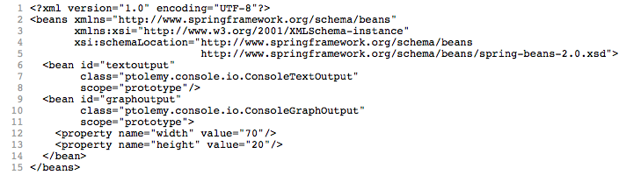
console-spring-config.xml
Gives the class to use for each device. (lines, 7 and 10)
Also allows specifying class specific constructor or getter/setter values. (i.e. lines 12 and 13 set the width and height of the graph)

Slide 9
SWT example
http://www.hpc.jcu.edu.au/git/?p=jc124742/ptII-swt.git;a=summary
Implements IO devices with SWT views.
Vergil is still used as the execution environment.
JFreeChart used to display graphing.
Problem: JFreeChart updates are very slow.
Problem: SWT has problems under mac os x when used this way, therefore demo only works on windows and linux.
Note: Problems are with SWT and JFreeChart, not the actor-io subsystem.

Slide 10
Problems
Many Output actors have properties associated with them that configure their views. These properties are ignored by the actor io system.
  These types of properties break the MVC architecture.
  Is is feasible to remove these types of properties?
The prototype as an extension requires the classpath to be finely tuned so that the actor.io jar is ahead of the ptolemyII jar.

