Slide 1

BULLETPROOF:
WEEKLY PLANNER APP
Dan Wood
zhv4465@autuni.ac.nz
Junha Yu
nbj3293@autuni.ac.nz
Tristan Kells
mjc7321@autuni.ac.nz

Slide 2
RATIONALE
PROBLEM & PURPOSE
Why is this project needed?
Context of this project
Existing research completed
Notes:
Tristan Intro
Context: Bulletproof cloud
Why & ER: Client unable to find compatible existing solution. Needed tailored solution (other apps too complex & cluttered) Research by our team (Jira, Google Cal, iCal, Outlook, Mavenlink, Asana, Trello etc).

Slide 3
SCOPE
Web application built on AWS cloud platform
Viewable on multiple devices
High-level consulting overview
Client table generated from input information
Login functionality for admin and team members to add/edit information
Notes:
Dan
Client mentioned Jira compatibility later in project dev. Client is a cloud consulting firm

Slide 4
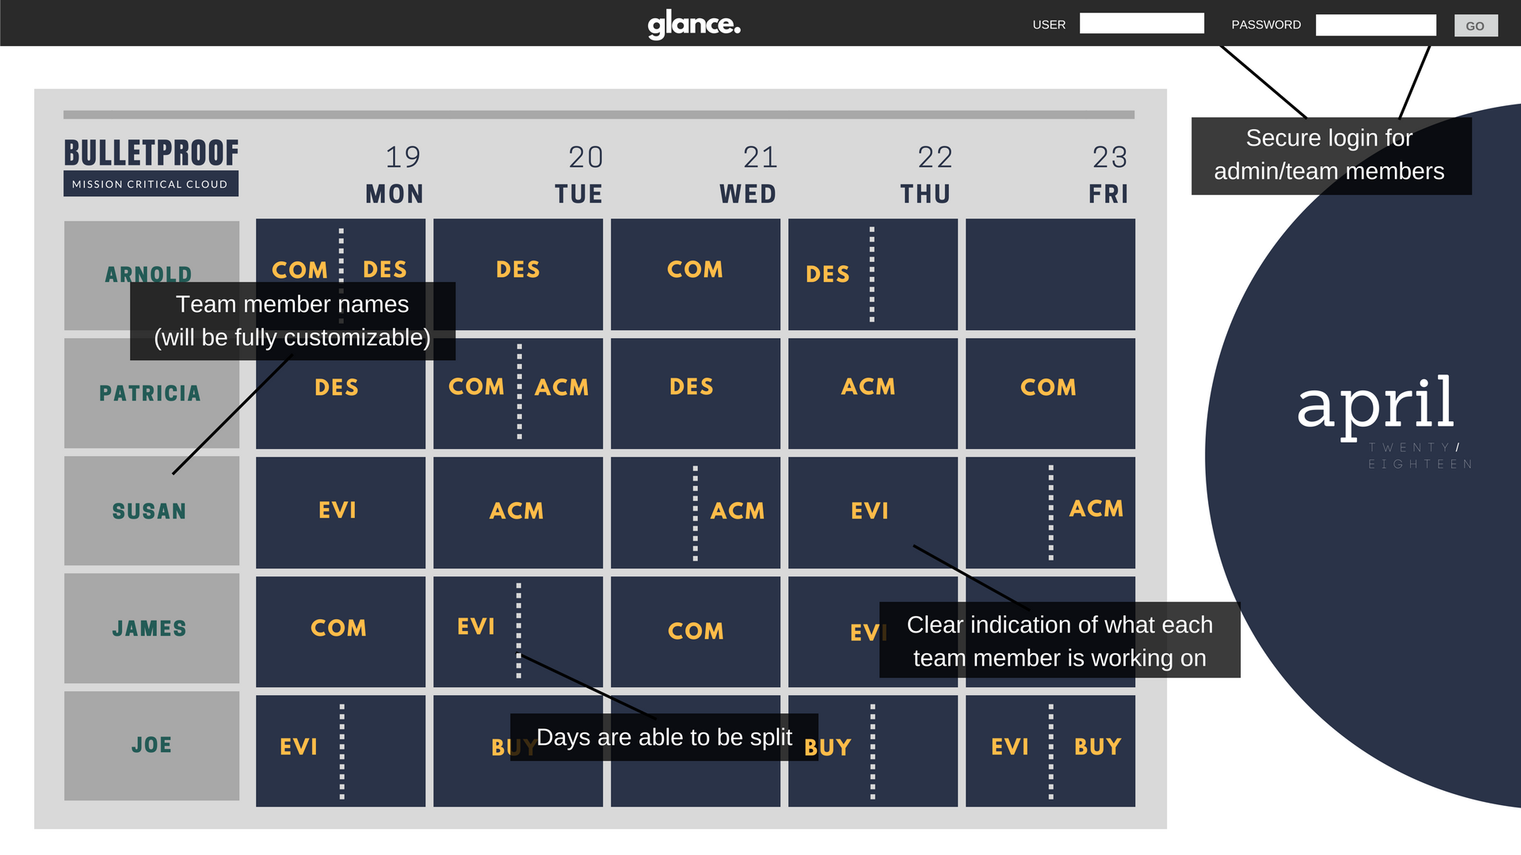

DESIGN
REQUIREMENTS
Customizable number of team members and clients
Login functionality
Auto-generate client list with associated team members
Simple and easy to use and understand UI/UX.
Visualisation
Notes:
Dan
Design core components were expressed explicitly by client.

Slide 5
METHODOLOGY
Agile Scrum
Why?
Familiarity
Benefit of monitored timed iterations
Project requirements (flexibility)
Client satisfaction
Notes:
Junha
Considerations
Waterfall (wasn't client friendly, needed to be able to adapt as client expressed interest in adding further functionality later in project dev)

Slide 6
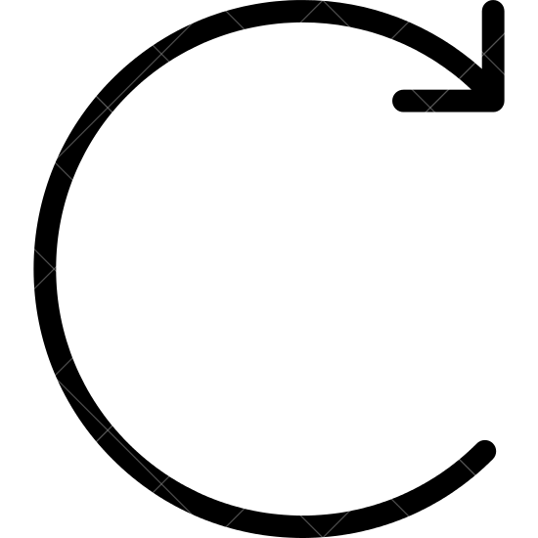

PROJECT PLAN
PRODUCT BACKLOG
WEEKLY STANDUP
SPRINT BACKLOG
User Stories
1-WEEK
POTENTIALLY SHIPPABLE PRODUCT INCREMENT
- Access calendar
- Account login
- Add client
- Add team member
- Generate client list
- Create database
2-WEEK
SPRINT
- Add login
- Create account
Notes:
All
Minimum viable product by sprint 8 (working application for presentation and feedback)
Sprint planning and retrospective at the start and end of each two week sprint
Client meeting each sprint
Weekly standup tuesday (10-11) and group work thursday (10-2)

Slide 7
THANKS!
Any questions?

