Slide 1
Live-Cell Tracking using Phase Stretch Transform
Mark Kubiak
Tristan Melton (504727735)
Can Vu

Slide 2
Division of Labor

Slide 3
Outline
Introduction
Background
Phase Stretch Transform (2D)
2D PST Mathematical Description
Project
Extension to 3D PST
Results
Show output of PST
Compare with other types of edge detectors
Conclusion

Slide 4
Background
Live Cell Imaging is the study of living cells using time-lapse microscopy
essential to advance the understanding of the cellular dynamics which influence cell fate
Currently, there is a lack of automated software tools for live-cell detection, tracking, and quantification suitable for long term time-lapse microscopy experiments
Although long-term imaging is possible, issues like phototoxicity hinder the process
One novel technique is to employ Phase Stretch Transform (PST)

Slide 5
Phase Stretch Transform: Introduction
PST is a physics-inspired, computational approach to signal and image processing with applications to feature detection and classification
Transforms an image by emulating propagation of EM waves through a diffractive medium with frequency dependent refractive index
The phase of the transform has properties which are useful for detection of edges and sharp transitions of an image
PST functionally operates similarly to phase-contrast microscopy
PST has an inherent equalization ability that gives a response ideal for feature detection in low contrast, visually impaired images
Has roots in photonic phase time stretch technique
Employs temporal dispersion to slow down, capture, and digitally process fast waveforms in real time
Notes:
PST is a fundamentally different approach to algorithm design. Whereas algs in CS are designed by ,athematics, the PST seeks to emulate physics and apply it to imaging

Slide 6
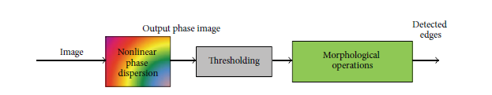
Phase Stretch Transform: Mathematical Description
In this method, the input image is smoothed using a localization kernel and passed through a 2D,nonlinear, frequency dependent phase function
PST can be described in the frequency domain as…
Argument is defined as the stretch operator and is a complex quantity
Edge Detection in Digital Images Using Dispersive Phase Stretch Transform (source)
Notes:
-P and q are two dimensional frequency variables and A is the phase image
-
-The function L is the frequency response of the localization kernel and K is the frequency dependent phase
- r= sqrt(p^2+q^2) = arctan(q/p). S and W are parameters to be designed w

Slide 7
Phase Stretch Transform: Mathematical Description
A common phase kernel used is one in which the kernel phase derivative is linear or sublinear
An example of such a phase derivative profiles is the inverse tangent function
Parameters S and W of the kernel control the edge detection process
In this method, there is a tradeoff between noise and spatial resolution in edge detection
Larger S results in better noise performance but lower spatial resolution; Larger W results in better resolution but also increases the noise
Once the PST is applied, the image is further post-processed.
For edge detection, post-processing can include cutting negative phase values, thresholding, and morphological operations
The image edges can be extracted by thresholding the PST output phase image
Edge Detection in Digital Images Using Dispersive Phase Stretch Transform (source)
Notes:
-W and S need to be adjusted (whether manually or optimized) to suit the needs of the application

Slide 8
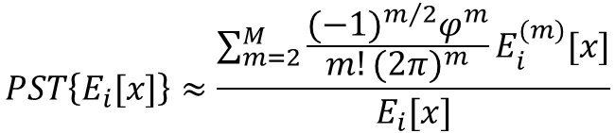
Phase Stretch Transform: Mathematical Description
PST functionality can be understood through the closed form expression in the 1D case under some simplifying assumptions
Output of the PST is related to the even-order derivatives of the input with weighting factors
Each derivative detects a different feature
Weighting factors can be designed to detect different features of interest
The output of PST is inversely related to the brightness (valid for small phase)
Output is larger for lower light regions of the image
This property equalizes the input brightness and allows for more sensitive feature detection and enhancement
$$PST\left\{E_{i}[x]\right\}≈\frac{\sum_{m=2}^{M}{\frac{{(−1)}^{m/2}φ^{m}}{m!{(2π)}^{m}}E_{i}^{(m)}[x]}}{E_{i}[x]}$$
Feature Enhancement in Visually Impaired Images (source)
Notes:
E[x] here is the brightness
PST is a reconfigurable operator that can be tuned to detect certain features

Slide 9
Extending the Algorithm to 3D
Add and describe code changes here

Slide 10
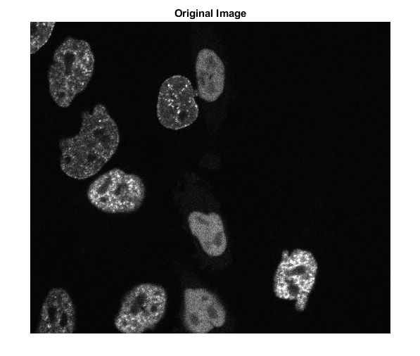
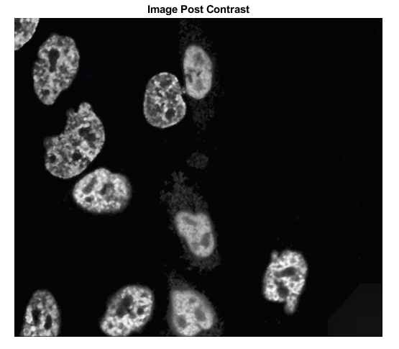
Effect of PST on Original Image
Below is a single frame of the data set
To improve the image post PST, we up the contrast of the original image before passing it through the PST
Notes:
-P and q are two dimensional frequency variables
-The function L is the frequency response of the localization kernel and K is the frequency dependent phase
-

Slide 11
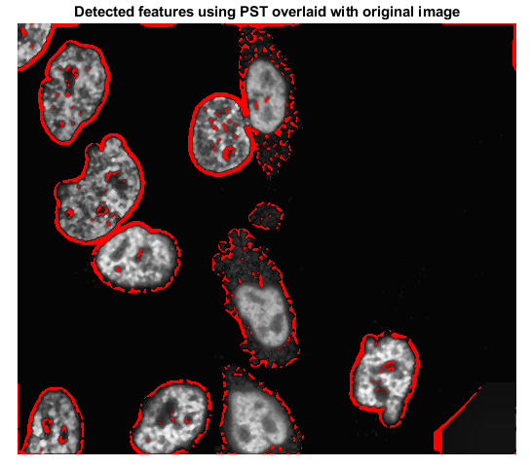
Overlaying PST Output on Original Image
The red outline is the features outputted by the PST overlaid on the original image

Slide 12
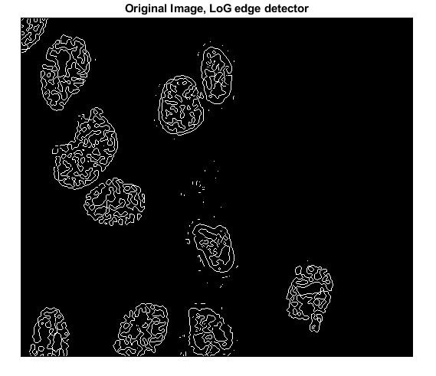
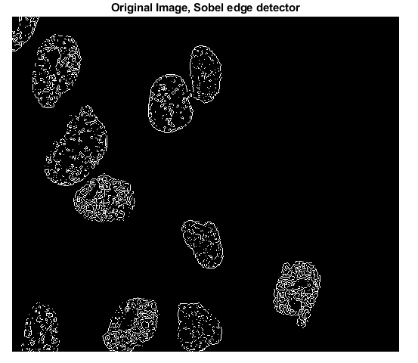
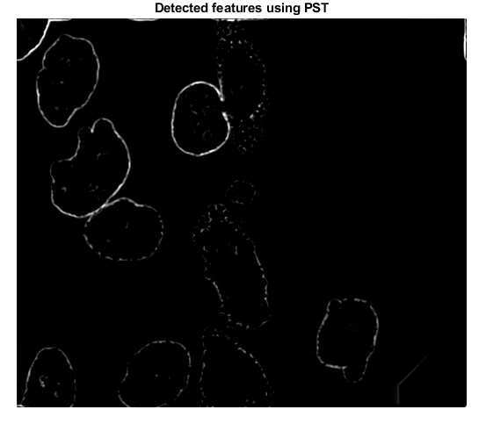
Comparison of PST to other edge methods
PST captures edges in low contrast areas where other detectors fail to do
This is due to PST’s inherent brightness equalization property
Notes:
-P and q are two dimensional frequency variables
-The function L is the frequency response of the localization kernel and K is the frequency dependent phase
-

Slide 13
Tracking the Cells over Time
To track cells over time, we are working on a solution based on centroid detection

Slide 14
Conclusion

