Slide 1
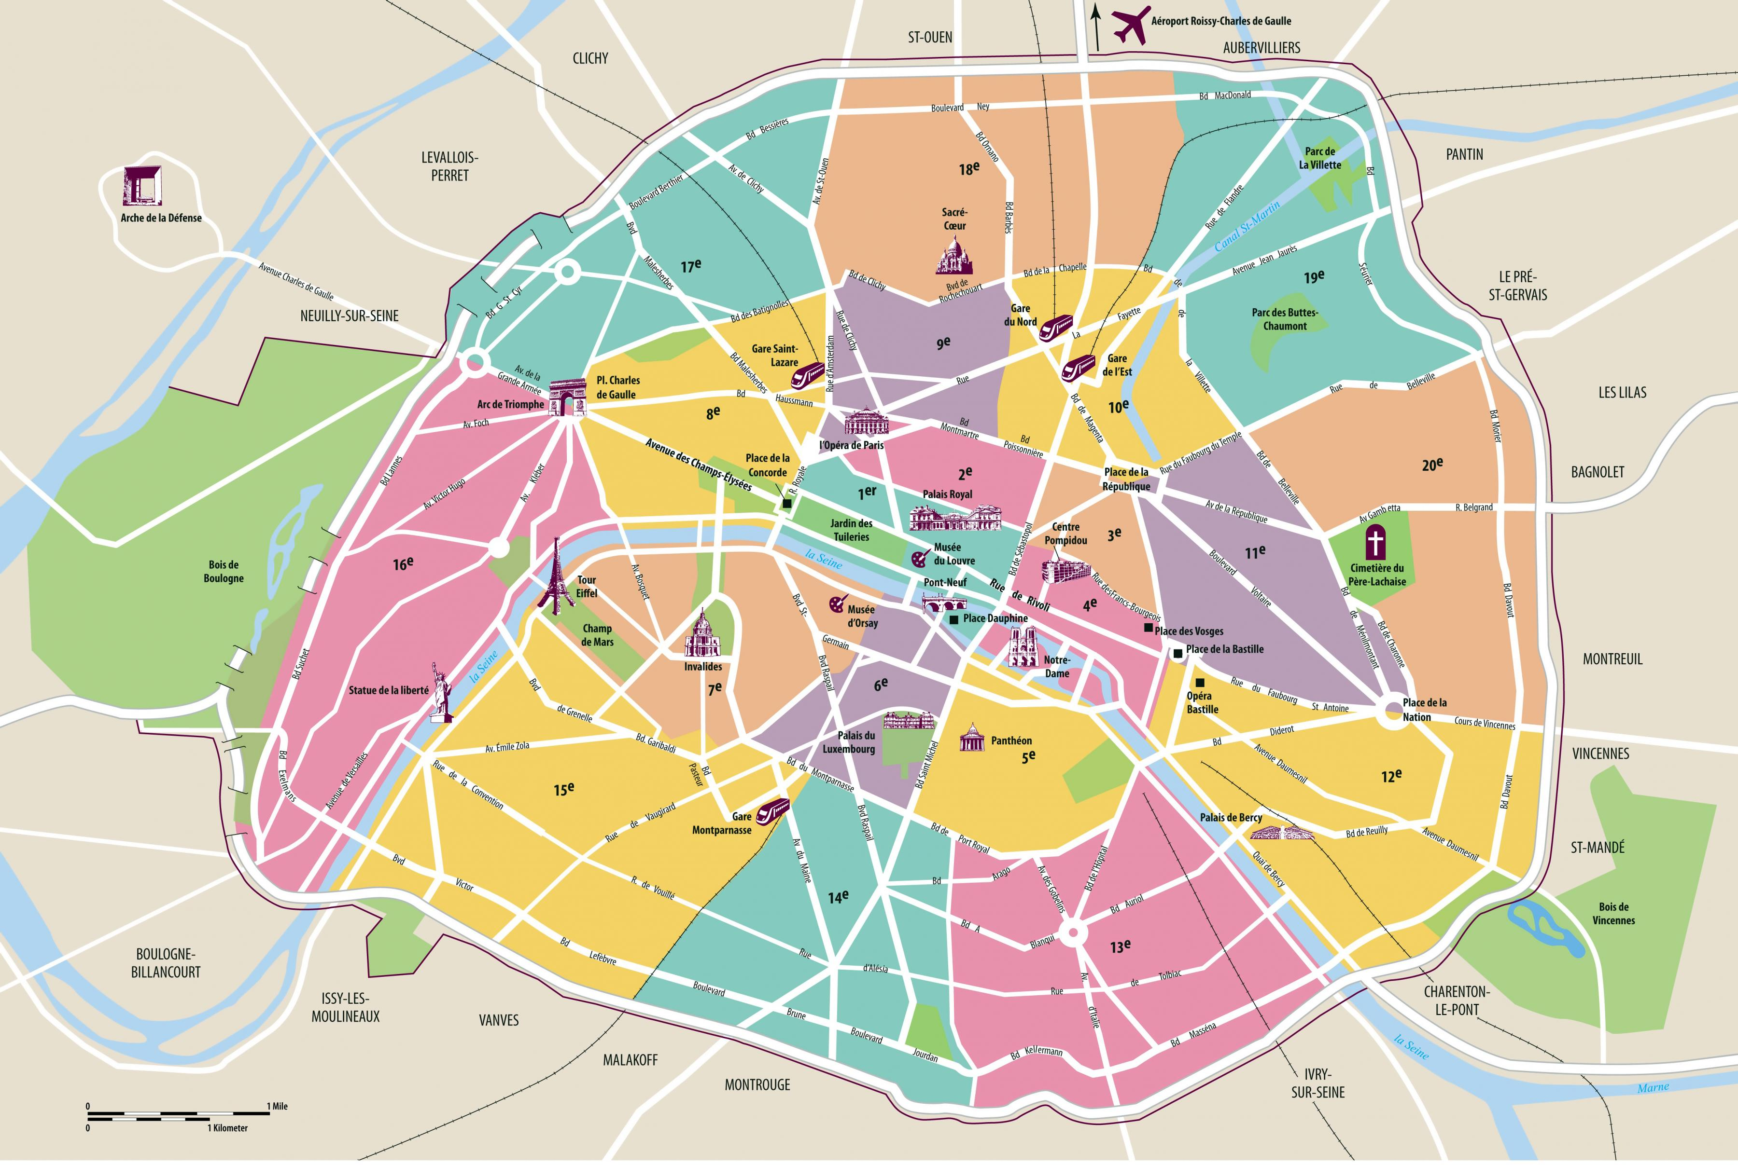
Barbes
Stalingrad
Etoile
Concorde
Trocadero
Chatelet
Bir-Hakeim
Nation
Vaugirard

Slide 2
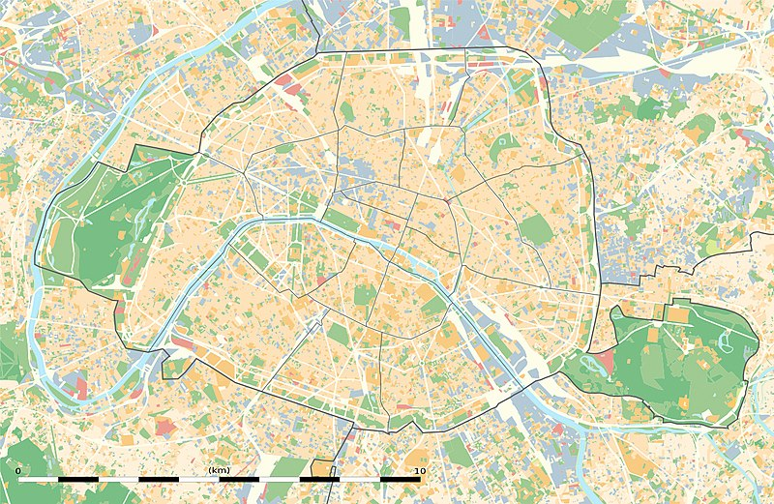
Barbes
Stalingrad
Etoile
Trocadero
Concorde
Chatelet
Bir-Hakeim
Nation
Vaugirard

Slide 3
Barbes
Stalingrad
Etoile
Trocadero
Concorde
Chatelet
Bir-Hakeim
Nation
Vaugirard

Slide 4
Barbes
Stalingrad
Etoile
Concorde
Trocadero
Chatelet
Bir-Hakeim
Nation
Vaugirard

Slide 5
Barbes
Z
Stalingrad
Etoile
Y
Trocadero
Concorde
Chatelet
Z
Bir-Hakeim
Y
Nation
Vaugirard

Slide 6
Etoile Y | x | x | x | x | x | x | barbes | x | x | x | x | x | x | Stalingrad Z
X | x | x |  |  |  |  | X |  |  |  |  |  |  | X
X |  | X | X | x | X |  | X |  |  |  |  |  |  | X
X |  |  |  |  | x |  | X |  |  |  |  |  |  | X
X |  |  |  |  | x | X | X |  |  |  |  |  |  | X
X |  |  |  |  |  | x | X |  |  |  |  |  |  | X
X |  |  |  |  |  |  | X |  |  |  |  |  |  | x
Trocadero |  |  |  |  |  | x | concorde | X | x | x | x | X | X | chatelet
X |  |  |  |  |  | X |  |  |  |  |  | X |  | X
X |  |  |  |  |  | X |  |  |  |  |  | X |  | X
X |  | x | x | x | x | X |  |  |  | x | x | X |  | X
X |  | X |  |  |  |  |  |  |  | X |  |  |  | X
X |  | X |  |  |  |  |  |  |  | X |  |  |  | X
x |  | X |  |  |  |  |  |  |  | X |  |  |  | x
Bir Z | x | x | x | x | x | x | vaugirard | x | x | X | x | x | x | Nation Y

Slide 7
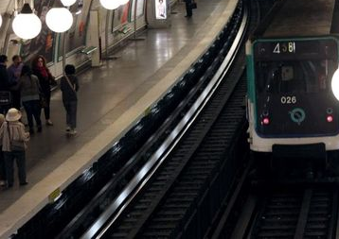
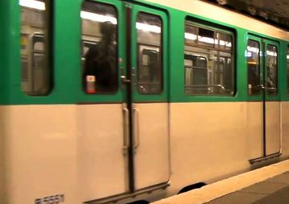
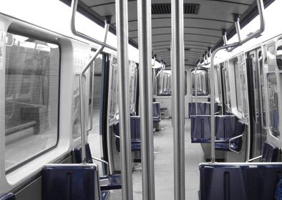
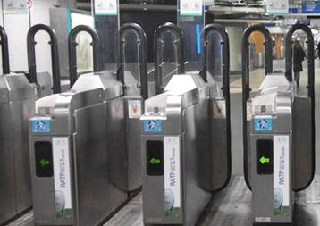
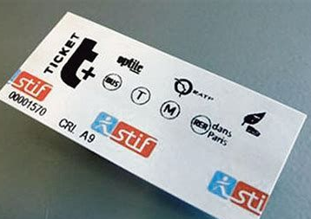
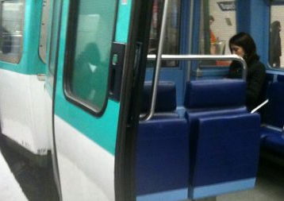
ARMES
ARME : rails
ARME : porte
ARME : barre
ARME : tourniquet
ARME : ticket
ARME : strapontin

Slide 8
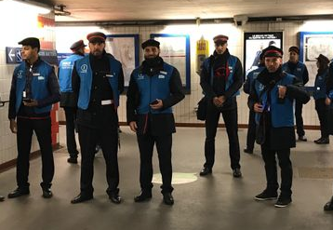
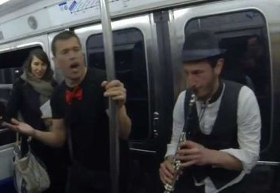
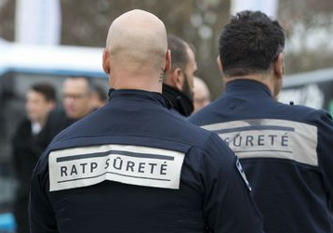
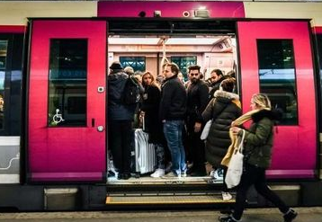
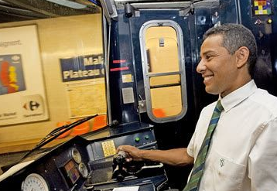
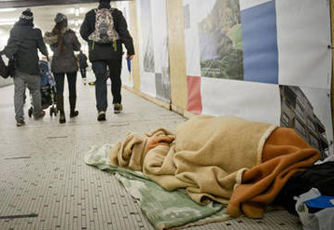
SUSPECTS
SUSPECT : contrôleur
SUSPECT : musicien ambulant
SUSPECT : agent de sécurité
SUSPECT : passager
SUSPECT : conducteur
SUSPECT : SDF

