Slide 1
Checkers Project
FA24 - SDEV265 - Team 3
Team 3 Members: Nolan Renie, David Lemmons, Joseph Moto, Tristan Shore

Slide 2
Table Of Contents
01
Requirements Document
06
User Documentation
02
Feasibility Study
07
Tool List for Project
03
Project Plan
08
Application Component Summary
04
Risk Assessment
09
Screenshots of Application
05
Design Document
10
Future Enhancements to the Project

Slide 3
Playable game of checkers with two modes:
Local multiplayer
Bot opponent with difficulty options
User Requirements
System Architecture
Procedurally coded in Python
System Evolution
Dev methodology: Waterfall-Agile Hybrid
Coding Completion Date: Week of Thanksgiving
Appendices
Lists the used software and hardware.
Requirements Document
Defines some basic requirements for the Checkers Project
Notes:
https://docs.google.com/document/d/1pHZcKVaBKlgWt5vRMklplOBwIN3rU4Kek1TxG9SPq_0/edit?tab=t.0

Slide 4
It's a game of checkers containing local play and bot play
It is definitely achievable
Technical Feasibility
Legal & Economic Feasibility
Checkers is not copyrighted
Not intending on profit
Operational Feasibility
The project could be done with a smaller team
Six members may have a “too many cooks” situation
Time Feasibility
We chose checkers due to its simplicity
Feasibility Study
Evaluates the realistic completion of project
Notes:
https://docs.google.com/document/d/1l7qUzaSvZHTIoSmf4OXJesNo2euT3UQUDkZmMgST6sM/edit?tab=t.0

Slide 5
Lists every possible risk to the project’s completion and defines them
Risk Identification
Risk Analysis
Lists how severe failing each of the above tasks would be to the overall project
Risk Planning
Summarizes preventative measures for risks
Work Breakdown
A weekly schedule on what needs to be done
Project Plan
Gives intro to project and Risk Assessment
Notes:
https://docs.google.com/document/d/1bknRYkZ2wZZf4Z37lZjOvVaBj8LupkkU3toI0Mtbzhc/edit?tab=t.0

Slide 6
Lists every possible risk to the project’s completion and defines them
Risk Identification
Risk Analysis
Lists how severe failing each of the above tasks would be to the overall project
Risk Planning
Summarizes preventative measures for risks
Work Breakdown
A weekly schedule on what needs to be done
Risk Assessment
The project plan uses the same material, I don’t know why its required
Notes:
https://docs.google.com/document/d/1LOgF1C9z9Zp9aIT3JGDv6HkqAhR_zL6W/edit

Slide 7
Model
View
Controller
Architecture
UML
The model is on a following slide
UML Use Case
The model is on a following slide
Test Cases
Lists test cases of likely
Design Document
Mostly diagrams or tables
Notes:
https://docs.google.com/document/d/1Tkoa52e_DyO2wA5OMB9aCrhrTROfdU177iNpbXo4KqI/edit?tab=t.0

Slide 8
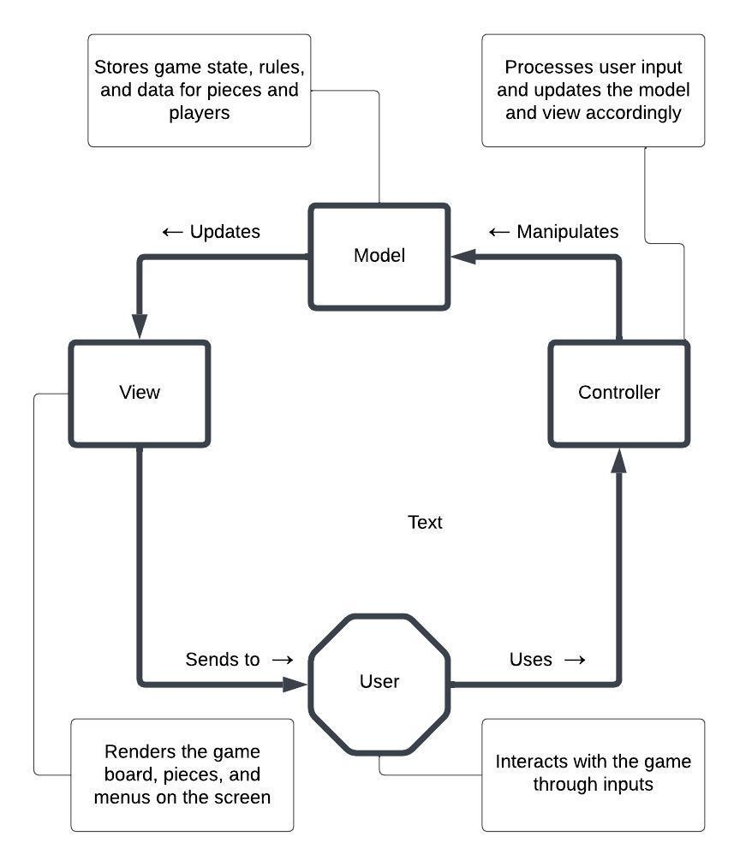
Design Document - Architecture
In this Pygame application, the MVC architecture can be visualized as follows:
Model: Contains classes for Game, Board, Piece, and Player to manage game data, rules, and player information.
View: Uses the UI class to render the user interface, displaying the board, pieces, and various menus.
Controller: The main game loop acts as the controller, handling user input and updating the model and view based on player actions.
Notes:
https://docs.google.com/document/d/1Tkoa52e_DyO2wA5OMB9aCrhrTROfdU177iNpbXo4KqI/edit?tab=t.0

Slide 9
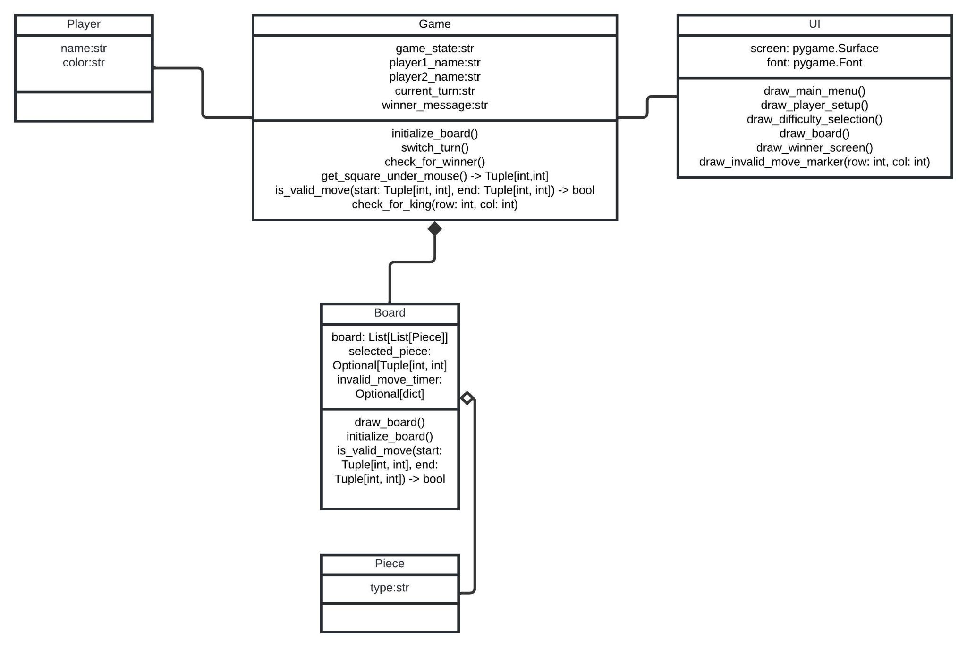
Design Document - UML
Notes:
https://docs.google.com/document/d/1Tkoa52e_DyO2wA5OMB9aCrhrTROfdU177iNpbXo4KqI/edit?tab=t.0

Slide 10
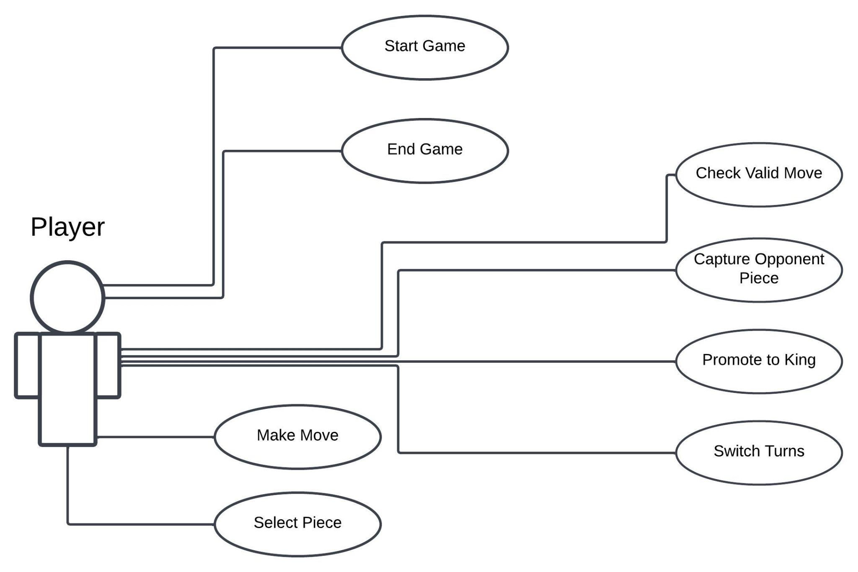
Design Document - UML Use Case
Notes:
https://docs.google.com/document/d/1Tkoa52e_DyO2wA5OMB9aCrhrTROfdU177iNpbXo4KqI/edit?tab=t.0

Slide 11
Local multiplayer
Bot mode with three difficulties
Compatible with and IDE the supports Python
Project Summary
Installation
Download the Program
Open in IDE
Run the Program
Game Operation
Main Menu
Local PLay
Bot PLay
Quit
Troubleshooting
Detailed instructions in the User Documentation
User Documentation
Contains brief project summary, install guide, basic operation, and troubleshooting
Notes:
https://docs.google.com/document/d/1O04Hrs2D8xlsHXW7JSG6dYjRlSwmGMtxC3hFc5Dgm0E/edit?tab=t.0

Slide 12
Coded in Python
Used pygame, sys, time, random, and copy imports
Visual Studio
GitHub
Sharing Project
Redundancy with text documents
Discord
Communication
Google Drive
Document creation
Tool List for Project

Slide 13
Successful
Local Play
Bot Play
Successful
Additional Features
None added, suggestions are listed later
Application Component Summary
Evaluating if we completed all goals set for project

Slide 14
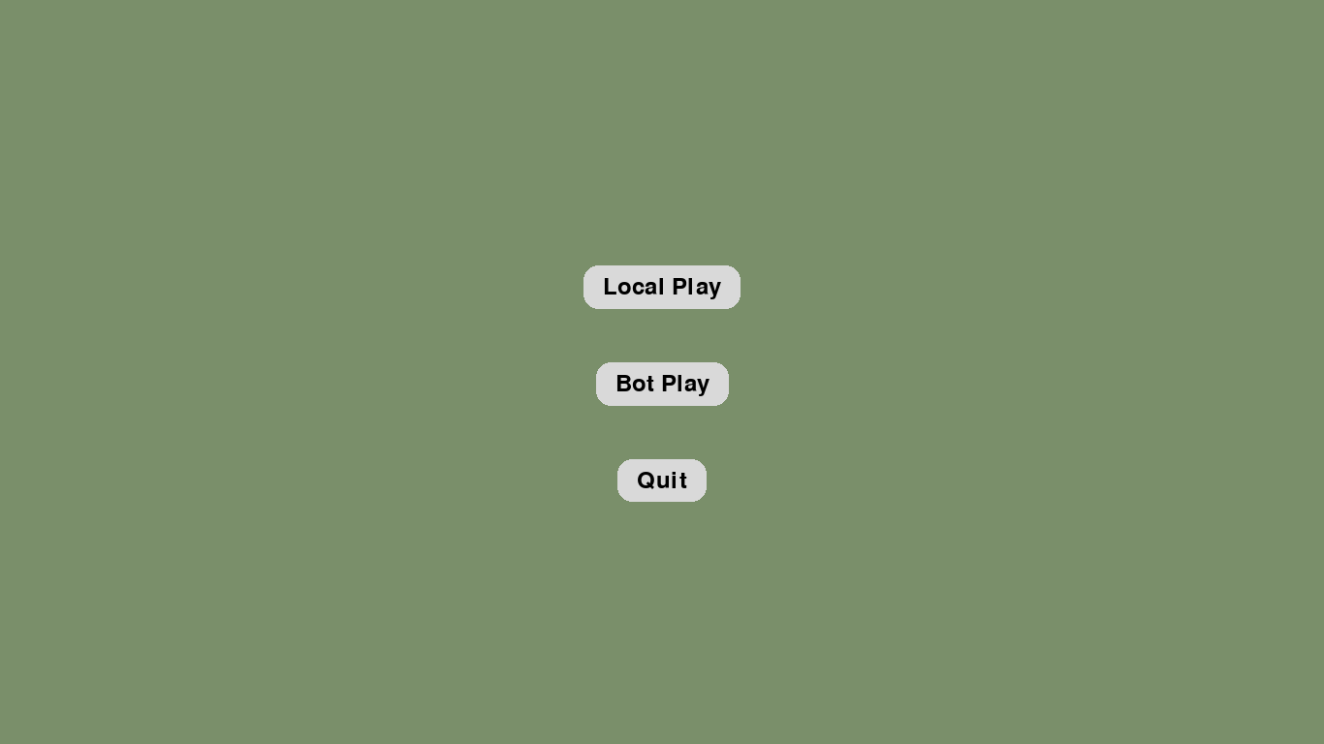
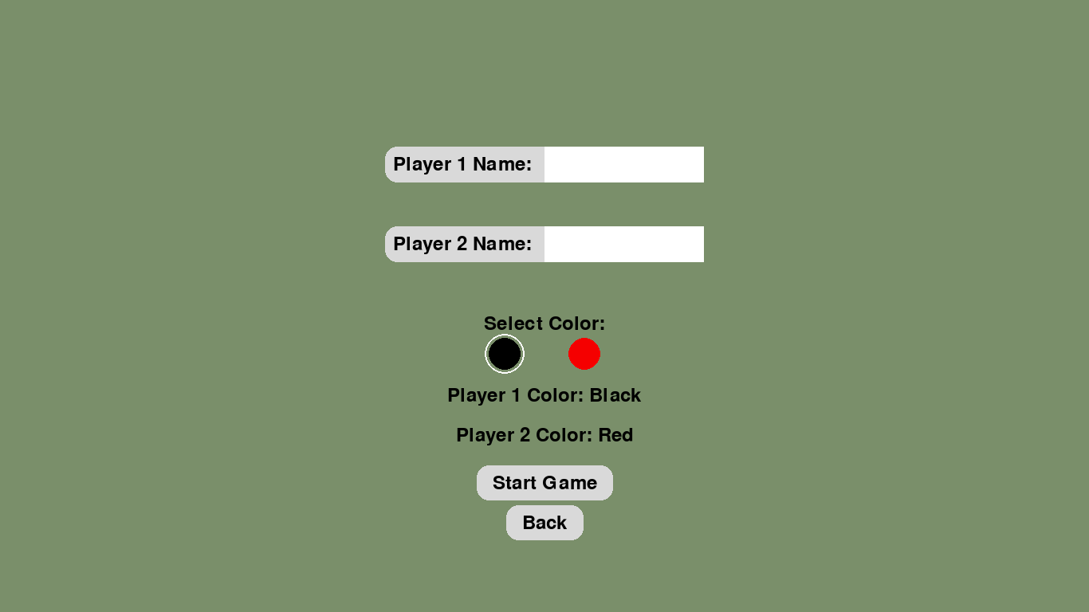
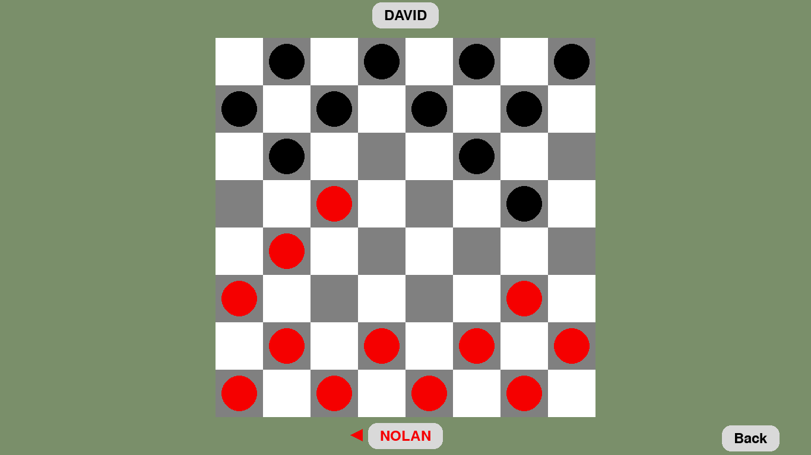
Screenshots of Application
The screenshots provided are of a two person local game and the main menu. The following slide will have pictures of the win screen and of the bot play screens.

Slide 15
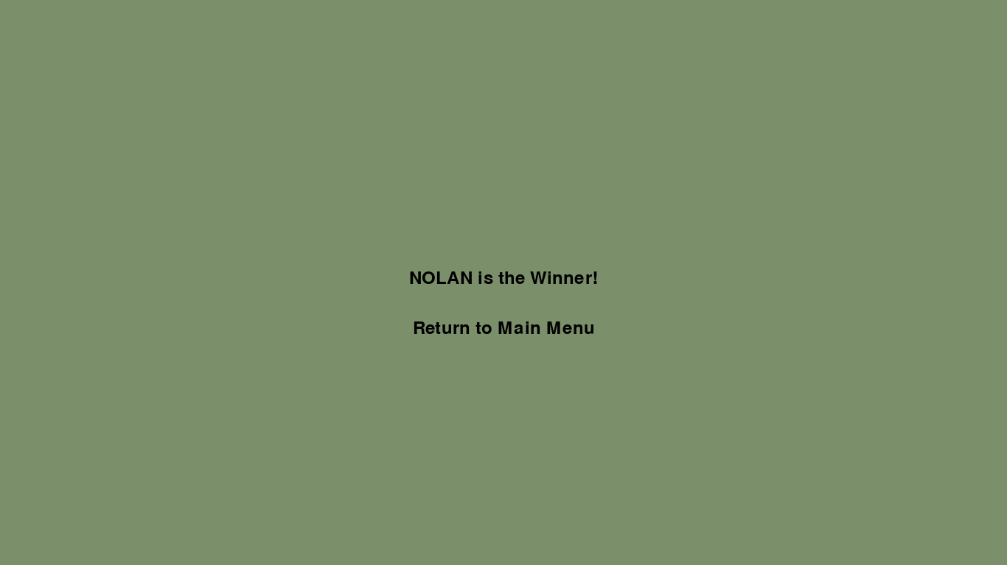
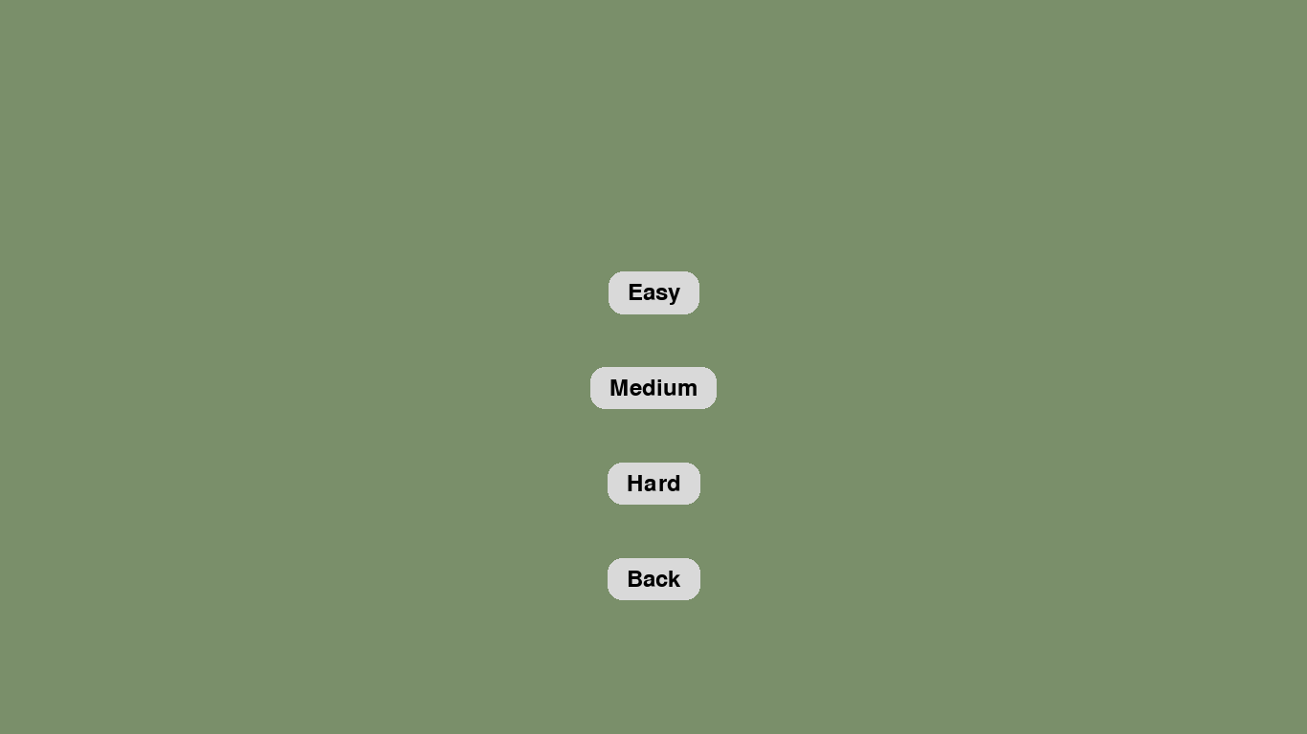
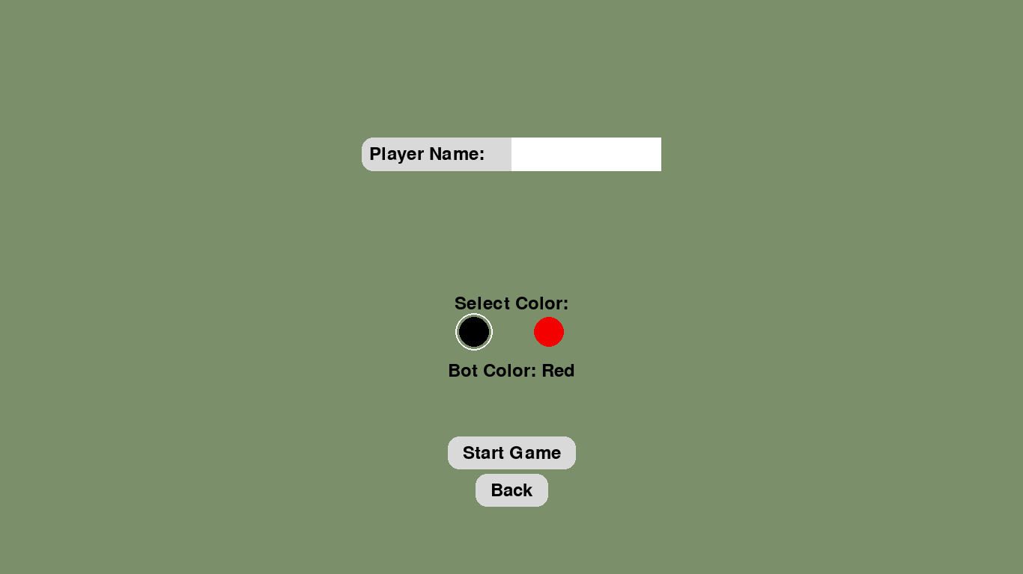
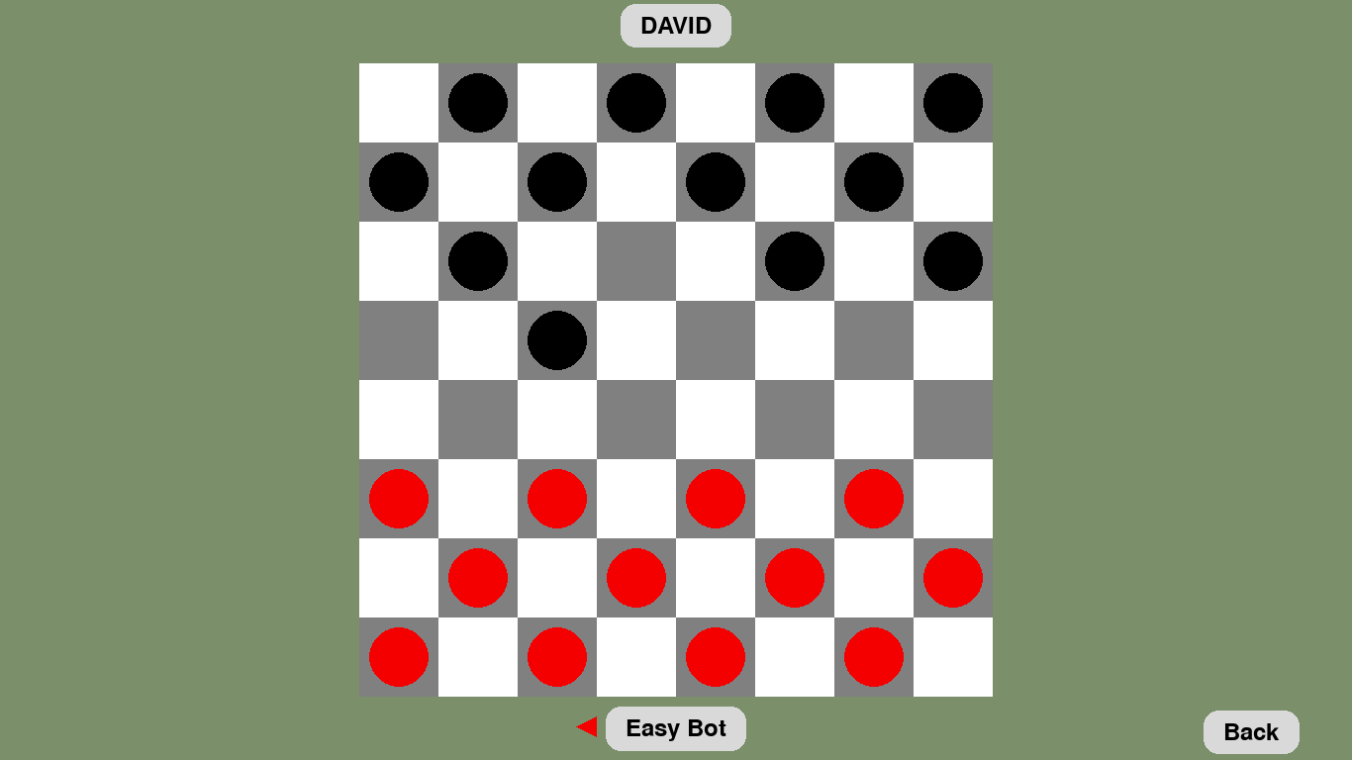

Slide 16
SFX for pawn selection and placement
Soundtrack
Audio
Animations
Sliding movement for pawns
Select movement for pawns
Quality of Life
Fullscreen or windowed option
Future Enhancements to the Project

Slide 17
Questions?

