Slide 1
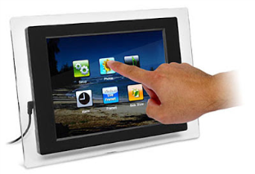


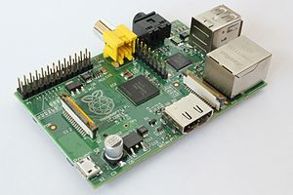






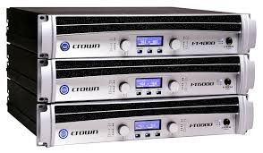
Touchscreen by sink to control all functions
Network switch (10/100Mbit is fine)
Router ??
IP Camera for security surveillance monitoring doorway
USB, HDMI
Lighting Controller
Relay
Raspberry Pi
Relay
Door Module
Insane amounts of
RGB lighting
Relay
RFID reader and servo
motor for turning the doorknob
Window Module
Input Sources: PC’s, TV, WX/FM Radio, Bluetooth A2DP, Voice Announcements
Audio Module
Window blind opener
and basic weather sensors
Amplifiers

Slide 2
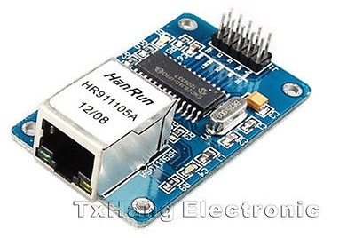
Topology
The system is based on Ethernet. Each module has network hardware and communicates to the Raspberry Pi (server) via simple sockets.
Ethernet is highly supported, cheap, expandable, and easy to implement on the Pi and in software
Need to develop a network protocol for communication between server and devices. Must be two-way so the Pi can push commands (“turn light 2 on”) and respond to requests from devices (“which lights are on?”)
Communication with phones and computers from an outside network should be supported, maybe via HTTP for easy integration in web applications.

Slide 3
The Pi
The controller of the room
I’m still working on some custom server software that will run on the Pi and control everything. It’ll provide a web interface for control from our laptops and phones and a scripting interface to allow smart behavior to be programmed, e.g. “If the door is opened, activate lighting, but not after 11PM.”
Has a touchscreen with a GUI interface placed somewhere in the room

Slide 4
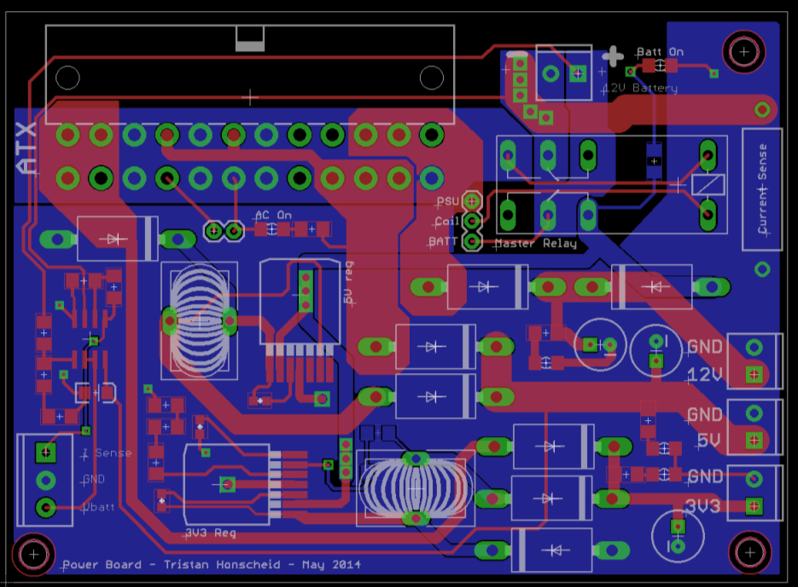
Power
Not shown in the diagram
Located near the Pi will be a computer PSU and backup battery that will provide 12V, 5V, and 3.3V for powering each module. Each rail will run around the perimeter of the room with taps going to each device.
Considered PoE, but most of the modules will require lots of power: the window module will have a big motor to pull up the blinds, the lighting controller will require lots of power for RGB strips, and the audio amplifiers need a bit.
Power board CAD drawing ready shown.
Provides current sensing, auto
backup transfer, and voltage
regulation.

Slide 5
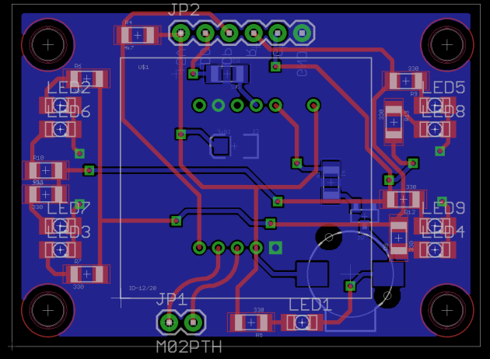
Door Module
RFID reader goes on outside. https://www.sparkfun.com/products/11827
Will read the MIT Card (125khz)
Authenticates with Pi Controller
If access granted, servo on inside of door will pull on knob and open door.

Slide 6
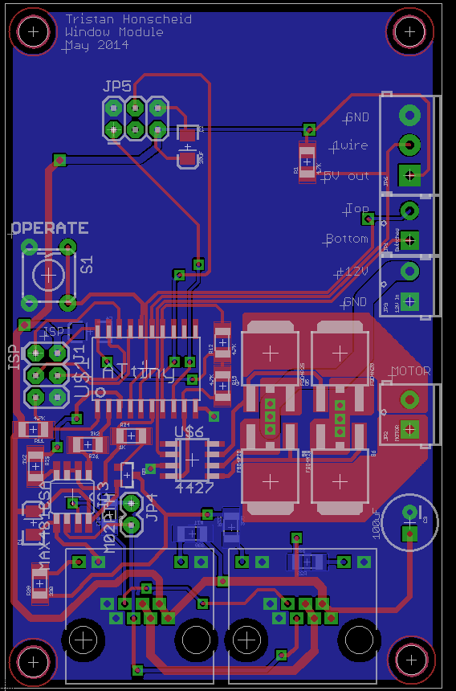
Window Module
Controls a motor that opens the blinds and also has some weather sensors to monitor the outdoors

Slide 7
Lighting Controller
Not sure yet about this one since I don’t know how we want to light the room.
I anticipate providing a lot of LED and RGB channels for strips, accent lights, and so on.
Quality LED lighting can get expensive but Chinese options on eBay are very inexpensive.

Slide 8
Audio Module
A programmable mixer/audio matrix that takes several sources…
Sound from computer/laptop soundcard output
TV audio line out
On-board FM radio chip
On-board Bluetooth receiver for streaming music over the air from a phone or tablet
Pi’s voice announcements, e.g. alarms, warnings, reminders.
…and outputs them to an amplifier/speaker. Programmable volume and mute of each channel

