Slide 1
Distributed Systems in Cloud
Yuzhe (Richard) Tang

Slide 2
Introduction

Slide 3
Two questions to start with
When it comes to “Cloud”, what is first thing coming to your mind?
And … what’s new in/with Cloud?

Slide 4



Conventional computer | Cloud system | Defining features
Hardware/Architecture | LARGE # of servers: Cluster/rack/servers Commodity hardware Is-one-computer: Homogenous hardware One organization Perf. | Large scale Error prone Performance variability
Software systems OS: resource mngt(FS, mem), concurrent prgm App: compiler, db | GFS, HDFS, BigTable → Spanner (NewSQL) ElasticSearch/Titan Memcached MapReduce→YARN: Impala/Spark/Hive Pregel/Giraph S4/Storm/Flume Chubby, Zookeeper Other: Scheduling, VM/Hypervisor, … | Scalability Elasticity, power efficiency CAP: Fault tolerance, availability, consistency Performance: SLA Trustworthy, secure Integrity, authenticity Data confidentiality
Users/Services | Iaas/PaaS/SaaS SLA Pay-as-you-go (Utility) Cheap Popularity | Dynamic workloads Cost-saving Big-data Always-on, accessible anywhere and anytime Don’t be evil
1
3
2

Slide 5
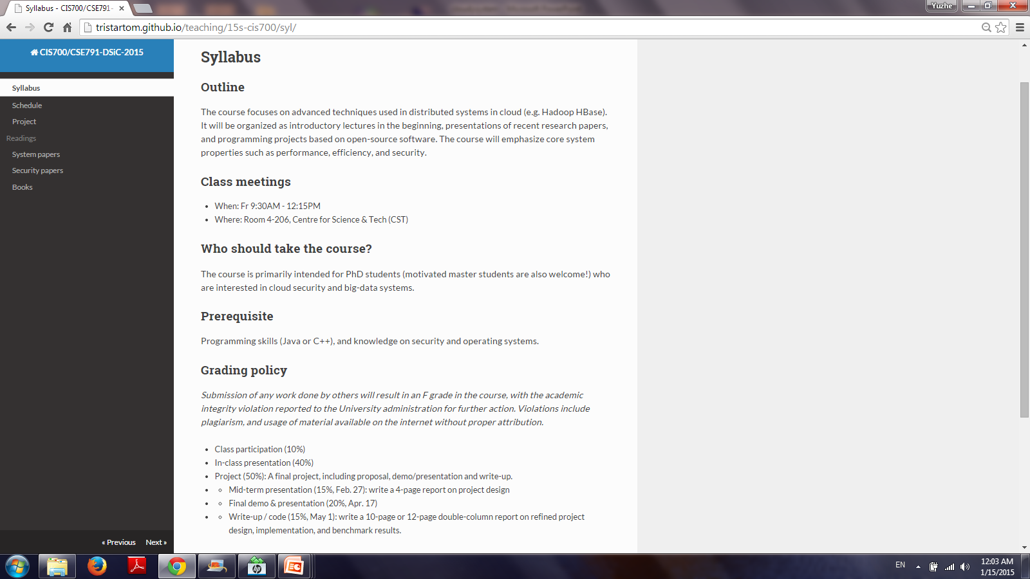
Course logistic and administrivia

Slide 6
Overview of introductory lecture
1
Cloud services
Cloud architecture
Cloud systems
Warehouse scale computer
2
3

Slide 7
Cloud services

Slide 8
Cloud services
IAAS (Infrastructure As A Service) :
The base layer: Virtual Machines, Storage (Hard Disks), Servers, Network, Load Balancers etc
IaaS Examples: Amazon EC2, Windows Azure, Rackspace, Google Compute Engine.
PAAS (Platform As A Service) :
On top of IAAS: Program runtimes, databases (mySql), web servers (tomcat)
PaaS Examples: AWS Elastic Beanstalk, Windows Azure, Heroku, Salesforce.com, Google App Engine, Apache Stratos.
SAAS (Software As A Service) :
On top on PAAS: user-facing apps; just use, no worry about maintenance.
SaaS Examples: Google Gmail, Google docs, Facebook, Microsoft Office 365.

Slide 9

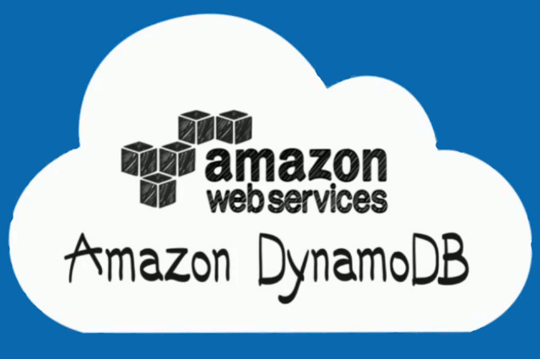
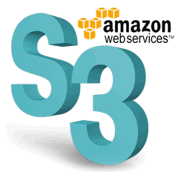
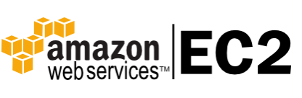
Cloud services: the case of AWS (Link)
SaaS
PaaS
IaaS

Slide 10
Cloud architecture

Slide 11
Cloud architecture
Cluster level: racks connected by one cluster-level switch
Rack level: 42 blade servers layered one above another, connected by a local Ethernet switch (1~10 GPS).
Server level: inside a blade enclosure, multiple units connected thru PCI bus.
Multi-core CPU, internal cache, local shared DRAM, directly attached disk drives

Slide 12
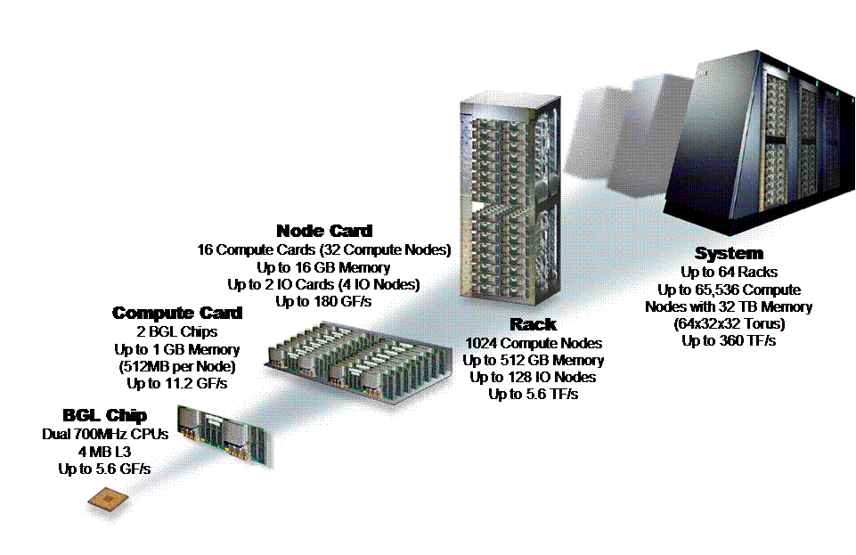
Cloud architecture
Typical organization
Node Card
16 compute, 0-2 I/O cards
Compute Card
2 chips
Chip (node)
2 processors
System
64 Racks
Rack
32 Node cards
© Timothy Mark Pinkston, José Duato

Slide 13
Cloud architecture: Networking (1)
Fundamental challenge:
How to interconnect 100K nodes using commodity switches?
Switch price goes super-linearly with port counts.
Cost too much by using one huge switch
Thus two-level switches at rack- and cluster-levels
Rack-level switch connects 40 servers inside a rack
Rack-level switches use uplinks to one cluster-level switch

Slide 14
Cloud architecture: Networking (2)
Characteristic: Cluster-level bandwidth is scarce
Intra-rack is faster, cheaper than inter-rack
Implication to software/programmer: be aware of rack-level locality

Slide 15
Cloud architecture: Networking (3)
Three-level fat tree topology
Cluster-level switch becomes the bottleneck
Oversubscribing network at cluster-level switch

Slide 16
Cloud networking: Other challenges
SDN: network virtualization
Idea: pulling control plane (intelligence) out of data plane.
In database, the idea is to separate schema and data store.
In computer, the idea is to virtualize computing unit from HW
SDN enables software controlled network management, and simplifies it.
Important: VM in cloud causes connection endpoints to float, making network management increasing complicated.
Comparing cloud, HPC network’s more demanding
Use of high-end Infini-band
Networking at CPU level.

Slide 17
Cloud architecture: Storage (1)
Two layout options:
NAS: Network attached storage
Dedicated cluster for storage service
Better security, easier to outsource
Disk collocated with computing units
Disk drives attached to individual servers
Better locality: adopted by GFS, HDFS

Slide 18
Cloud architecture: Storage (2)
Storage medium
HDD:
Class: desktop-class, enterprise-grade
Characteristics: fault rate with variance
SSD: NAND flash technology
SSD is displacing HDD, but still more $ per byte.

Slide 19
Commodity hardware used in cloud
How commodity?
Wimpy servers
Brawny servers
High-end servers

Slide 20
Wimpy servers
Use even slower CPU:
CPU for embedded system, mobile-class CPU,
The cases for slower CPUs and wimpy servers:
It is cheaper to buy slower CPUs for the same throughput.
Many applications are memory- or IO-bound
Slower CPUs are more power efficient:
Power decreases by O(k²) if CPU frequency decreases by k.
Systems:
FAWN project[8]: Key-value storage on Flash memory with less powerful cores.
Industry: AMD SeaMicro [1], HP Moonshot [74]

Slide 21
Brawny versus wimpy servers
Wimpy server: Atom-based embedded machines
Brawny server: Xeon-based servers
The cases against wimpy servers
Hardware cost versus software cost
CPU cost versus networking cost
Challenging to schedule if smaller server/bins
Bottom-line:
The sweet spot is to favor low-end range of server-class machines (or high-end personal computers)

Slide 22
Cloud architecture: performance
x

Slide 23
Interaction btwn network and storage
Network perf. is so improved that locality does not even matter (much) in the disk tier.
Remote memory access (thru network) is faster than local disk IO.
Data locality matters at Flash level and above in storage hierarchy

Slide 24
Cloud software systems

Slide 25
Cloud software systems
User-facing software
Programming framework
Hardware abstraction
Examples: GFS/HDFS, BigTable/Spanner/ElasticSearch/Titan, Memcached, MapReduce/YARN/Impala/Spark/Hive, Chubby/Zookeeper
System software: used by administrator
Maintenance by resource mgmt, scheduling, perf. monitoring/debugging
Deployment by image config./distr.
Examples: Dapper/Htrace/Xtrace, MS Autopilot, Google’s system health

Slide 26
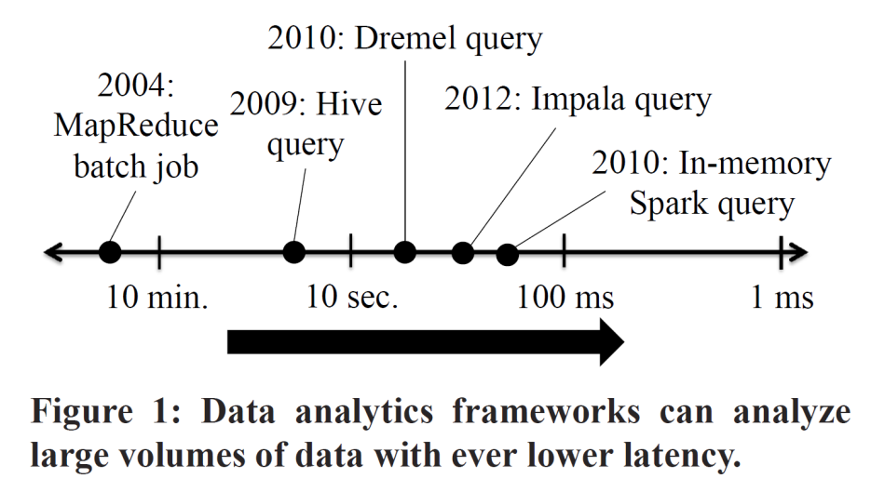
User-facing software: Programming frameworks
Why programming framework dedicated for cloud?
Handles all complexities introduced by large-scale cloud
Data sharding, distribution, fault tolerance
Present programmer an abstract and clean view
Programming framework: Computation
MapReduce: map()/reduce()
Hive: SQL
Drayd: DAG dataflow
Spark: parallelized dataset (RDD)
Pregel: Graph computations
Chubby/zookeeper: locking
Programming framework: Storage
BigTable, Dynamo, etc: put()/get()
Google FS, HDFS, etc: file abstraction
Titan: graph abstraction

Slide 27
MapReduce Programming Model
Input & Output: sets of <key, value> pairs
Programmer writes 2 functions:
map (in_key, in_value) -> list(out_key, intermediate_value)
Processes <k,v> pairs
Produces intermediate pairs
reduce (out_key, list(interm_val)) -> list(out_value)
Combines intermediate values for a key
Produces a merged set of outputs
From MapReduce OSDI09 slides

Slide 28
Example: Counting Words…
map(String input_key, String input_value):
// input_key: document name
// input_value: document contents
for each word w in input_value: EmitIntermediate(w, "1");
reduce(String output_key,
Iterator intermediate_values):
// output_key: a word
// output_values: a list of counts
int result = 0;
for each v in intermediate_values:
result += ParseInt(v);
Emit(AsString(result));
MapReduce handles all the other details!
From MapReduce OSDI09 slides

Slide 29
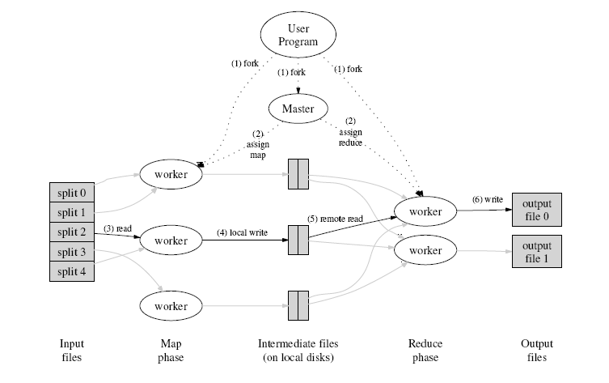
How does parallelization work?
INPUT
FILE(s)
From MapReduce OSDI09 slides

Slide 30
Hadoop MapReduce: A Closer Look
From CMU CS 15-440
Gregory kesden
Node 1
Node 2
Files loaded from local HDFS store
Files loaded from local HDFS store
InputFormat
InputFormat
file
Split
Split
Split
Split
Split
Split
file
file
file
RecordReaders
RR
RR
RR
RR
RR
RR
RecordReaders
Input (K, V) pairs
Input (K, V) pairs
Map
Map
Map
Map
Map
Map
Intermediate (K, V) pairs
Shuffling
Process
Intermediate
(K,V) pairs
exchanged by
all nodes
Intermediate (K, V) pairs
Partitioner
Partitioner
Sort
Sort
Reduce
Reduce
Final (K, V) pairs
Final (K, V) pairs
OutputFormat
OutputFormat
Writeback to local HDFS store
Writeback to local HDFS store

Slide 31
User-facing software: storage abstractions
Unstructured data storage
Structured data storage

Slide 32
Unstructured storage in cloud
Storing large data blobs
GFS/Closure[58,55,101]
Core design: fault tolerance
Where to replicate: avoid colocation in single fault domain.
How to replicate: extra data copy, or Reed-Solomon code

Slide 33
Structured storage in cloud: Databases
Scalable data store:
BigTable[26], Dynamo[36]: eventual consistency, sacrificed functionality
Megastore, Spanner: stronger-consistency, SQL-like functionality
Megastore[13]: synchronous writes
Spanner[32]: efficiently serialize globally distributed tx.
In-memory store: high-performance
Memcached[53]: a distributed cache on top of storage
RAMCloud[113]: storage purely in memory
Replicated on 3 remote memory units = stored on disk
FAWN-KV[8]: on SSD

Slide 34
Cloud storages by design principle
 | BigTable, Dynamo | Spanner, megastore | RAMCloud, FAWN-KV | Memcached
Consistency | ☹ | 😐 | ☹ | ☹
Richness of functionality | ☹ | 😐 | ☹ | ☹
Fault tolerance | ☺ | ☺ | 😐 | ☹
Performance | 😐 | ☹ | ☺ | ☺

Slide 35
System software: Monitoring/perf. debugging
Service-level dashboards
End-to-end request time
Quality of service (for SLA)
Performance debugging tools
Need to know “why” a service is slow
Per-node health monitoring

Slide 36
Perf. debugging in distributed systems
Tracing: track distributed execution of a request on multiple machines
Instrumentation systems:
Modify application/middleware to pass tracing info. across machine/component boundaries.
Pip, Magpie, X-trace and Dapper.
Black-box monitoring systems:
Observing network traffic.
Inferring the message correlations.
Profiling: resource utilization
By sampling performance counter
GWP: per-machine profile information combined with procedure identity (symbolic information in binary)
Which program uses memory the most?

Slide 37
Example: HBase tracing project
Client
YCSB
Other Hbase programs
YCSB is a service-level measurement tool
How long is a Get?
HTrace is a tracing tool
How long Get spend on ZK?
How long Get spend on RS?
…
Log collection
Log analysis
Log application
Client
HTrace
Servers
ZK
HMaster
RS
RS
RS
…

Slide 38
Example use of traces: Tail tolerance to achieve SLA
Traces are used to build detailed cost model
Performance variability in individual system components can not be ignored!
The effect accumulates as system scales.
Tackled by speculative execution

