Slide 1
Predictive Performance
Zhi Xing

Slide 2
On Predictive Modeling for Optimizing Transaction Execution in Parallel OLTP Systems

Slide 3
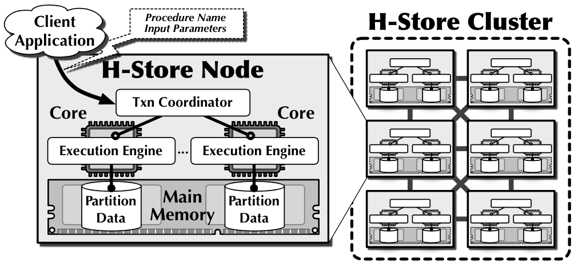
Introduction
Goal: optimize transaction throughput based on predictions
Online Transaction Processing (OLTP) workloads: short-lived, repetitive, highly concurrent, access small subset of data
Share-nothing parallel database
Notes:
Share-nothing parallel database: nodes share nothing, data is separated into partitions. Transaction coordinator manages single-thread execution engine, each with exclusive access to a data partition stored in memory. Clients initiate transactions by sending predefined procedure name and input to any node in the cluster.

Slide 4
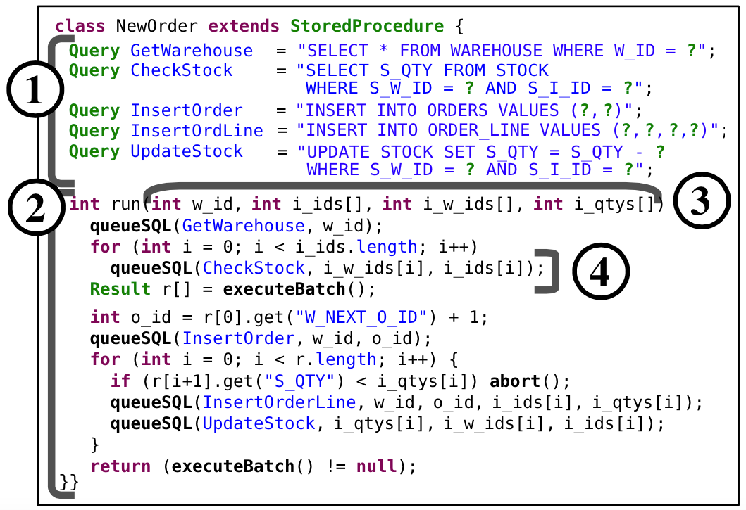
Introduction
Stored procedure-based transactions: effective for OLTP applications (reduce round-trips)

Slide 5
Transaction Optimizations
OP1 - Execute the transaction at the node with the partition that it will access the most
OP2 - Lock only the partitions that the transaction accesses
OP3 - Disable undo logging for non-aborting transactions
OP4 - Speculatively commit the transaction at partitions that it no longer needs to access
Notes:
OP1 - Transaction coordinator chooses which node to run the control code, the node’s partition is called the base partition - best base partition reduces data movements - determining the correct base partition can dramatically improve throughput and latency
OP2 - lock required partitions only, avoid overhead of deadlock detection and fine-grained row-based locking - access unlocked partition leads to abort, lock unaccessed partition leads to resource waste
OP3 - undo log (big overhead) only needed when abort (not for recovery in memory-only databases) - wrong prediction will corrupt data and halt the node, so must be careful with it
OP4 - for distributed transactions only (as oppose to signal-partition transactions) - save delay for two-phase commit. - speculatively execute other transactions: if other transactions only read, then can be committed directly, otherwise wait until the original distributed transaction commits. - wrong prediction: all speculatively executed transactions need to be aborted and restarted.

Slide 6
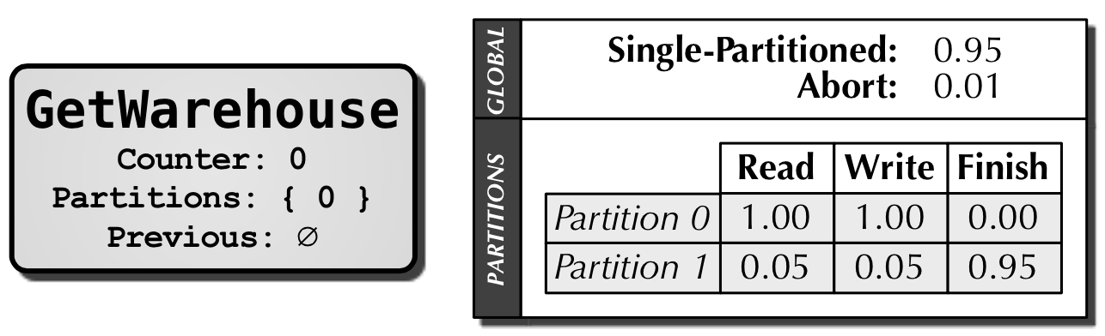
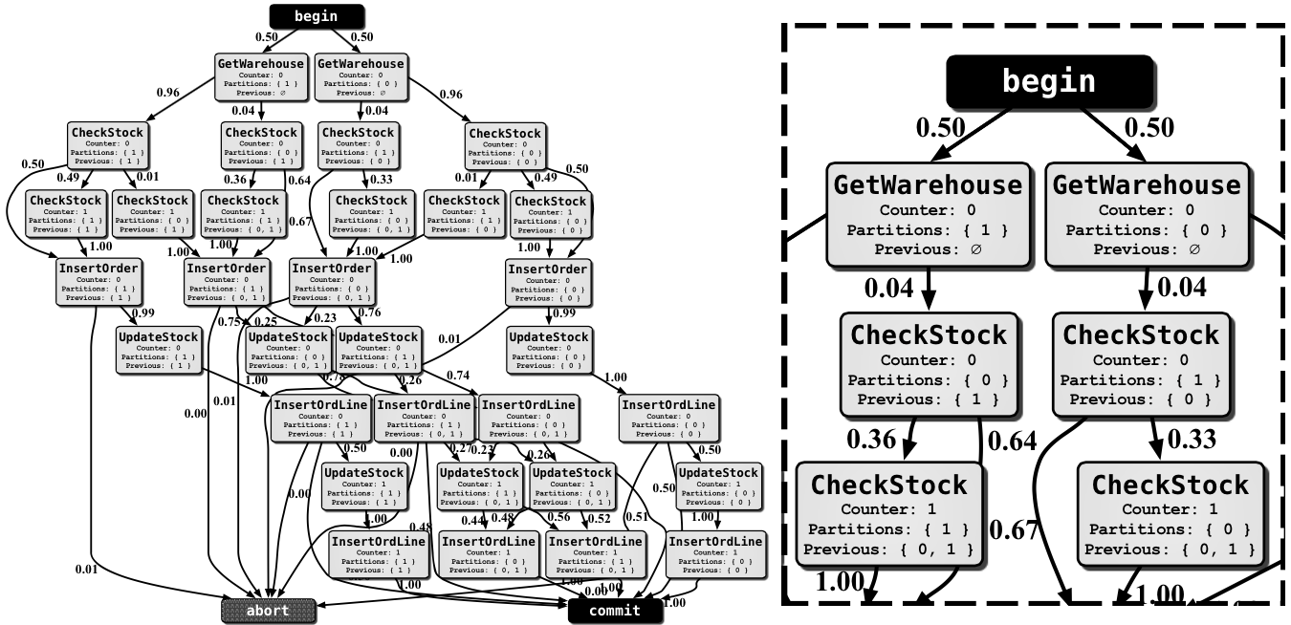
Transaction Models
Markov models
Generated from transaction histories (workload trace) - procedure input parameters - queries - query parameters
One model for each procedure

Slide 7
Notes:
Vertex: execution state (1) name of query (2) number of time executed (3) partitions being accessed (4) partitions previously accessed (5) table containing probabilities for predictions (used for choosing optimizations, 4 for 4)
Edge & Execution path

Slide 8
Model Generation
Construction phase - start with begin, abort, commit - add vertices and edges while going through each transaction
Processing phase - traverse bottom-up to calculate probabilities
Notes:
For example, probability of an edge = number of times edge is visited / number of times vertex is visited, for a partition that is not accessed in a state (vertex), read/write/finish probabilities are the weighted sum of children’s.

Slide 9
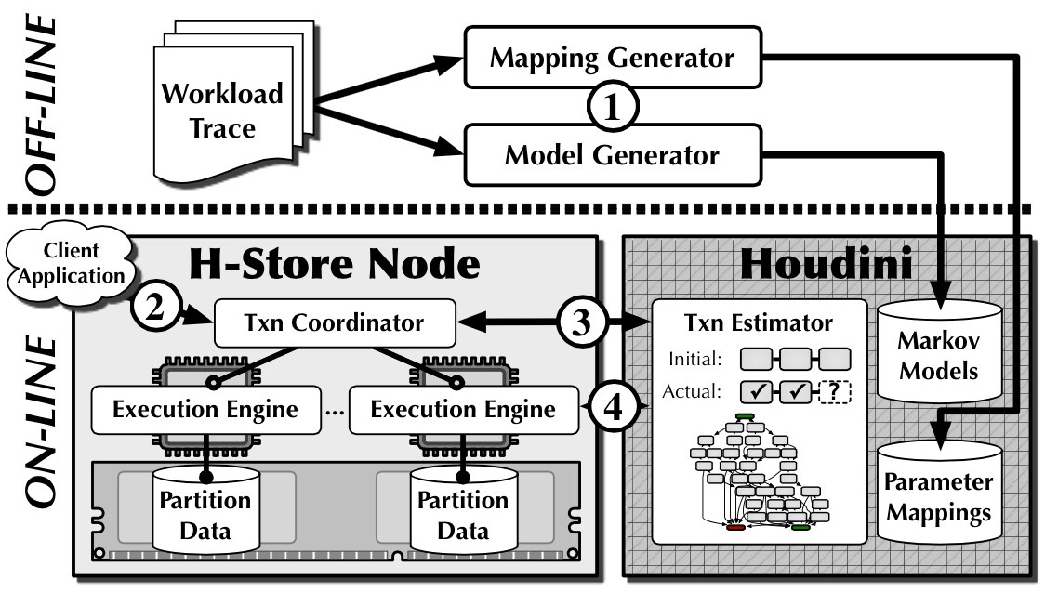
Predictive Framework
Notes:
Houdini run on each node, with all the Markov models generated offline for the application’s stored procedures. Based on the initial estimate of execution path, Houdini inform transaction coordinator which optimizations to enable.

Slide 10
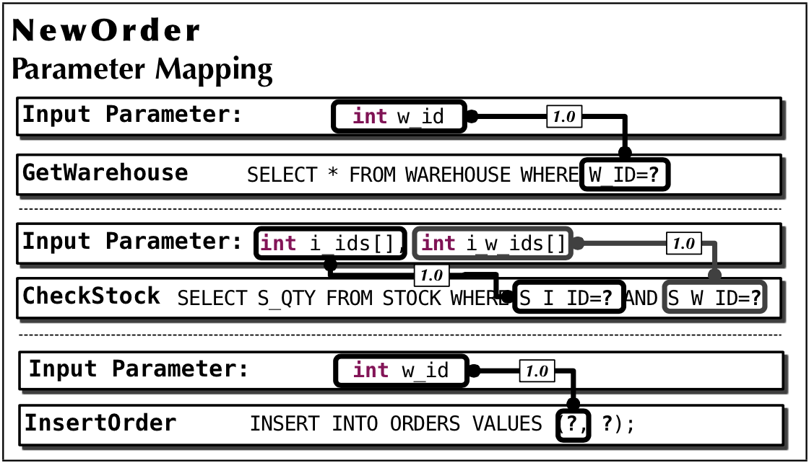
Parameter Mapping
Observation: query parameters for table partitioning attributes are often provided as procedure input parameters
For each pair of procedure parameter and query parameter - count the number of times they have the same value - mapping coefficient = count / number of comparisons
Notes:
Parameters in repeated queries are treated as different parameters, each element in an array is treated as different parameters. Threshold is set to filter out false positives.

Slide 11
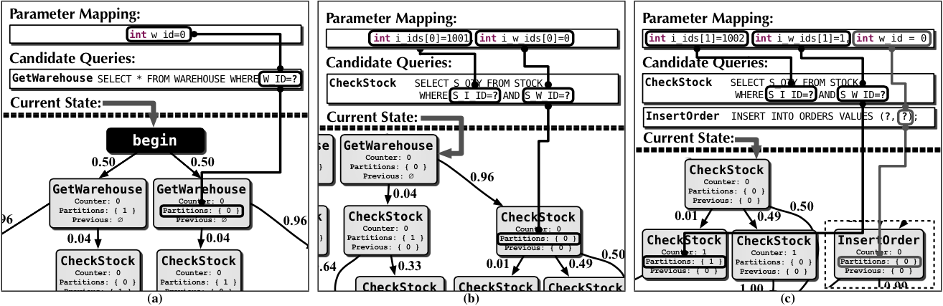
Initial Estimate of Execution Path
A state is valid if - partition to be accessed can be determined from the mapping - next state has the correct previous accessed partitions
Go to the valid state with the highest probability
Repeats until either abort or commit is reached

Slide 12
Optimizations
Initially based on initial estimate of execution path
Updated according to actual execution path
Confidence coefficients are calculated by aggregating the probabilities on the vertices
Notes:
For example, when a state is reached where the confidence value for commit is above the threshold, a speculative commit optimization maybe applied.

Slide 13
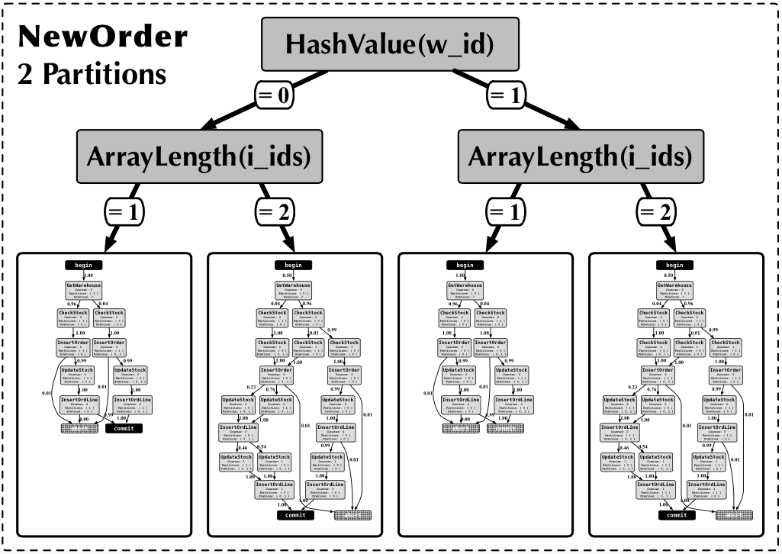
Model Partitioning
Limitation: too many useless states and transitions
Improvement: - cluster transactions - find the best clustering
Notes:
To improve performance, first cluster transactions using different features, which are extracted from procedure parameters, and find the best clustering that most effectively increase performance.

Slide 14
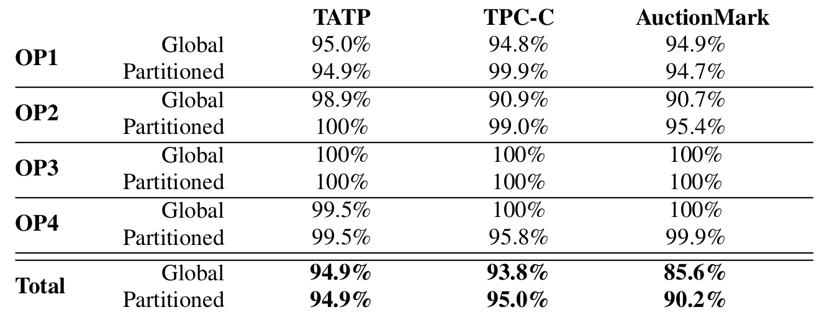
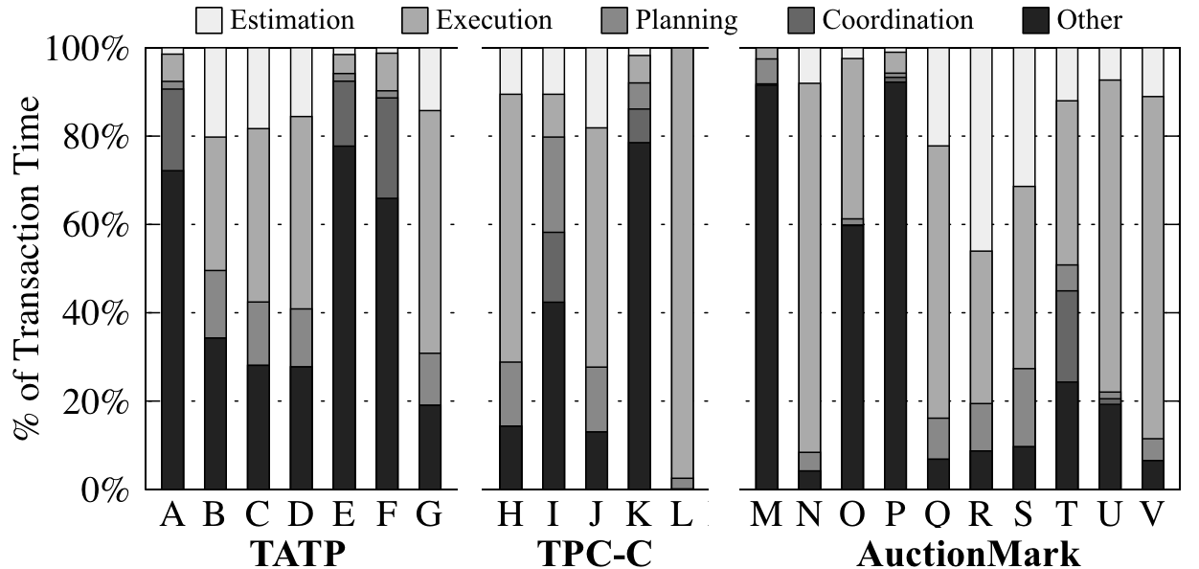
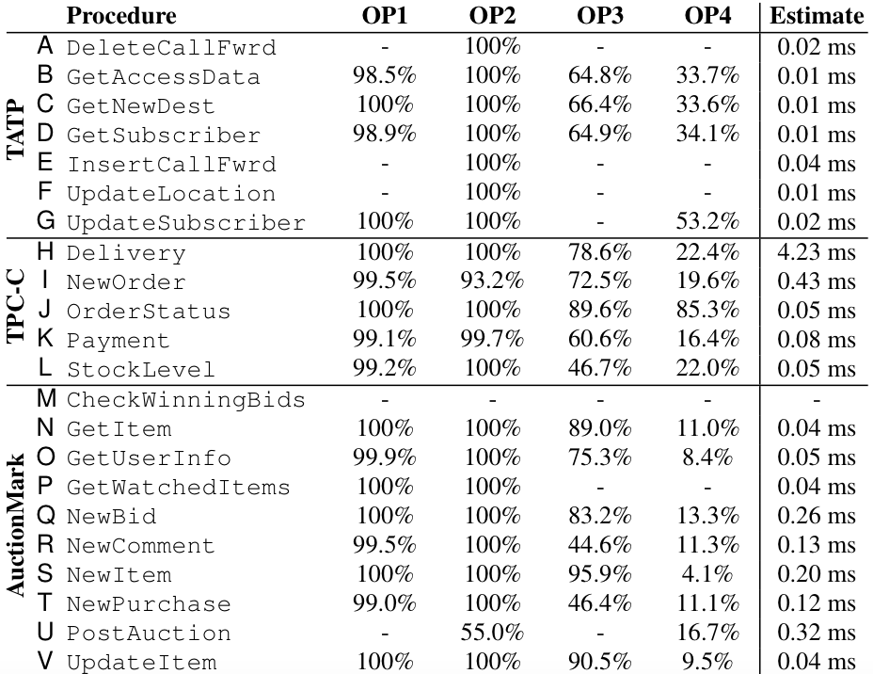
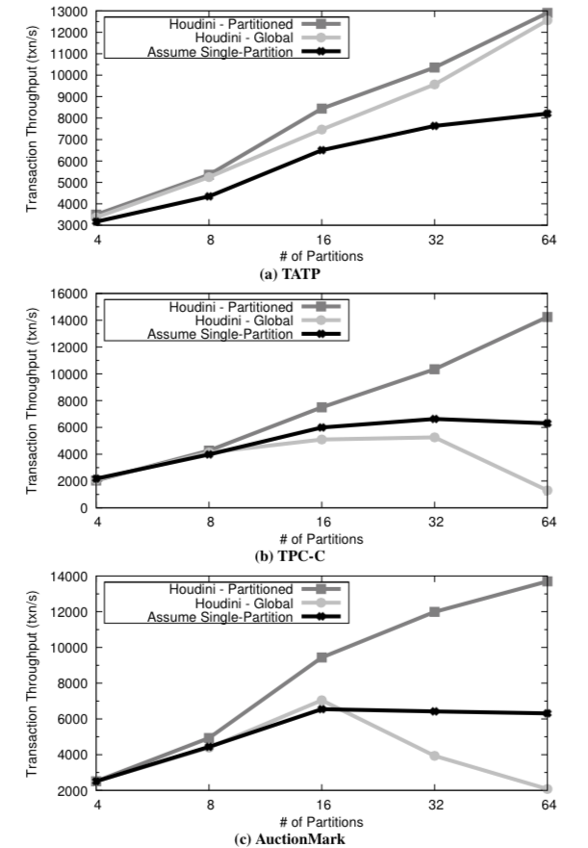
Experiments
Notes:
Experiments show that the framework greatly increase throughput.

Slide 15
Performance and Resource Modeling in Highly-Concurrent OLTP Workloads

Slide 16
Introduction
Goal: predict resource usage for concurrent workloads
Existing tools fail to model performance problems resulting from interactions between concurrent queries
OLTP workloads: high concurrency, complex interactions between transactions
DBSeer: produces models that accurately predict resource usage such as disk I/O, RAM, and locks (for MySQL)
Notes:
competition for different resources such as locks, cache, I/O, etc. non-linear effects

Slide 17
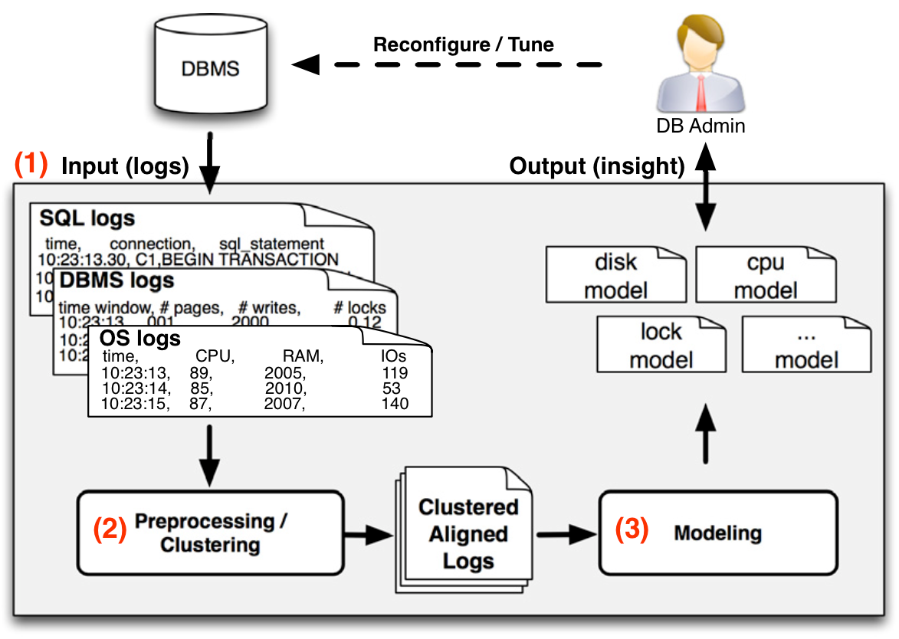
Overview
Notes:
Models accept a mixture (different fractions) of transaction types and a target TPS (transactions per second), and accurately answer attribution and what-if questions.

Slide 18
Preprocessing
Gather regular logs and statistics from - SQL query - DBMS (MySQL) - OS (Linux)
Transaction clustering - Extract transaction summaries (time, type of lock, accessed table, number of rows accessed) - Learn transaction types using unsupervised clustering
Estimate access distributions - Extract exact pages accessed from SQL logs - Calculate probability distribution of page by access (read/write) and by transaction type

Slide 19
Modeling Disk I/O and RAM
Log writes - proportional to the rate of each transaction type in the load (linear regression)
Log-triggered data flushes - log is full and needs to be rotated or recycled
Capacity misses - buffer pool is full

Slide 20
Capacity Misses
Create a list of N elements to represent buffer pool (Assuming RAM has N pages)
Derive access distribution for all the disk pages according to the transaction mixture
Randomly select pages according to the distribution
Simulate LRU cache policy, record the number of disk reads and writes
Calculate reads and writes per transaction per second

Slide 21
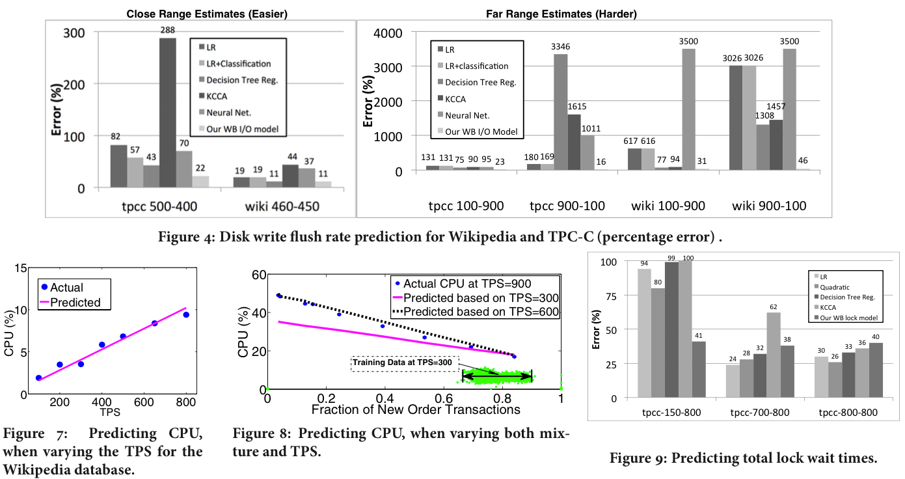
Experiments
Notes:
There’re other models for other resources in the paper, some of which are fairly simple. For example, linear regression is used for predicting CPU usage because CPU usage closely correlated with the number of queries served.
Experiments show that the models have very accurate predictions.

Slide 22
Some Other Researches

Slide 23
Towards Predicting Query Execution Time for Concurrent and Dynamic Database Workloads - predicting the execution time of a single query in a concurrent and dynamic setting
Uncertainty Aware Query Execution Time Prediction - add indication of uncertainty to the last paper - give predictions like “with probability 70%, the running time of this query should be between 10s and 20s”
Automated Analysis of Multithreaded Programs for Performance Modeling - predict performance for multithreaded programs such as DBMS (with different configurations)

Slide 24
Q & A

