Slide 1
Distributed Systems in Cloud (2)
Yuzhe Tang

Slide 2

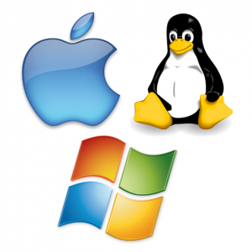

Conventional computer | Cloud system | Defining features
Hardware/Architecture | LARGE # of servers: Cluster/rack/servers Commodity hardware Is-one-computer: Homogenous hardware One organization Perf. | Large scale Error prone Performance variability
Software systems OS: resource mngt(FS, mem), concurrent prgm App: compiler, db | GFS, HDFS, BigTable → Spanner (NewSQL) ElasticSearch/Titan Memcached MapReduce→YARN: Impala/Spark/Hive Pregel/Giraph S4/Storm/Flume Chubby, Zookeeper Other: Scheduling, VM/Hypervisor, … | Scalability Elasticity, power efficiency CAP: Fault tolerance, availability, consistency Performance: SLA Trustworthy, secure Integrity, authenticity Data confidentiality Automated operations
Users/Services | Iaas/PaaS/SaaS SLA Pay-as-you-go (Utility) Cheap Popularity | Dynamic workloads Cost-saving Big-data Always-on, accessible anywhere and anytime Don’t be evil
1
3
2

Slide 3
Cloud software systems

Slide 4
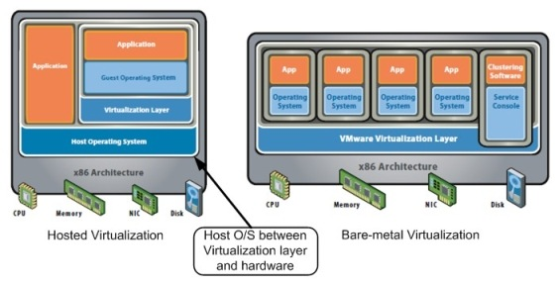
Layer of interest (w Virtualization)
System software: managing VM
From bare-metal HW to VM:
Hypervisor, guest OS, etc
Application software: using VM
From guest OS to service interface facing cloud users

Slide 5
Cloud software systems
User-facing application
Programming framework
Hardware abstraction
Examples: GFS/HDFS, BigTable/Spanner/ElasticSearch/Titan, Memcached, MapReduce/YARN/Impala/Spark/Hive, Chubby/Zookeeper
Management software: used by administrator
Maintenance by resource mgmt, scheduling, perf. monitoring/debugging
Deployment by image config./distr.
Examples: Dapper/Htrace/Xtrace, MS Autopilot, Google’s system health

Slide 6
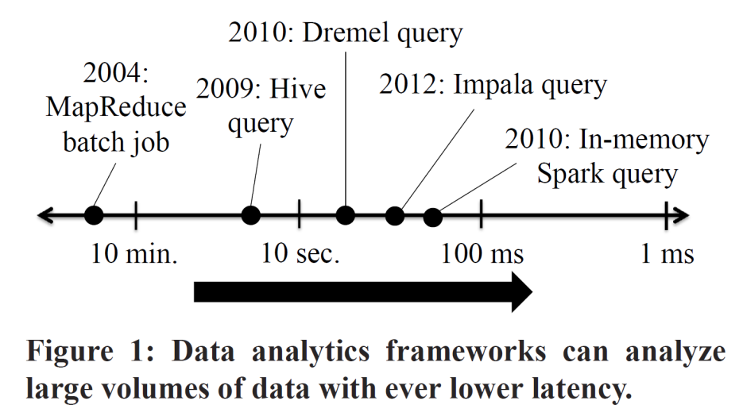
User-facing software: Programming frameworks
Why another programming framework?
Handles all complexities introduced by large-scale cloud
Data sharding, distribution, fault tolerance
Present programmer an abstract and clean view
Programming framework: Computation
MapReduce: map()/reduce()
Hive: SQL
Drayd: DAG dataflow
Spark: parallelized dataset (RDD)
Pregel: Graph computations
Chubby/zookeeper: locking
Programming framework: Storage
BigTable, Dynamo, etc: put()/get()
Google FS, HDFS, etc: file abstraction
Titan: graph abstraction
Google Spanner/F1: scalable database

Slide 7
MapReduce

Slide 8
MapReduce API: Programming model
Input & Output: sets of <key, value> pairs
Programmer writes 2 functions:
map (in_key, in_value) -> list(out_key, intermediate_value)
Processes <k,v> pairs
Produces intermediate pairs
reduce (out_key, list(interm_val)) -> list(out_value)
Combines intermediate values for a key
Produces a merged set of outputs
From MapReduce OSDI09 slides

Slide 9
MapReduce API example: Word counts
map(String input_key, String input_value):
// input_key: document name
// input_value: document contents
for each word w in input_value: EmitIntermediate(w, "1");
reduce(String output_key,
Iterator intermediate_values):
// output_key: a word
// output_values: a list of counts
int result = 0;
for each v in intermediate_values:
result += ParseInt(v);
Emit(AsString(result));
MapReduce handles all the other details!
From MapReduce OSDI09 slides

Slide 10
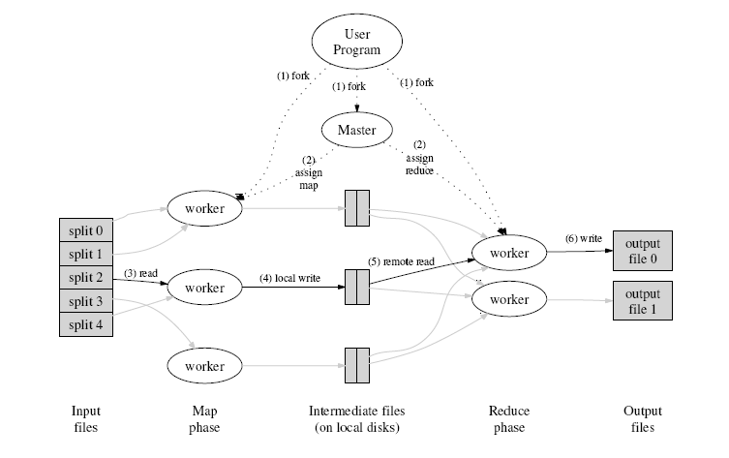
Internal: How does MR work?
INPUT
FILE(s)
From MapReduce OSDI09 slides

Slide 11
Internal: A Closer Look
From CMU CS 15-440
Gregory kesden
Node 1
Node 2
Files loaded from local HDFS store
Files loaded from local HDFS store
InputFormat
InputFormat
file
file
Split
Split
Split
Split
Split
Split
file
file
RecordReaders
RR
RR
RR
RR
RR
RR
RecordReaders
Input (K, V) pairs
Input (K, V) pairs
Map
Map
Map
Map
Map
Map
Intermediate (K, V) pairs
Shuffling
Process
Intermediate
(K,V) pairs
exchanged by
all nodes
Intermediate (K, V) pairs
Partitioner
Partitioner
Sort
Sort
Reduce
Reduce
Final (K, V) pairs
Final (K, V) pairs
Writeback to local HDFS store
OutputFormat
OutputFormat
Writeback to local HDFS store

Slide 12
Cloud Storage

Slide 13
User-facing software: storage abstractions
Unstructured data storage
Structured data storage

Slide 14
Unstructured storage in cloud
Storing large data blobs
GFS/Closure[58,55,101]
Core design: fault tolerance
Where to replicate: avoid colocation in single fault domain.
How to replicate: extra data copy, or Reed-Solomon code
References are in textbook: The Datacenter as a Computer: An Introduction to the Design of Warehouse-Scale Machines, second edition

Slide 15
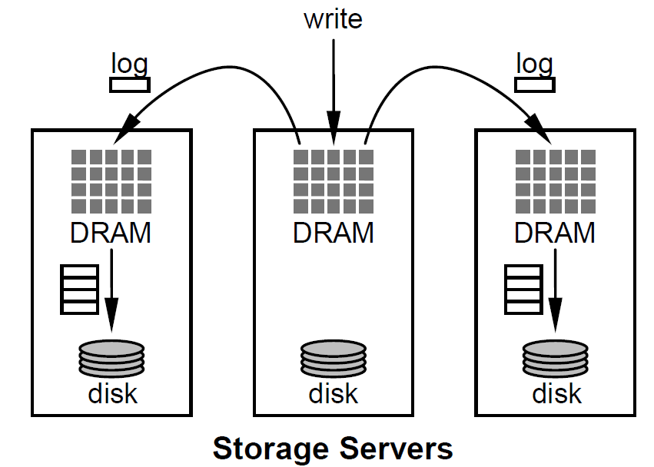
Structured storage in cloud: Databases
Scalable data store:
BigTable[26], Dynamo[36]: sacrificed functionality, various consistency models
Spanner: external-consistency (strong time semantics), multi-cloud/dc, schema change.
Megastore, F1: SQL-like usability, NoSQL like scalability
In-memory store: high-performance
Memcached[53]: a distributed cache on top of storage
RAMCloud[113]: storage purely in memory
Replicated on 3 remote memory units = stored on disk
FAWN-KV[8]: on SSD

Slide 16
Cloud storages by design principle
 | BigTable, Dynamo | Spanner, megastore | RAMCloud, FAWN-KV | Memcached
Consistency | ☹ | 😐 | ☹ | ☹
Richness of functionality | ☹ | 😐 | ☹ | ☹
Fault tolerance | ☺ | ☺ | 😐 | ☹
Performance | 😐 | ☹ | ☺ | ☺

Slide 17
Advanced features
Performance (monitoring)
Trace analysis, Predictive performance
Performance isolation, IO optimization in kernel
Data security in cloud
Differential privacy
Optimizing MPC, Applying MPC at scale, ORAM
SGX, Verifiable computing
Malware detection, Information flow
Other features
Not-only SQL, Deployment on multi-cloud
Consistency, Elasticity
Workload aware storage

Slide 18
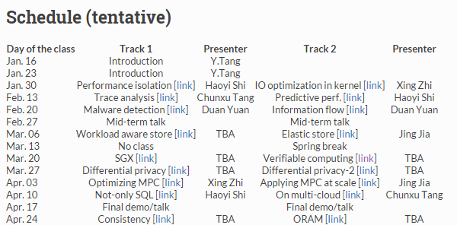
Advanced features
Performance (monitoring)
Performance isolation, IO optimization in kernel
Trace analysis, Predictive performance
Data security in cloud
Differential privacy
Optimizing MPC, Applying MPC at scale, ORAM
SGX, Verifiable computing
Malware detection, Information flow
Other features
Not-only SQL, Deployment on multi-cloud
Consistency, Elasticity
Workload aware storage

Slide 19
Reading topics: Other features
Not-only SQL
How to support SQL on scalable cloud architecture
Deployment on multi-cloud
Given various cloud option (e.g. multi-, hybrid-, and mobile- cloud), how to do the deployment efficiently and automatically?
Consistency
Cloud user is not that concerned about consistency, and how to exploit this to achieve better performance?
Elasticity
Cloud resource provisioning needs to be elastic, to save costs at off-peak hours, and to guarantee SLA at peak hours.
Workload aware storage
Workload is dynamic in cloud, how to make system design be aware of workloads.

Slide 20
Performance Monitoring

Slide 21
Perf. monitoring/debugging
As management software
Used by system administrator
Service-level dashboards
End-to-end request time
Quality of service (for SLA)
Performance debugging tools
Need to know “why” a service is slow
More detailed view:
Per-request view: traces
Per-node/process view: logs, profiled data

Slide 22
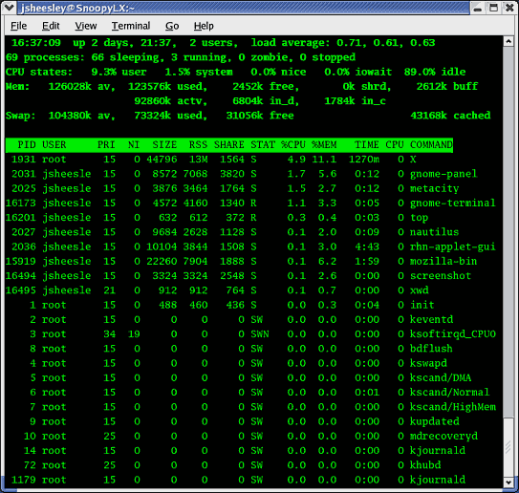
Perf. debugging in distributed systems
Profiling: resource utilization
By sampling performance counter (oprofile)
By instrumenting the program (gprof)
GWP: per-machine profile information with procedure identity (like gprof)
Which (part of) a program uses memory the most?
Tracing: track distributed execution of a request in cloud
Instrumented systems:
Modify application/middleware to pass tracing info. across machine/component boundaries.
Pip, Magpie, X-trace and Dapper.
Black-box monitoring systems:
Observing network traffic.
Inferring the message correlations.

Slide 23
Reading topics: Performance
Trace collection and analysis
Correlate trace events on different nodes and perform analysis for various application.
Predictive performance
Based on collected log/traces, model the cloudy system in a way to predict performance (and enforce SLA requirement).
Performance isolation
Isolate performance between co-located VMs in multi-tenant data store.
IO optimization in kernel
Optimize IO operations for data-/IO- intensive applications

Slide 24
Data security in cloud

Slide 25
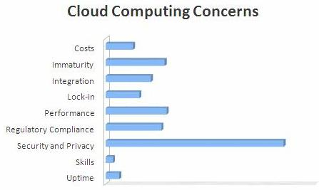


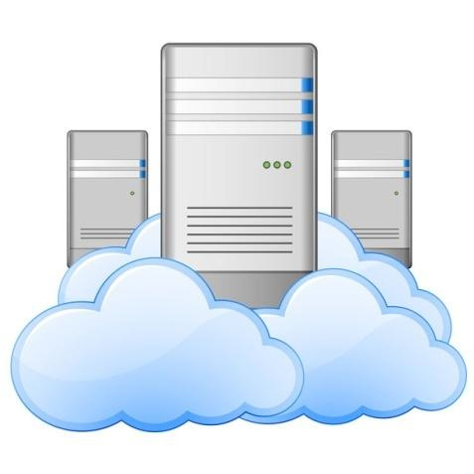
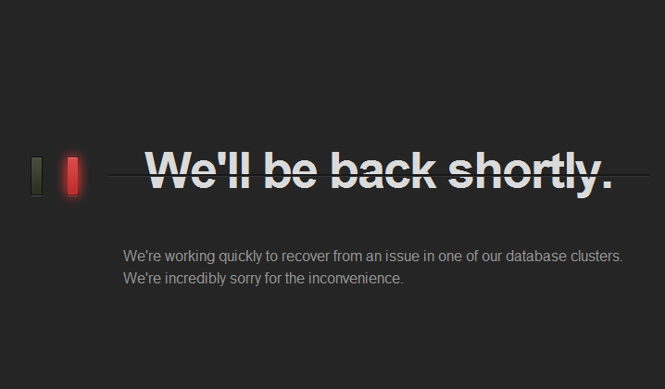

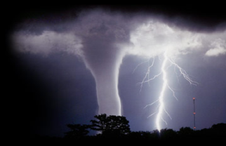

Cloud Security/Lack of Trust
Security becomes the biggest issue for adoption of cloud
Lack of trust to public cloud
“Don’t be evil?”
Being caught evil all the time.…
Intentionally evil
Accidentally
from Internet
“Evil" cloud service provider
U.S. gov wants your online data (PRISM scandal!)

Slide 26
Challenges in cloud security
Challenging to design a safe and secure cloud system
Lack of trust → data encrypted/signed.
Big data → performance optimization
Complex software system→ vulnerability
Regulatory req. → not clear, hard to enforce

Slide 27
Reading topics: Data security in cloud
Verifiable computing
When your data is delegated to the cloud, how do you know your data is not modified by the cloud (without your consent or awareness)?
SGX
For cloud service provider, can we just trust Intel but not trust Amazon?
Malware detection, Information flow
Let’s say Amazon is trusted, how to help Amazon to build a “trusted computing base” that is trustworthy and resilient to various attacks.
Differential privacy
When the cloud storing your data needs to publish your data, your privacy should be respected and protected.
MPC and ORAM
When cloud is governed by multiple autonomous parties (e.g. in health domain), how to enable information sharing while preserving privacy.

Slide 28
Project topics

Slide 29
Sample projects
Analysis in distributed social networks
Multi-party similarity computation
SGX simulation and programming
Verifiable sorting
Request trace analysis in cloud
NoSQL on SSD (reading [link])
…

