Slide 1
Elasticity
What is it? What kind of system need it?

Slide 2
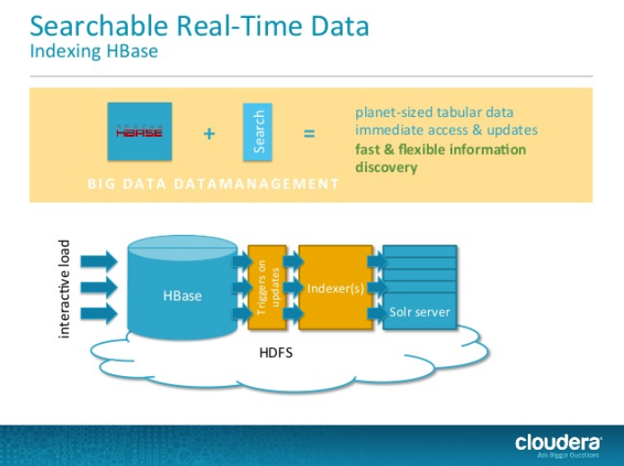
Computing resource or storage

Slide 3
What needs Elasticity the most
Distributing system, cloud system etc

Slide 4

Cloud computing

Slide 5
The Cloud is a complex environment composed of various subsystem that, although different, are expected to exhibit a set of fundamental features:
High availability, high performance, elasticity

Slide 6
Cloud computing provides virtually unlimited capacity on demand,
On demand processing, storage and network resources are provided

Slide 7
Elasticity is important to the cloud environment and closely tied to the pay-as you go model
What is Elasticity?

Slide 8
Elasticity: ability of a system to grow or shrink its resource consumption according to demand.
An open challenge and a topic of many recent research

Slide 9
MET: Workload aware elasticity for NoSQL
An elastic system that not only adds and removes nodes, but also reconfigures them in a heterogeneous manner according to the workload’s access patterns.(HBase)

Slide 10
Gather system level metrics such as CPU usage, memory consumption and disk load, and then add or remove nodes from the cluster according to demand.
Normally a manual task, this paper help to do autonomous elasticity of NoSQL

Slide 11
Heterogeneity of data access patterns also was taken into account to optimize the use of available resource
MET: Elastic System heterogeneously reconfigures nodes according to the observed workload

Slide 12
Downside is: MET greatly increases the complexity of cluster management.
Algorithm detail in paper

Slide 13
E-Store: Fine-Grained Elastic Partitioning for Distributed Transaction Processing Systems
An elastic partitioning framework for distributed OLTP DBMSs.

Slide 14
On-line transaction processing(OLTP) database management systems(DBMSs)
Serve time-varing workload due to daily, weekly or seasonal difference in demand, or because of rapid growth in demand due to a company’s business success. Many OLTP workload are heavily skewed to : hot: tuples o ranges of tuples

Slide 15
E-store: an elastic partitioning framework for distributed OLTP DBMSs.
It automatically scales resources in response to demand spikes, periodic events, and gradual changes in an application’s workload.

Slide 16
E-store
Two-tier data placement strategy: cold data is distributed in large chunk, while smaller ranges of hot tuples are assigned explicitly to individual nodes.

Slide 17
Tree-schema
All non-replicated tables of an OLTP database form a tree-schema based on foreign key relationship

Slide 18
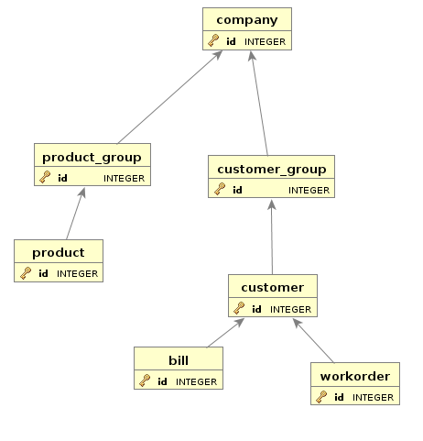
Root to leaf order

Slide 19
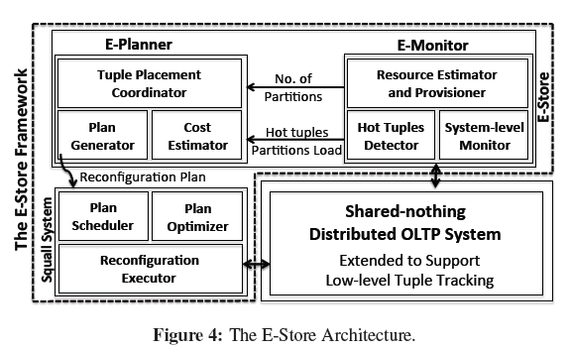

Slide 20
E-store ensure the high performance and availability of a distributed DBMS when react to changes in the workload and dynamically adjust the database without incurring downtime.
Problem can be broken into three parts

Slide 21
How to identify load imbalance requiring data migration? How to choose which data to move and where to place it? How to physically migrate data between partitions?
Data migration, two tier partition.

Slide 22
Squall provides on-line reconfiguration for distributed DBMSs that can update the physical layout of partitioned data with minimal latency overhead and no system downtime
Installed on every DBMS node in the cluster

Slide 23
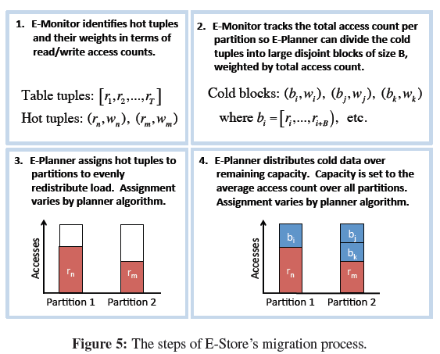

Slide 24
E-store identifies a collection of keys with high activity.
Keys are extracted from their block and allocated to nodes individually. Participate hot keys separately from cold ranges.

Slide 25
E-store: avoid the overhead of collecting and processing monitoring data by using two-phase monitoring component called the E-Monitor.
Standalong program running continuously outside of the DBMS.

Slide 27
During normal operation, the system collects a small amount of data from each DBMS node using non-intrusive OS-level statistics.
Detect imbalance by using CPU utilization in a main memory of DBMS.

Slide 28
E-Monitor then triggers per-tuple monitoring that is implemented directly inside of the DBMS.
After a brief collection period, E-Monitor switches back to lightweight mode and sends the data collected during this phase to E-Planner to generate a migration plan for the DBMS.

Slide 29
Tuple-Level Monitoring
Monitoring only the root tuples provides a good approximation of system activity and minimizes the overhead of this phase.

Slide 30
Need algorithms to generate new partition scheme for database after collects tuple-level access count
Detail in the paper

Slide 31
