Slide 1
Introduction to Intel SGX (misc)
Dr. Y. Tang

Slide 2
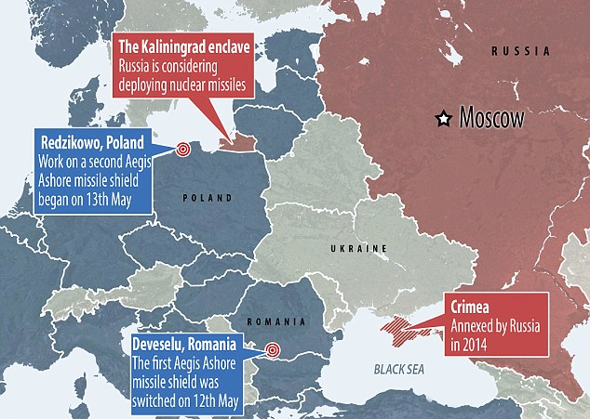
The Concept of Enclave

Slide 3
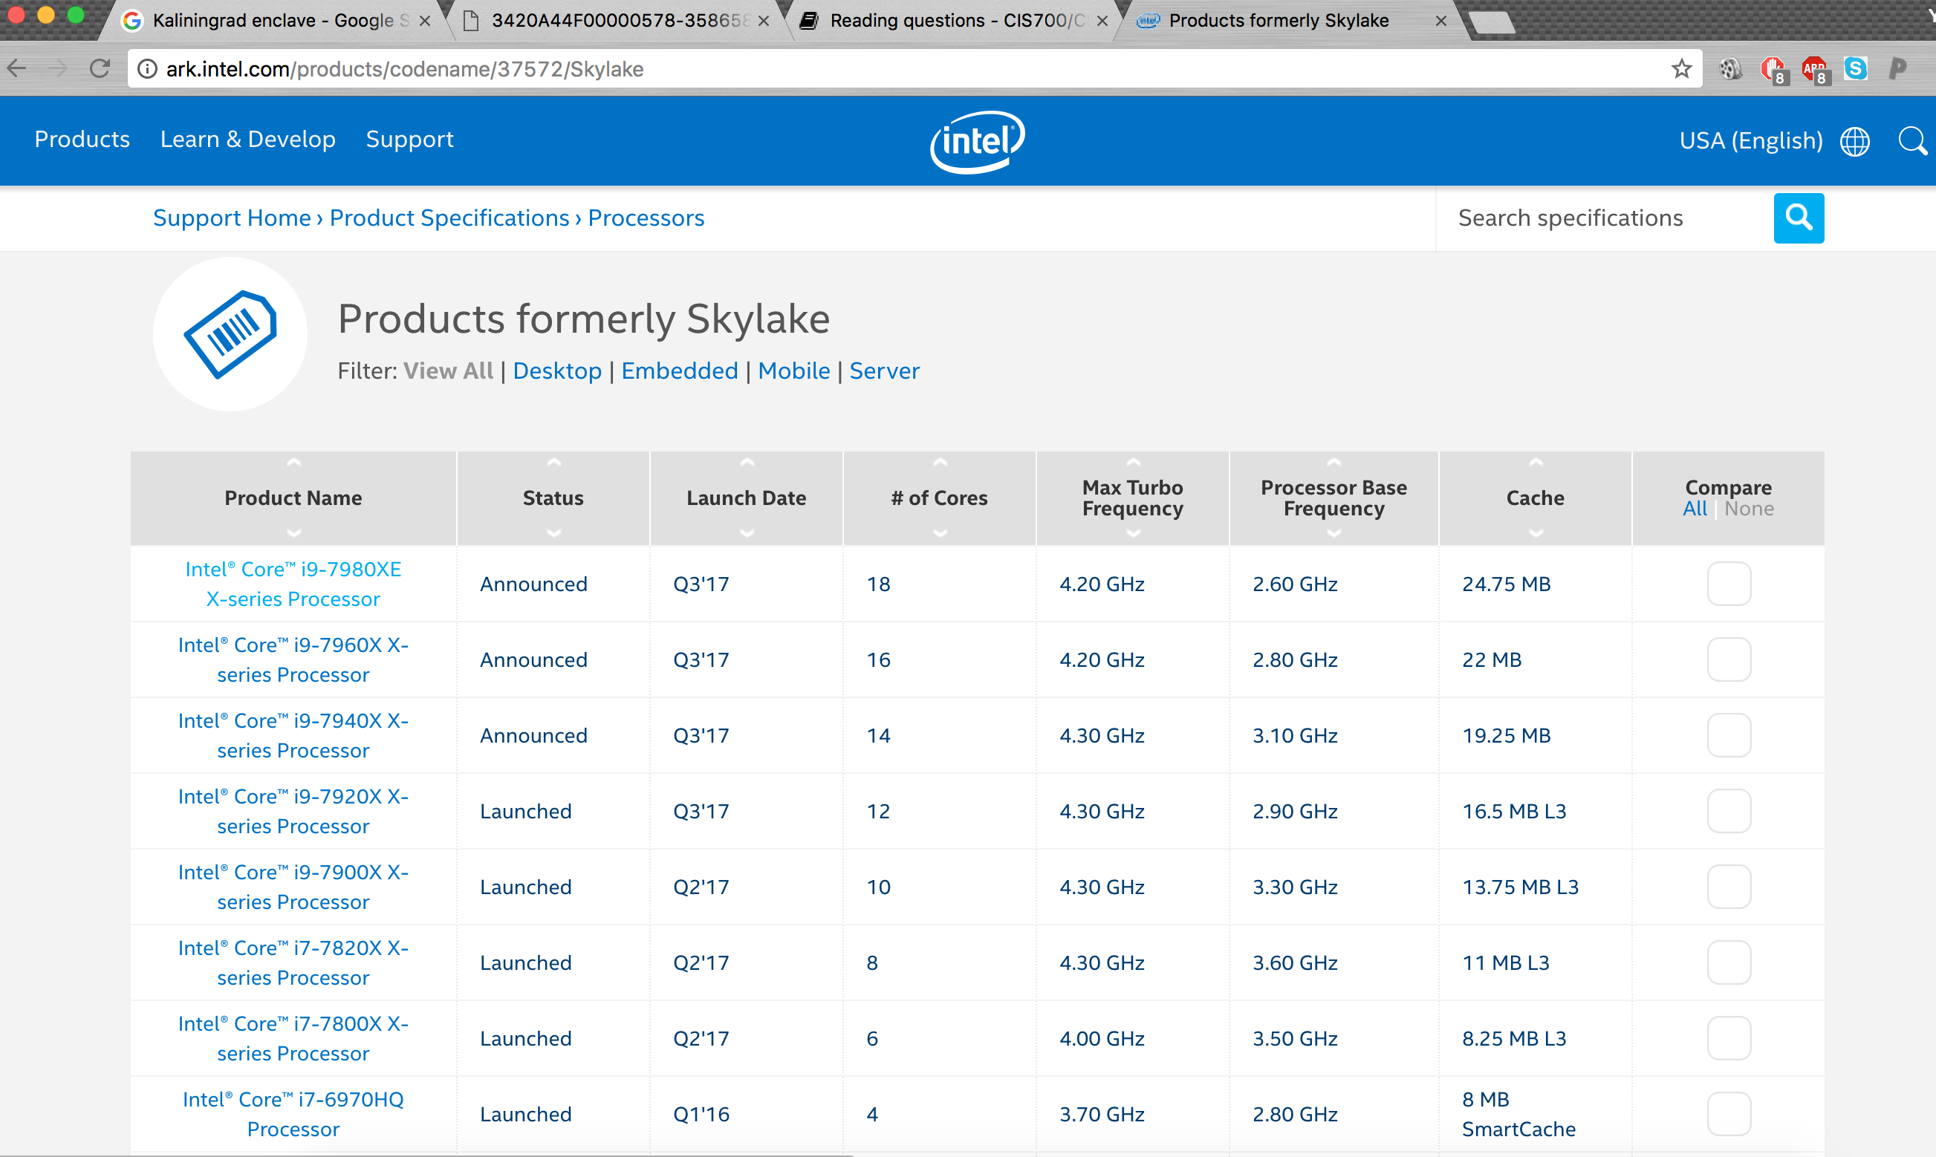
Intel Skylake processor

Slide 4
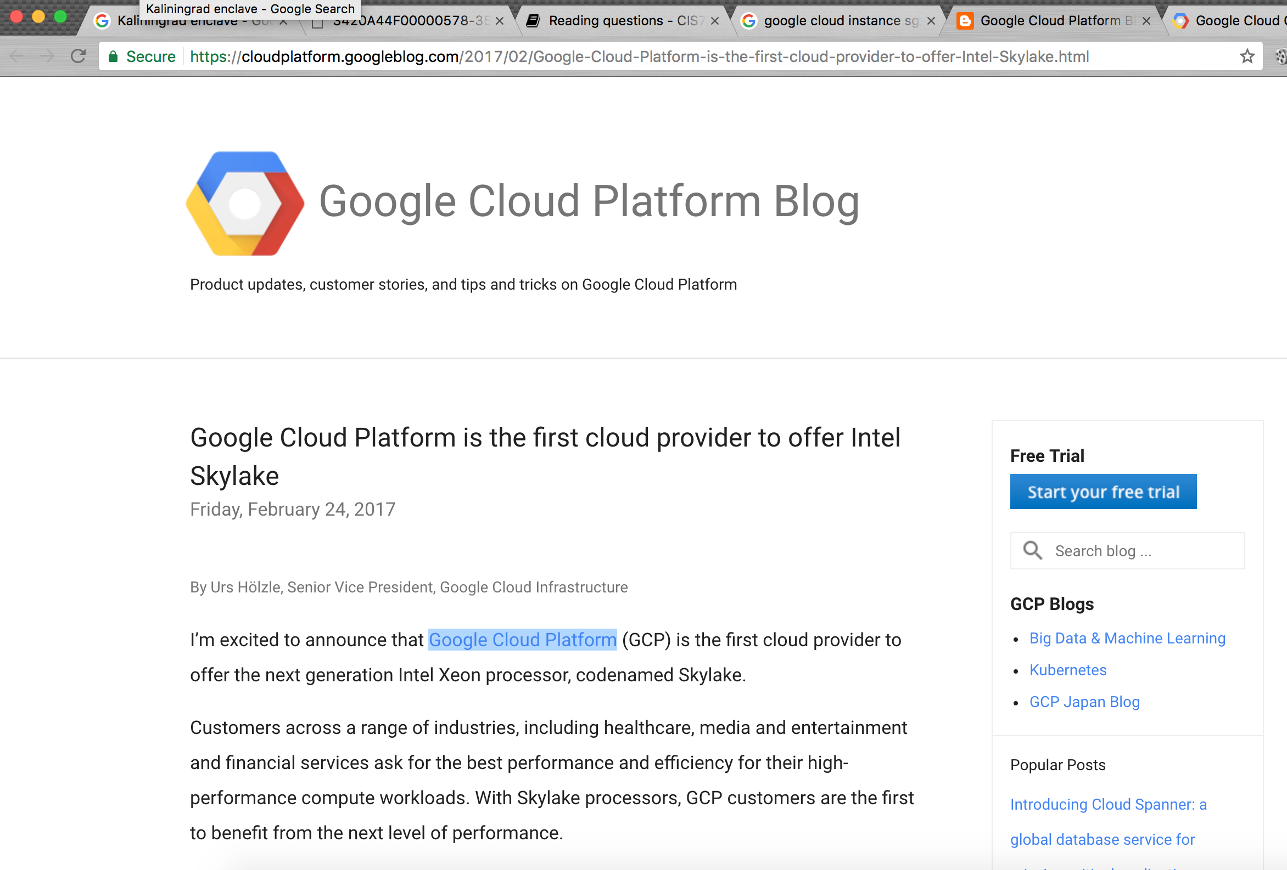
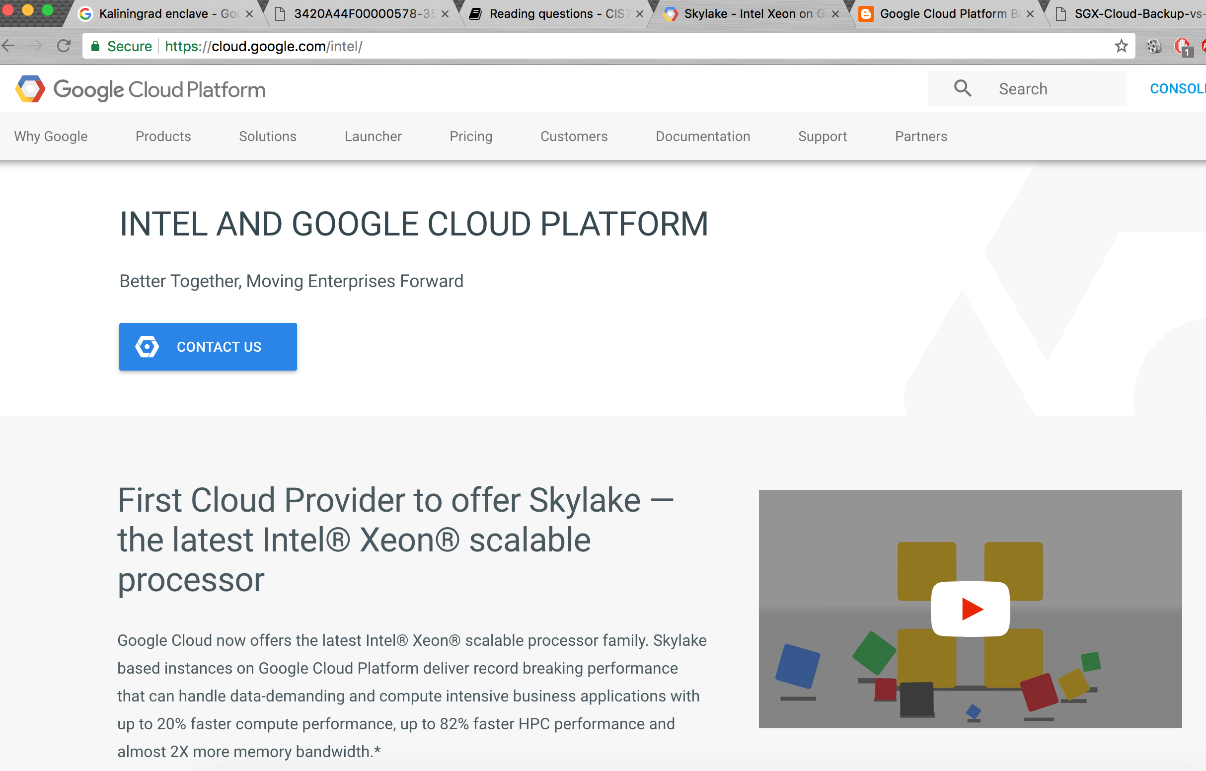
SGX Instances on Google Cloud
Announcement:
https://cloudplatform.googleblog.com/2017/02/Google-Cloud-Platform-is-the-first-cloud-provider-to-offer-Intel-Skylake.html
Website:
https://cloud.google.com/intel/

Slide 5




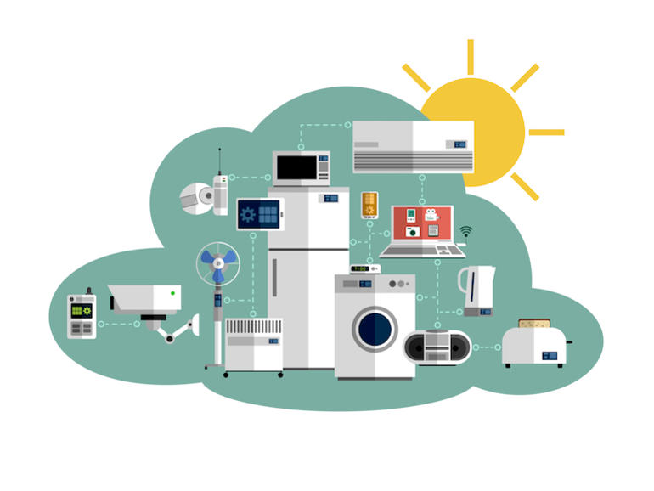

Cyber-Security Applications
Online shopping, social networking
Healthcare
Political campaign
Smart home, IoT devices
Many more.

