Slide 1
Cs 7001 Mini Project Demo for Privacy Preserving Networks
Yuzhe Tang
Dec., 11, 2009

Slide 2
General Goal
To illustrate how clients could use PPN to search for resources that are distributed across different geometrical locations.
Basic usecases
Given a patient’s name, return the list of locations of medical organizations that have records of this patient.
Given location of provider, retrieve the patient’s record.

Slide 3
Demos
Given patients’ names, return list of medical organizations, and with searcher’s location, show how PPN route.
Show search process in a real-world map
The grid is mapped over the map
Zoom in/out.
Show how grid adapts to dynamic network.

Slide 4
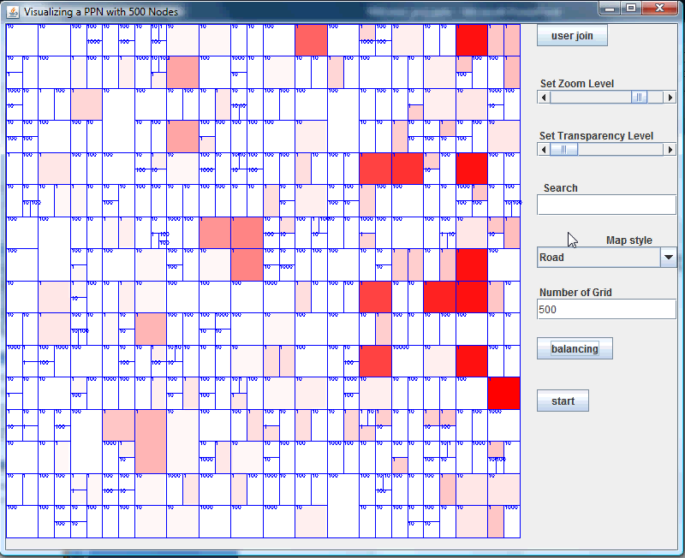
-Search for medical organizations -Show how PPN route there

Slide 5
Show demo in a more realistic context
Add real-world maps
Switch between grid layer and map layer.
Zoom in/out

Slide 6
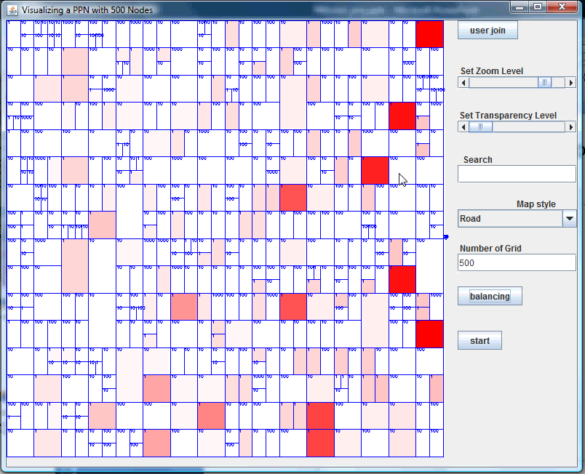

Slide 7
Show demo in a more dynamic setting
With different number of nodes
Different balancing strategy
How things work in dynamic workload

Slide 8
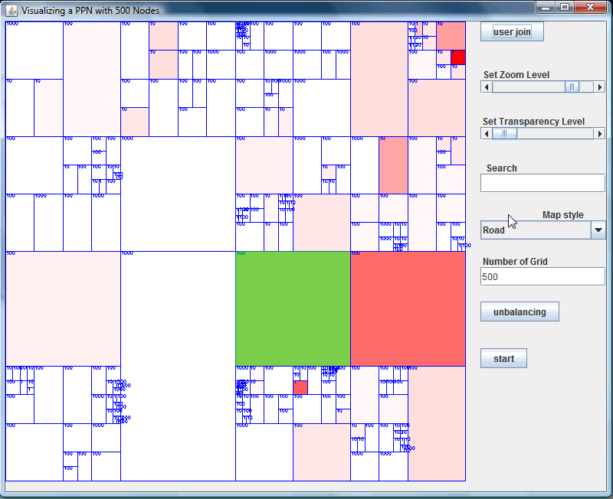

Slide 9
Implementation
Implemented as independent package to GeoCast/Grid code.
Use Bing Maps web services to get maps.
Translate address to lat/long
Render map/image
Search for keywords

Slide 10
Future work
Demo-related Research
Keyword search in spatial database.

