Slide 1
Performance Isolation
Haoyi Shi

Slide 2
Paper Reading
Performance Isolation and Fairness for Multi-Tenant Cloud Storage
CPI²: CPU performance isolation for shared compute clusters
End-to-end Performance Isolation Through Virtual Datacenters

Slide 3
Performance Isolation and Fairness for Multi-Tenant Cloud Storage

Slide 4
Two key, related issues
Multi-tenant interference and unfairness
Variable and unpredictable performance
Target
Max-min fairness(PP,WA,RS,WFQ)
Low overhead and high utilization

Slide 5
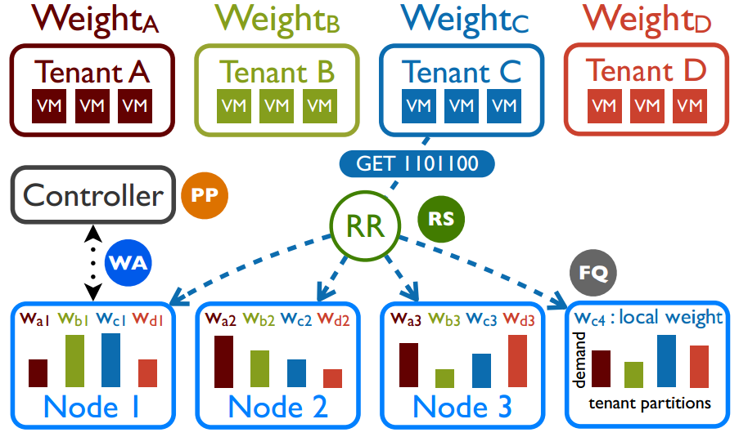
Pisces multi-tenant storage architecture

Slide 6
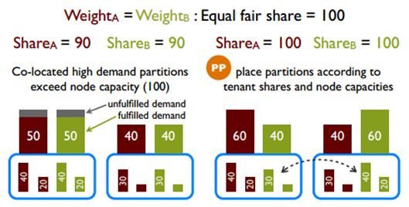
Partition Placement
Ensure the feasibility of the system-wide fair shares
assign its data partitions (and their replicas) to service nodes
load on each node does not exceed the node’s rate capacity

Slide 7

Weight Allocation
Iteratively adjusts the local tenant shares (R) to match the demand distributions
Detecting mismatch
Minimize the maximum demand-share mismatch (or cost)
reciprocal swap

Slide 8
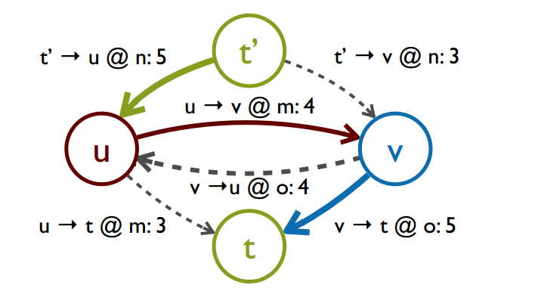
Reciprocal swap

Slide 9
Replica Selection
Distribute tenant requests to partition replicas in proportion to their local shares
Round-robin between partition replicas (nodes), consuming slots from their respective request windows
Larger tenant share, lower latency

Slide 10
Fair Queuing
Deficit (weighted) round robin (DWRR)
Dominant Resource Fairness
Each tenant receives a fair share of dominant resource relative to other tenants
Each tenant’s share of its dominant resource is lower bounded by the max-min fair share of a single common resource.

Slide 11
CPI²: CPU performance isolation for shared compute clusters

Slide 12
Metric: CPI
Relatively stable across well-behaved executions of applications
Well-correlated with the bad behavior caused by antagonists.
Most latency-sensitive applications in compute clusters have fairly consistent CPIs across tasks and time

Slide 13
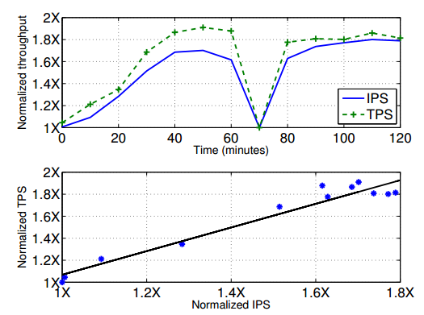
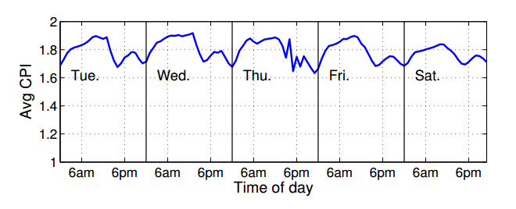
Application-specific measure of throughput (transactions per second, TPS)
V.S
CPU instructions per second (IPS)
CPI changes slowly

Slide 14
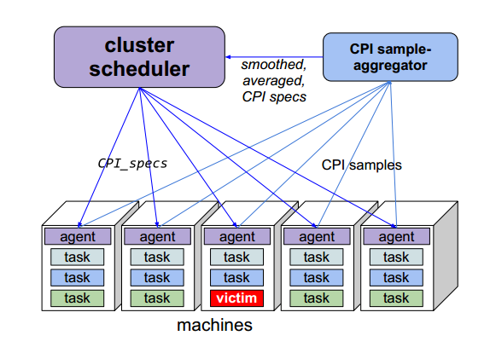
Architecture

Slide 15
CPI Collection
Derived from hardware counters
CPU_CLK_UNHALTED.REF/INSTRUCTIONS.RETIRED
For every task on a machine
Including jobname, platforminfo, cpu-usage …
CPI spec
Mean and standard deviation of CPI for each job
Acts as a predicted CPI for the normal behavior of a job

Slide 16
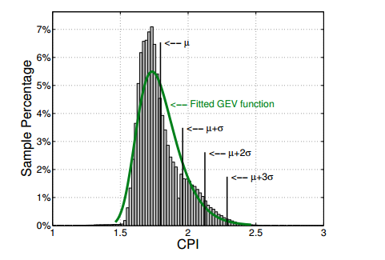
Identify antagonists
Flagged as an outlier If the observed CPI is significantly larger than the predicted CPI
2σ
3 times in a 5 minute

Slide 17
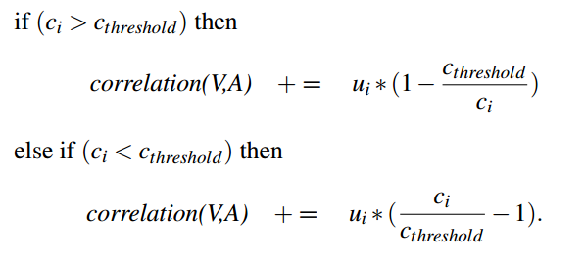
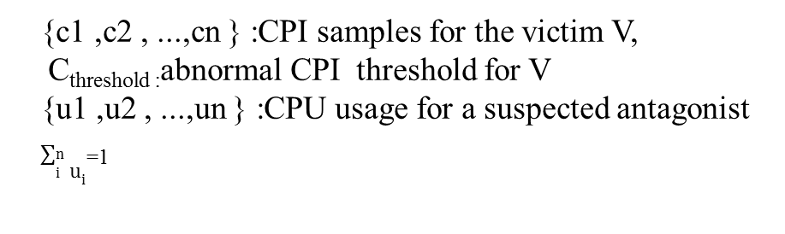
Identify antagonists
By correlations between the victim’s CPI values and the CPU usage of the suspects
Higher the correlation value, greater the accuracy
At least 0.35 works well
{c1 ,c2 , ...,cn } :CPI samples for the victim V,
C_{threshold :}abnormal CPI threshold for V {u1 ,u2 , ...,un } :CPU usage for a suspected antagonist
$\sum_{i}^{n}{u_{i}}$₌₁

Slide 18
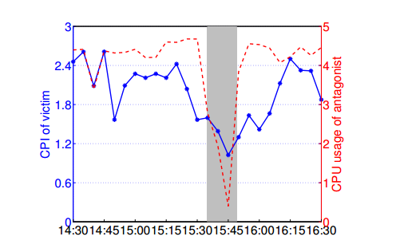
Deal with antagonists
Applying CPU hard-capping
Limit the amount of CPU a task
Throttling the most-suspected one
Batch jobs are more possible
Expect victim’s performance to improve

Slide 19
Similarities
Use smoothed average value as threshold
Consumed rate and the configured local share
Observed CPI and predicted CPI
Focus on dominant resource fairness
In the second paper, that is CPU usage
Not interested in root-cause finding

Slide 20
Differences
Anomaly-prevention V.S Anomaly-detection and treatment
Dredging V.S throttling
Swap capacity
Limit antagonist’s CPU usage
Dynamic balance V.S Emergent treatment

