Slide 1
Differential Privacy - Apps
Presented By
Nikhil M Chandrappa

Slide 2
Overview
Background on Differential Privacy
PINQ
- Introduction
- Design and Implementation
3. Privacy in Pharmacogenetics
- Background
- Model Inversion
- Results

Slide 3
Introduction
Wealth of information about individuals is available
Data analysts can use it for finding exciting new patterns
Data collectors only release privatized or aggregated results
Security violations caused by Netflix and AOL datasets
Question:
How many people in our class are married?

Slide 4
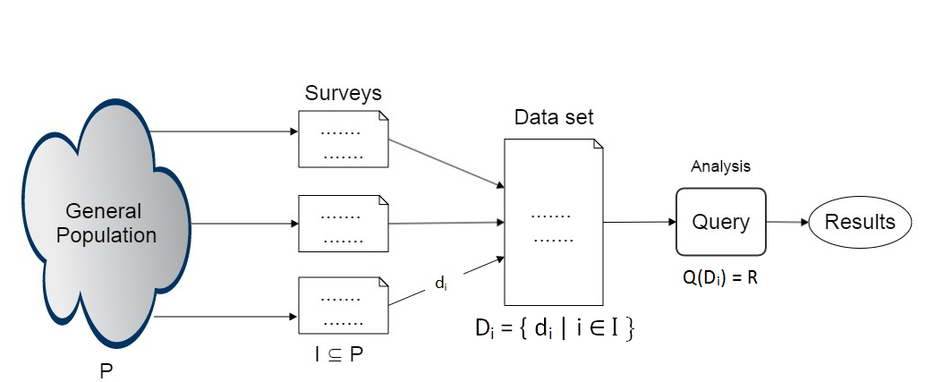
Introduction
Will you consider it safe?
If data you have given has no impact on the results
If attacker could not infer any new information about me looking at the results

Slide 5

Differential Privacy
Definition: A randomized computation M gives ε-differential privacy iff for all input data sets A, B and all S ⊆ Range(M),
Pr[M(A) ∈ S] ≤ Pr[M(B) ∈ S] ×
Ensures: Any event S “Equally Likely” with/without your data. Does not prevent disclosure. Ensures disclosure is not our fault.
[from work w/Cynthia Dwork , K.Nissim, and A.Smith ]
Participant thinks considerably different outcome is produced without their participation
If disclosure should happen, its in appropriate to charge mechanism for mishandling participant data
Mechanism is differentially private, not the data set

Slide 6

Sensitivity of Function
Given that D1 and D2 are two data sets that differ in exactly one person, and F(D) = X is a deterministic, non – privatized function over dataset D, which returns a vector X of k real number results.
Then the Global Sensitivity of F is:
Worst case difference is that caused adding or removing one record from the dataset
Amount of noise added is proportional to sensitivity of query
Adding noise is essential to make deterministic query into differentially private
Laplacian noise is sufficient to cover the sensitivity of the query

Slide 7
Sensitivity
Questions:
How many people are married in our class?
How many courses are students enrolled in the semester?
How many courses are students enrolled in and how many of them are CSE?
How many courses are offered in CSE and CIS?
Overlapping Counts
Disjoint Subsets

Slide 8
Paper 1 - PINQ

Slide 9
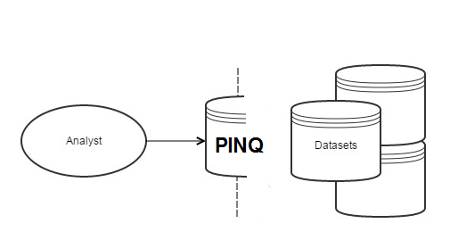
Privacy Integrated Queries (PINQ)
PINQ is prototype based on C#’s LINQ language
PINQ is wrapper around c# LINQ data sources
PINQ is declarative programming language for differentially private data analysis
All the programs written using LINQ are differential private
Language serves as proof of differential privacy
Data providers don’t need to trust analysts

Slide 10
Operations
Operations Supported by PINQ
Aggregation
Transformation
Composition
Partition [specific to PINQ]
Doesn’t Support
Enumeration

Slide 11
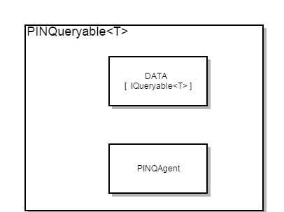
PINQ Implementation
PINQueryable<T>
is based on c#’s IQueryable<T>
Data in itself is unprotected
Differential privacy is provided PINQAgent
PINQ doesn’t provide execution engine

Slide 12
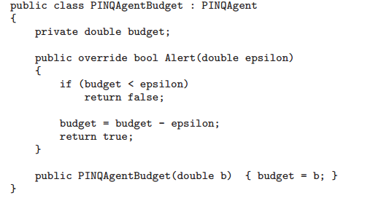
PINQAgent
Data providers have to set the privacy requirements of a dataset
Privacy budget determines the access on a dataset
Privacy policy can be different for different level of users
Privacy enforcement can be achieved by implementing PINQAgent Interface

Slide 13
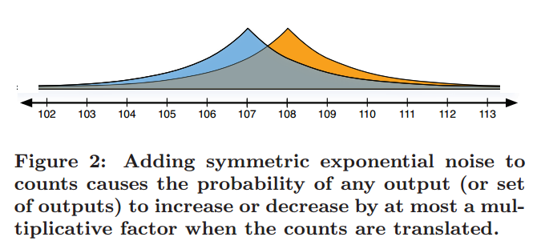
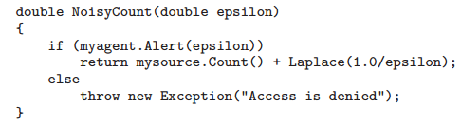
Aggregations: Noisy Counts
- Differential privacy is obtained by adding Laplace noise
- PINQ supports NoisyCount, NoisySum, NoisyAbg, NoisyMed

Slide 14
Transformations
Transformations Supported by PINQ,
Where and Select
Output changes by at most one with change in a input
Groupby
- Change in input can change at most two output records
Join
- Is restricted

Slide 15
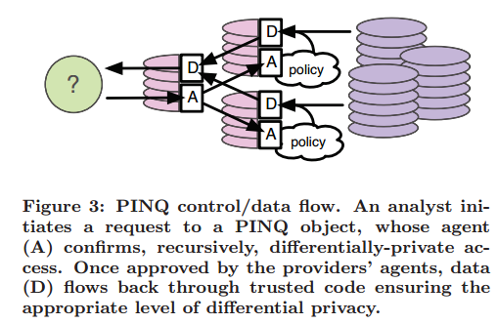
Control Flow
Transformation results in a new PINQueryable and PINQAgent
Queries are forwarded recurisvely, with appropriate value of epsilon

Slide 16
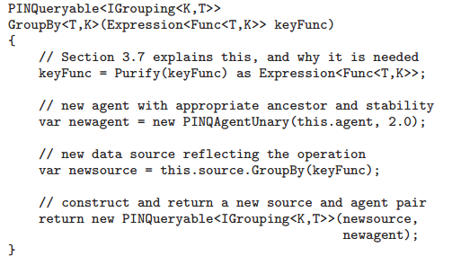
Sample Implementation

Slide 17
Composition
Sequential Composition
- subsequent computations incorporate the outcomes of preceding computations
- ε value of each query will be added
Parallel Composition
- disjoint queries cost only maximum privacy differential
Partition Operator
Works on disjoint sets
Analyst must explicitly provide set of candidate keys
Analyst is rewarded by set of PINQueryable objects
PINQAgents of these objects reference PINQAgent of same source data
It is implemented using a shared vector of maximum value of epsilon

Slide 18
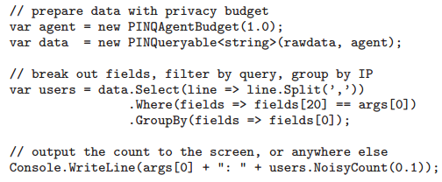
Example of PINQ

Slide 19
Paper 2 – Privacy In Pharmacogenetics

Slide 20
Privacy In Pharmacogenetics
Background
What is Pharmacogenetics?
Warfin and Initial dosage
International Normalized Ratio (INR)
Genes: VKORC1, CYP2C9 [ 54% of warfin dosage requirement]
Dataset
Containing information on demographics, genetics markers and Clinical Histories of Patients
Divided in to training cohort and validation cohort
Restricted to patients with target INR in the range 2-3

Slide 21
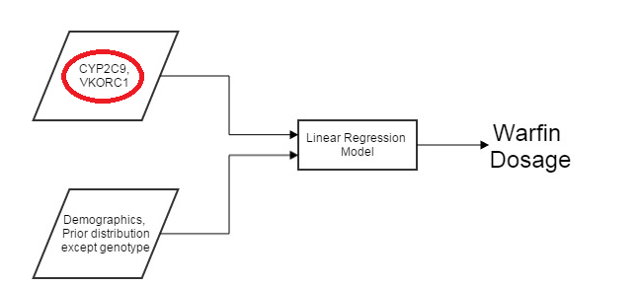
Pharmacogenetic Model
Problem Statement
Risk Involved in releasing regression models trained over private data
using differential privacy in Pharmacogenetic models
Utility of differential private Pharmacogenetic models
Notes:
- Least Square Linear model

Slide 22
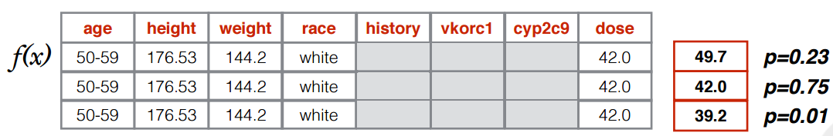
Model Inversion
Attack model assumes that Adversary has access to the following,
Basic Demographics (race, height, weight)
Stable Warfin dosage of target
Black box access to Pharmacogenetics model
Marginal priors on patient distribution
Intuition behind model inversion
Find the rows in the database that have similar warfin dosage
Fill the unknown with priors and check the model’s response value with target value
Then rows which are potential match will be weighted and target attribute with highest weight is outputted
Notes:
F(x) is least square linear model

Slide 23
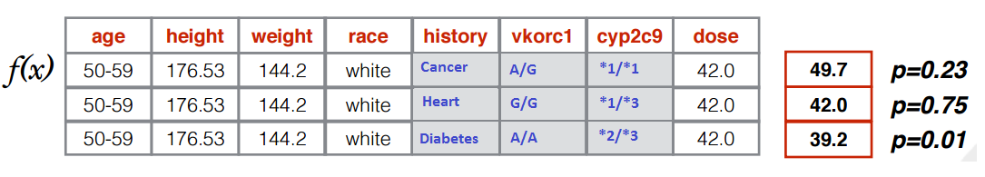
Actual Dataset

Slide 24
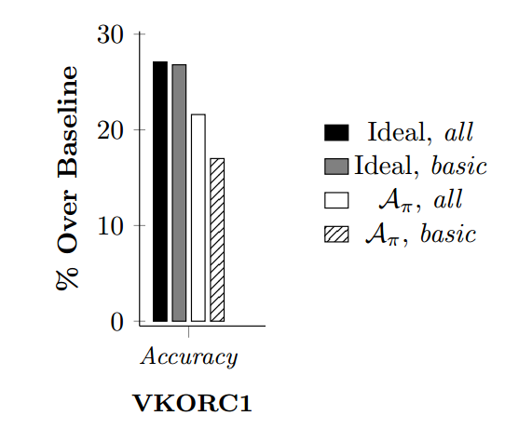
Result
Compared against “best possible” results achieved using multinomial logistic regression model
Prediction of VKORC1 is close to ideal accuracy
Only 5% less accurate with all the background information
Notes:
% of samples for genotype was correctly predicted
Baseline accuracy is 35% correct

Slide 25
Cost of Privacy: case study
They Use publically available implementation of differentially private machine learning algorithms,
Private projected histograms
Functional mechanism for learning private linear regression
Determine the impact of differential private mechanism in effectiveness of dosage
Simulation Settings
Enrollment
Initial Dosing
Does Titration
Result

Slide 26
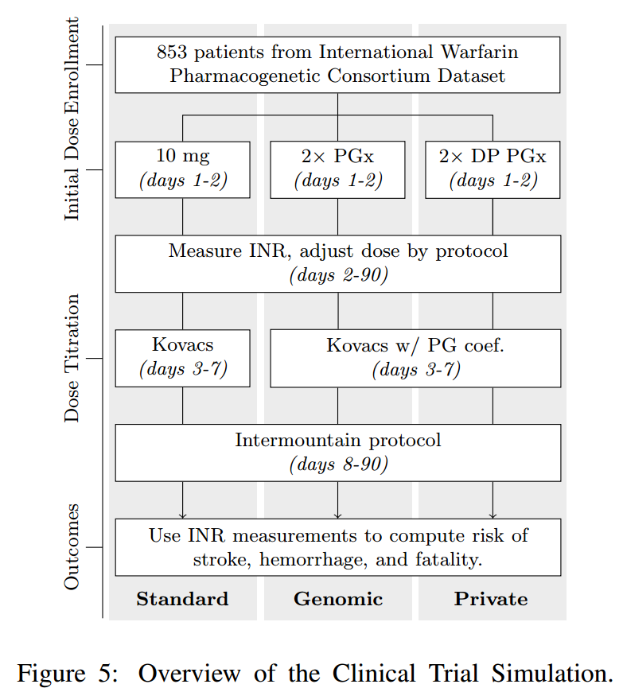
Stages of Clinical Trail Simulation
Three simulation dosing algorithms: standard, genomic and Private – genomic
PK/PD Model is used to predicit INR respose to warfarin

Slide 27
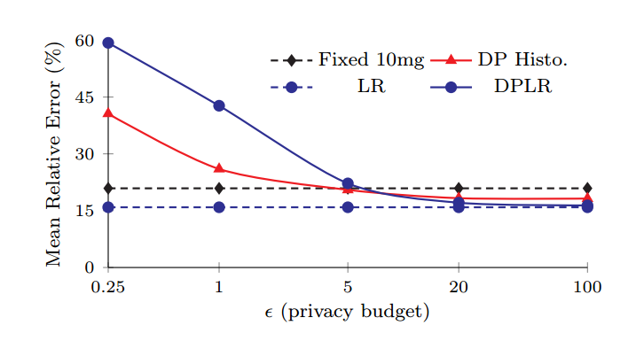
Initial Warfin Dosing
Differentially private models are constructed with different privacy budget
ε = 0.25, 1, 5, 20, 100
Average error of DP models is quite high

Slide 28
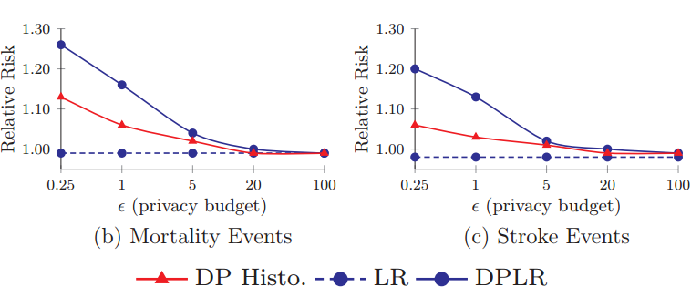
Calculating Patient Risk
Sorensen et al. analysis of correlation between store and bleeding events for patients undergoing warfarin treatment at varying INR levels
Probability of events from above study is used as measure for INR levels produced by PK/PD
Reasonable privacy budget of ε =5, resulted in greater risk of stroke, bleeding and fatality events

Slide 29
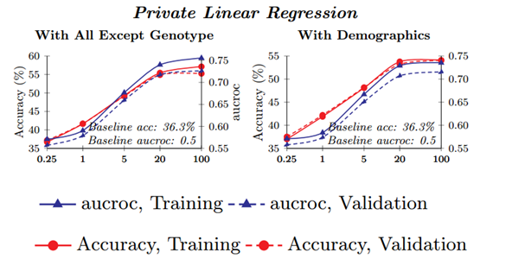
Calculating Patient Risk
ε > 20 provided good results, however it yields little privacy

Slide 30
Reference
C. Dwork, “Differential privacy,” in ICALP, 2006, pp. 1–12.
Privacy in Pharmacogenetics: An End-to-End Case Study of Personalized Warfarin Dosing, SEC14
PINQ: Privacy Integrated Queries, SIGMOD09
Video : CERIAS Security Seminar, CRCS Lunch Seminar

Slide 31
Thank You

