Slide 1
Consistency of cloud storage service
CIS 700
Wenqing Zhuang

Slide 2
1. Caelus: Verifying the Consistency of Cloud Services with Battery-Powered Devices
Caelus system detects consistency violation of cloud storage service
2. Consistency-based service level agreements for cloud storage
Consistency-based SLA helps clients direct read operation to the suitable server to meet consistency-latency desire

Slide 3
Consistency model
In a computer system, consistency model defines specific rules that operations on memory must follow. It specifies a contract between programmer and system, in this contract, the system guarantees that if the programmer follows the rules, memory will be consistent and the results of memory operations will be predictable.

Slide 4
Types of consistency models
Strong consistency, eventual consistency, causal consistency, sequential consistency, cache consistency, release consistency......

Slide 5
Type example
Strong consistency
It requires that the value returned by the read operation is the value written by the most recent write operation to that location, the write operation may possibly not actually done to the memory.
Eventual consistency
All accesses to a given data item will return the actual last updated value.
Causal consistency
It categorizes events to causally related set and unrelated set. It defines that only write operations that are causally related must be seen in the same order by all processes.

Slide 6
Why propose Caelus
Consistency of cloud storage service may be compromised by external or internal malicious users
Shortcomings of current proposals:
Can only check single consistenct model
Require long battery power
Rely on trusted third party to transfer message

Slide 7
Caelus uses a device(PC or smart phone) as attestor to sign the order and timing of operations declared by cloud service to produce attestation periodically
Attestor writes back the attestations to cloud service
Clients read the attestations from cloud service to verify consistency of their operations
Clients only communicate with the cloud storage service, no need to communicate with other clients or with attestor

Slide 8
In order to minimize battery assumption, Caelus partitions attestor to two devices instead of one: root attestor and active attestor
root attestor: periodically accessible, can be sleeping to conserve battery
active attestor: must be active, selected by root attestor, only devices which are already awake can be selected. Active attestor can be changed.

Slide 9
Supported consistency model
Strong consistency model
Eventual consistency model
Causal consistency model

Slide 10
Security model
Clients:
Devices(laptop, smart phone...)
Clients can become unavailable or malicious because of injection of malware
Each client has a public-private key pair used for digital signatures, public key can be accessed by other clients or cloud service, private key encrypts user's data to prevent it from exposure to cloud service or other clients
Client have synchronized clocks with limited clock skew

Slide 11
Network:
Provide connection between each client and cloud service
No direct connection among clients

Slide 12
Cloud service:
Operations are guaranteed to become visible to all clients with certain time bound
An honest cloud service can respond to the clients with promised consistency model
A malicious cloud service violate consistency model and make clients use inconsistency data

Slide 13
Collusion
Assume the clients are cloud-secure, the malwares or other things which make clients malicious are not controlled by cloud service

Slide 14
Security guarantees
Caelus provide some security guarantees against malious cloud service and malicious client
Against a malious cloud service:
SRV1: A malicious cloud service cannot read user data
SRV2: A malicious cloud service cannot modify user data without being detected
SRV3: A malicious cloud service could be detected within certain time bound: T(Caelus)

Slide 15
Against malicious client:
CLT1: malicious clients cannot repudiate the modifications they made to data on cloud
CLT2: malicious clients cannot falsely accuse cloud service of violating consistency model
Additional guarantee:
AV1: If there is no malicious activity or operation failure, Caelus will not cause unavalaibility or delays of cloud service

Slide 16
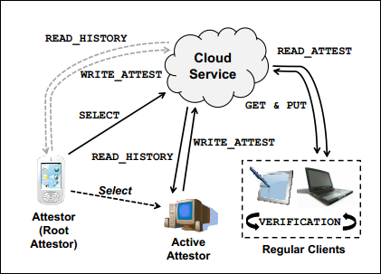
Design
Cloud service includes distributed key-value store and history server which is added by Caelus
Root attestor selects an active attestor through SELECT operation to history server. Active attestor reads history log from history server and produce attestion, then write attestion back to cloud service every T(A)
Clients access data from cloud service through GET and PUT, and read attestation every T(A)+ε. Each client runs verification procedure to check the consistency of its own operations.

Slide 17
Verification procedure
Verify strong consistency:
PUT must appear in the next attestation
T(read_attest2)-T(read_attest1)=T(A)+ε
T(S): delay of PUT effect
Maximum possible value of T(S) is T(A)+ε
GET must return the value of immediate preceding PUT
Read_assert1
PUT
Read_attest2
PUT effect

Slide 18
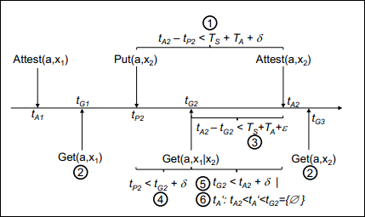
Verify eventual consistency:
Order of checking
t(A2)-t(p2)<T(S)+T(A)+δ, δ is clock skew between clients
t(A2)-t(G2)<T(S)+T(A)+ε, attestation for matching put must appear within certain time period
t(G2)>t(p2)-δ, Get must be after the timestamp of Put
If Get is before Put attestation, check t(G2)<t(A2)+δ
if Get is after Put attestation (t(G2)>=t(A2)+δ), there is no new attest op t(A2) and t(G2)

Slide 19
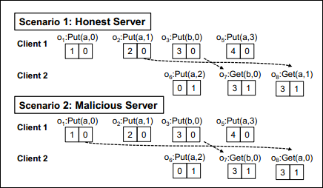
Verify causal consistency
Get must return the value of most recently causal dependent data
First do the same verification as eventual consisency
Attach vector clock for each opearation, denoted as C1C2, only put operation increase the clock value
Scenario 1 has no violation, because there is no Put operation between o2 and o8
Scenario 2 is either violation or error, because o2 is between o1 and o8, o8 should return the data of o2

Slide 20
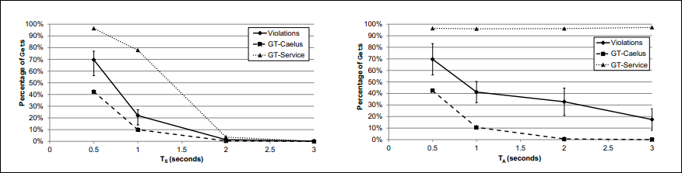
Evaluation
middle line: percentage consistency violation, top line: percentage of T(S) violation in which delay of Put operation is larger than T(S), bottom line: percentage of T(A) violation in which Caelus failed to detect inconsistency every T(A)
As T(S) grows, percentage all kinds of violations decrease
As T(A) grows, T(S) violation remains the same, the other two decrease

Slide 21
Consistency-based SLA
In existing multi-consistency storage services, developers must decide the single consistency model during development time, but such decision may not be suitable for all situations.
Pileus storage system allows developers to provide consistency-based SLA that specifies consistency-latency desires. Applications issue a read request with associated SLA, then the system directs the read operation to the most suitable server which can best balance consistency with latency.

Slide 22
Categorization of applications
Applications can be categorized by consistency-latency desire, for example:
Latency-favoring applications, rigid response time requirement, weaker consistency could be acceptable
Consistency-favoring applications, rigid consistency model requirement, latency within a certain range can be acceptable
Note: the type of application decides the consistency-latency desire, developers declare SLA according to the desire, then clients in Pileus system rely SLA to direct read operation to apporiate server

Slide 23
System API
Key-value store:
Pileus manages a collection of tables which contain data objects that a string-value key and opaque byte-sequence value
Put: add or update a data object with a given key
Get: take an additional parameter: SLA, return data object and a condition code which indicates whether the SLA was met

Slide 24
Consistency guarantees
Pileus system provides consistency guarantees such as strong consistency, eventual consistency, read-my-write consistency, causal consistency......

Slide 25
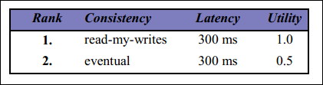
Service level agreements
SLA is a set of subSLAs which is a consistency-latency pair
The subSLAs with higher utility are prefered, subSLAs with lower utility are acceptable

Slide 26
System design
Storage nodes: provide put and get interface, divided into primary nodes and secondary nodes, primary nodes store master data, other nodes are secondary nodes.
Each storage node contains tablets (a set of <key, value, timestamp>, keys are in certain range) and highest timestamp
Replication agent: secondary nodes periodically pull newly updated data objects from primary nodes and record highest timestamp through replication agent
Client library: provide system API to developers

Slide 27
Monitors: each client has its monitor, monitor measures round-trip latency between client and storage node
Monitor provides three functions:
PNodeCons(node, consistency, key): returns estimated probability that the given storage node is sufficiently up-to-date for given key
PNodeLat(node, latency): returns the estimated probability that the node can respond to Gets within given latency
PNodeSla(node, consistency, latency, key): returns estimated probability that the node can meet consistency and latency desire for given key

Slide 28
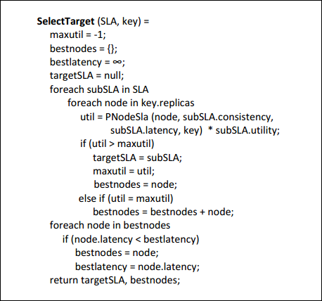
Choose target subSLA and best node

Slide 29
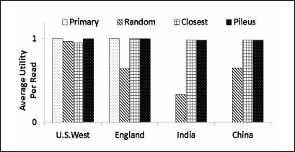
Evaluation
Application instance: shopping cart, latency-favoring application.
(Always run Gets on primary node; perform Gets on randomly selected node; perform Gets on node with lowest latency; use Pileus to select node)

Slide 30
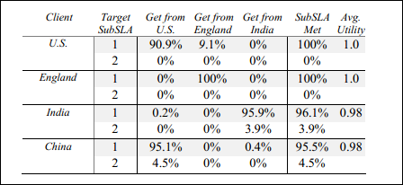
Most read operations run on the servers in the same country as the client
Most read operations can meet the first subSLA

Slide 31
Thank you

