Slide 1
Succinct Non-Interactive Zero Knowledge for a von Neumann Architecture
Eli Ben-Sasson, Alessandro Chiesa, Eran Tromer and Madars Virza
USENIX Security Symposium 2014

Slide 2
Outline
Warm-up example
Problem definition
Contribution
Evaluation
Comparison
Question time

Slide 3
What is zero knowledge proof
Interactive zero knowledge proof
theoretical systems where a first party ('Prover') exchanges messages with a second party ('Verifier') to convince the Verifier that some mathematical statement is true.
Properties
Completeness: honest prover can convince the verifier
Soundness: no cheating prover can convince the verifier
Zero-knowledge: no cheating verifier learns anything other than the fact that the fact is true/false

Slide 4
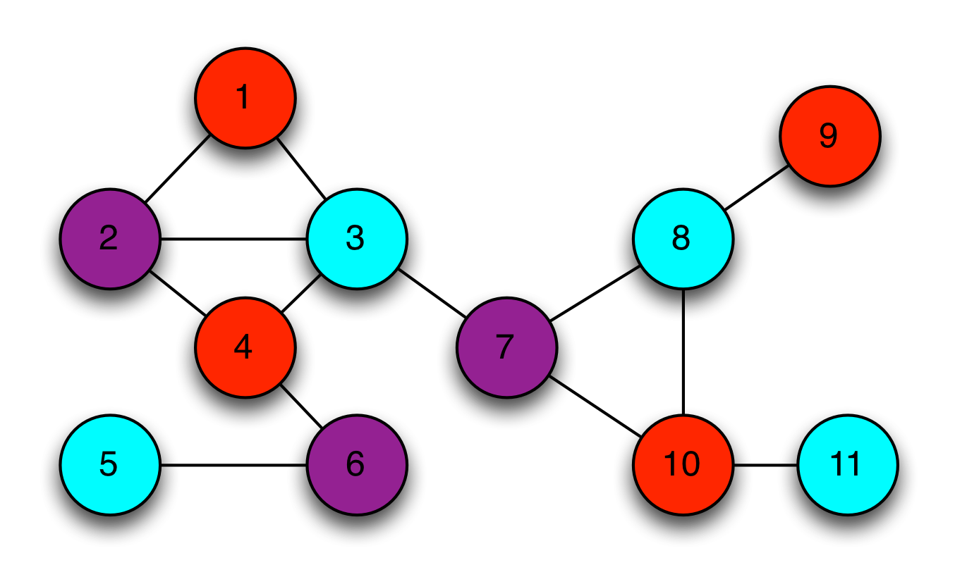
Example
AT&T want to assign frequency optimally across base stations
Seeking help from Google
No pay until knowing them have the coloring
No solution until they are paid up

Slide 5
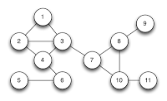
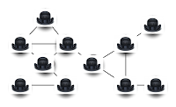
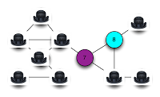
Solve the dilemma
Zero knowledge proof
AT&T place empty chart in the room and leave
Google walk in, shuffle the pens, color and cover node by hats
AT&T walk in, challenge one of the edges
Repeat until confidence is high enough

Slide 6
Non-interactive zero knowledge proof
Problem with interactive solution
No conversation, no proof
Cannot maintain conversation with many verifiers
Desired properties
Solution and proof achieved in one pass

Slide 7
Non-interactive solution
Let Google prepare a sequence of color pairs
Trivial to cheat: modifying the coloring whenever adjacent nodes conflict
An extra mile – no control over the edge sequence
Solution
Take all the commitments from proof iterations, join them into a batch
Compute the hash of the batch, and treat the hash as if it was a sequence of integers
hash

Slide 8
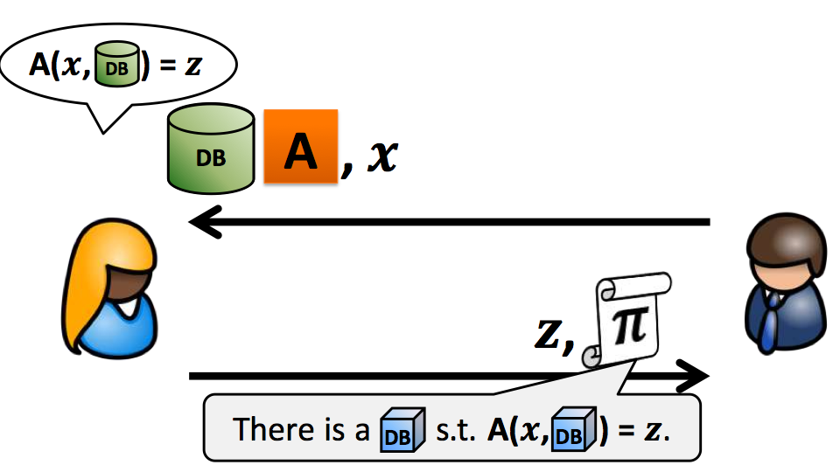
Problem definition
Security problem
A client owns a public input x
A server owns private input DB
Client wishes to learn z = A(x,DB) for problem A known to both parties
Integrity vs. confidentiality

Slide 9
More than that
Universality
“hash” function for all kinds of problems
Efficiency
Interfacing problem to a universal setting
Conduct efficient proving & verfication

Slide 10
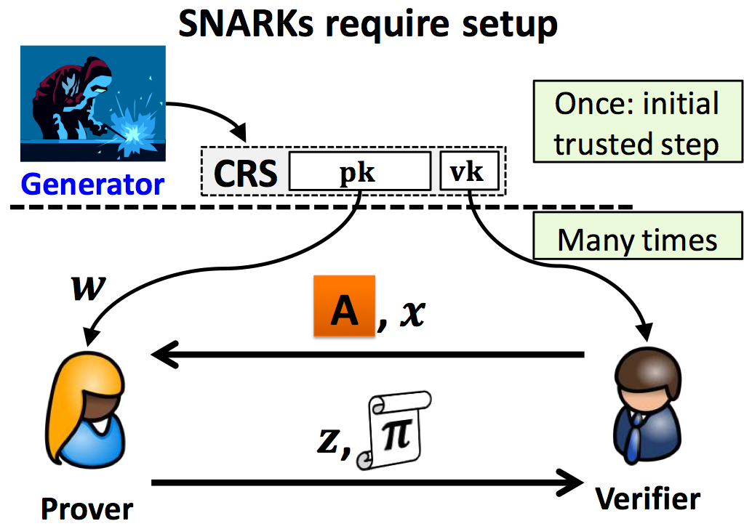
General Solution

Slide 11
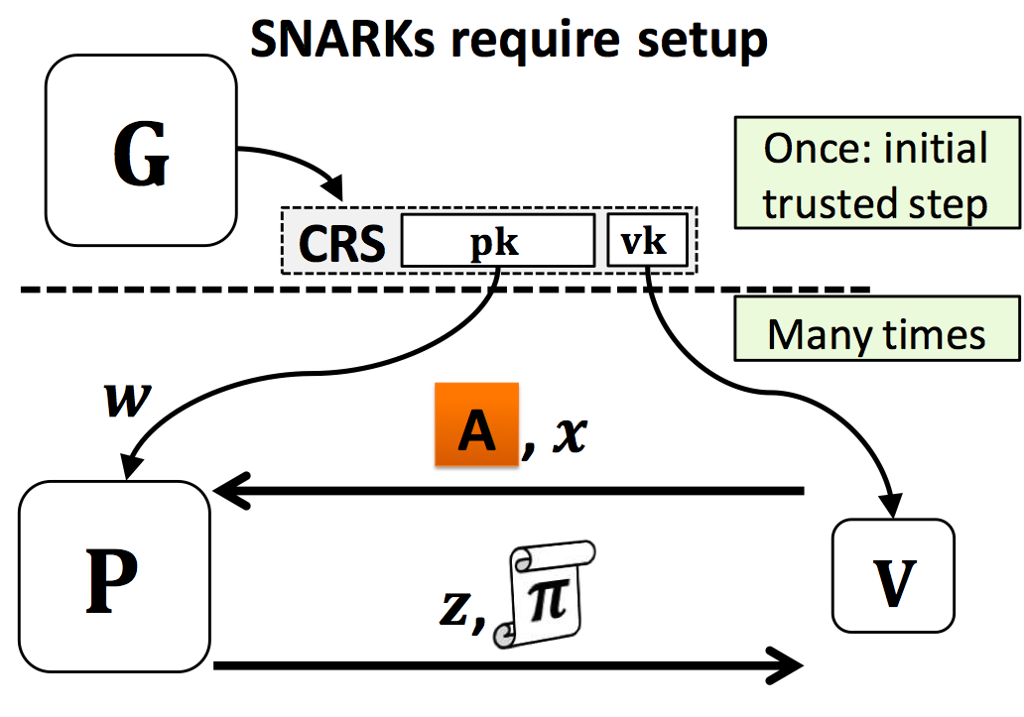
General Solution

Slide 12
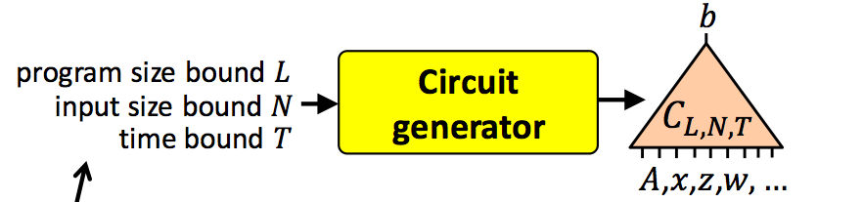
Circuit generation
Limitation of prior work
Per program key generation
Limited support to high level language
Proposal
One setting for all problem
Python?
A mini von Neumann architecture: vnTinyMem

Slide 13
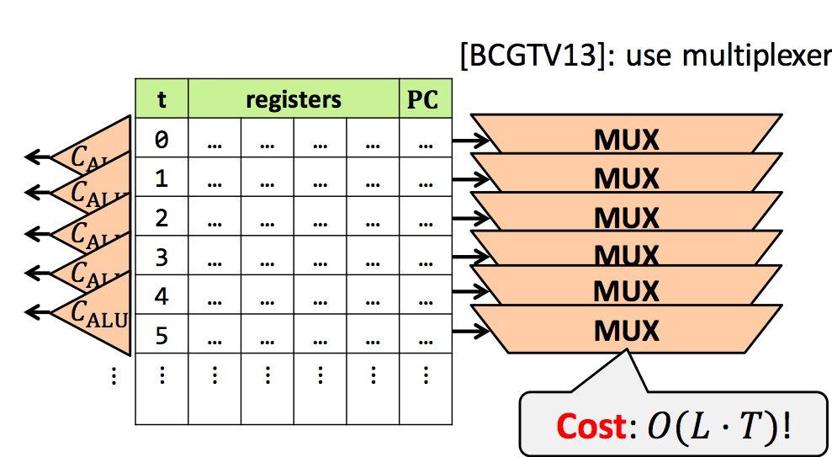
Circuit generation
Goal
Validity of instruction fetch
Validity of instruction execution
Validity of memory access

Slide 14
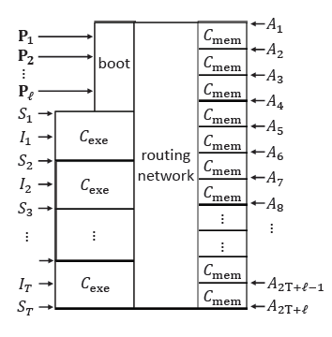
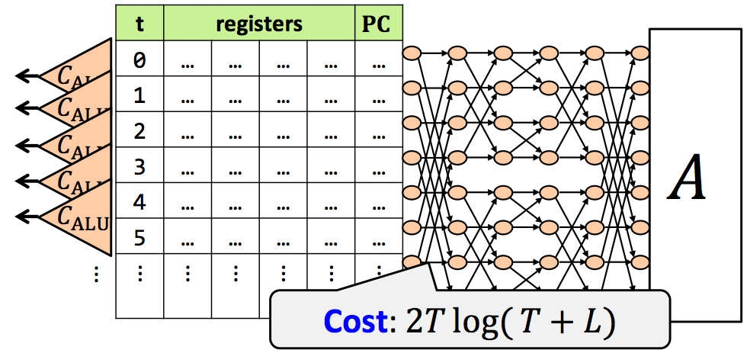
Circuit generation
Approach
CPU operation states (registers S and instruction I)
Trace = (S₁, I₁, … S_{T}, I_{T})
Non-deterministic rounting

Slide 15
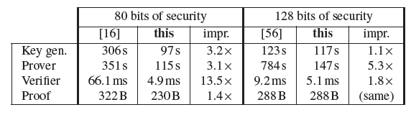
SNARK for circuit
Tailored implementation of underlying components
Finite-field arithmetic, elliptic-curve group arithmetic, pairing-based checks, and so on
Performance

Slide 16
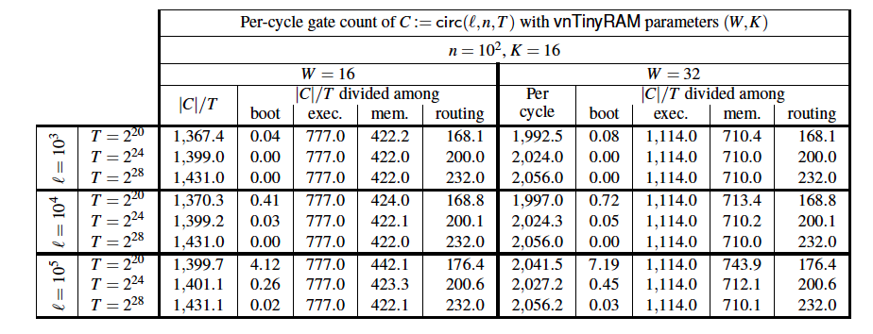
Evaluation
Circuit generator
Additive dependence of program size
Most gates dedicated to check execution

Slide 17
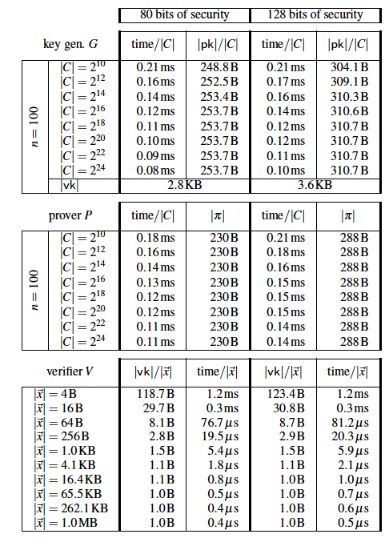
Evaluation
SNARK
Low time consumption per gate
Small proof/key size

Slide 18
Comparison
Pinocchio: Nearly Practical Verifiable Computation
Similar proof tool chain workflow
Constant proof size
Circuit generation: program analysis
Restrict loop iteration bounds and memory accesses to be known at compile time
Good for circuit-like routines
Bad for memory intensive programs

Slide 19
Comparison
Pantry: Verifying computations with state
Re-implemented protocol in “Pinocchio”, allow data dependent memory access
Extend verifiable map-reduce framework
Gate consumption is high for memory accesses
Also rely on program analysis

Slide 20
Comparison
TRUESET: Faster Veriﬁable Set Computations
Mixture arithmetic gates and set gates
Specialized in set operation (SQL subset)
Intersection, union and set difference
Input specific runtime

Slide 21
Thank you
Question & answer

