Slide 1
Workload-aware Storage
CSE791 Course presentation
Qiuwen Chen

Slide 2
Outline
Problem definition
f4: Facebook’s Warm BLOB Storage System
Pelican: A Building Block for Exascale Cold Data Storage
Focus
Approach
Evaluation
Conclusion

Slide 3

Problem definition
BLOB (Binary Large OBjects)
Immutable: once written, seldom modified
Unstructured: no uniform format
Diverse: size, life cycle, access pattern
A lot of them

Slide 4
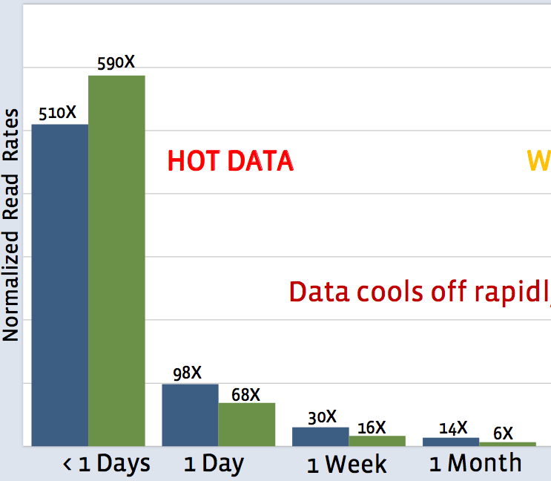
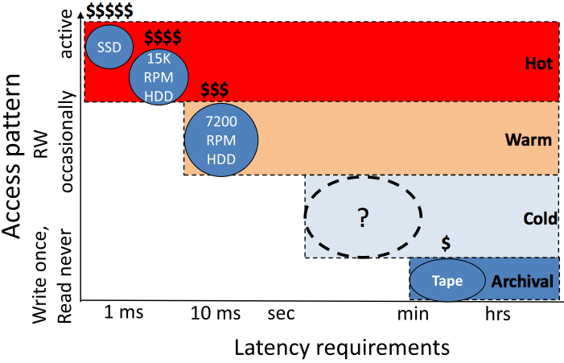
Problem definition
Data cool off – use different infrastructure

Slide 5
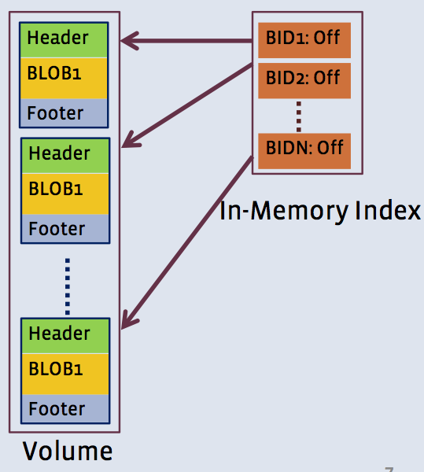
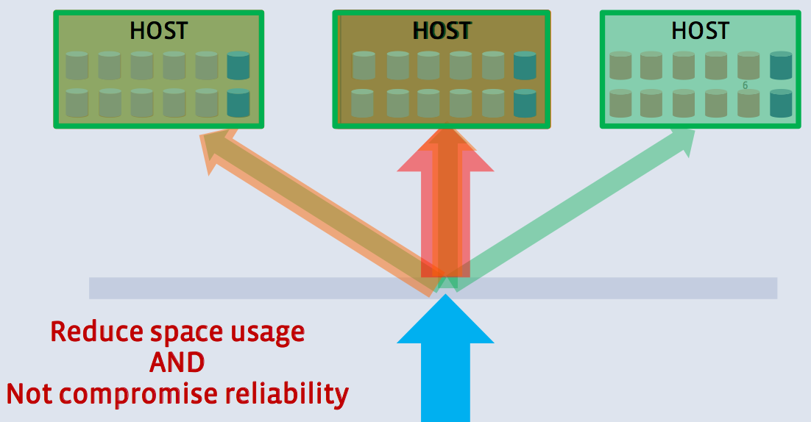
Problem definition
Hot data
Haystack
3.6X

Slide 6
Warm data
f4: Facebook’s Warm BLOB Storage System

Slide 7
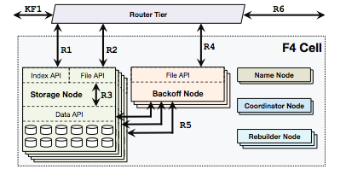
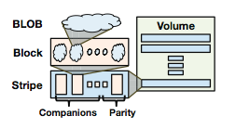
Goals
Storage space efficiency
Error detection & correction
Cell
Storage & compute
Reside in a datacenter

Slide 8
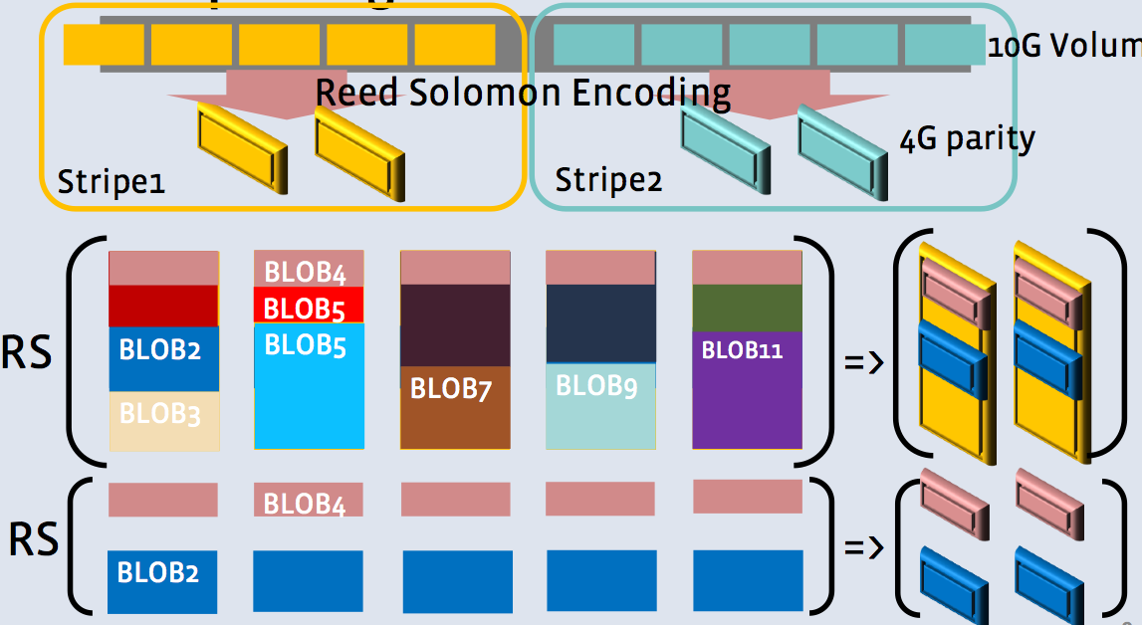
Data placement and error correction
Reed-Solomon (10, 4), rate 1.4x
Tolerate 4 racks failure

Slide 9
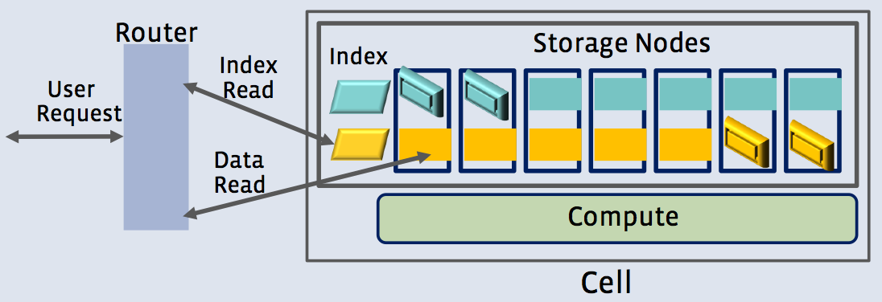
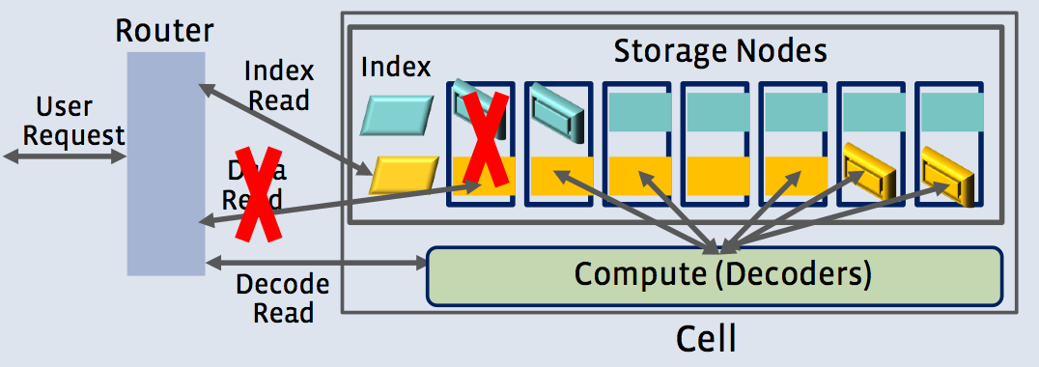
Read operation
Index read -> data read
Cell local failure

Slide 10
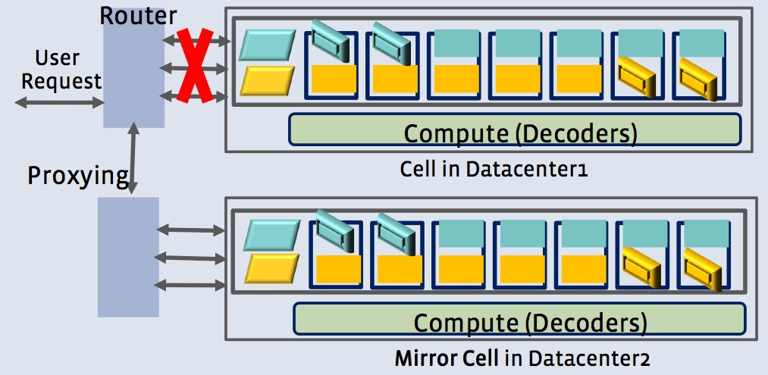
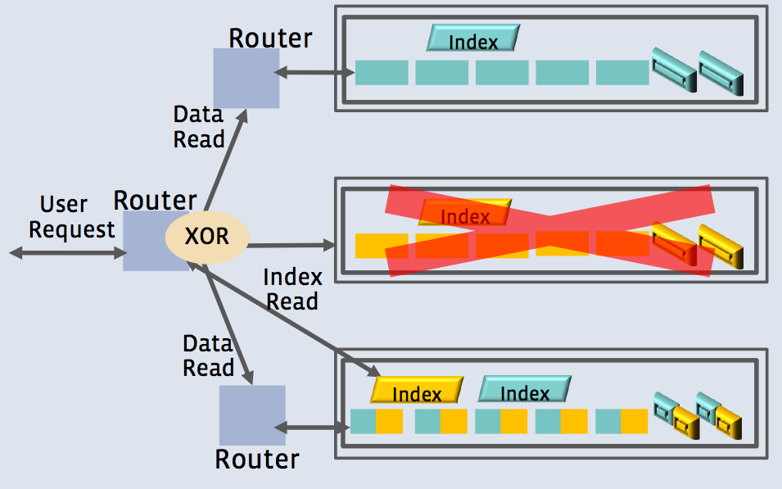
Datacenter failure
Duplication
1.4 * 2 = 2.8x
XOR encoding
1.4 * 3 / 2 = 2.1x

Slide 11
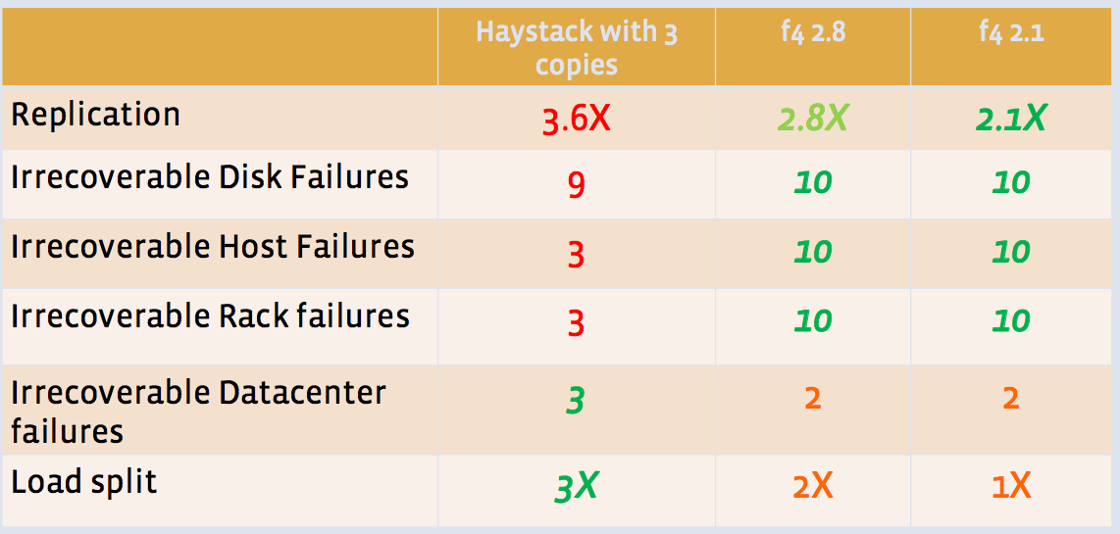
Comparison

Slide 12
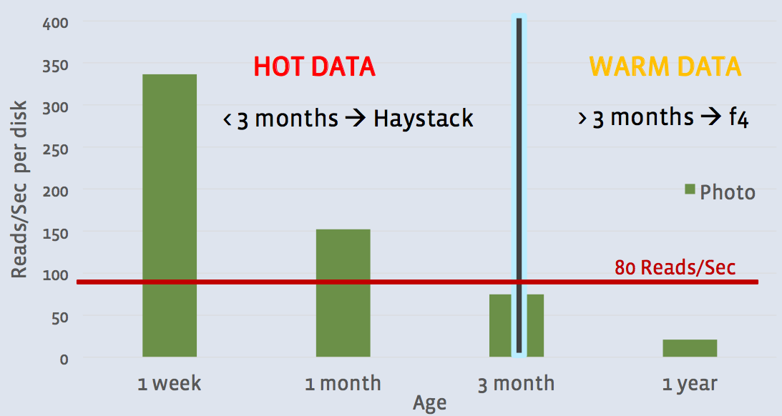
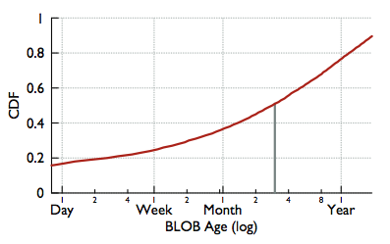
Evaluation
Hot and warm
Two week sample from the router tier of 0.1% of reads

Slide 13
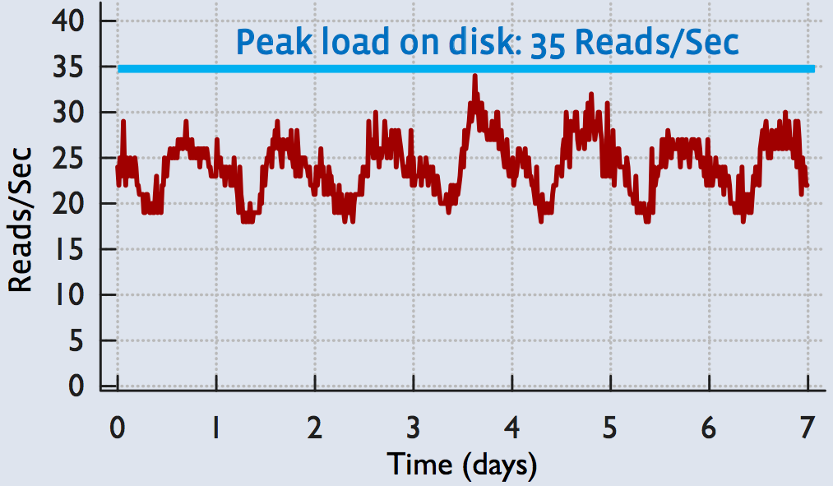
Evaluation
Workload
Peak at 8.5 IOPS/TB < 20 (Maximum rate of f4)

Slide 14
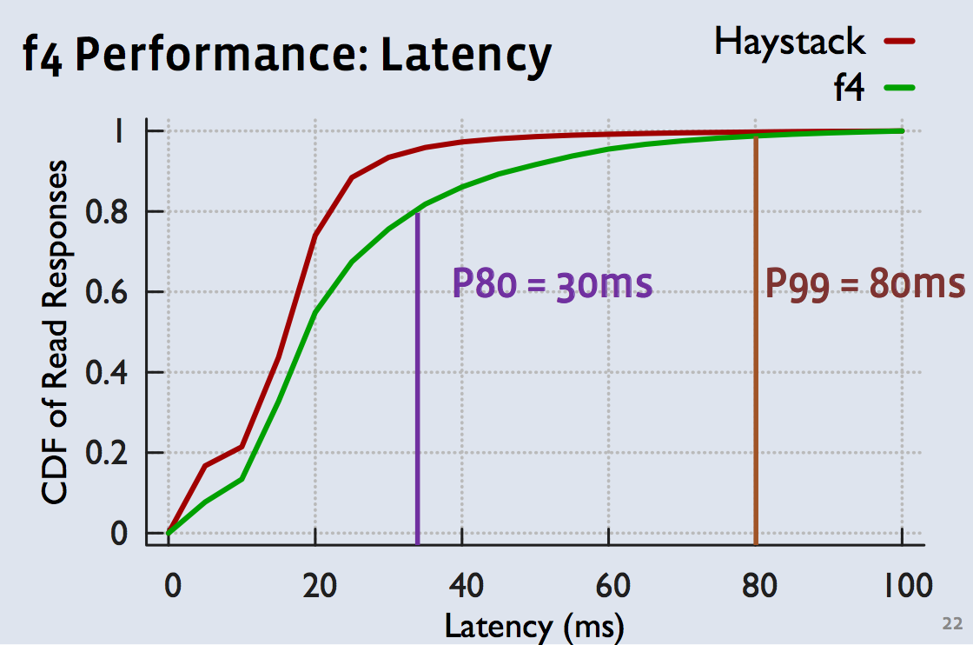
Evaluation
Latency
Sufficiently good

Slide 15
Cold data
Pelican: A building block for exascale cold data storage

Slide 16
Goals
Achieve right-provisioning (vs. full-provisioning) in rack level
At most 8% of disks spun up
Not only subject to failure domain, but also power and cooling
Hard, soft
Data placement
IO scheduling

Slide 17
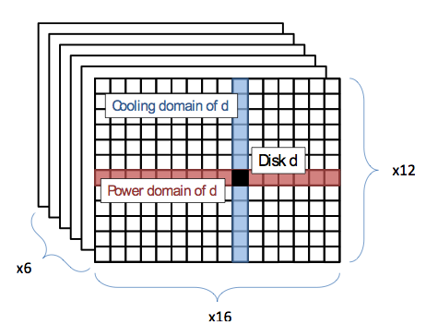
Setup
Rack -> tray -> disks
2 disk spun up per tray
1 disk spun up per vertical array

Slide 18
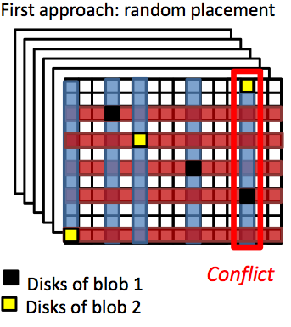
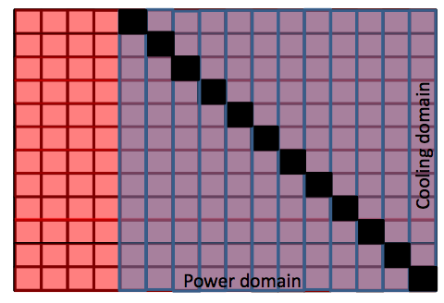
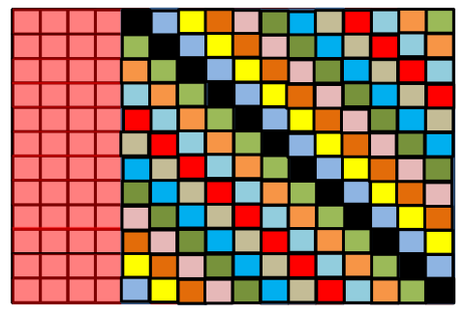
Data placement
Random placement O(n2)
Maximizing concurrency O(n)
Groups
Fully conflicting
Fully independent

Slide 19
Data placement
Error correction
RS(15, 3) -> 18 disks for 1 blob
Rump up to 24 disks per group (4 sets, find the top 3 available ones)
Assignments
12 fully conflicted groups -> class
4 independent class -> 6 racks
48 groups of 24 disks

Slide 20
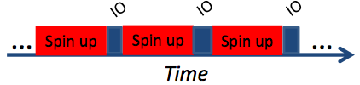

IO scheduling
4 independent scheduler for each class
One group out of 12 can be active
Naïve approach
Group activation: 14.2 sec
High latency
Request batching
Re-order limitation u
u – tradeoff between fairness and throughput
Two queue for client and rebuilt traffics

Slide 21
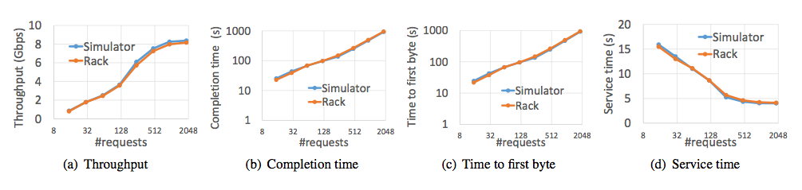
Simulator
Model
Poisson arrivals of 1GB blobs
Cross validation

Slide 22
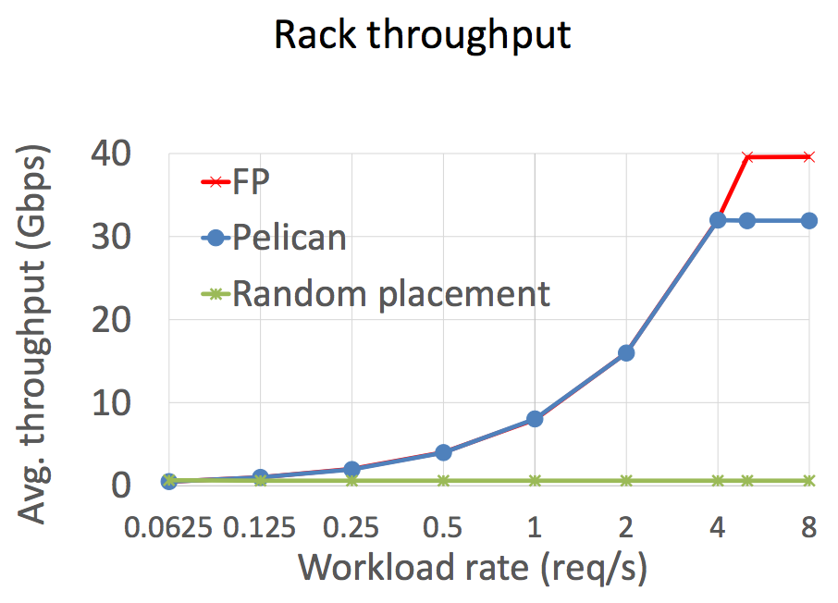
Evaluation
Throughput

Slide 23
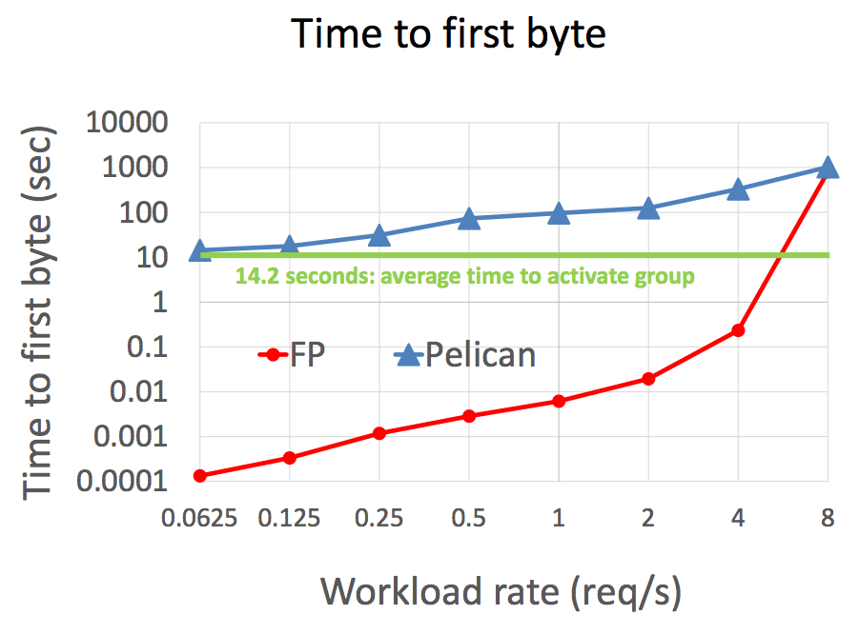
Evaluation
Time to first byte

Slide 24
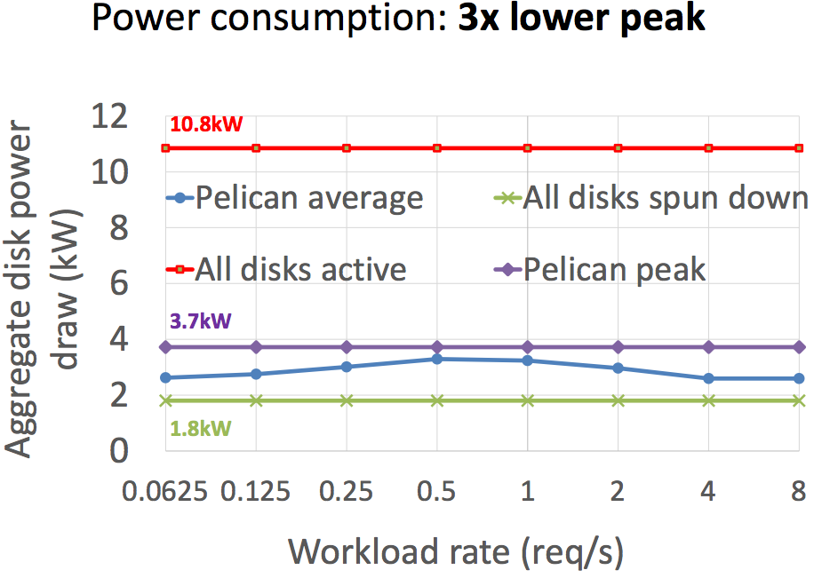
Evaluation
Power consumption

Slide 25
Conclusion
Production level system design for storing less frequently accessed data
Characterizing Storage Workloads with Counter Stacks
Data placement over storage architectures
Approximate algorithm to estimate the MSR (miss ratio curve)
Improvement
Use sophisticated soft encode schemes
Turbo, LDPC, etc

