Slide 1
Trace Analysis
Chunxu Tang

Slide 2
The Mystery Machine: End-to-end performance analysis of large-scale Internet services

Slide 3
Introduction
Complexity comes from
Scale
Heterogeneity

Slide 4
Introduction (Cont.)
End-to-end:
From a user initiates a page load in a client Web browser,
Through server-side processing, network transmission, and JavaScript execution,
To the point client Web browser finishes rendering the page.

Slide 5
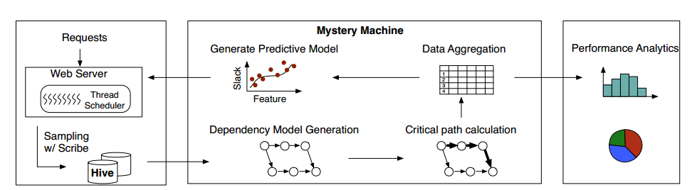
Introduction (Cont.)
UberTrace
End-to-end request tracing
Mystery Machine
Analysis framework

Slide 6
UberTrace
Unify the individual logging systems at Facebook into a single end-to-end performance tracing tool, dubbed UberTrace.

Slide 7
UberTrace (Cont.)
Log messages contain at least:
1. A unique request identifier.
2. The executing computer.
3. A timestamp that uses the local clock of the executing computer.
4. An event name.
5. A task name, where a task is defined to be a distributed thread of control.

Slide 8
The Mystery Machine
Procedure:
Create a causal model
Find the critical path
Quantify slack for segments not on the critical path
Identify segments that are correlated with performance anomalies.

Slide 9
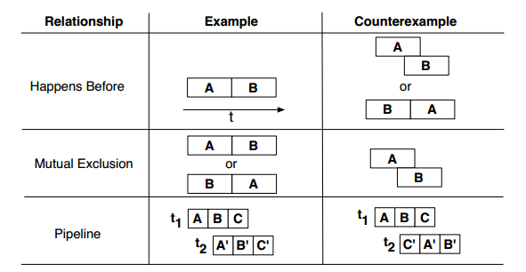
Causal Relationships Model
Happens-before (->)
Mutual exclusion (˅)
Pipeline (>>)

Slide 10
Algorithms
1. Generate all possible hypotheses for causal relationships among segments.
The execution interval between two consecutive logged events for the same task.
2. Iterate through traces and rejects a hypothesis if it finds a counterexample in any trace.

Slide 11
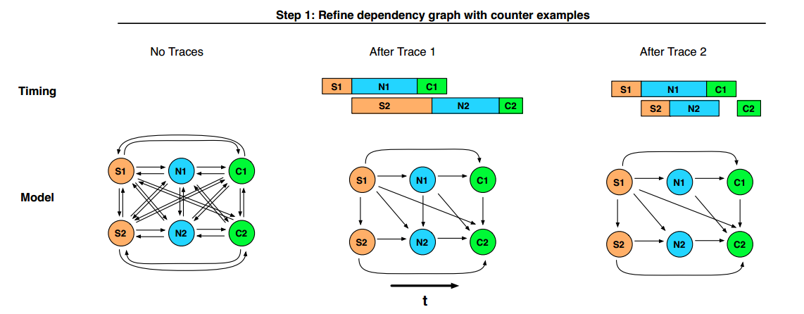
Algorithms (Cont.)

Slide 12
Analysis
Critical path analysis
The critical path is defined to be the set of segments for which a differential increase in segment execution time would result in the same differential increase in end-to-end latency.

Slide 13
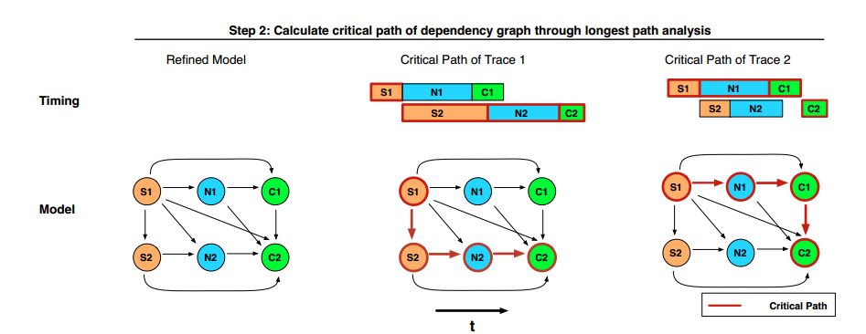
Analysis (Cont.)

Slide 14
Analysis (Cont.)
Slack Analysis
Slack is the amount by which the duration of a segment may increase without increasing the end-to-end latency of the request, assuming that the duration of all other segments remains constant.

Slide 15
Implementation

Slide 16
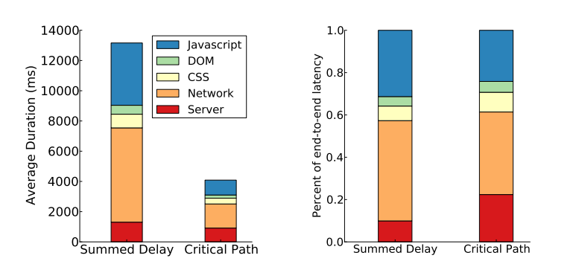
Results

Slide 17
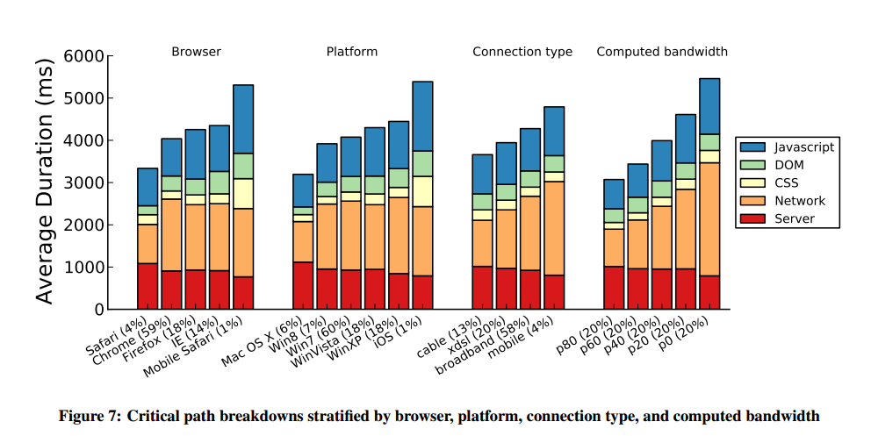
Results (Cont.)

Slide 18
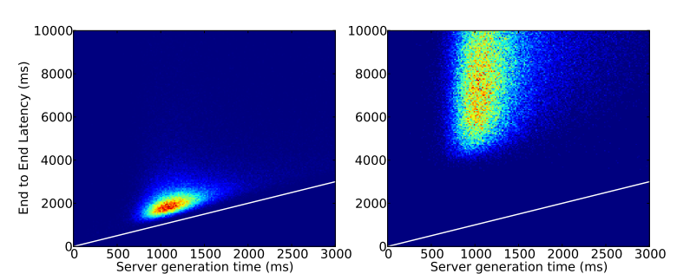
Results (Cont.)

Slide 19
Towards General-Purpose Resource Management in Shared Cloud Services

Slide 20
Introduction
Challenges of resource management
Bottleneck on hardware or software
Ambiguous which user is responsible for system load
Tenants interfere with internal system tasks
Resource requirements vary
Unpredictable which machine execute a request and how long
Goals
Effective
Efficient

Slide 21
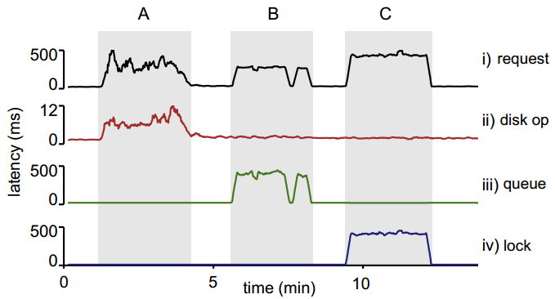
Resource Management Design Principles
Observation: Multiple request types can contend on unexpected resources.
Principles: Consider all request types and all resources in the system.

Slide 22
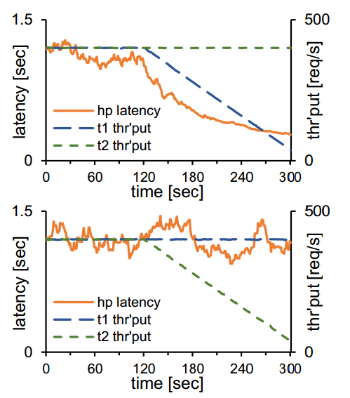
Resource Management Design Principles (Cont.)
Observation: Contention may be caused by only a subset of tenants.
Principle: Distinguish between tenants.

Slide 23
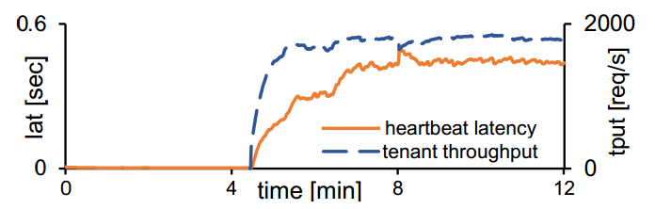
Resource Management Design Principles (Cont.)
Observation: Foreground requests are only part of the story.
Principle: Treat foreground and background tasks uniformly.

Slide 24
Resource Management Design Principles (Cont.)
Observation: Resource demands are very hard to predict.
Principle: Estimate resource usage at runtime.

Slide 25
Resource Management Design Principles (Cont.)
Observation: Requests can be long or lose importance.
Principle: Schedule early, schedule often.

Slide 26
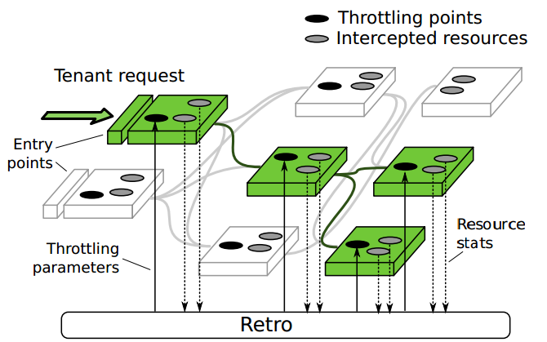
Retro Instrumentation Platform
Tenant abstraction
End-to-End ID Propagation
Automatic Resource Instrumentation using AspectJ
Aggregation and Reporting
Entry and Throttling Points

Slide 27
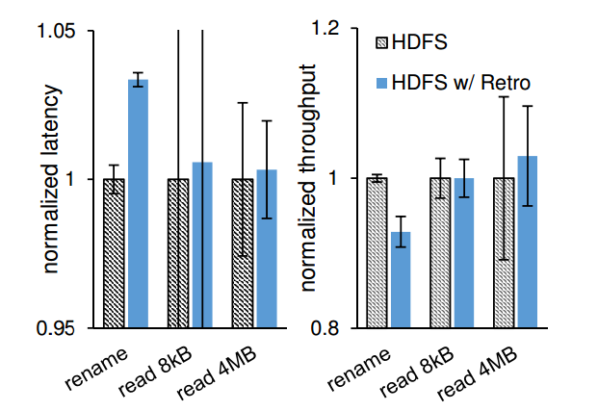
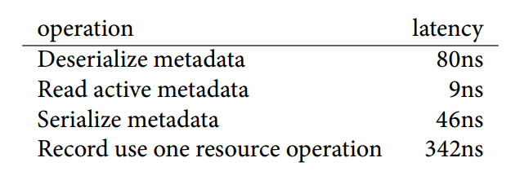
Evaluation on HDFS

Slide 28
IntroPerf: Transparent Context-Sensitive Multi-Layer Performance Inference using System Stack Traces

Slide 29
Introduction
Functionality:
With system stack traces as input, IntroPerf transparently infers context-sensitive performance data of the software by measuring the continuity of calling context – the continuous period of a function in a stack with the same calling context.

Slide 30
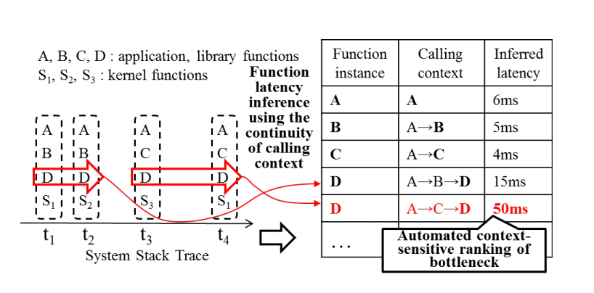
Introduction (Cont.)

Slide 31
Introduction (Cont.)
Contributions:
Transparent inference of function latency in multiple layers based on stack traces.
Automated localization of internal and external performance bottlenecks via context-sensitive performance analysis across multiple system layers.

Slide 32
Design of IntroPerf
RQ1:
Collection of traces using a widely deployed common tracing framework.
RQ2:
Application performance analysis at the fine-grained function level with calling context information.
RQ3:
Reasonable coverage of program execution captured by system stack traces for performance debugging.

Slide 33
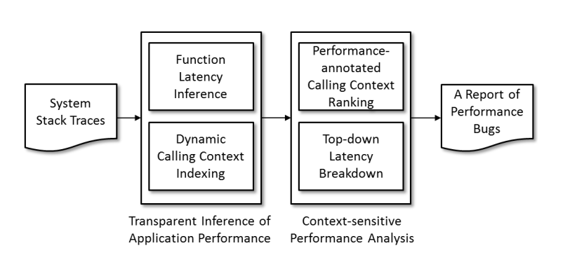
Architecture

Slide 34
Inference of Function Latencies
Conservative estimation:
Estimates the end of a function with the last event of the context
Aggressive estimation:
Estimates the end with the start event of a distinct context.

Slide 35
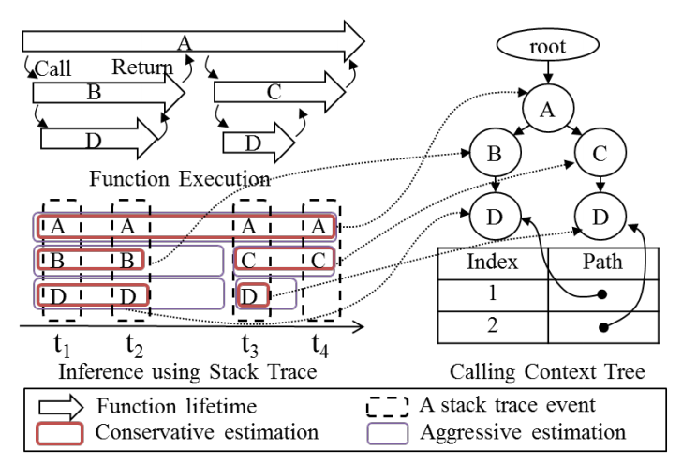
Inference of Function Latencies (Cont.)

Slide 36
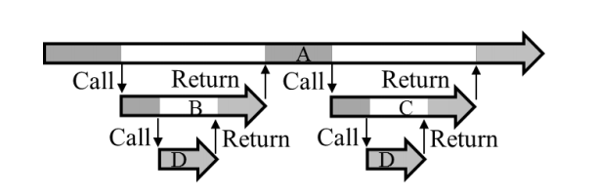
Context-sensitive analysis of inferred performance
Top-down latency normalization
Performance-annotated calling context ranking

Slide 37
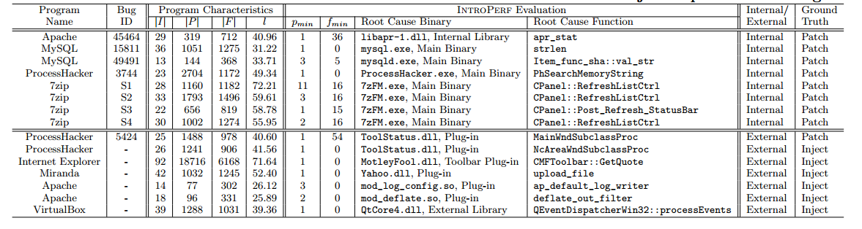
Evaluation

Slide 38
Summary of the papers
http://joshuatang.github.io/timeline/papers.html

