Slide 1

420-W45-SF Installation de serveurs et de services
Claude Roy
Bastion de sécurité

Slide 2
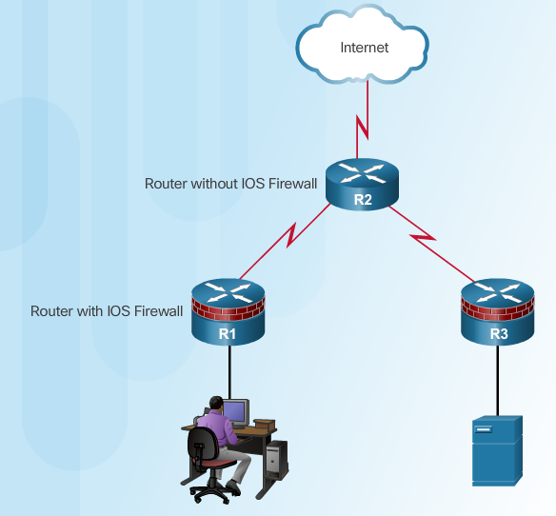
Coupe-feu de sécurité
Les coupes-feu séparent les zones protégées des zones non protégées pour empêcher des utilisateurs non autorisés d'accéder aux ressources du réseau protégées.
Ils sont résistants aux attaques
Ils sont le seul point de transit entre les réseaux parce que tous les flux de trafic passent à travers le pare-feu
Applique la politique de contrôle d'accès
Notes:
4.2.1.1 Defining Firewalls

Slide 3
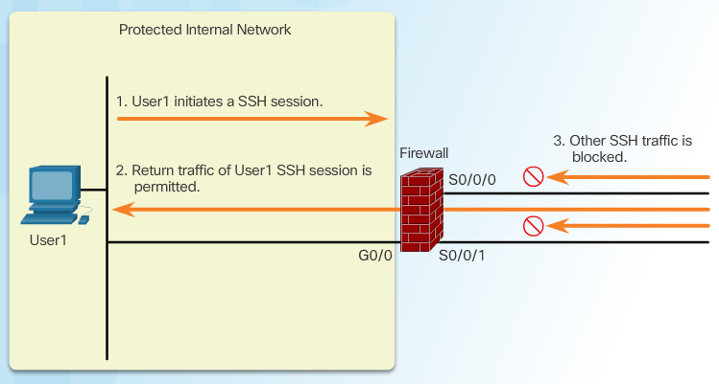
Classic Firewall
Notes:
4.2.3.1 Introducing Classic Firewall

Slide 4
Types de bastion de sécurité

Slide 5
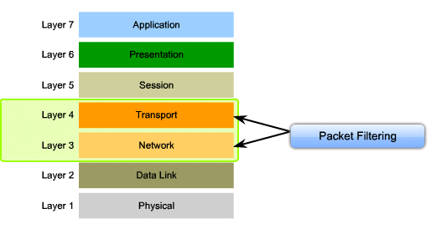
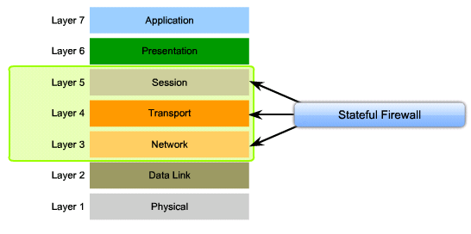
Types de pare-feu - Firewalls
Filtrage de paquets Packet-filtering firewall
Pare-feu à états Stateful firewall

Slide 6
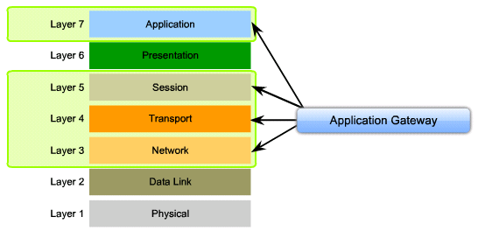
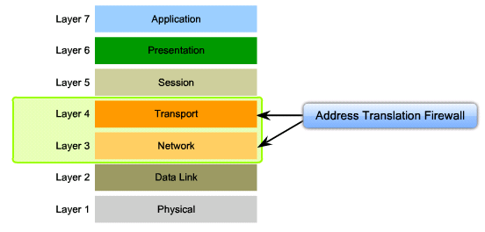
Autres bastions de sécurité
Application gateway firewall (proxy firewall):
Filters information at OSI Layers 3, 4, 5, and 7.
Firewall control and filtering is done in software.
Address-translation (NAT) firewall:
A firewall that expands the number of IP addresses available and hides network addressing design.

Slide 7
Stateless versus Stateful Packet Filtering
Stateless packet filtering:
Les ACLs filtrent en utilisant les adresses IP source et destination, les numéros de port TCP et UDP, les drapeaux TCP et les types de code ICMP.
Stateful packet filtering:
L’inspection garde en mémoire certains détails ou états de la requête.
L’appareil garde des entrées de toutes les connexions passant au travers le pare-feu et il est capable de déterminer si un paquet est le début d’une connexion ou s’il fait partie d’une connexion existante.
Notes:
In the mid-1990s, packet filters and proxy servers were the two technologies that administrators used to build firewall systems. As the number of applications that needed to pass through firewalls increased, proxy server vendors could not keep up with the development of new proxy servers. On the other hand, packet filtering also could not support the dynamic nature of the many modern applications. Therefore, a new technology was born.
Unlike static packet filtering, which examines a packet based on the information in the packet header, stateful inspection tracks each connection and verifies that the connections are valid. A stateful firewall may examine not just the header information but also the contents of the packet up through the application layer in order to determine more about the packet than just information about the packet source and destination.
For example, if the initial packet of a request arrives through the inside interface, the stateful packet filter remembers certain details of that request. This remembering is called “saving the state.” Each time a TCP or UDP connection is established for inbound or outbound connections, the state information is logged in the stateful session table. When the outside system responds to the initial request, the firewall compares the received packets with the saved state to determine if the packet should be allowed into the network.
Stateful firewalling, also known as stateful packet filtering, is an application-aware method of packet filtering that works on the connection level. A stateful packet filter is application-aware, so the filter is able to recognize all sessions of a dynamic application. In addition, a stateful packet filter maintains a state table (or connection table), where the filter keeps track of all the active sessions over the firewall.
Stateful packet filtering is effective for these reasons:
This filtering works on packets and connections.
This filtering operates at a higher performance level than packet filtering or using a proxy server.
This filtering records data for every connection or connectionless transaction in a stateful session flow table. This table serves as a reference point to determine if packets belong to an existing connection or are from an unauthorized source.

Slide 8
Stateful Firewalls
Aussi appelé “stateful packet filters” et“application-aware packet filters.”
Les pare-feu Stateful sont meilleurs que les packet filters:
Ils gardent une table de session (state table) où ils suivent toutes les connexions.
Ils reconnaissent les applications dynamiques et ils savent quelles connexions supplémentaires seront initiées entre les deux extrémités.
Notes:
The state table, or session table, is part of the internal data structure of a stateful packet filter. The table tracks all the sessions and inspects all the packets that pass over the stateful packet filter firewall. The packets only pass if they have the expected properties that the state table predicts. The state table dynamically changes and adapts with the traffic flow. If no state exists, a state is created and entered into the state table if the traffic flow meets the rules allowed in the firewall.
Stateful packet filters are application-aware through additional inspection of passing traffic. By inspecting the session more closely, up to the application layer, a stateful packet filter is able to associate any dynamic channels of the application with the initial session of the application.
The concept of a session in the stateful packet filter world is connected to the TCP and UDP notion of a session. Some stateful packet filter implementations, however, can keep the state of other protocols, such as the Internet Control Message Protocol (ICMP) or generic routing encapsulation (GRE).

Slide 9
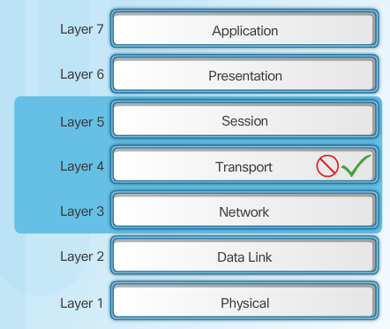
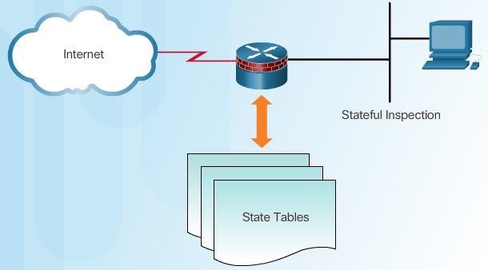
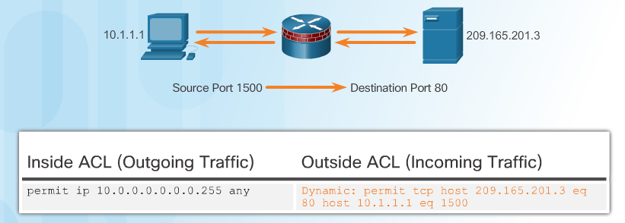
Stateful Firewalls
Stateful Firewalls
State Tables
Stateful Firewall Operation
Notes:
4.2.2.3 Stateful Firewalls

Slide 10
Coupe-feu dans le réseau

Slide 11
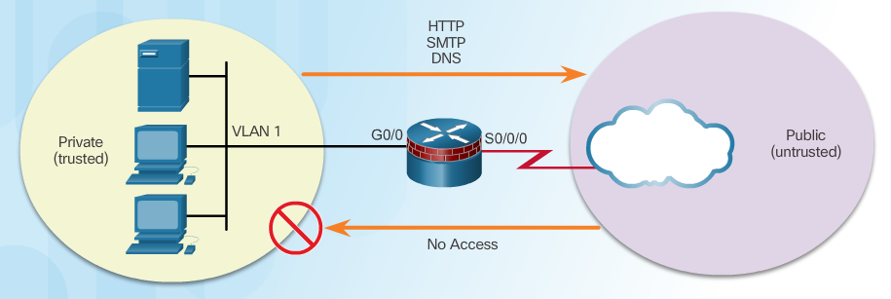
Réseau interne (Inside) et externe (Outside)
Notes:
4.2.4.1 Inside and Outside Networks

Slide 12
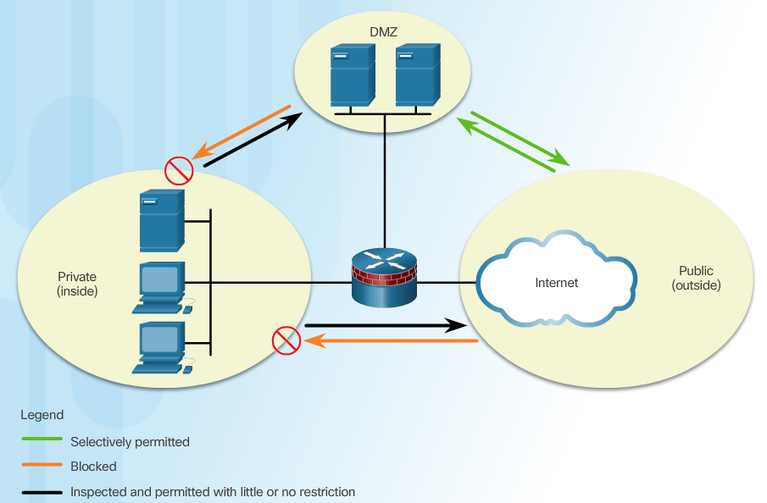
Zone démilitarisée (DMZ)
Notes:
4.2.4.2 Demilitarized Zones

Slide 13
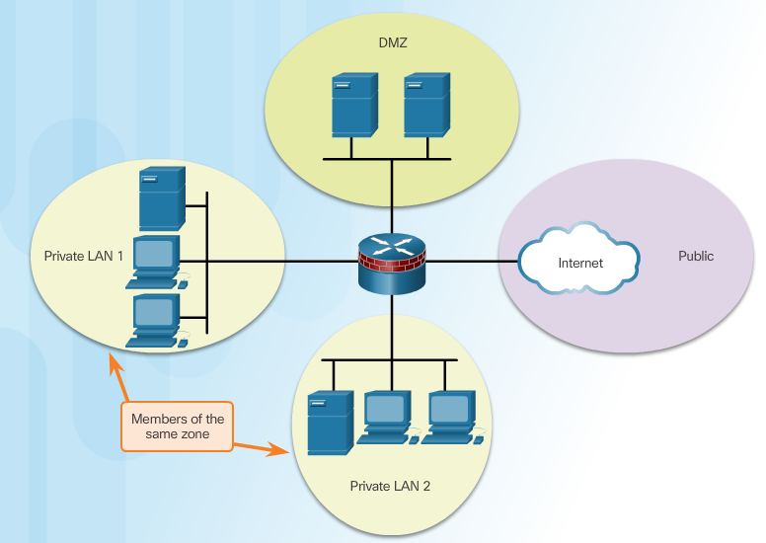
ZBF (Zone-Based Policy Firewalls)
Notes:
4.2.4.3 Zone-Based Policy Firewalls

Slide 14
Meilleurs pratiques
Les meilleurs pratiques Firewalls :
Placer les pare-feu aux frontières de sécurité.
Il est imprudent de se fier seulement aux pare-feu.
Refuser tout trafic par défaut. Permettre seulement les services nécessaires.
L’accès physique aux pare-feu doit être contrôlé.
Sureveiller les journaux (logs) des pare-feu.
Faire la gestion de changement pour tout changement à la configuration des pare-feu.
Notes:
4.2.4.4 Layered Defense

