Slide 1
表示值
127
+0
-0
码值
00000000
01111111
10000000
11111111
重复0
-127

Slide 2
表示值
127
+0
-0
码值
00000000
01111111
10000000
11111111
重复0
-127

Slide 3
表示值
127
+0
-0
码值
00000000
01111111
10000000
11111111
-127
-128

Slide 4
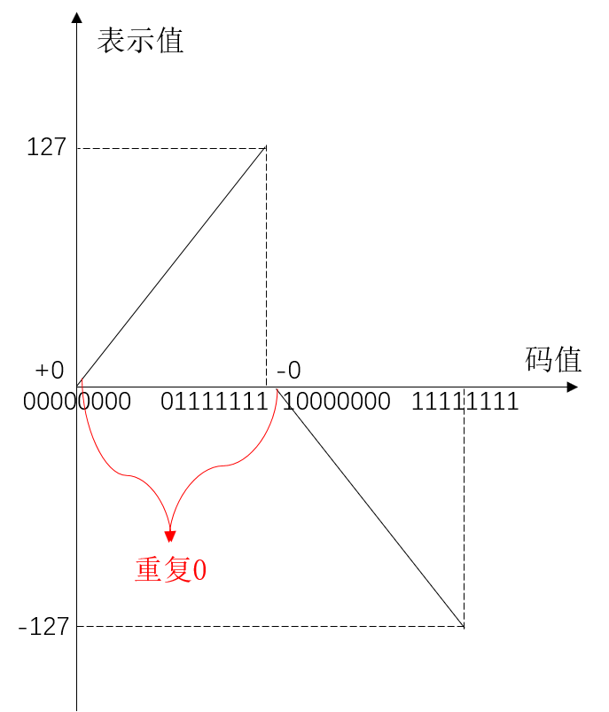
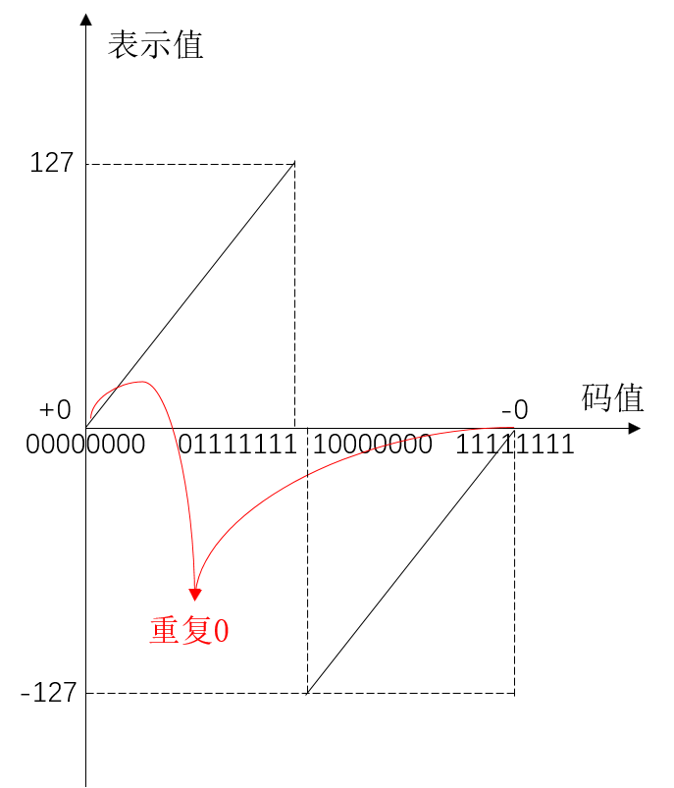
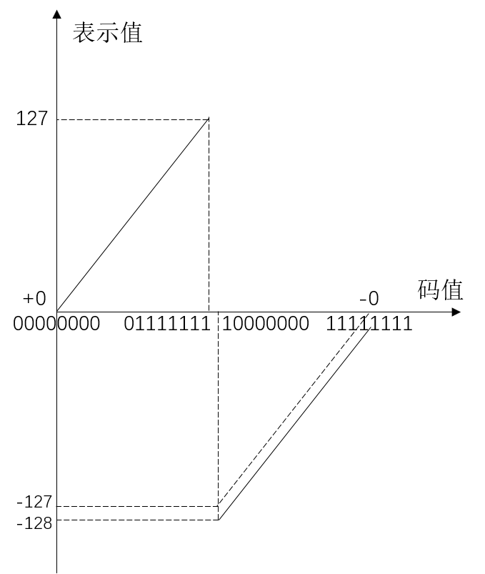
原码
反码
补码

Slide 5
00000000
负
10000000
正正得正
正负得正
正负得负
负负得负
正
00000000
负
负
10000000
正
正
正
正
00000000
负
负
正
负
10000000
负
正
00000000
负
10000000
正
00000000

Slide 6
Axis
Axis
Tensor
Tensor
Index
Along the axis which item should be chosen in the Tensor is specified by the index number contained in this cell, then collect all the layers in the Index we will get the result tensor which has the same shape with Index.

Slide 7
index_select
gather
Axis 0
Total 3
Axis 0
× 3
Along the axis function index_select only select the total slice of the specified tensor by the index number, but function gather will focus on the precision of cell data and select them by the index tensor.

Slide 8
Distribution
autoconf
configure.ac
configure
make
configure
Makefile
automake
Makefile.am
Makefile.in
make install

Slide 9
Agent
Env
PID
initialize_env()
ACK
Init()
env.reset()
rx_env_state()
Notify()
send_actions()
step()
rx_env_state()
send_actions()
step()
...
rx_env_state()
Notify()/SimulationEnd/GameOver
send_close_command()
terminate
terminate

Slide 10
Agent
Env
PID
initialize_env()
ACK
Init()
env.reset()
rx_env_state()
Notify()
send_actions()
step()
rx_env_state()
...
Notify()
env.close()
terminate
terminate

