Slide 1



Lending Club EDA
By,
Tritam Mohanty

Slide 2

Business Problem
Overview:
Lending Club is the largest online loan marketplace, facilitating personal loans, business loans, and financing of medical procedures. Borrowers can easily access lower interest rate loans through a fast online interface.
Expectations
Derive driving factors for loan default and risk assessment
This Data Analysis was to explore the business driven and data driven conclusion to discover the driving factors for loan default.

Slide 3

Approach to Problem
Data Understanding.
Data Cleanup
Deriving New Columns.
Performing Univariate Analysis.
Performing Segmented Univariate Analysis.
Performing Bivariate Analysis.

Slide 4

Understanding Data
39,717 records and 111 features
Removal of Data
Duplicate Records
50% of columns with no values
Columns with 60% or more missing values
Columns with less relevance for the analysis
Outliers
Formatting Data
Fixing Columns
Standardize Precision
Correcting Data Types and invalid values

Slide 5

Key Business Metrics
Positive Metrics
87% fully paid
Increase in business year on year
57.49% of the funded amount could be recovered for Charged Off loans
Profit of 17.31% from Fully Paid loans
96.14% match of funded amount to loan amount
Negative Metrics
13% Charged off loans
50% borrowers not verified
Avg Charged Off from 2007 to 2011 is 13.6%
42.51% of the Charged Off loan were not recovered
3.85% when loan amount did not match funded amount

Slide 6
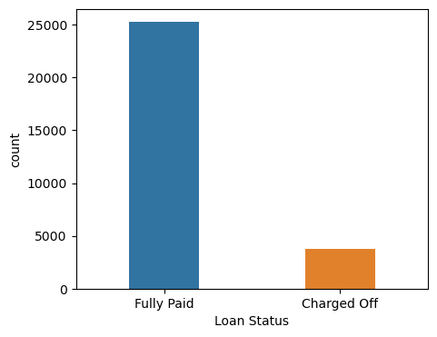
Univariate Analysis
87% Full paid and 13% Charged off loans
36.1% (Maximum) borrowers in interest rate < 10%
Maximum borrowers in 0-50K income group (49.05%) income group and 0-3Y(44.13%) employment length
82.1% borrowers fall in 36 months term and 17.8% in 60 months term
50% borrowers are not verified
Grades A and B have minimum defaults
Loans issued show huge growth year on year
More loans taken towards Year End may be due to Festive season

Slide 7
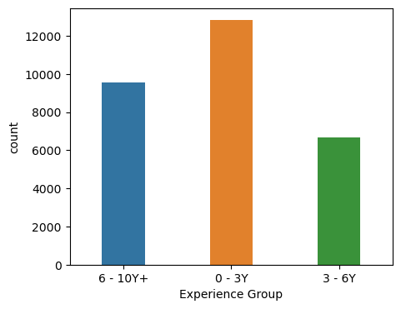
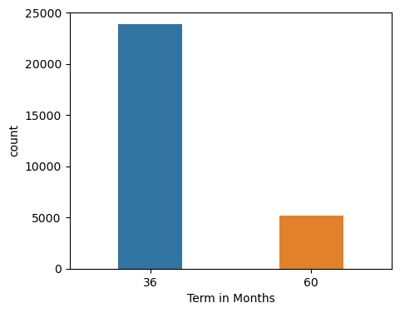
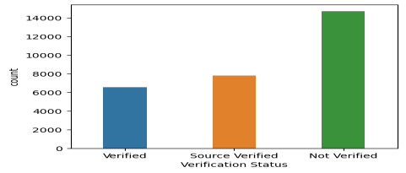
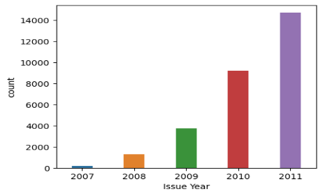
Univariate Analysis

Slide 8
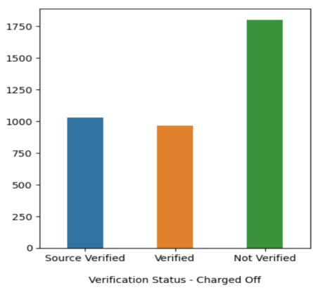
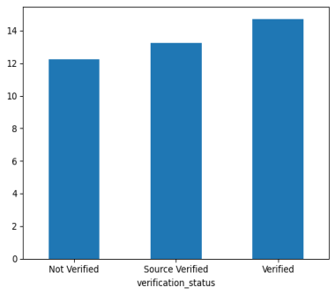
Bivariate Analysis
Verification status / Loan Status
More number of charged off loans from Not Verified Applicants
Verified Applicants default 2.7% more when compared against total loans in Verified category

Slide 9
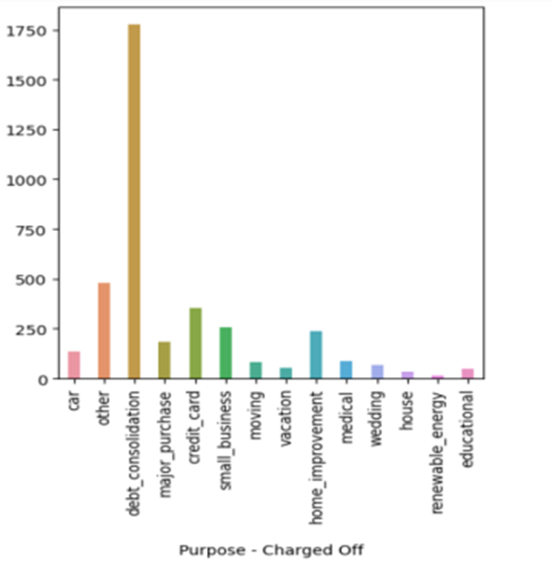
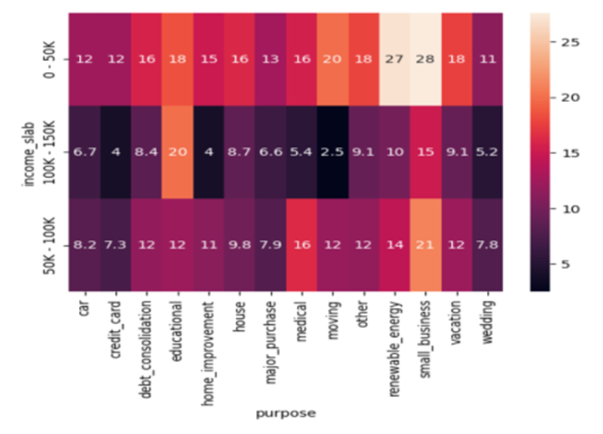
Bivariate Analysis
Purpose
Small businesses, education and renewable energy are the top 3 defaults in loan categories
Small businesses most likely default in income slabs below 50K and higher than 100K
For income range 50-100K, education is the top contributor followed by small businesses

Slide 10
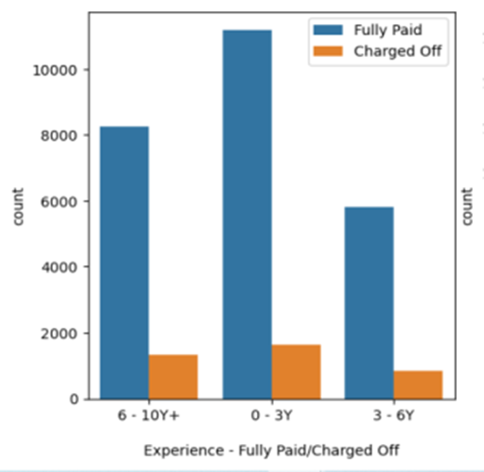
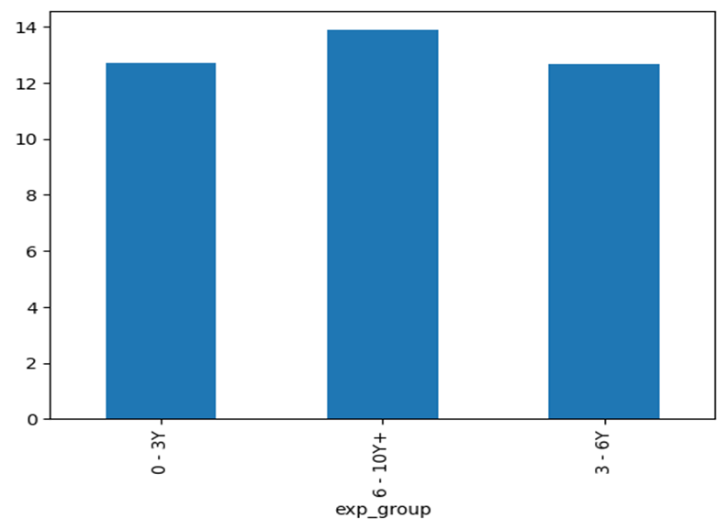
Bivariate Analysis
Employment Length
We have more borrowers who have fully paid and charged off in 0-3 Years employment length
Borrowers in 6-10 Years employment length default more when compared with total borrowers in the same group
More default comes from large fund amounts (12K or more) and the surprisingly amounts below 3K also that they borrow and are not able to repay

Slide 11
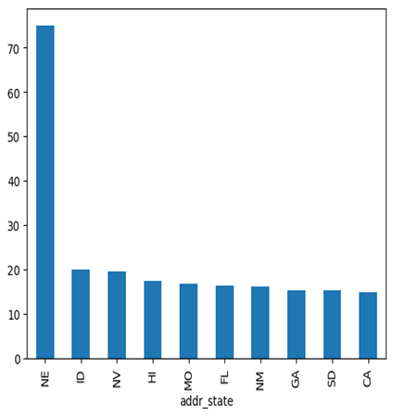
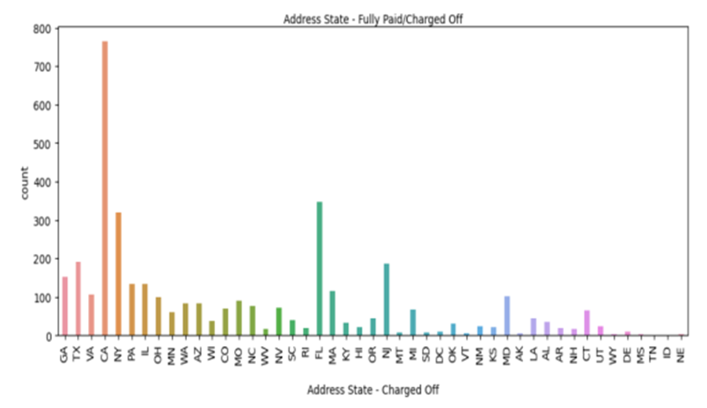
Bivariate Analysis
State
We have more borrowers who have fully paid and charged off from CA and FL
Borrowers in NE, ID and NV default more when compared with total borrowers in the same area
More verification preferred for top 10 default regions marked in the graph below

Slide 12

Recommendations
Verify applicants before providing loans
Consider revisiting or improving the verification process as verified applicants also default more
Recommend applicants from Grades A and B. Applicants from Grade C and above have higher default rates
More caution and verification is recommended for funding higher amounts with a tenure of 60 months as they tend to default more
Recommend more controls while funding applicants with multiple open accounts as they default more
Recommend lower interest rates with thorough evaluation of other factors like annual income etc. before choosing higher interest rates

Slide 13
Recommendations
Recommend caution while funding small businesses in general and specially in income range below 50K
Loans borrowed for education and renewable energy also default more. More verification/controls to be exercised in these categories
Loans funded with amounts 12K and above default more in all income groups specially in 6-10Y+. A better verification process needs to be exercised here
Recommend Not to fund applicants with Inquiries in last 6 months
Recommend Not to consider applicants with public records and public record bankruptcies
Recommend more verification for applicants coming from Nebraska, Nevada Idaho, California and Florida

Slide 14
Thank You

