Slide 1
NIH Meeting April 19th 2017

Slide 2

Green-Technology

Slide 3
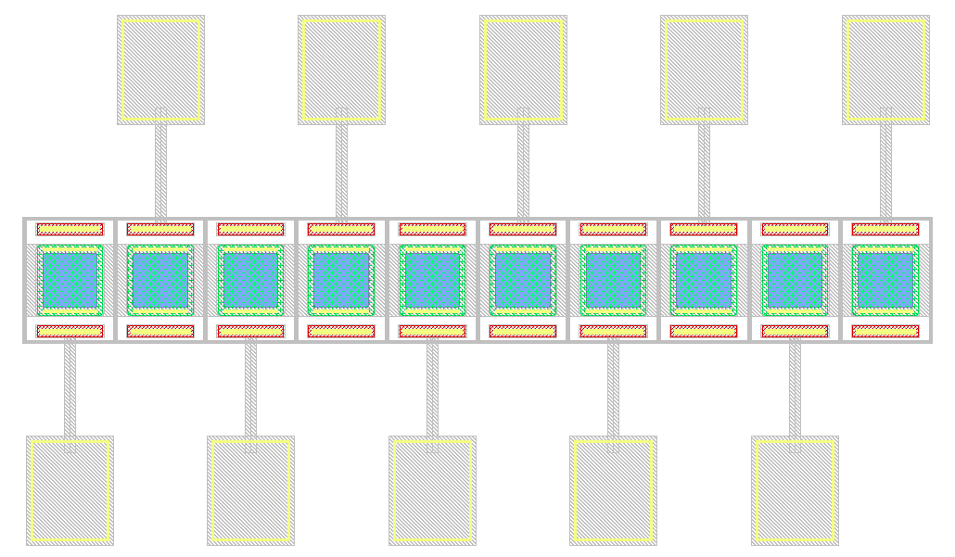
Option #1
Lx
Ly
Data:
  Pitch≅ Lx + 33μm
  Fill Factor= Lx/Pitch
Example with Lx=50μm:
  Pitch≅ 80 - 85 μm
  Fill Factor≅ 60%
Questions:
  Lx= ??
  Ly= ??

Slide 4
Option #2 – “Extreme”
Lx
Ly
Data:
  Pitch≅ Lx + 10μm
  Fill Factor= Lx/Pitch
Example with Lx=50μm:
  Pitch≅ 60 μm
  Fill Factor≅ 80%
Questions:
  Lx= ??
  Ly= ??

Slide 5
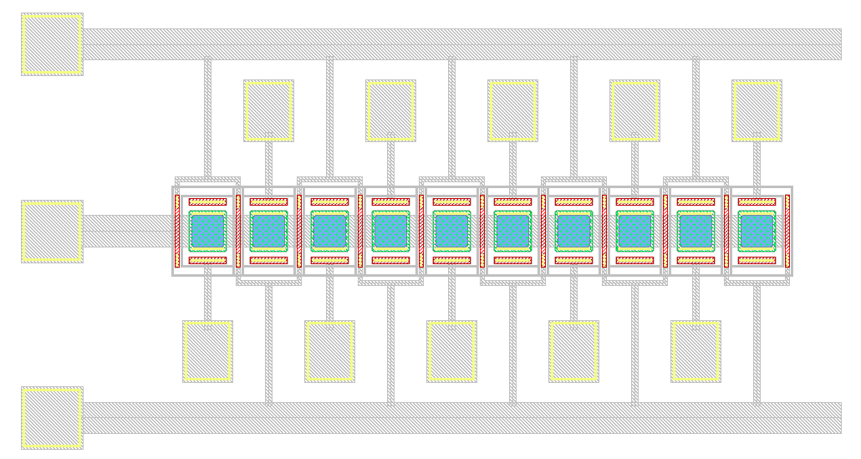
Option #3
Ly
Lx
Data:
  Pitch≅ Lx + 45μm
  Fill Factor= Lx/Pitch
Example with Lx=50μm:
  Pitch≅ 95 - 100 μm
  Fill Factor≅ 50%
Questions:
  Lx= ??
  Ly= ??

Slide 6
Red-Technology

Slide 7
With Guard-Rings:
  Pitch≅ 250μm
Without Guard-Rings:
  Pitch≅ 60μm / 80 μm / 100μm

