Slide 1
Controlling Micro Servos Using Processing
Tristrum Tuttle

Slide 2
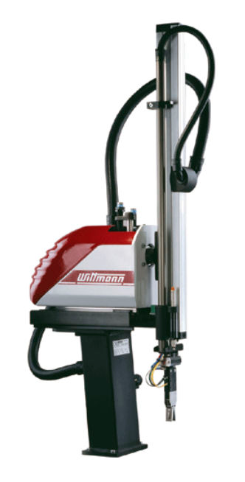
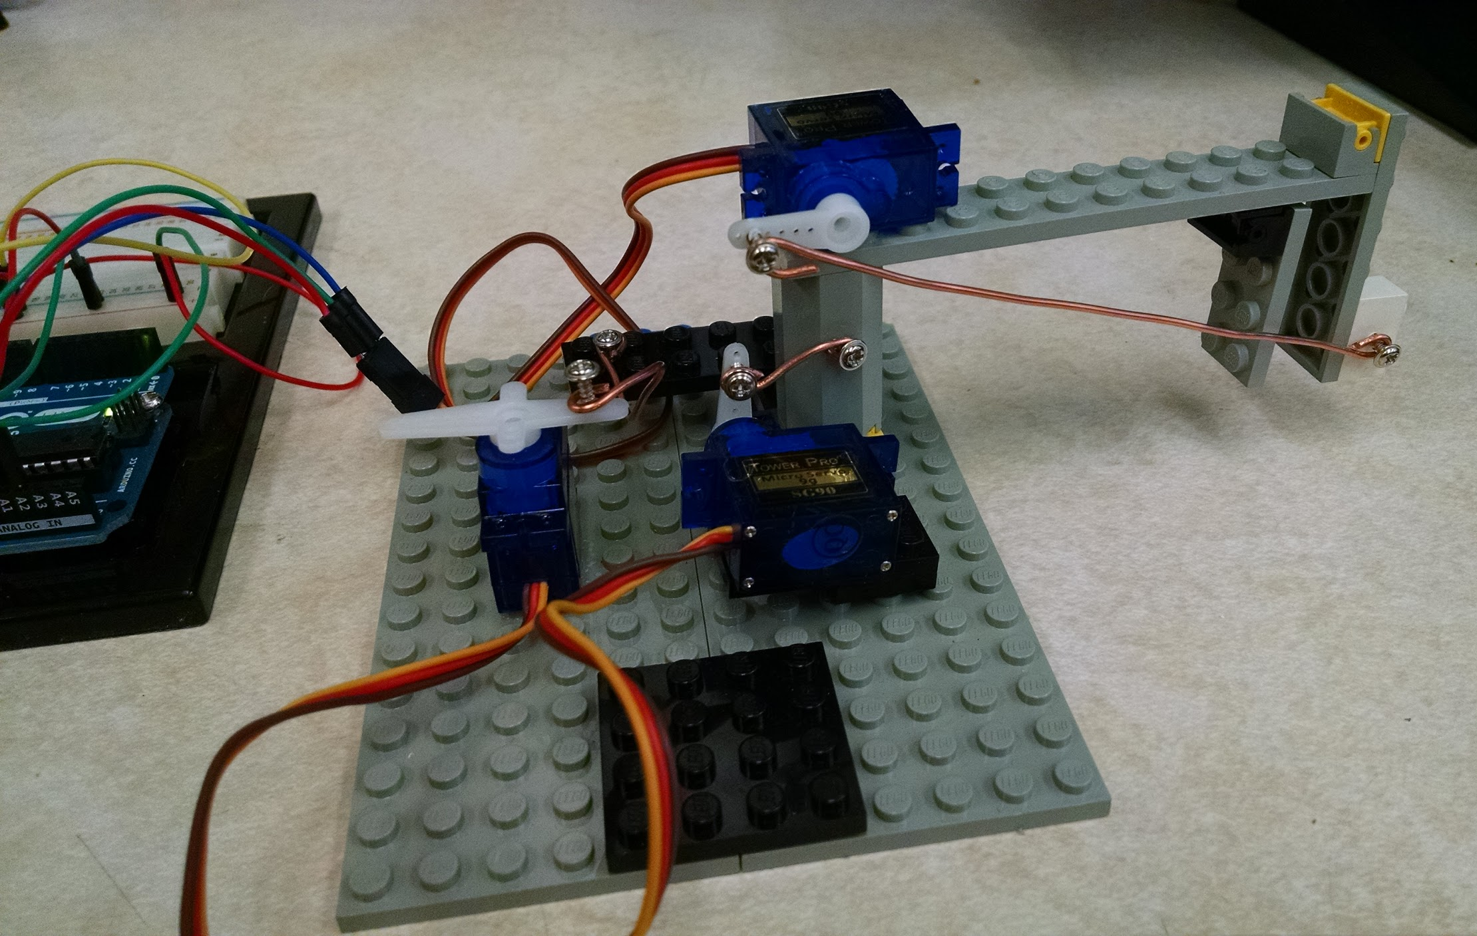
Project Explanation and Application

Slide 3
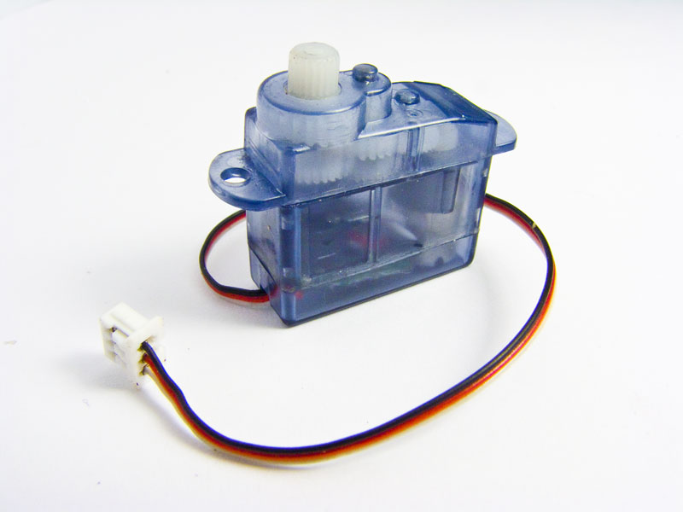
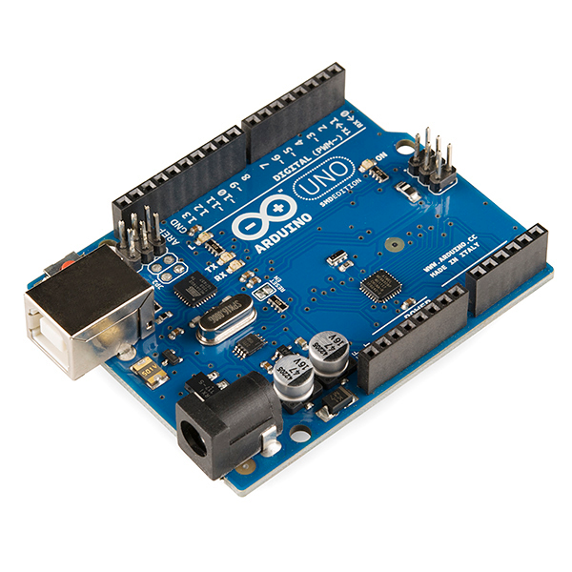

Background Information
Servo Motor
Arduino
2 Programs
Processing (the language)

Slide 4
Experimental Design
Goals: To control servo using a computer keyboard
Hypothesis: If I write a program on Processing and use it to send data to an arduino, I will be able to move servos with my keyboard.

Slide 5
Experimental Design
Variables:
Dependent: Servo movement
Independent: Lines of programming
Uncontrolled: Faulty components, Miracles
Procedure:
Build Lego Arm 3. Write Code
Build Circuit 4. Test / Analyze

Slide 6
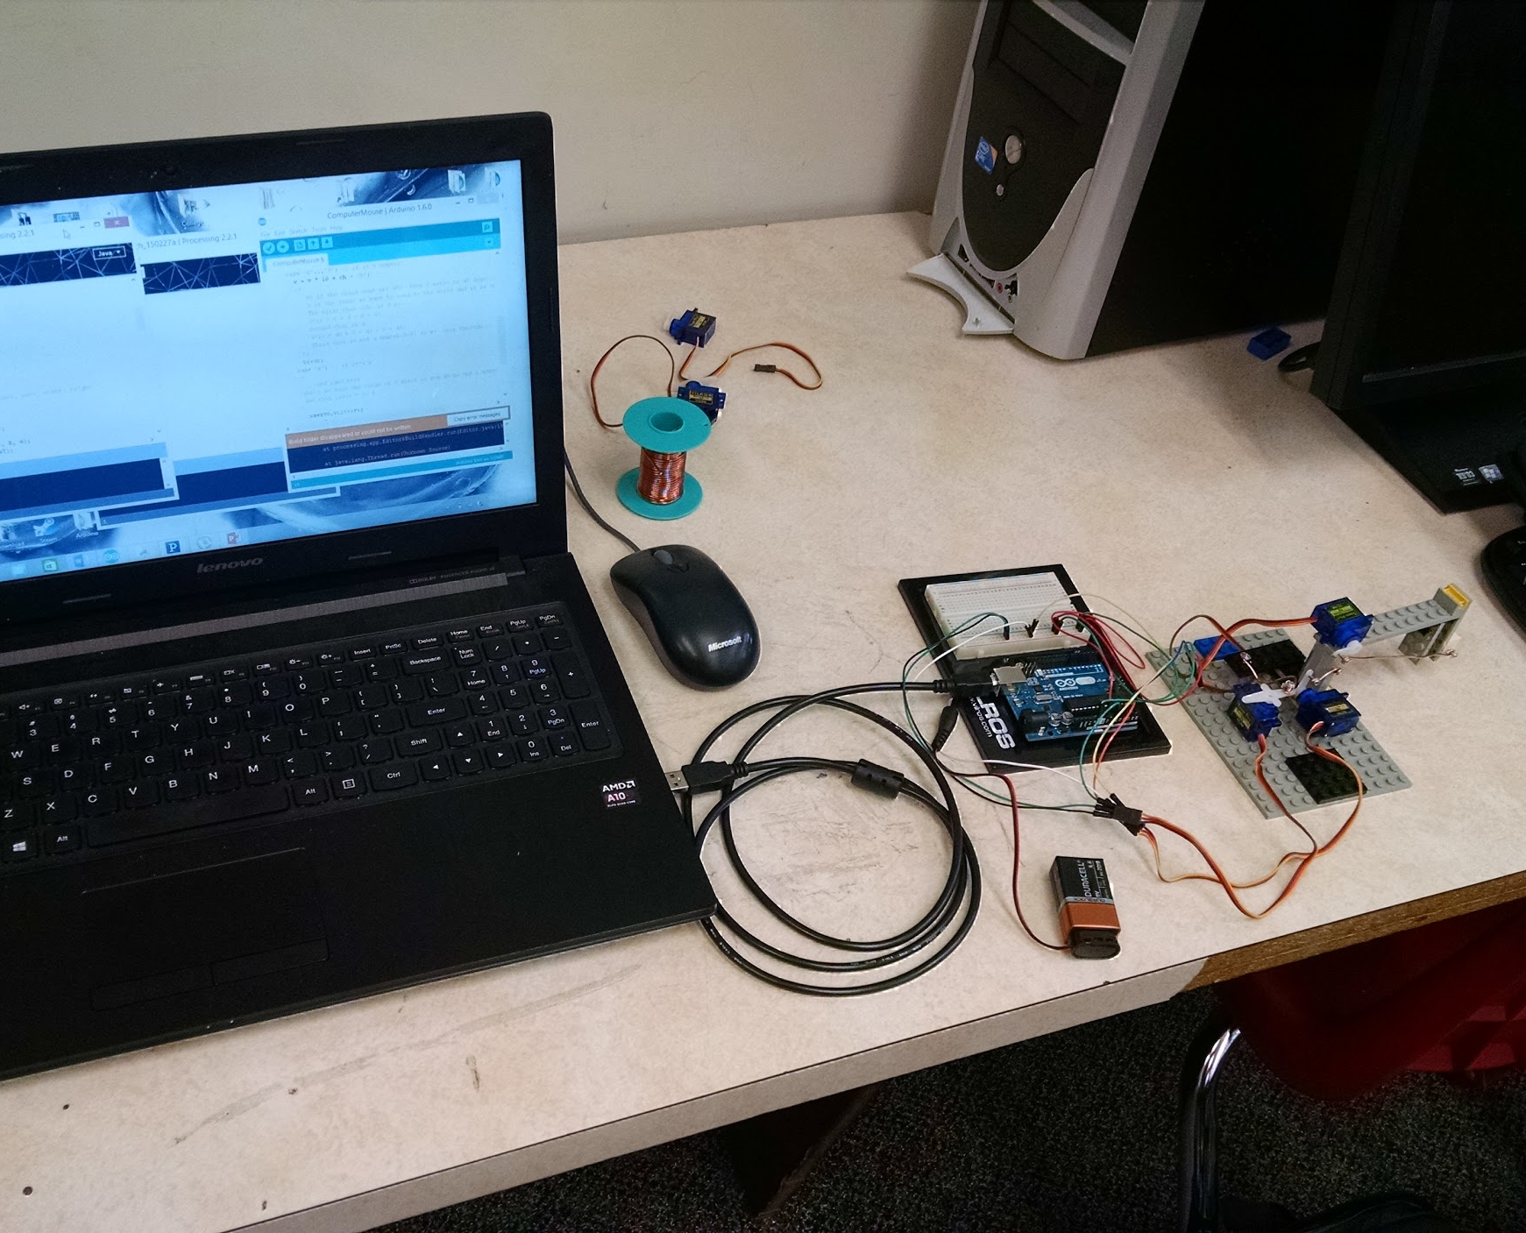
Materials
Computer
Arduino
3 Servos
Legos
Glue
3 Screws
Copper wire
Arduino software
Processing software
9V battery
Connector wires

Slide 7
Set-up
Processing Code
Bread Board
Computer
Arduino
9 Volt Battery
= Servo Motor

Slide 8
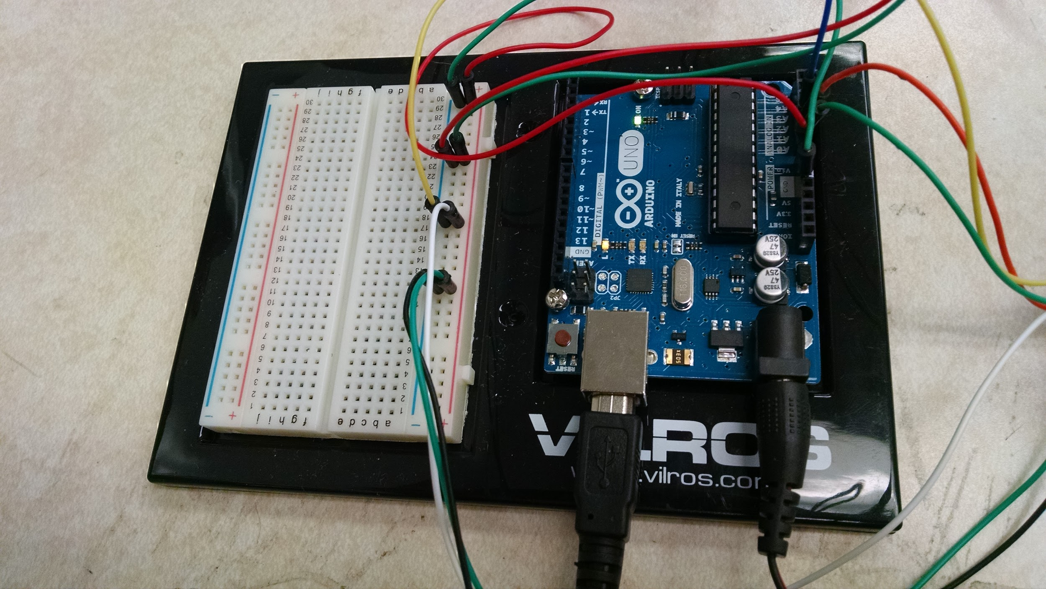
Circuit

Slide 9
Arm

Slide 10
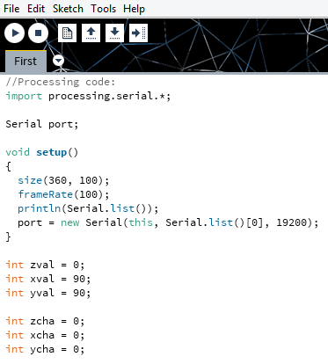
Processing Code
Serial Library
Find Arduino Port
Value
Change

Slide 11
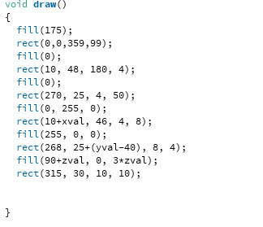
Processing Code

Slide 12
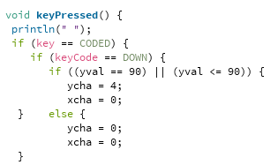
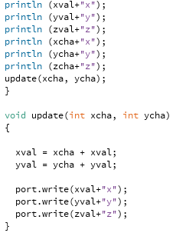
Processing Code
Keyboard Controls
Debug Purposes
Send to Arduino Code

Slide 13
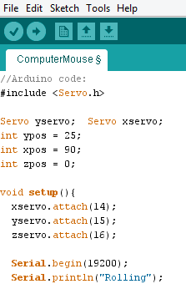
Arduino Code
Servo Library
Initial Positions
Servos to Pins
Communication and Debug

Slide 14
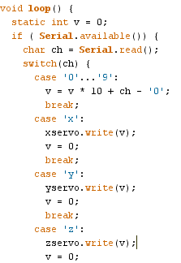
Arduino Code
Data from Processing
Formula
Send to Arduino

Slide 15
Conclusion
Summary
Improvements / Changes
Hypothesis = True
Application
Conclusion

Slide 16

The End
Thank you!
Questions?

Slide 18
Circuit Diagram
= Power
= Analog Pins 1,2,3
= Ground
Arduino
Bread Board
Servo Motors
9 Volt Battery (Power)
Computer
(Input)

Slide 19
Physical Analysis
Torque rating : 1.8 kg*cm
Arm Length = 10 cm
1.8/10 = 0.18
The arm can lift 0.18 kg or about 180 grams

Slide 20
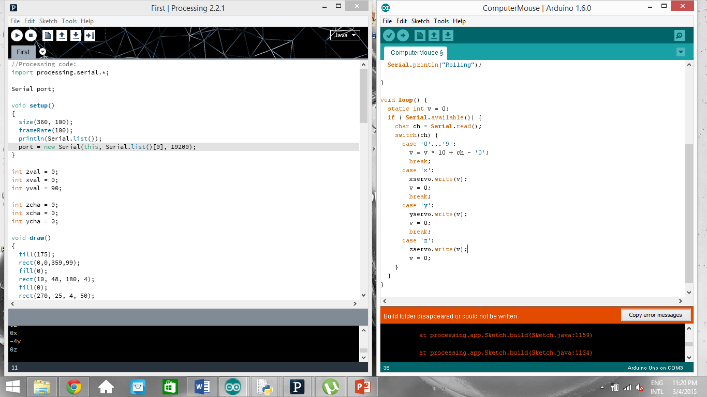
Programs

Slide 21
First Project

