Slide 1
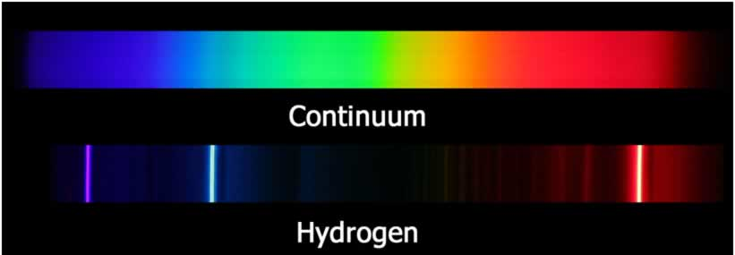
Atomic Emission Spectra
Tristrum Tuttle
Sophomore
Fairview High School
Notes:
Picture of atomic spectra

Slide 2
Introduction to Atomic Spectra
Visible Spectrum: 400 – 750 nm
Hot objects → Continuous Spectrum
Ex: Sun → Rainbow of color
“Hot” Atoms → Discrete Spectrum
1860s: Balmer: visible spectral lines of hydrogen
1912: Bohr’s Model: Physical explanation

Slide 3
Experimental Design
Goal: Measure the wavelength of visible light emitted from various elements
Hypothesis: If I measure the wavelengths of light emitted by different atomic lamps, then my results will be comparable to those done previously.
Procedure:
1. Look at atomic lamp through diffraction lens, record location of spectral and central lines on meter stick
2. Calculate the wavelength of spectral lines seen
3. Apply to hydrogen, helium, mercury lamps
4. Compare results to previous experiments

Slide 4
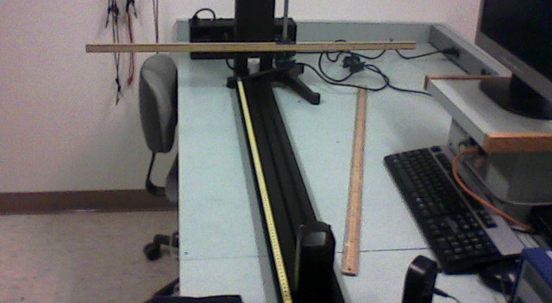
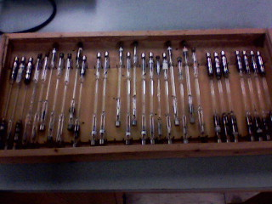
Set-up
Experiments done at Behrend Physics Lab

Slide 5
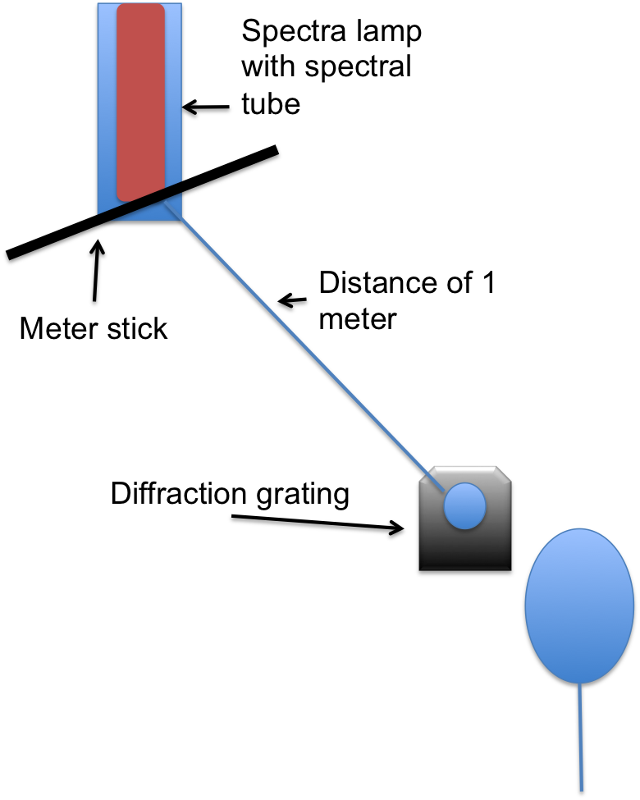
Set-up
Z
L
Me
Z is measured ~ 5-35 cm
Z uncertainty ~ 0.2 cm
Notes:
Show L, Z, and variables

Slide 6
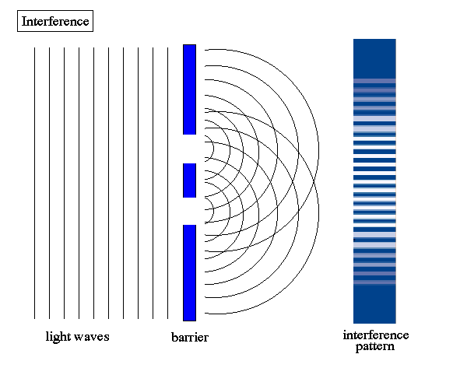
Basic Theory
Diffraction
Interference
Top View
Constructive Interference = bright spots
λ = d sinθ
Not to scale: d << Z
θ
Z
d
L=1m
λ
Notes:
Make pic less stretched, add lines showing constructive and destructive interference

Slide 7
Data - Hydrogen

Slide 8
Results: Hydrogen
★
★Textbook, Wikipedia

Slide 9
Results: Helium
★
★
★Emission Spectrum of Helium – web.centre.edu
Wikipedia

Slide 10
Results: Mercury
★
★Emission Spectrum of Mercury – web.centre.edu
Wikipedia

Slide 11
Results: Argon
Source:
⁷Humphreys, Curtis. “First spectra of neon, argon, and xenon.” J. Phys. Chem. vol. 2, no. 3, (1973) First spectra of neon, argon, and xenon. Web. 9 Dec. 2012.

Slide 12
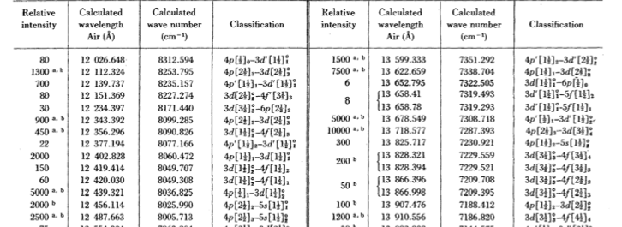
Reference Data Argon
Source:
⁷Humphreys, Curtis. “First spectra of neon, argon, and xenon.” J. Phys. Chem. vol. 2, no. 3, (1973) First spectra of neon, argon, and xenon. Web. 9 Dec. 2012.

Slide 13
Results: Xenon
Source:
⁷Humphreys, Curtis. “First spectra of neon, argon, and xenon.” J. Phys. Chem. vol. 2, no. 3, (1973) First spectra of neon, argon, and xenon. Web. 9 Dec. 2012.

Slide 14
Results: Krypton
Source:
⁶Bruce, C. F., and R. M. Hill. "Wavelengths of Krypton 86, Mercury 198, and Cadmium 114." Australian Journal of Physics vol. 14 (1961): 64. Wavelengths of Krypton 86, Mercury 198, and Cadmium 114. Web. 9 Dec. 2012.
Notes:
Show original source

Slide 15
Conclusion
Hypothesis: Accepted
Ways my experiment/data could be used:
- Lighting companies
- Comparison
Sources:
¹Dingrando, Laurel. Chemistry: matter and change. New York, N.Y.: Glencoe/McGraw-Hill, 2005. Print
²"Chapter 14: Interference and Diffraction." Study Guide. MIT, n.d. Web. 6 Dec. 2012
³"The Electromagnetic and Visible Spectra." The Physics Classroom. comPADRE, n.d. Web. 10 Dec. 2012.
⁴"Emission Spectrum of Hydrogen." Purdue University College of Science Welcome. National Institute of Standards and Technology, n.d. Web. 10 Dec. 2012.
⁵”Emmision spectrum of helium." web.centre.edu. N.p., n.d. Web. 9 Dec. 2012.

Slide 16
The End
Thank you!
Are there any questions?

Slide 17
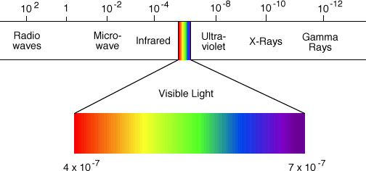
Background Information
Light: electromagnetic radiation
Particle and wave characteristics
Electromagnetic spectra
Amplitude, Frequency, and Wavelength

Slide 18
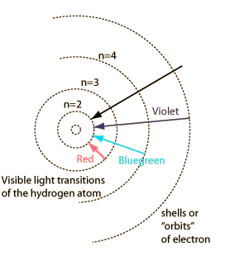
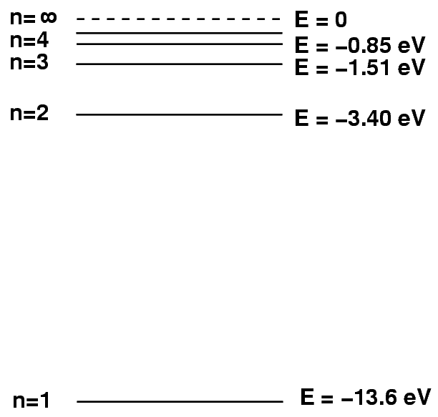
The Bohr Model
1912: Bohr’s Model
E_{n}=-13.6eV/n²

Slide 19
Analysis - Hydrogen
1/λ = R * (1/2² - 1/n²) → 1/λ = - R * (1/n² ) + R/2²
My Value Balmer’s Value %diff
R(nm^-1) 0.0114 0.01097 +3.92
Notes:
Convert Units of R

Slide 20
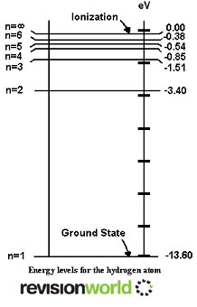
Analysis
Actual:
Using my data…
Second energy level: -3.40eV
Third energy level: -1.52eV
Fourth energy level: -0.84eV
Fifth energy level: -0.51eV

Slide 21
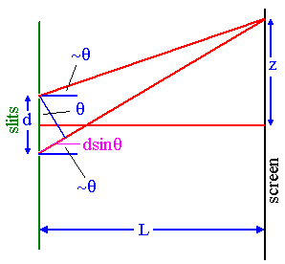
Calculating wavelength
Measure Z and L = 1 meter
*absolute value(central line – point)
Z² + L² = Hypotenuse²
Hypotenuse/Z = sinθ = Vertical angle
d sinθ = λ

