Slide 1
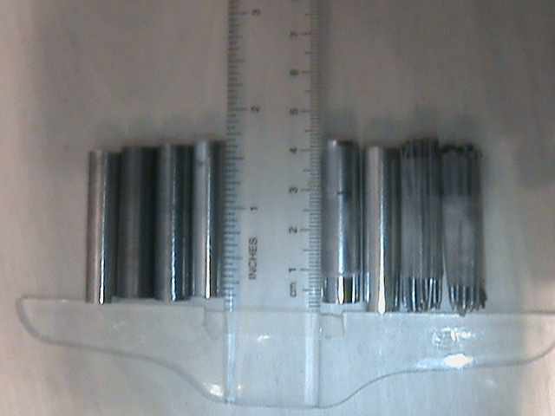
Magnetism in Materials
Tristrum Tuttle

Slide 2
Magnetism Background
Common Magnets [ Ferro-magnets ]
  Fridge magnets
  Earth
  Compass
  Iron
Permanent vs Induced Magnets
Electromagnets ~ Wires with current

Slide 3
Experimental Design
Goal: To compare the magnetic field induced in various metals by an external electromagnet
Experiment
  Check for induced magnetism
  Check for permanent magnetism
  Place cylinder inside an electromagnet
  Measure the induced magnetic field
  Repeat experiment
Hypothesis: Iron nails have largest induce field

Slide 4
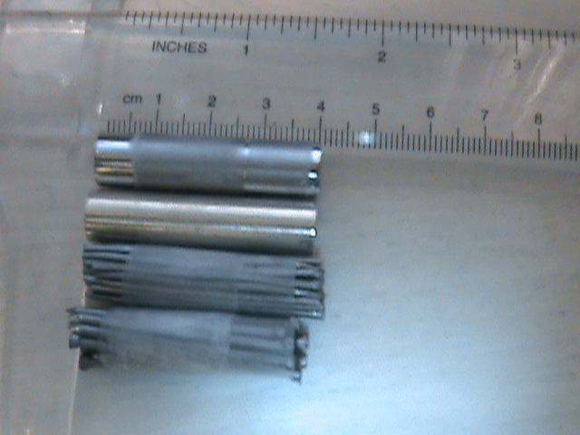
Effected by Fridge Magnet
Chromium Alloy
Brass
Piano Wire
Nails

Slide 5
Cylinder Dimensions
Cylinder: | Length (cm) | Diameter (cm)
Brass | 4 | 1
Chromium | 4 | 1
Piano Wire | 4.1 | 1
Nails` | 3.9 | 1
Uncertainty:
  Brass and chromium ~ 0.05 cm
  nails and piano ~ 0.1 cm

Slide 6
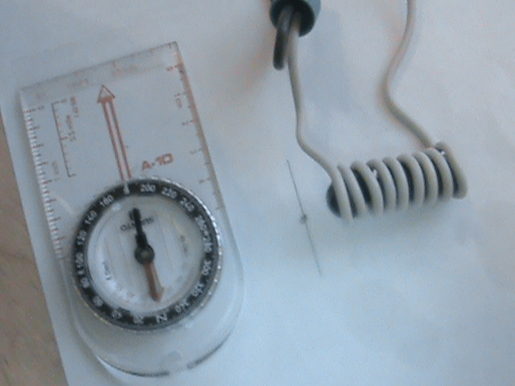
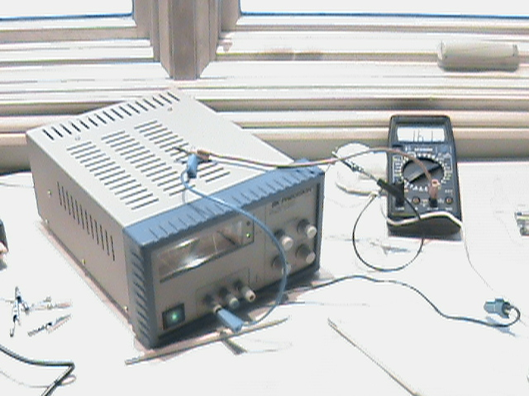
Photos
5 cm
Uncertainty ~ 1 degree
1.8 Amps

Slide 7
Experimental Setup
N
Metal Cylinder + Electromagnet
Battery
Compass
Current
Meter
Measure angle of compass deflection

Slide 8

Data: No Battery
Cylinder | Angle (Towards) | Angle (Away)
Brass | 0 | 0
Chromium | 11 | 10
Piano wire | 12 | 8
Nails | 20 | 17
Away/Towards: Poles switched
Two Trials
Uncertainty ~ 1 degree

Slide 9
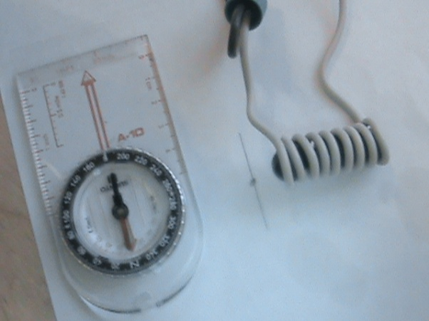
Battery Data
Cylinder | Angle (Towards) | Angle (Away)
None | 7 | 7
Brass | 10 | 8
Chromium | 45 | 22
Piano Wire | 44 | 28
Nails | 45 | 15
Current = 1.8 Amps
Two trials
Uncertainty ~ 2 degrees

Slide 10
Corrected angle ~ total induced magnetism
Cylinder | Corrected angle (toward) | Corrected angle (away)
None | 7 | 7
Brass | 9 | 8
Chromium | 34 | 32
Piano Wire | 32 | 36
Nails | 25 | 32
Toward ~ together
A w/Batt
A corr
A w/o Batt
Away ~ opposite
A w/Batt
A corr
A w/o Batt
Corrected angle = A(w/ Batt) +/- A(w/o Batt)

Slide 11
Analysis: B = Magnetic Field
N
Cylinder | Corrected angle towards | Induced B-field | Corrected angle away | Induced B-field
None | 7 | 0.12 | 7 | 0.12
Brass | 9 | 0.16 | 8 | 0.14
Piano Wire | 32 | 0.62 | 36 | 0.73
Chromium | 34 | 0.67 | 32 | 0.62
Nails | 25 | 0.47 | 32 | 0.62
B( induced )
B( Earth )
B(induced) = B( Earth ) x tan (angle )
Notes:
Please note: switch Chrome and p wire!!!!!!!!!!!

Slide 12
Analysis: Relative Permeability
Cylinder | Induced B-field towards | µ | Induced B-field away | µ
None | 0.12 | 1 | 0.12 | 1
Brass | 0.16 | 1.3 | 0.14 | 1.2
Piano Wire | 0.67 | 5.6 | 0.62 | 5.2
Chromium | 0.62 | 5.2 | 0.73 | 6.1
Nails | 0.47 | 3.9 | 0.62 | 5.2
µ = Btot / Bext = Btot / 0.12 Bearth

Slide 13
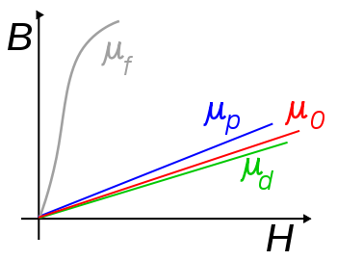
Comparative Analysis
Relative permeability of materials
Steel: μ ~ 100 at .002 Tesla
Wikipedia
Nails:
~ 6
B ~ .0005 T
B = μ N I / L = 4 pi x 10-7 x 9 x 1.8 Amps / 4 cm

Slide 14
Conclusion
No Magnetism
  Aluminum, lead, copper, zinc
Permanent Magnetized
  Piano Wire ~ Chromium Alloy ~ Nails
Induced Magnetism
  Brass smallest
  Piano Wire ~ Chromium Alloy ~ Nails

Slide 15
Sources
http://www.scienceprojectstore.com
http://www.coolmagnetman.com/
Also, special thanks to Erie Magnetics,
and the audience and judges for listening to my presentation.

