Slide 1
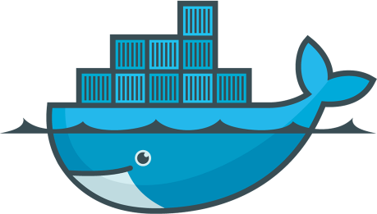
Docker at TritonDigital
http://git.io/vISJo
mike.mclean@tritondigital.com

Slide 2
What is Docker – The 100,000,000 foot view
Not virtualization. Containers.
Offers a workflow to build and containerize applications
Docker Engine - Daemon and CLI
Docker Hub - Image repository
Demo …
Notes:
time docker run debian:wheezy echo “Hello World”
docker run –ti debian:wheezy /bin/bash
cat /etc/debian-release

Slide 3
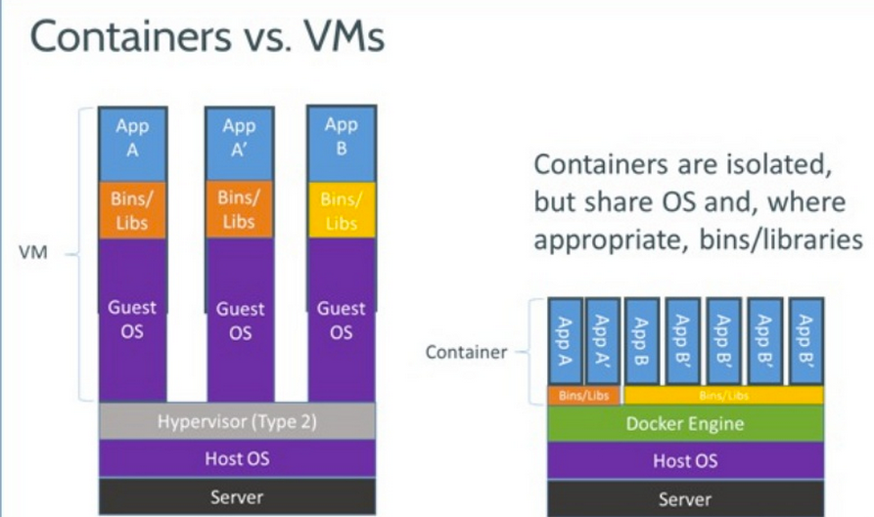
Notes:
docker run -ti debian:wheezy /bin/bash
time docker run -ti debian:wheezy echo "Hello”
docker run busybox

Slide 4
Why?
Reproducibility across environments
A workflow that allows products to be developed and shipped quicker
Lightweight and fast
Run everywhere

Slide 5
Building a Docker image
Simple DSL. Just a few commands
FROM: Which image to base this one off of
RUN : Execute a command
ADD : Add a file
VOLUME : create mount points to share directories
…
Advantages:
Can be versioned
Can easily recreate an image from scratch

Slide 6
Dockerfile demo
https://github.com/tritondigital/scala-meetup-june15/tree/master/apache2_dockerfile

Slide 7
Docker and Native Packager
Native Packager uses the Docker CLI directly
Native Packager can’t authenticate to private repositories
For us the value is questionable, so we don’t use it.
Use the Docker CLI and write Dockerfile directly

Slide 8
JVM application Dockerfile
FROM docker-registry.tritondigital.com/java7-bare
EXPOSE 8080
ADD target/sirocco.jar /
ENTRYPOINT ["java", "-jar", "/sirocco.jar"]

Slide 9
Private Registry
Hosted service
Setup your own with ... Docker. Make sure to lookup Registry 2.0 (https://docs.docker.com/registry/deploying/)
We use Artifactory. Except for a central place for all our artifacts, the value is limited.

Slide 10
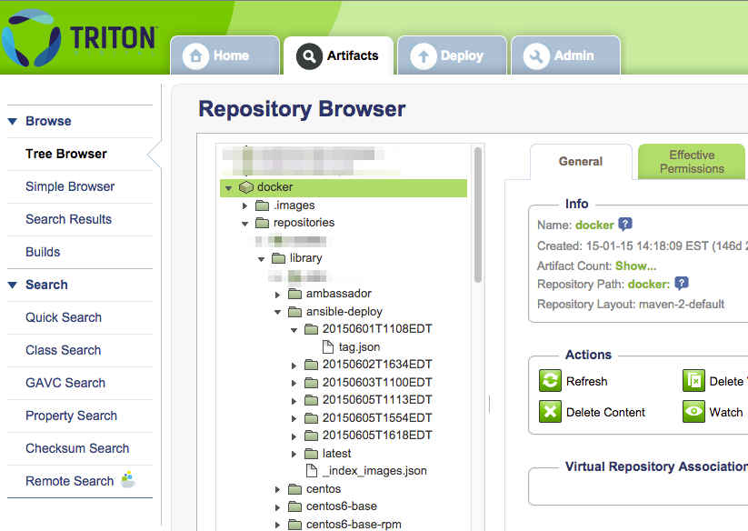
Artifactory for Docker images

Slide 11
Testing with Overcast
https://github.com/xebialabs/overcast
“A Java library to test against hosts in the cloud”
Docker is one of the providers
Also supports EC2, Vagrant and Virtual Box
Simple jar which you include in your dependencies

Slide 12
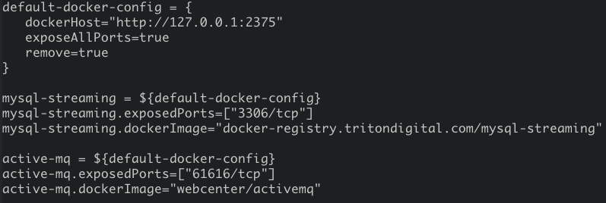
Overcast setup – overcast.conf
Uses Typesafe config

Slide 13
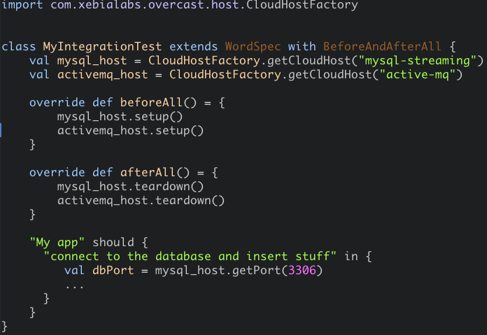
Overcast with ScalaTest

Slide 14
Overcast - Not all good
Need to force pull Docker images manually.
Uses the Docker remote API over http through the Spotify DockerClient library.
A problem in multi-platform environments: tcp://localhost:2375
No easy way of knowing when a container is ready to work
In a Linux only environment: +1
Notes:
If you’re doing plain vanilla Docker, then DIY is probably simpler than dealing with the cons.

Slide 15
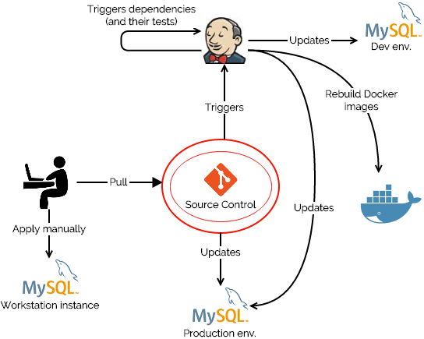
Docker, DB’s and Continuous Delivery

Slide 16
Docker in Continous Delivery
Keep a bare bones slave installation:
docker run -v $(pwd):/data td-node-0.12.1 npm test
docker run -v ~/.ivy2/cache:/root/.ivy2/cache -v $(pwd):/workspace td-sbt-java7 compile
docker run -v $(pwd):/workspace -v ~/.ssh:/root/ansible_keys -h $(hostname) ansible-deploy dev

Slide 17
Docker in Continuous Delivery - Ideas
Build packages for different architectures on a single Jenkins slave
Replicate your whole Jenkins setup locally?
docker run --rm --name=jenkins -p 8080:8080
-v ~/.ssh:/var/jenkins_home/.ssh
-v ~/Jenkins_Home:/var/jenkins_home
-v ~/workspace:/workspace
-v /var/run/docker.sock:/var/run/docker.sock
-v $(which docker):/bin/docker
-e DOCKER_CERT_PATH:/var/jenkins_home/.docker/
-e DOCKER_HOST=$DOCKER_HOST
-e DOCKER_TLS_VERIFY=1
td-jenkins

Slide 18
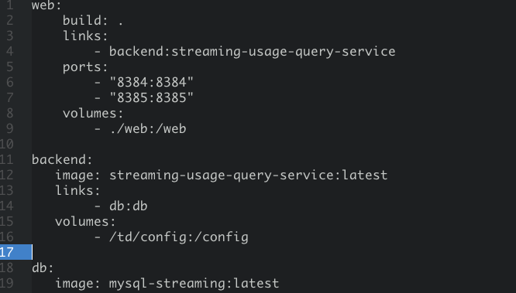
Docker Compose
Managing links between small single purpose containers can be cumbersome.
Notes:
The reason for wanting Docker Compose is that containers should be small and single purpose. This means that management of the links between them can become painful.
Example from Docker employee: Container for application, Container for greping logs, Container for editing logs, etc …

Slide 19
Docker Compose
Commands look a lot like normal Docker CLI commands:
dockercompose build
dockercompose run
dockercompose pull
…
More info at https://docs.docker.com/compose/

Slide 20
Docker – Not all good
In a multi os environment, some hoops need to be jumped through. (i.e.: Boot2Docker)
Works on most Linux versions, but not all are supported equally.
Ubuntu 14.04 bare metal
Others are slow
https://www.andreas-jung.com/contents/docker-the-pain-of-finding-the-right-distribution-kernel-hardware

Slide 21
Still immature – Best practices?
Test images just like you would code
Protect from external images
Allows for safer refactoring of a Dockerfile
Cleanup of images and containers?
Build downstream dependencies
Notes:
For example when we changed a node version ssh wasn’t available in the new version.

Slide 22
Questions?
http://git.io/vISJo

