Slide 1
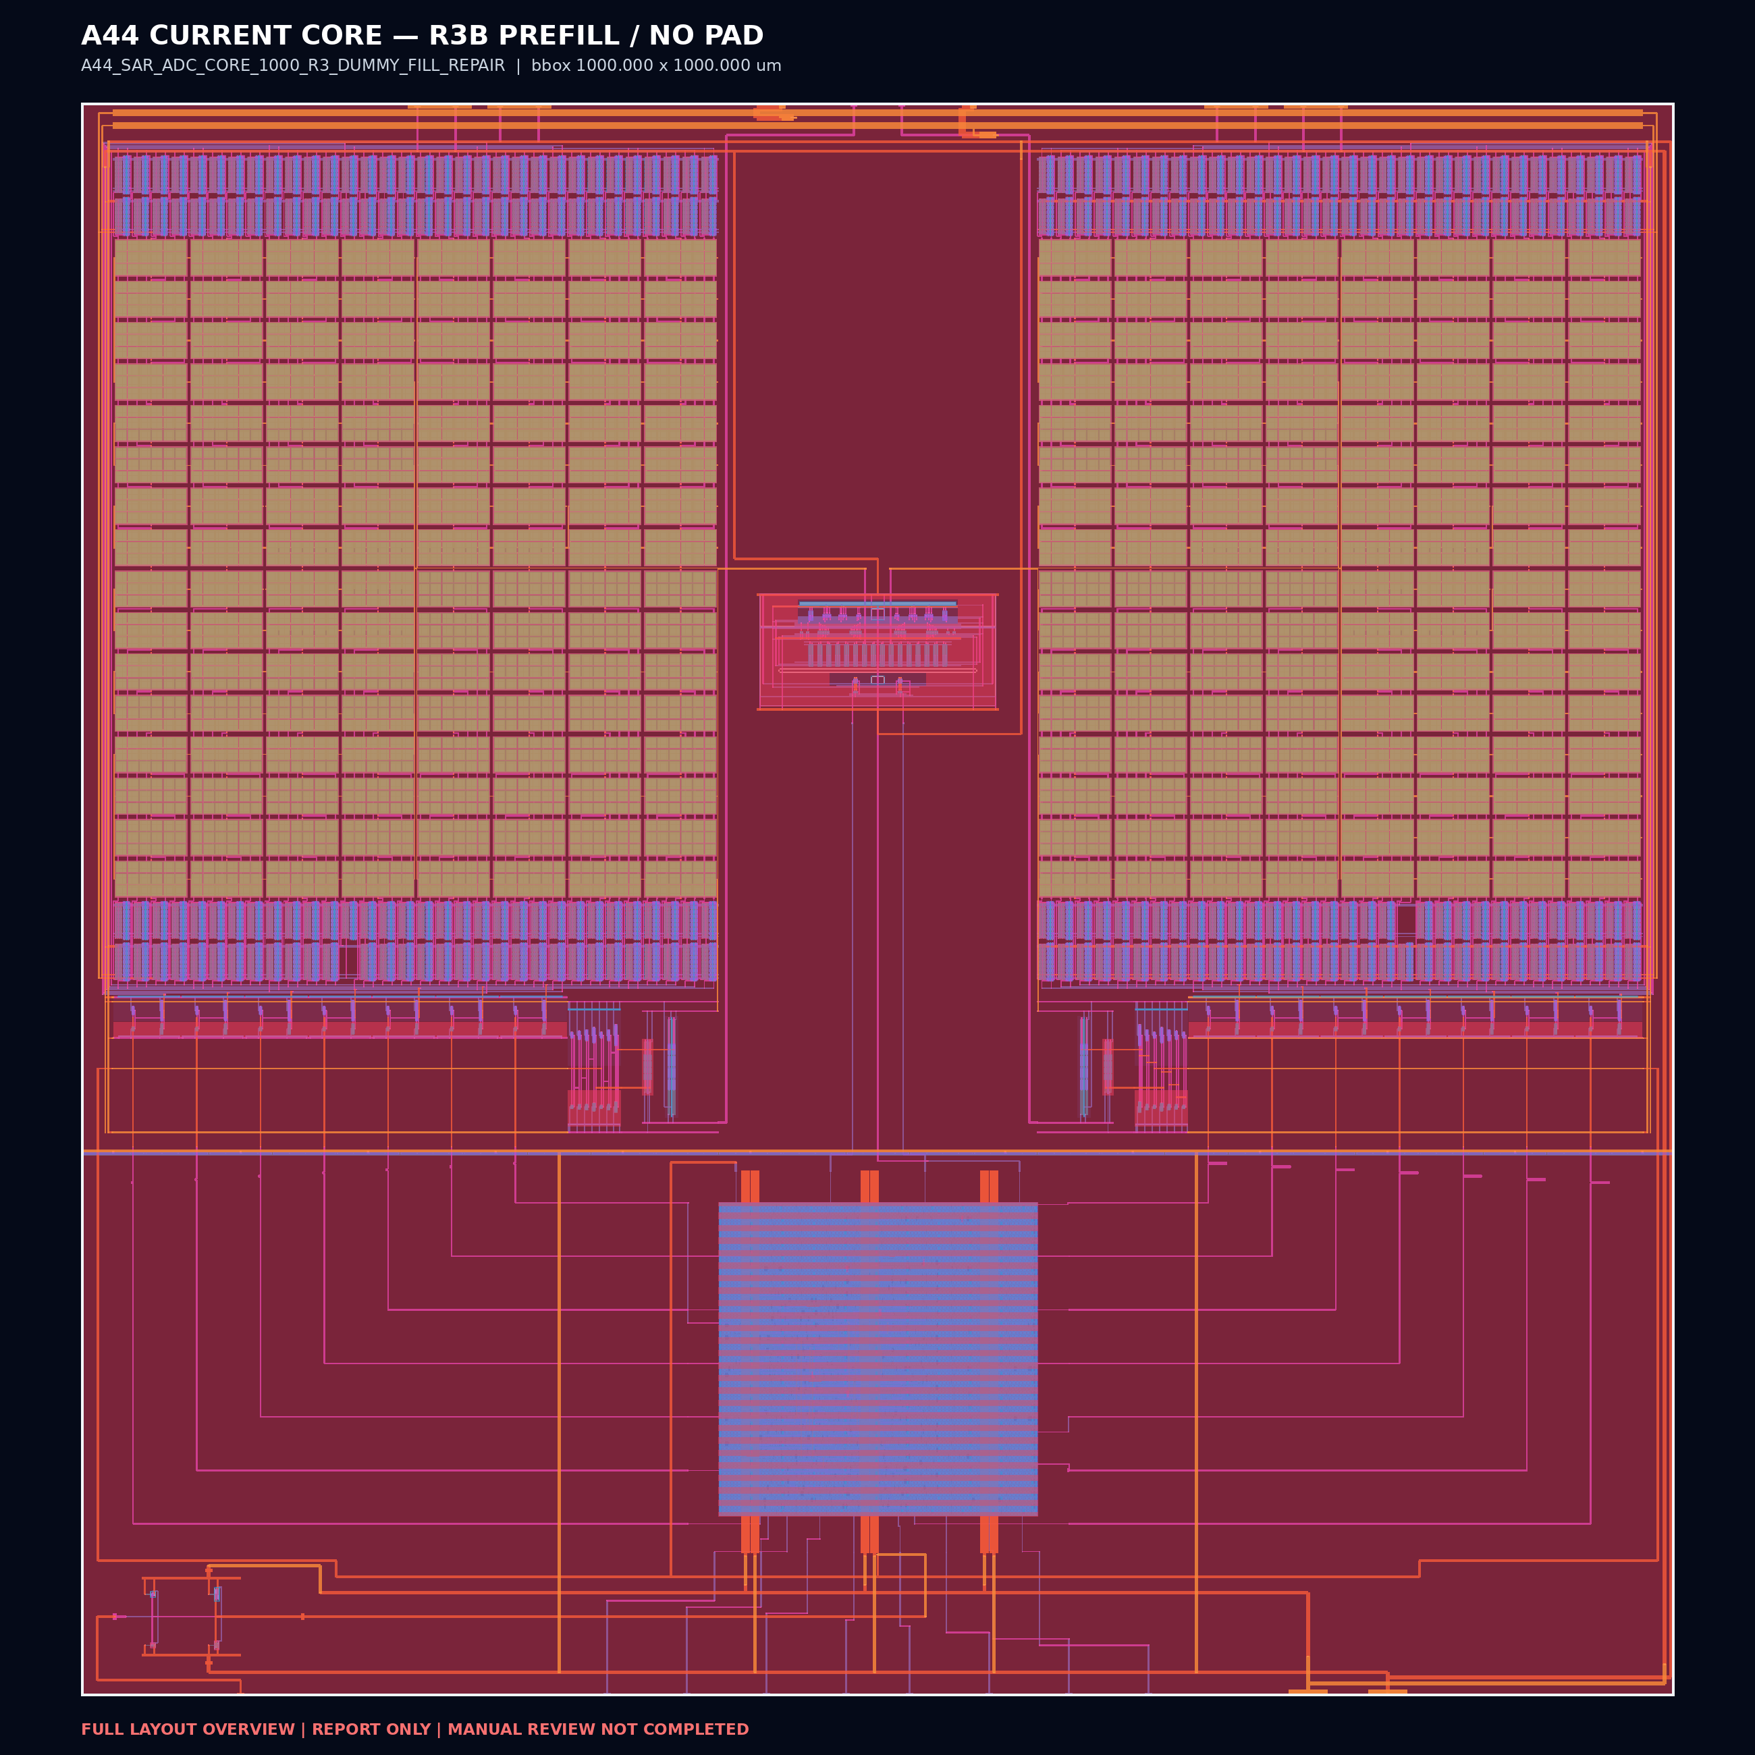
SSCS CHIPATHON 2026 • TEAM A44 JST
A44 SAR ADC
Layout Review
Current no-pad CORE and direct component layouts
8-bit
2 MS/s
3.3 V
GF180MCU
Review target
Top-level Layout Review • 2026-08-21
Publication scope: GDS + integration views + full-layout images + slides
A44_SAR_ADC_CORE_1000
Current pre-fill baseline • no I/O pads

Slide 2
REPOSITORY CONTRACT
Chipathon submission binding
The official checker resolves the CORE GDS from the repository main branch.
main
info.yaml
lvs_config.json
CORE GDS
submission branch
relative lvs_config path
TOP_LAYOUT + LAYOUT_FILE
configured LAYOUT_FILE path
CURRENT BINDING
REVIEW SCOPE
A44_SAR_ADC_CORE_1000
One hierarchical CORE GDS
Five standalone direct-component GDS files
LEF abstracts; SAR logic DEF
One full-layout image per GDS
No audit, manifest, checksum, or result payload
gds/A44_SAR_ADC_CORE_1000.gds
1000 × 1000 µm
NO PADFRAME
PRE-FILL

Slide 3
TOP LAYOUT
Current CORE hierarchy
Five direct blocks inside the 1000 µm × 1000 µm CORE boundary.
Direct instances
CDAC E
(10.00, 350.00)
390 × 626
CDAC W
(600.00, 350.00)
390 × 626
Comparator
(416.00, 609.35)
168 × 100
SAR logic
(380.44, 90.00)
240 × 240
Clock buffer
(20.00, 20.00)
120 × 60
CORE interface
VDD, GND, VREFP, VREFN, VINP, VINN, CLKS, DOUT[7:0]

Slide 4
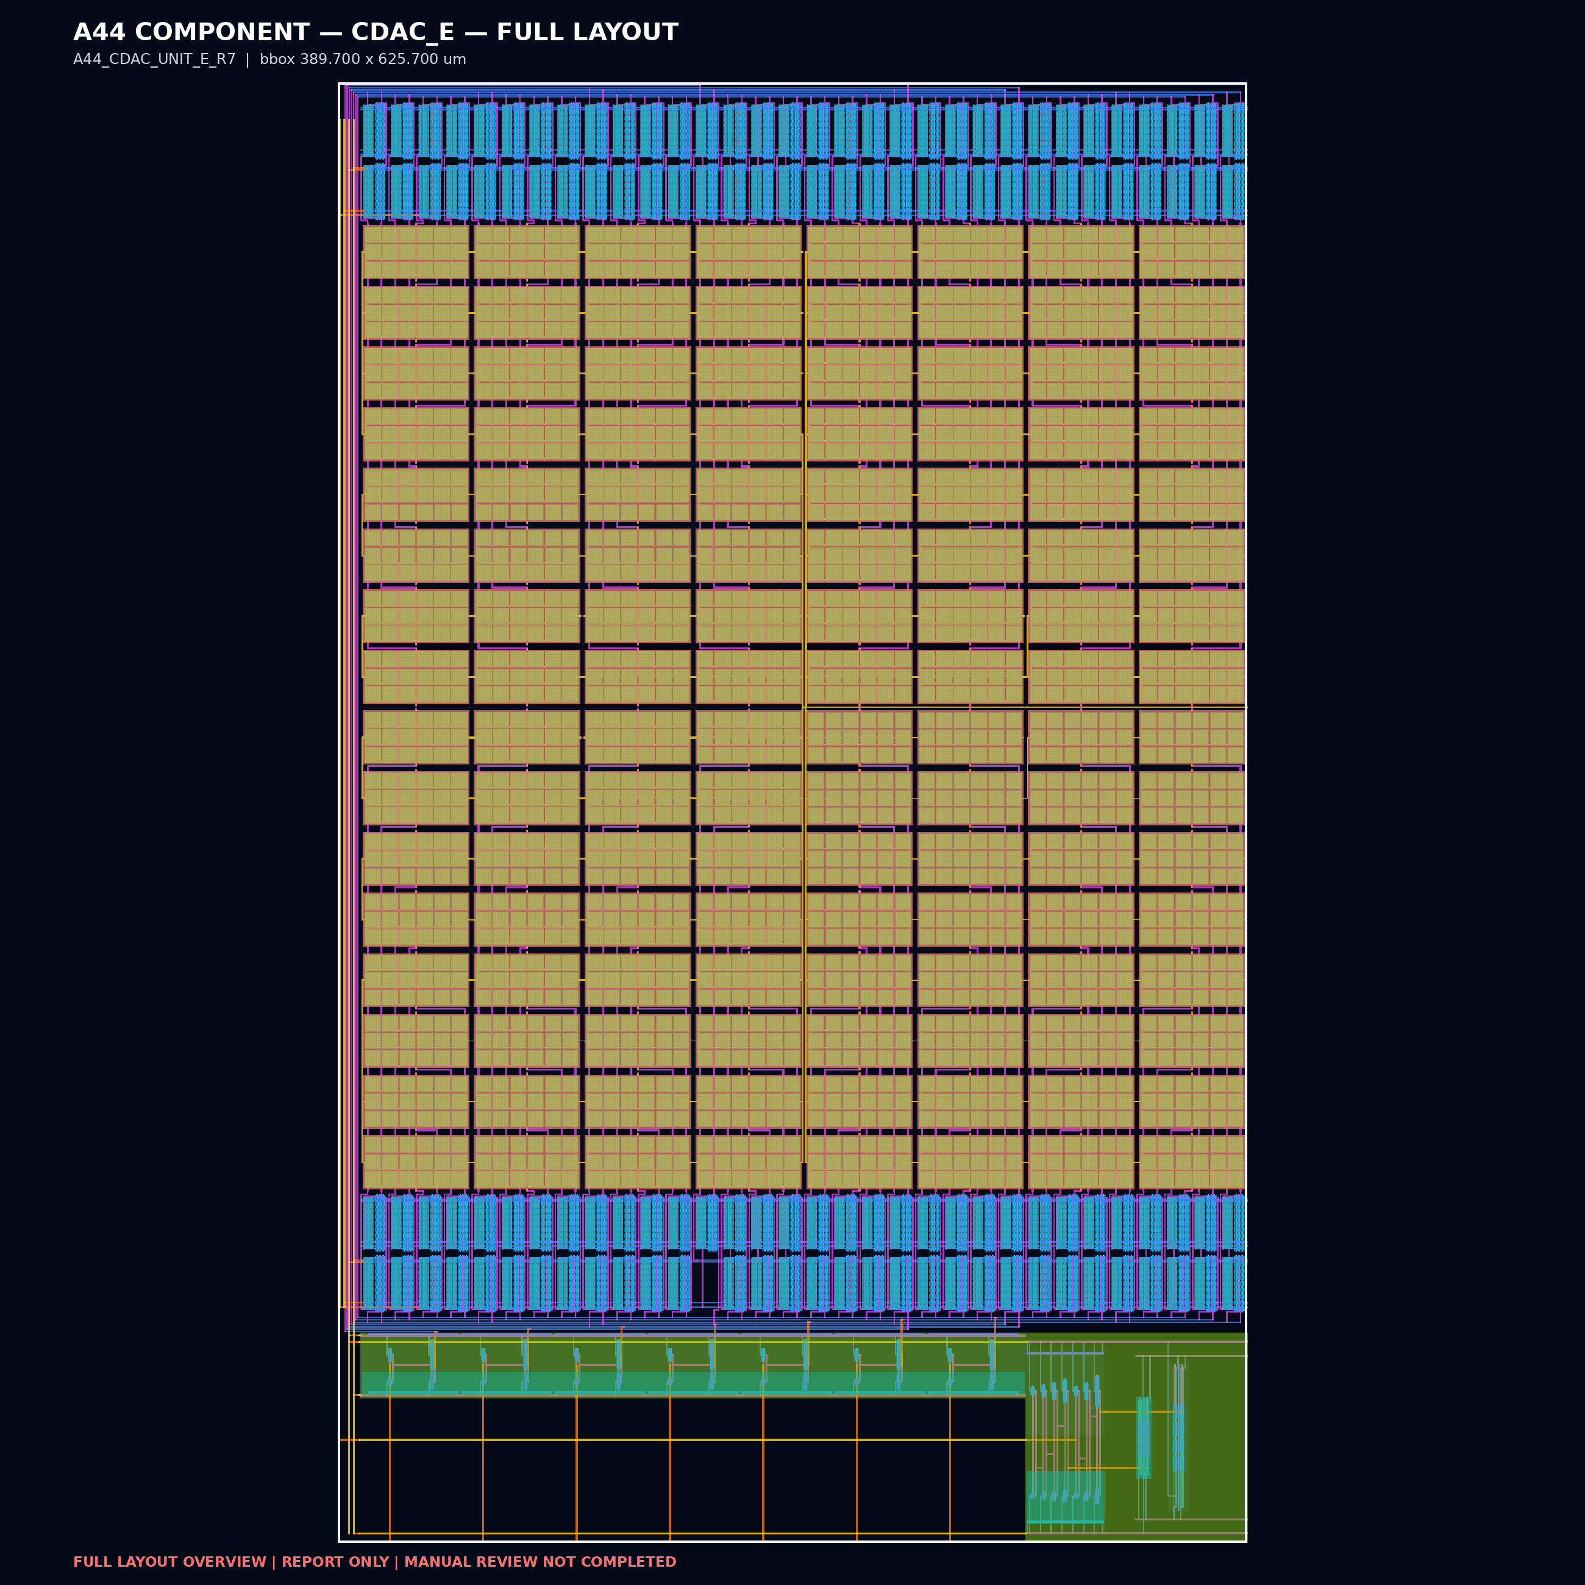
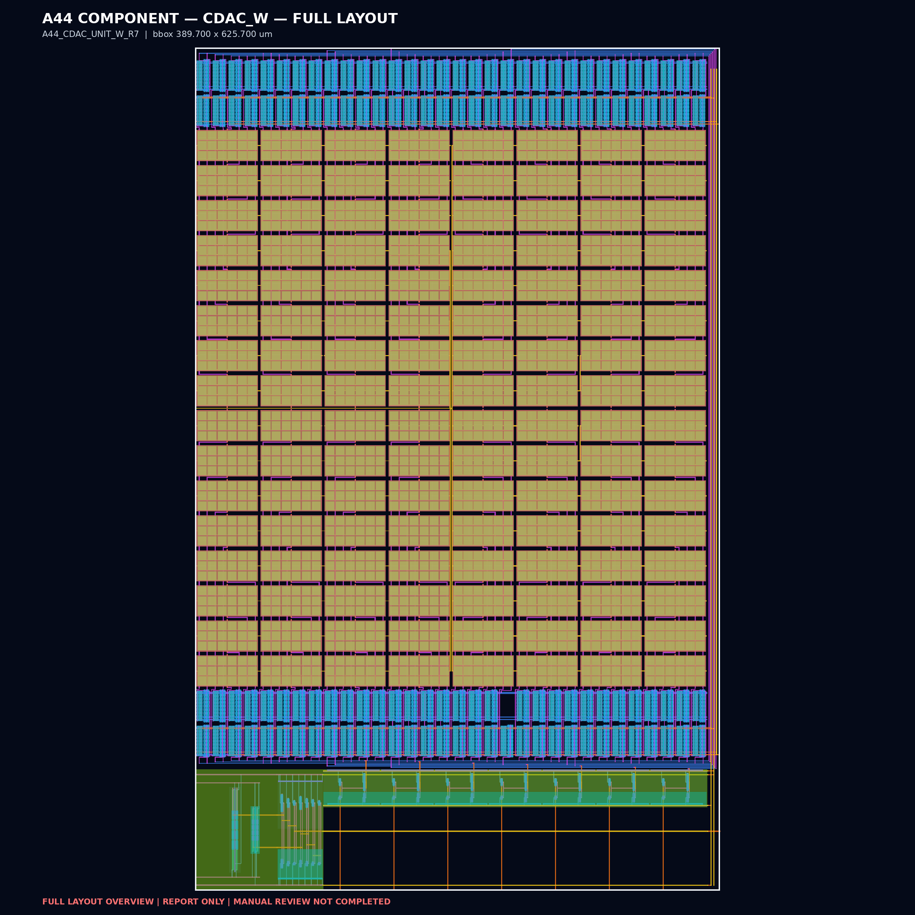
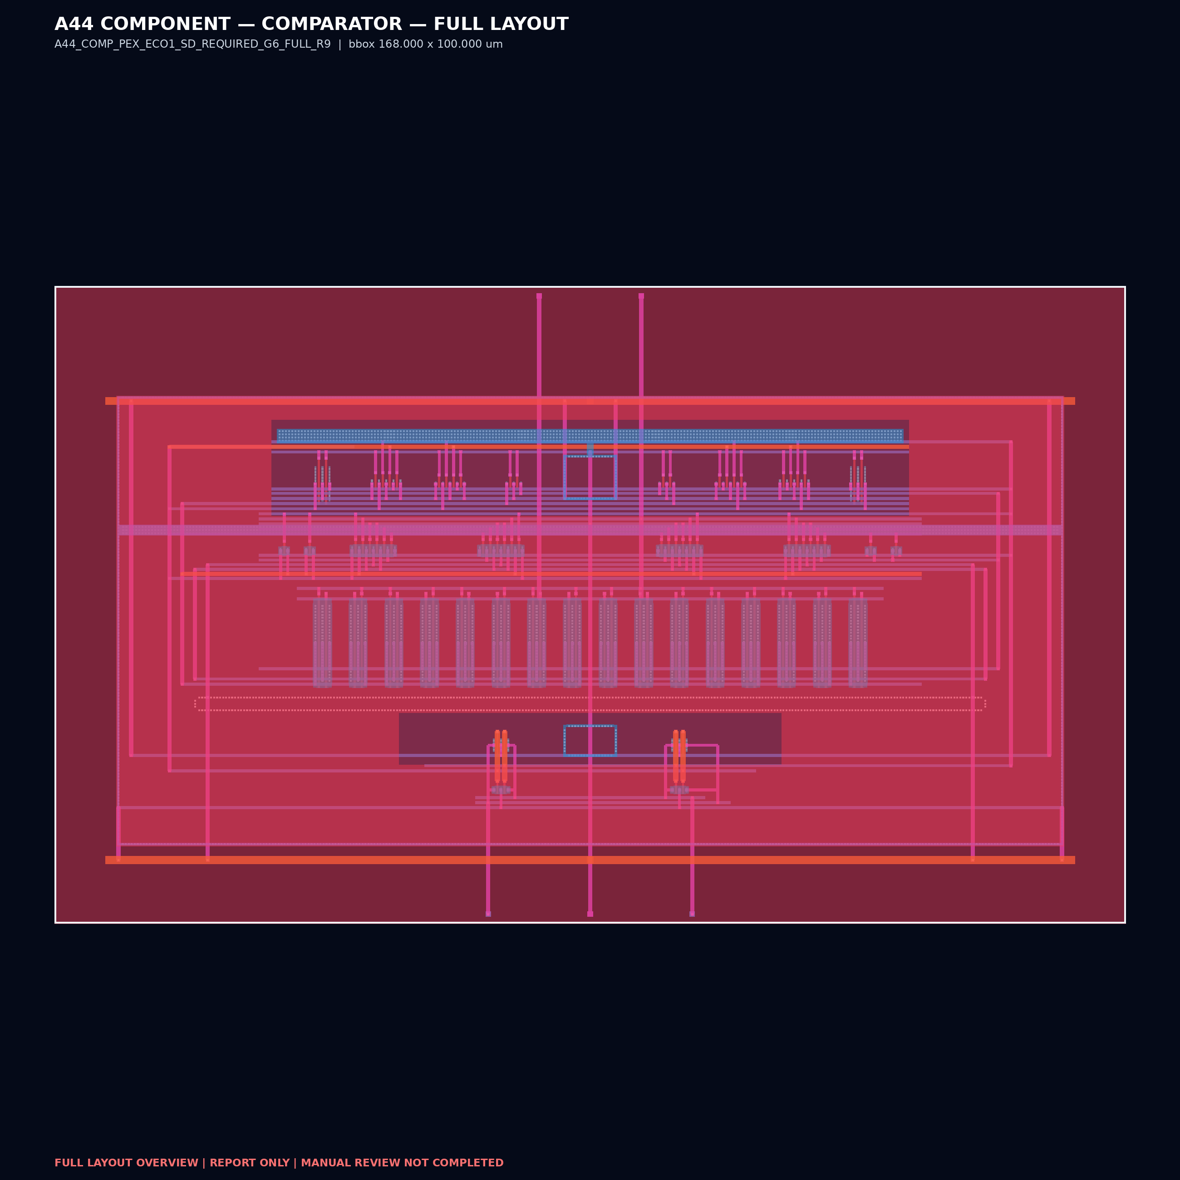
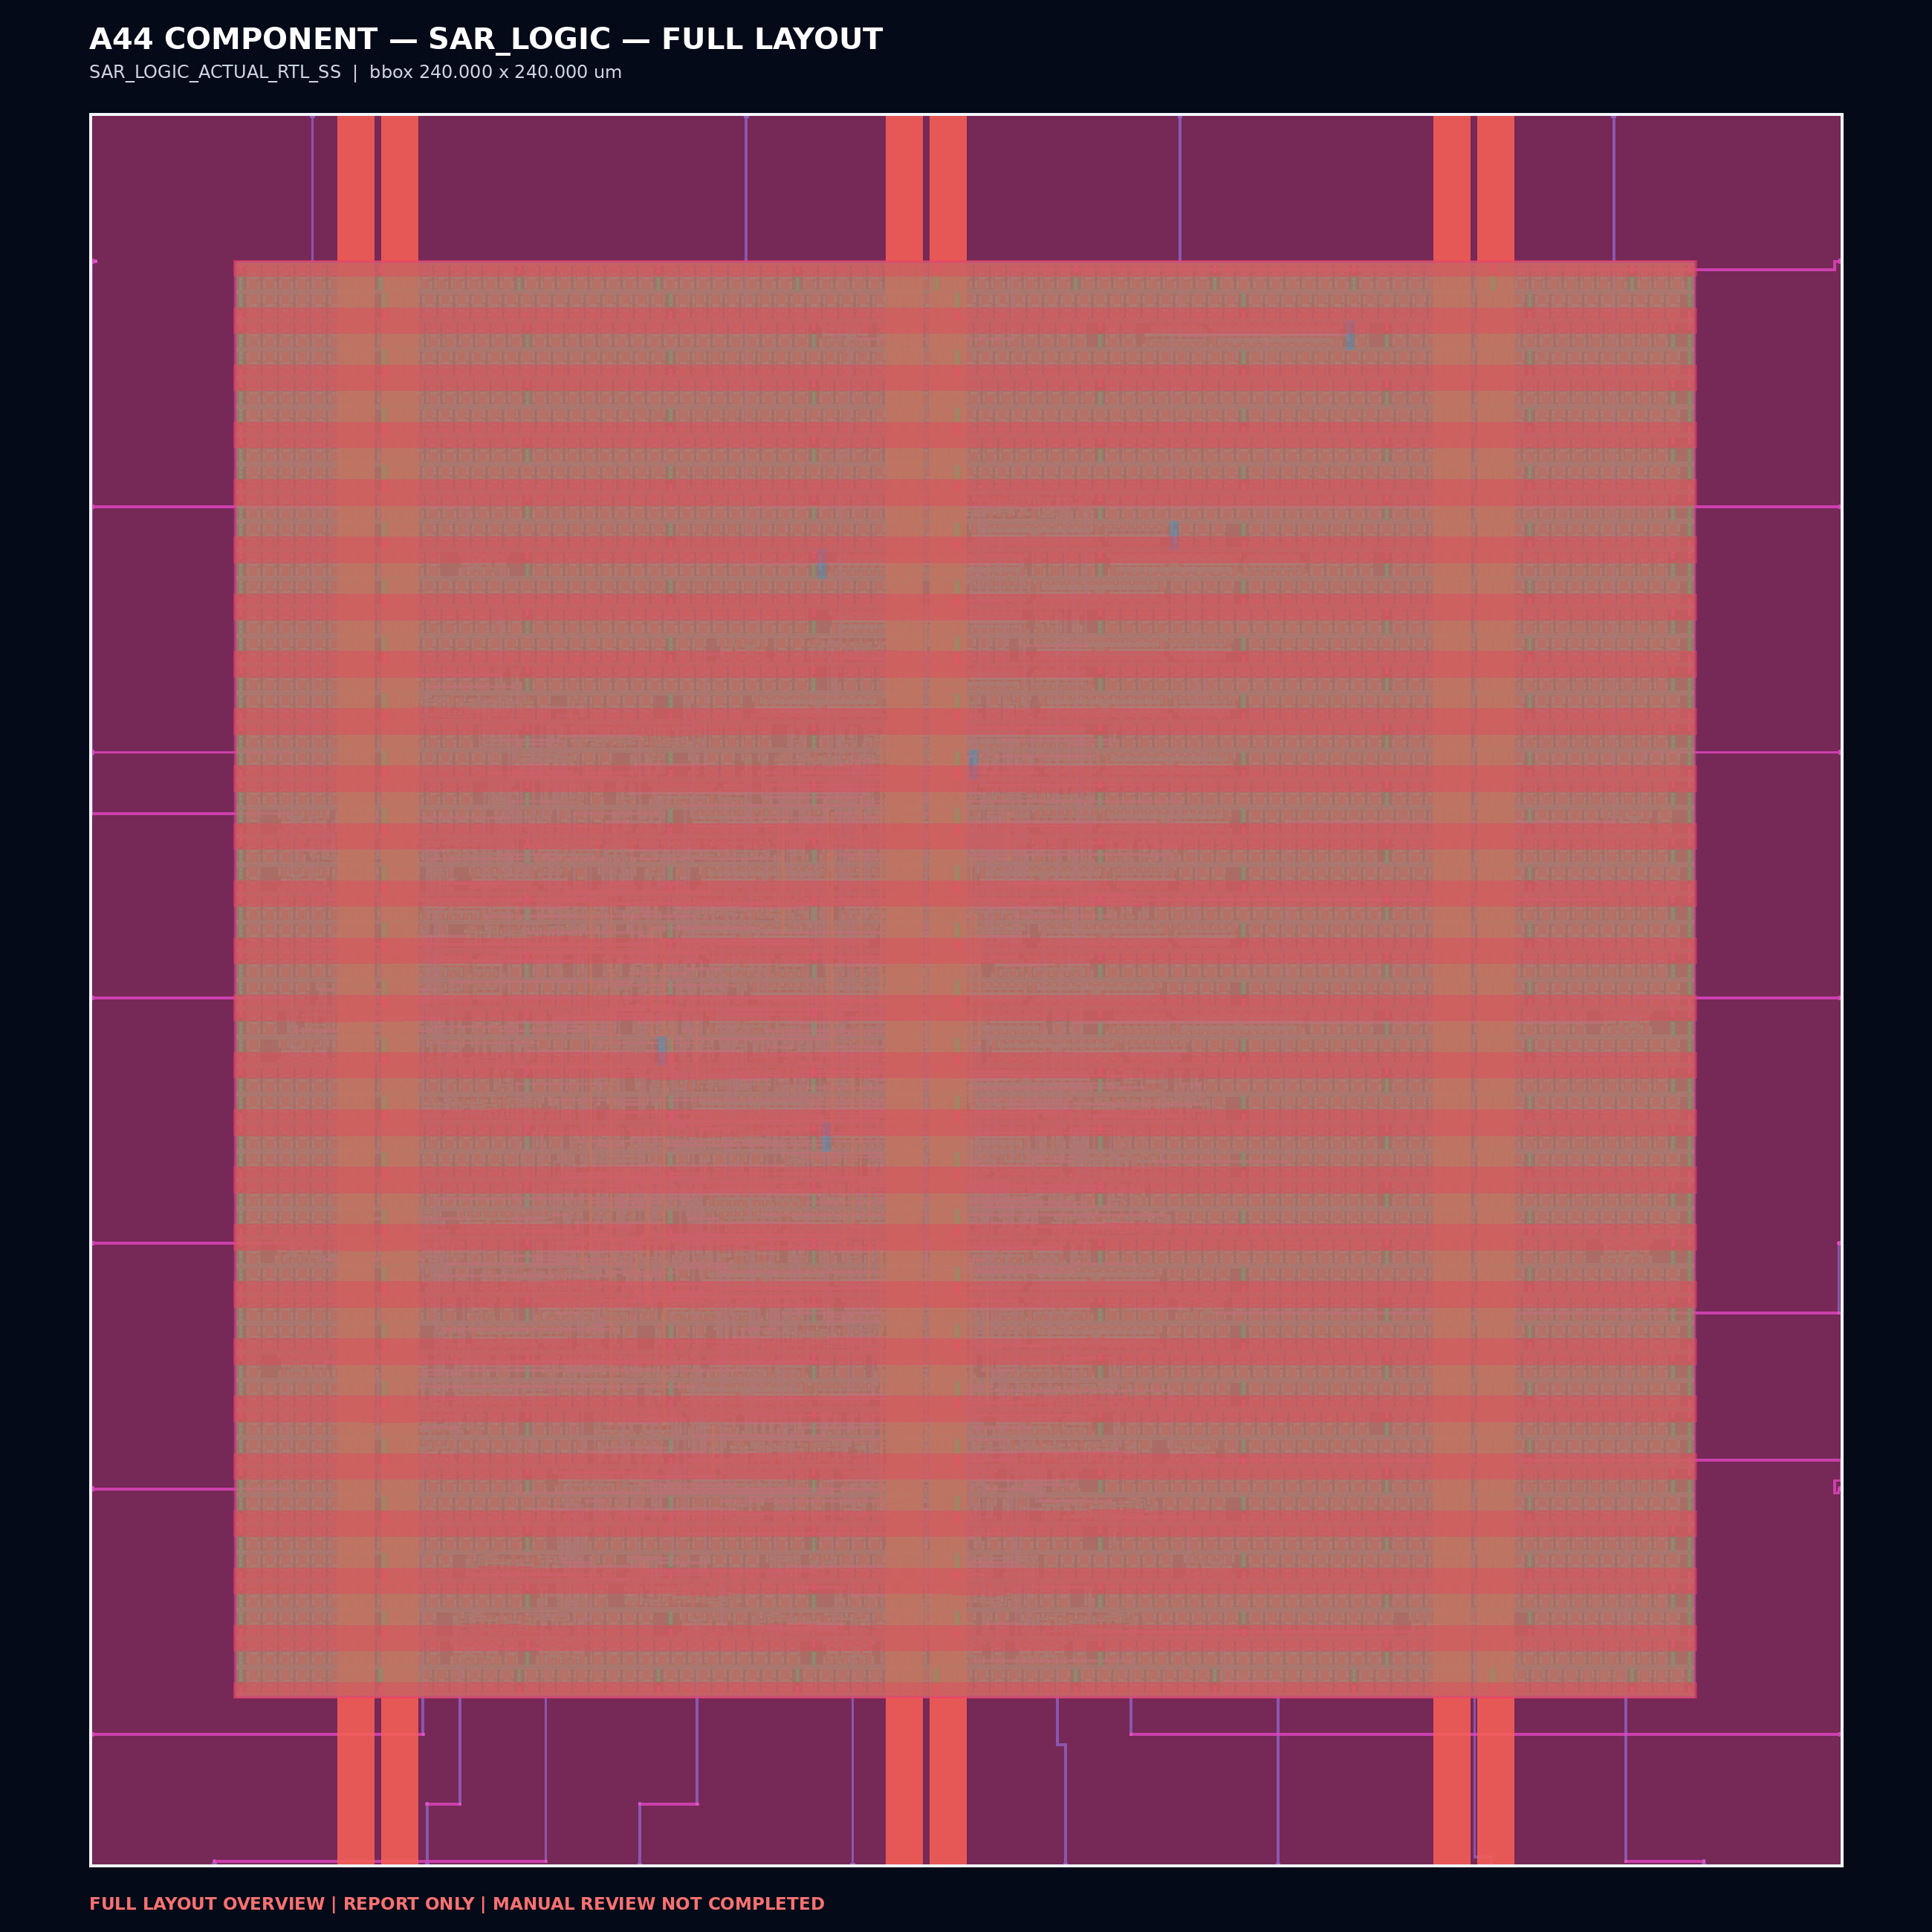
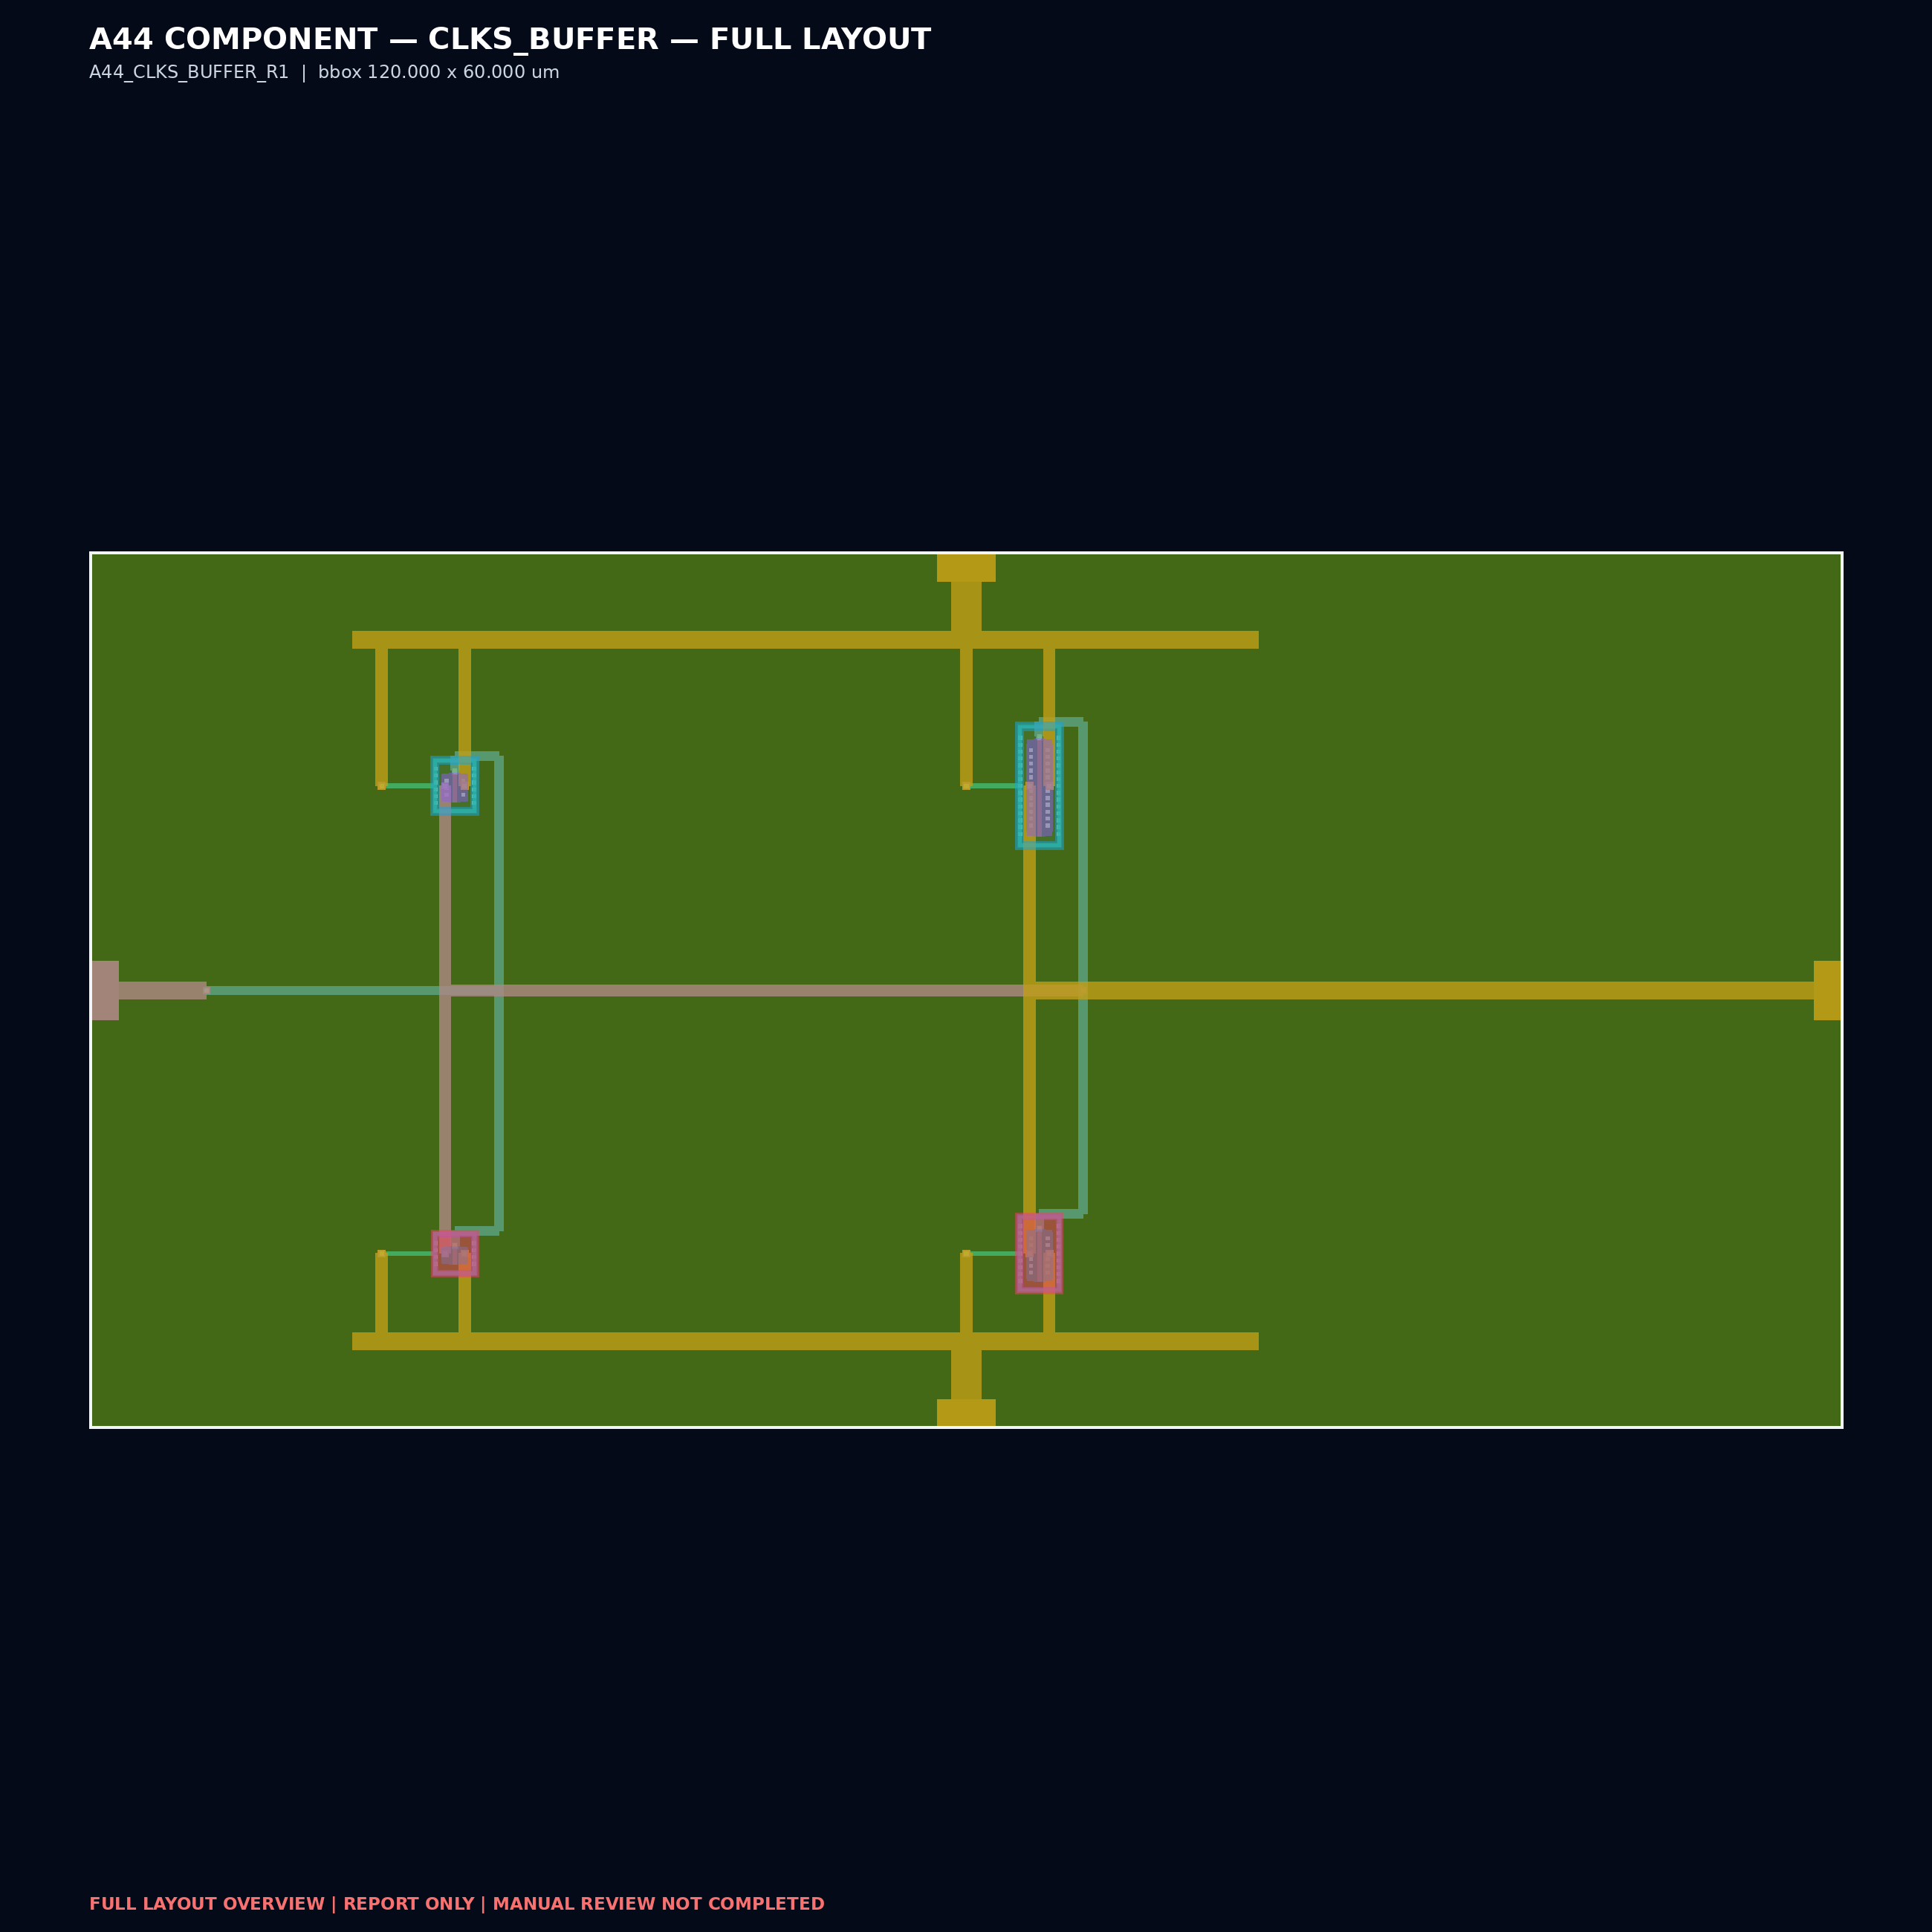
PUBLISHED VIEWS
Unified layout catalog
Public filenames share one project prefix; internal cell names are preserved.
CORE
1000 × 1000 µm
CDAC east
390 × 626 µm
CDAC west
390 × 626 µm
Comparator
168 × 100 µm
SAR logic
240 × 240 µm
Clock buffer
120 × 60 µm

Slide 5
ANALOG ARRAY
Differential CDAC pair
East and west arrays are published as independent GDS trees extracted from the current CORE hierarchy.
A44_SAR_ADC_CDAC_E
top: A44_CDAC_UNIT_E_R7
A44_SAR_ADC_CDAC_W
top: A44_CDAC_UNIT_W_R7
Shared integration interface
VIN • CLKS • VTOP • DCTRL[7:1] • VREFP • VREFN • VDD • GND

Slide 6
DECISION + CONTROL
Comparator, SAR logic, and clock buffer
Independent GDS views retain the cell names used by the CORE hierarchy.
Comparator
168 × 100 µm
SAR logic
240 × 240 µm
Clock buffer
120 × 60 µm
COMPARATOR
SAR LOGIC
CLOCK BUFFER
CLK, DCMPP, VINP, DCMPN, VINN, VDD, GND
CLKS, CMPCK, DCMP[N/P], DCTRL[N/P][7:1], DOUT[7:0], VDD, VSS
PAD_CLK, CLKS_CORE, VDD, GND

Slide 7
REVIEW HANDOFF
What this publication establishes
A focused CORE-layout submission, with explicit separation from full-die signoff.
PUBLISHED NOW
OPEN / OUT OF SCOPE
Current pre-fill CORE GDS at the configured repository path
Five direct component GDS files
CORE and component LEF integration views
SAR logic DEF physical view
Exactly one full-layout image per GDS
Layout-review presentation
Padframe, I/O pads, and primary/secondary ESD
Workshop full-die wrapper and Channel Partner package
Density/fill and antenna closure
Full-chip PDN, EM, and latch-up closure
Final full-chip DRC/LVS/PEX signoff
Tapeout readiness or foundry acceptance
NEXT PUBLIC MILESTONE • TOP-LEVEL LAYOUT REVIEW • 2026-08-21

