Slide 1
TriValley Coders Events Project

Slide 2
Site Demo

Slide 3
Tech Stack

Slide 4
Tech Stack
React
Material UI
React Router
date-fns
Ramda
Redux
React Redux
Redux Form
Redux Thunk
Express
AWS SDK
MongoDB Node Driver
Passport
Helmet (to be added)
Ramda
MongoDB
Locally in development
MongoDB Atlas for production

Slide 5


Material Design
A “design language”
A design language or design vocabulary is an overarching scheme or style that guides the design of a complement of products or architectural settings.
Wikipedia

Slide 6

Material UI
Material UI is a set of React components that implement Google’s Material Design
Saves you a lot of work
Excellent layout grid component
Add consistency to your UI
Is highly customizable
New
Version 1.0 on 17-May-18
Currently v3.1.1 and evolving fast
I enjoy their styling & customization model

Slide 7

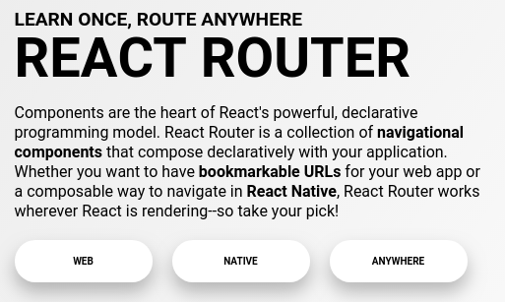
React Router for Navigation
React Router is a set of React components.
Your components are displayed based on the path in the browser’s address bar.
There are web and native versions

Slide 8
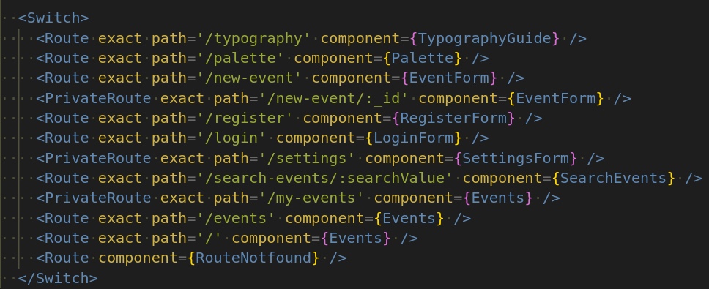
React Router Code Example
1
2
3

Slide 9
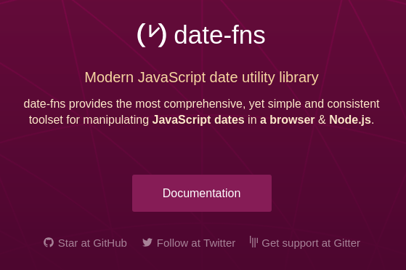
date-fns
JavaScript programmers need help with dates
Date functions
Light weight
Moment

Slide 10
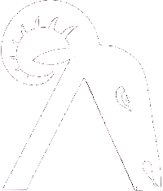
Ramda
Immutability library with a functional style
Large library of functions for working with lists/arrays and objects
Evetns only users 6 or 7 Ramda functions

Slide 11
Project Structure

Slide 12
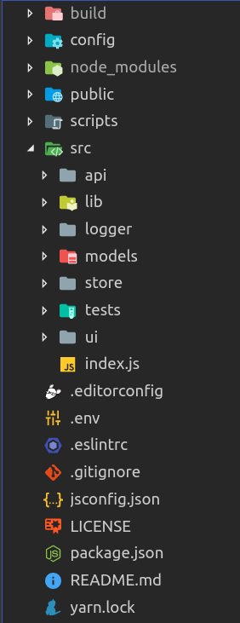
Top Level Folder Structure

Slide 13
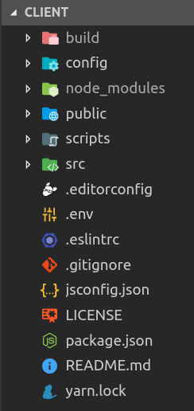
Root Directory
build – production build
config – for test, Webpack, etc.
public – fairly empty html file
scripts – Create React App scripts
src – application code where most work is done
.editorconfig – VS Code config settings
.env – environment variables
.eslintrc – custom ESLint rules
.gitignore – rules for Git
jsconfig.json – more VS Code config
LICENSE – MIT open source
package.json – npm configuration
README
yarn.lock – used by Yarn to manage package versions

Slide 14
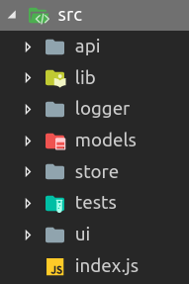
/src Directory
api – all API calls are made from files in this directory
lib – utility functions used throughout the project
logger – an alternative to console.log() that produces colored output to the browser’s console
models – not in use
store – the Redux store
test – test suite
ui – all UI components and where 95% of code is written
index.js – main entry point for app

Slide 15
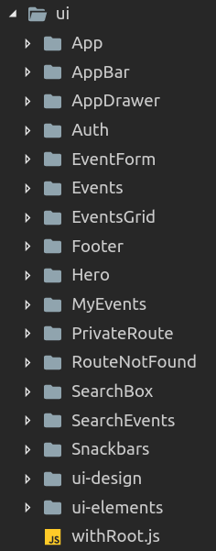
/ui Directory
App – main app director, i.e., App.jsx
AppBar – bar at top of page
AppDrawer – menu slides out from left side
Auth – components used for registration and authorization (register, login, etc.)
EventForm – create, edit and view details of an event
Events – container for EventsGrid
EventsGrid – grid of events displayed on the home page
Footer – the footer
Hero – top section of home page that has search box
MyEvent – view of events for the currently logged-in user
PrivateRoute – higher order component that wraps Route and blocks access unless user is logged-in
RouteNotFounc – used only in development
SearchBox – component for search input
SearchEvents – grid of events that are the result of a search
Snackbars – temporary ui that shows results of user actions e.g., ‘Events loaded’
ui-design – contains components that display colors and typography
ui-elements – common components such as Button used through the app
withRoot.js – contains the project theme

Slide 16
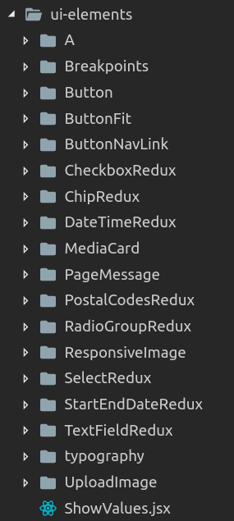
/ui-elements Directory
Why?
Reuse of common components
Encapsulate styling and or desired functionality
Reduce redundant code
A (<a>), Button – encapsulate styling
ChipRedux, RadioGroupRedux, etc
Wrap Material UI components with Redux Form
typography – components for displaying text
Explained later
UploadImage – used on EventForm to upload images while creating/editing events

Slide 17
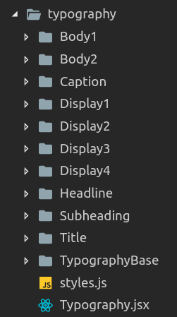
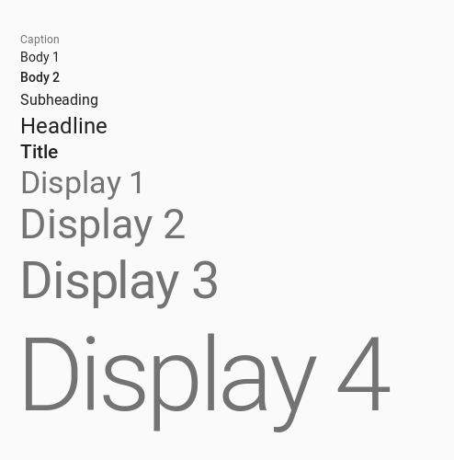
/src/ui-elements/typography

Slide 18
Project Startup
index.js
withRoot(<App />)
<AppBar />
/new-event
<EventForm />
<SnackBars />
/my-events
<MyEvents/>
<AppDrawer />
/register
<Register />
<App />

Slide 19
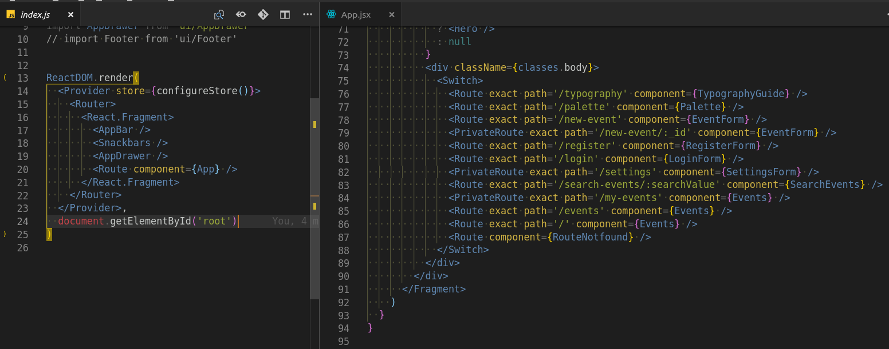
Routing

Slide 20
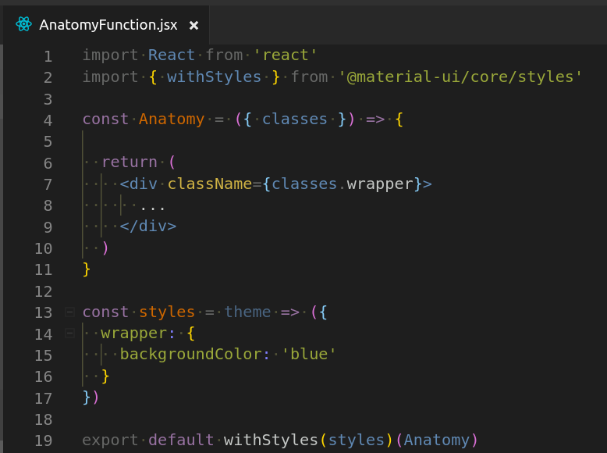
Basic Componant Anatomy (functional component)
1
Import withStyles()
Create a ‘styles’ object optionally passing it the theme
Write the style as an object using camelCase properties
‘classes’, an object, is passed in as a prop
Use classes.propertyName inside of className={}
1
2
4
3
5
4
2
5
3

Slide 21
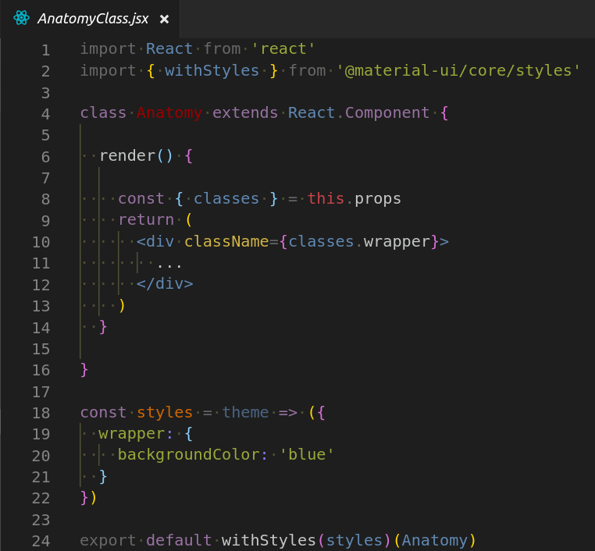
Basic Componant Anatomy (class component)

Slide 22
Debugging

