Slide 1
Specifications of the dataset
File name: Kaggle_Salary.csv
15,426 responses and 395 different questions (features)
Prediction problem (Yearly compensation)
Outline of the Presentation
Feature Selection
Model Tuning & Testing
Data Cleaning
Exploratory Analysis
Model Implementation

Slide 2
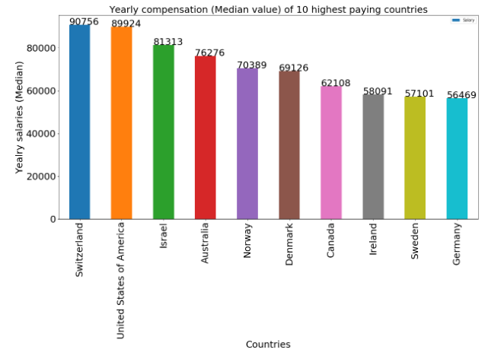
Data Cleaning
Out of 395 columns (features), only 356 were picked up for analysis
Two whole null columns are removed
For Q1 to Q10, because the data is related to the person or in other words, the question surveyed is the personal question, missing values at those places were replaced with the mode of the particular columns.
After Q10, almost all the columns are multiple choice responses.
Label encoding has been applied on the data.
Exploratory Analysis
Yearly median compensation for top 10 highest paying countries

Slide 3
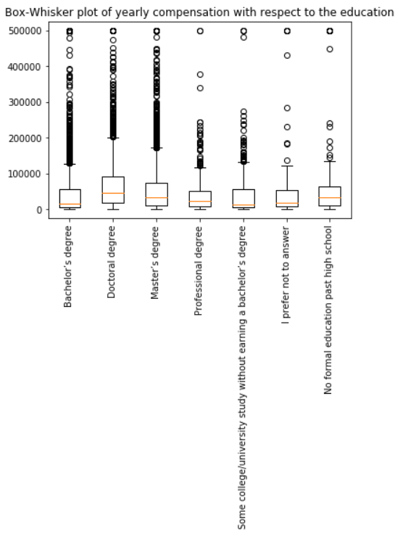
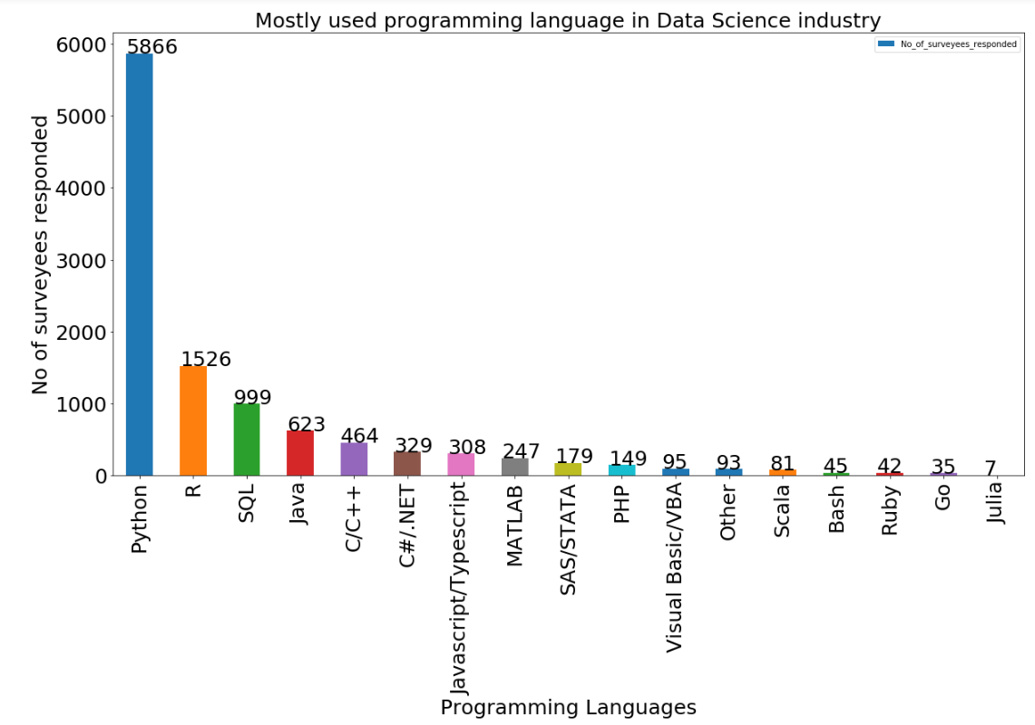
Exploratory Analysis

Slide 4
Feature Selection
An attempt has also been made using L1- regularizer and PCA.
Finally, for analysis the label encoded data without PCA was selected.
Gradient Boosting=0.53 R2
Linear Regression=0.36 R2
Model Implementation
K-NN=0.15 R2
Begging with linear regressor=0.36 R2

Slide 5
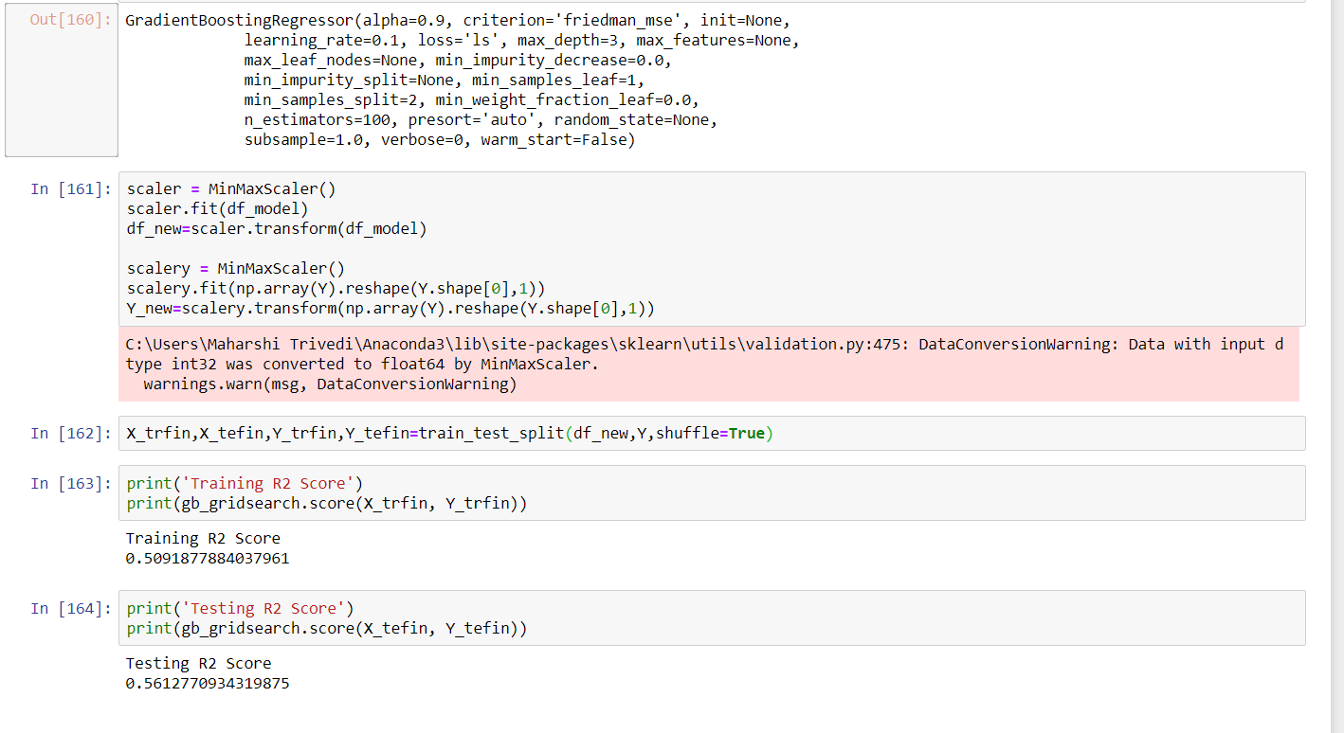
Model Tuning & Testing

